Slide 1
Organize and actuate the advertisement
Bugi Satrio Adiwibowo, S.E., M.I.Kom.

Slide 2
Advertising agency is the best choice to organize and actuate your ads

Slide 3
An advertising agency is a professional services firm to conceive, produce and manage the showing of commercial messages regarding the goods or services.

Slide 4
The role of the agency
Act as the person in charge
Producing movies and videos, creative teams and art, photography, printing, setting letters, marketing research and offering the media an economical way of buying and selling advertising space and time.
Production quality is preferred and supervised by law and ethical code

Slide 5
For a huge company, internal advertising agency might have included in structure of organization as in house advertising agency

Slide 6
Flow of advertising process
Advertising Division
Advertising Agency
Media

Slide 7
Company
Advertising Division (Advertiser/Company) contacts the advertising agency to assist advertising program.
Advertising Agency

Slide 8
Advertising Agency
Advertising Agency assists the Advertiser (company) to prepare advertising program.
Company

Slide 9
Account Executive
Account Executive (a part of Advertising Agency) would meet the Advertiser (company) to discuss about the promotion and ads material making and some detailed information
Company

Slide 10
They would discuss about the status quo of current marketing, planning and goals, competitive situation, marketing target, etc.
This forum is called as Marketing Brief or Client’s Brief.

Slide 11
Account Executive
After reach the necessary information from Advertiser, Account Executive would meet the creative team and media planner in Advertising Agency.
Creative Team
Media Planner

Slide 12
They would discuss about marketing planning (product, price, promotion, place), target, competitive situation, and product knowledge that gotten from Advertiser.
It is called as Brainstorming.

Slide 13
Result
In Brainstorming, they discuss about the temporary suggestions from creative team and media planner to discuss with Account Service, Creative Team, and Media.
Brainstorming Process

Slide 14
Account Executive
After the result is agreed by three parties (Account Service, Creative Team, and Media), then it would be the Creative Plan.
Creative Team
Media
Creative Plan

Slide 15
Creative Plan
Creative Plan is made based on Creative Director. It is also include the visualization and copywriter.
In order to present the dummie to Advertiser, they usually build a mock up ads.
Ads Making

Slide 16
If the ads need a lot of material, facilities, and complicated process (outdoor or audio-video ads), advertising agency often offer it to the third-party to handle.
It is known as a Production House.
Advertising Agency
Production House

Slide 17
Production House
An professional organization that specialized into ads material making, especially in ads on TV, radio, and outdoor ads (billboard).

Slide 18
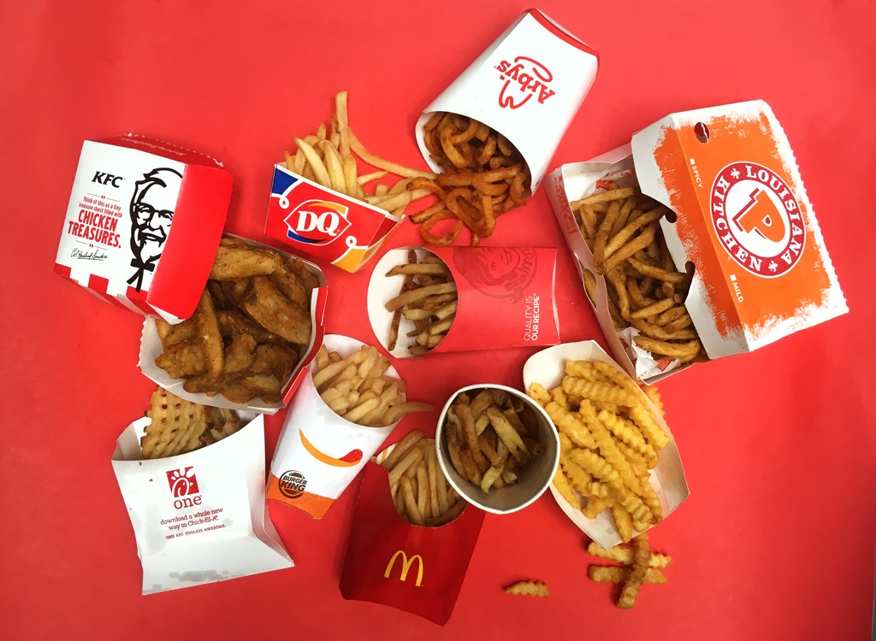
Even some Production House also offer the production of visual design ads making, copy-writing, and jingle.

Slide 19
Production House
Production House convey the final result of ads to the Advertising Agency after get the approval from the Advertiser.
Advertising Agency

Slide 20
Advertising Agency
If everything is accepted, the advertising agency would contact the media to provide the ads spot.
Media

Slide 21
Thank you

