Slide 1
Line of advertisement
Bugi Satrio Adiwibowo, S.E., M.I.Kom.

Slide 2
DIFFERENCE among Marketing, Advertising, Public Relations, and Branding

Slide 3
Advertisement Management
Planned managerial process designed to oversee and control the various advertising activities involved in a program to communicate with target market and influence the consumer’s purchase decision.
Keywords: Plan; oversee and control; to communicate; target market; purchase.

Slide 4
Advertising is the most expensive expense in Profit organizations

Slide 5
…And count the whole cost
You can pick three of them
Local TV
Newspaper
National Magazines
Entertainment Website
Radio
Outdoor Advertising
Web Portals
Email
Social Media
Merchandises

Slide 7
How big the cost is? Are you sure it will increase your profit?

Slide 8
So, you should establish a proper advertisement instruments

Slide 9
7 principles of effective advertisement
Visual Consistency : Build specific image/display
Campaign Duration : Be concise!
Repeatedly Taglines : Mention 3 Times for Minimum
Consistent Positioning : Your superior things
Simplicity : Be easily to remember
Identify A Selling Point : It’s a must!
Create an Effective Flow : Design keypoints eyecatching-ly

Slide 10
What to concern..
Target audience: Who do we want to talk to?
Message (or creative) strategy: What do we want to say to them?
Media Strategy: How will we reach them?
Measuring Advertising Effectiveness: How do we know our messages were received?

Slide 11
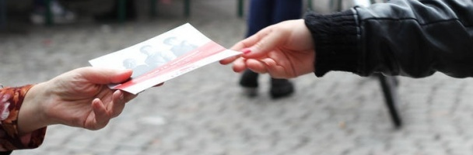
Then, how we distribute the advertisement?

Slide 12
Above The Line (ATL)
Medium of Advertisement
Below The Line (BTL)
Through The Line (TTL)

Slide 13
Above the Line
A very broad reach and largerly untargeted
Used for building brand awareness and goodwill
Example:
TV Adv., Newspaper, Radio Adv., Outdoor Billboard, Cinema Adv., Football League Sponsorship, etc.

Slide 14
*only for brand awareness, no direct response element

Slide 15
Below the line
Target specific groups of people with focus
Best for conversion and direct response
Example:
Targeted leaflet drop, Trade Show/Exhibition, Mall Stand, Door to Door Selling, Direct Mail Marketing, Catalogues, etc.

Slide 16
booth
*Face-to-Face to people, direct interactions, and direct selling

Slide 17
Trough the line
Integrated approach and collaboration between ATL and BTL
Use to reach their customer base and generate conversions
Covers both a wide and a focus customer
Social Media Account and Advertisment, etc

Slide 18
Social media Posting
*building brand awareness and has direct response element included

Slide 19
What is the best medium for our organization? You decide..

Slide 20
Medium | Goals
ATL | Brand Building
BTL | Direct Response
TTL | Both of Them

Slide 21
Conclusion
Advertising management is planning to oversee and control also communicate to the target market to purchasing action;
Advertising cost money so much, so we should make it effective and efficient;
Effective Advertisement covers visual consistency, duration, taglines, positioning, simplicity, selling point, and effective flow;
Advertisement must concern to target, message, strategy, and measurement.
Advertisement distributed by Above, Below, and Trough The Line (A/B/T TL)
ATL for branding, BTL for direct responses, TTL for combination.

Slide 22
Thank you

