Slide 1
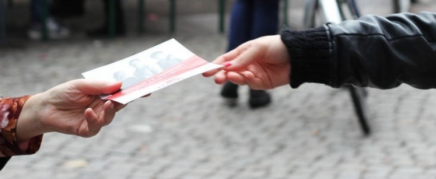
Media of advertisement
Bugi Satrio Adiwibowo, S.E., M.I.Kom.

Slide 2
Advertisement media analysis
Discuss the impact of advertisements from various advertisement media instruments which is comparing between strength and weakness of each.

Slide 3
Media of advertisement
Outdoor Advertisement;
Newspaper/magazine/tabloid;
Television;
Radio;
Printed Media; and
Internet.

Slide 4
1. Outdoor advertisement
Billboard is the most effective advertisement instrument for outdoor advertisement.
Billboard is used for announcing a brand/product or short messages.

Slide 5
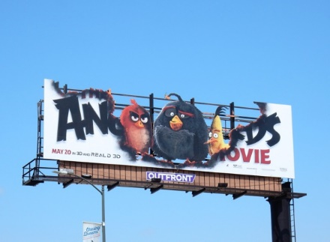
Billboard
Placed at full and height
highway
Gigantic size of Flexy Fabric
(10x6 m or 8x4m)
Advertisement agency often
rent it monthly
Upgraded into Digital/LED

Slide 6
Strengh of billboard
Geographically flexible
Affordable price
Monopoly the location

Slide 7
Weakness of billboard
Unsegmented and untargeted
Quick time notice
Hard to measure how many people whom noticed
If it isn’t aesthetic enough, it will disturb driver

Slide 8
2. Newspaper
A media to persuade, convey the idealism,
and deploy provocative message to people
Limited place for advertisement
Adv. should be in line with newspaper/
magazine idealism and image
The more strategic the place it would be,
the more cost to expense

Slide 9
Strengh of newspaper
People are in exact emotion when read
the message printed
Wide-spread reader segmentation
Have an opportunity to deploy the
message in detail
Not limited in time

Slide 10
Weakness of newspaper
We don’t know where it placed
High cost for regular advertiser
Reproduct quality is not really good
It will burden if potential buyer is far away

Slide 11
3. magazine
A big number of magazine spreaded away in Indonesia with specific genre off lifestyle, like otomotive, sport, beauty, health, fashion, women, business, etc.

Slide 12
Strengh of magazine
Wide-spread segmentation and targeting
Selective
Reproduct quality is high
Convey messages in detail

Slide 13
Weakness of magazine
Can’t guarantee the reader will be interested, they usually do skimming-reading
Untidy layout for advertisement, they can put advertisement everywhere
We can’t do segmentation

Slide 14
4. Radio
Radio included in big three favorite media to advertise. Every car and smartphone has radio application.

Slide 15
Strengh of radio
Suitable with segmentation of people
Reach the listeners individually
Real time
Affordable Cost
Repeatable

Slide 16
Weakness of radio
Doesn’t have fixed time
In sound type of performance
Depends on the listener’s choice

Slide 17
5. televisi
Almost everyone have their own TV in their house
Media TV corporation have some space for advertisements session (commercial break)

Slide 18
Strengh of tv
Could be a demonstration in how to use the product
Able to appear as our expectation
Could be eyecatching
Capable to use humour
Have a big impact to influence people

Slide 19
Weakness of tv
High Cost to be broadcasted
It depends on how people’s interest in TV program

Slide 20
6. Interactive advertising media
Due to the globalization era, advertising activity can easily use the internet to promote their product through social media. This day, we can pay the public figure to promote our product through their social media account by text, photos, or videos.

Slide 21
Strengh of endorsement
Public figures have vary style to promote by their creativity
The potential buyer can easily go to our website/account by one click
Regular product might have special treatment

Slide 22
Weakness of endorsement
In social media, people usually skip the ads
The segmentation might be blur
Our product shows in the same time with competitors

Slide 23
conclusion
Discuss the impact of advertisements from various advertisement media instruments which is comparing between strength and weakness of each.
Advertisment media instruments are outdoor advertisement, newspaper, magazine, radio, TV, and Interactive Advertisement Media.

Slide 24
Thank you

