Slide 1
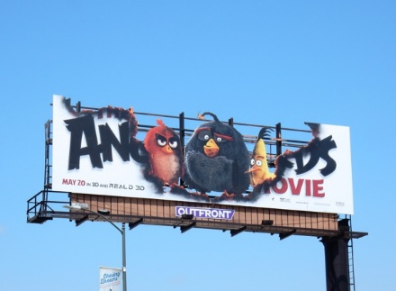
Typology of outdoor advertisment
Bugi Satrio Adiwibowo, S.E., M.I.Kom

Slide 2
Billboard
Placed at full and height
highway
Gigantic size of Flexy Fabric
(10x6 m or 8x4m)
Advertisement agency often
rent it monthly
Upgraded into Digital/LED

Slide 3
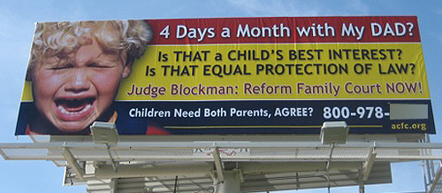
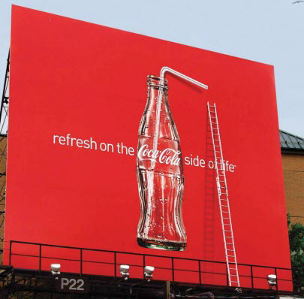
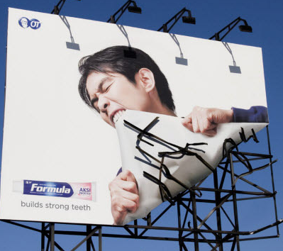
Which one interest you the most?
Why?

Slide 4
6 rules of effective billboard by ryan sawyer marketing
Six Words or Less.
Remember, the reader is fast-driven.
There’s only room for one hero.
Choose the best location with no billboard there.
Billboard isn’t a direct-response medium.
You don’t need to point out the detailed information. Phone number and email is enough. Pick iconic place as your address.

Slide 5
6 rules of effective billboard by ryan sawyer marketing
Be smart, not clever.
Understand the problem you want to solve, with no
words explained. Once again, be smart!
Don’t say it, show it.
Billboard is visual medium. It isn’t a gigantic flyer.
More is better.
Advertising is 3 times mention of name.

Slide 6
Mistakes to avoid in offline ads by Grassroots Advertising inc
MISTAKE #1 : Making It All About You
What is your product will do for them?
Does it can improve the betterment of their life?
Why they need it?
How they can get it?
Be consumer-centric..

Slide 7
Mistakes to avoid in offline adv by Grassroots Advertising inc
MISTAKE #2 : Emphasizing Quantity Over Quality
Altough advertising is 3 times mention, it doesn’t mean you can rule out the quality of your billboard
It’s important to produce a quality campaign and creative.
Make sure you have a solid campaign strategy emphasizing both.

Slide 8
Mistakes to avoid in offline adv by Grassroots Advertising inc
MISTAKE #3 : Forgetting Your Existing Customers
The best advertising is through Word of Mouth, and it’s free
We need to leverage the power of our current customers to win over new customers
If they buy from you, reward them something as a faithful clients

Slide 9
Billboard design tips by Billboard Connection
Simplicity is The Key
Make the Text Larger and Bolder
Stick to One Message or Idea
Be Short and Sweet
Use Eye-Catching Color
1 Image, 1 logo, and 1 headline
Test Your Idea

Slide 10
Example..

Slide 11
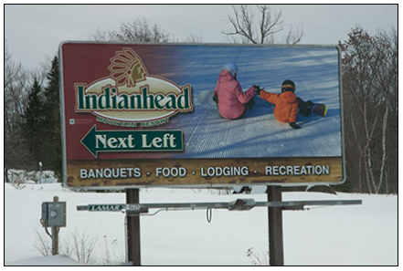
Well-designed
Easy to Read
Strong and Emotional Photo
Big Logo

Slide 12
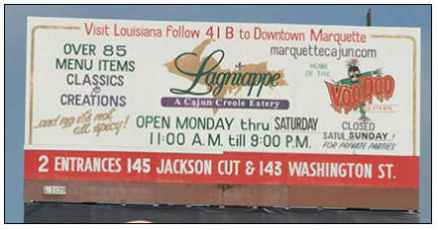
Too much information
This design can be upload only for website

Slide 13
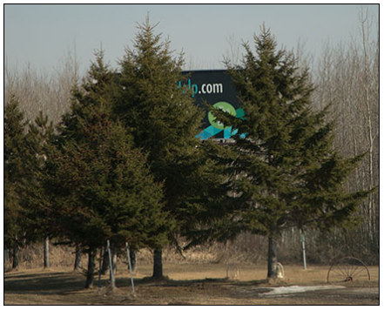
Avoid the objection,
like tree, highway,
portal, building, etc.
in front of
point of view

Slide 14
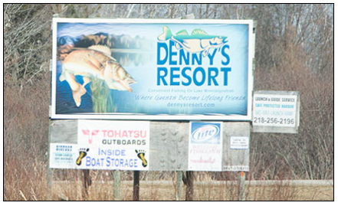
Good design, nice graphic, and strong logo
We can’t read the message, because of the color brightness

Slide 15
Then, Guess the product/message
Although you aren’t sure..

Slide 16
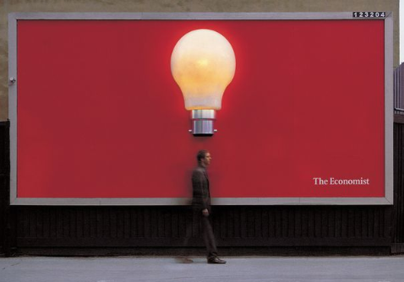
Simple
Involve the audiences
By: The Economist

Slide 17
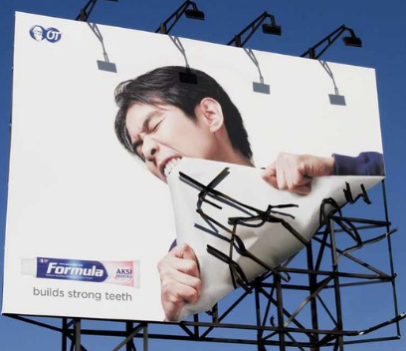
Explain by visualization
By: Ogivly & Mather Jakarta

Slide 18
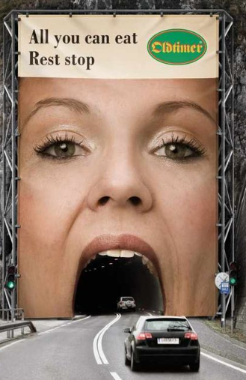
Involve the environment
By: Demner, Merlicek, & Bergmann

Slide 19
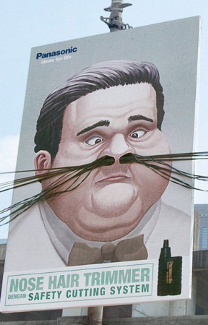
Good message
Involve external tools
By: Saatchi & Saatchi Indonesia

Slide 20
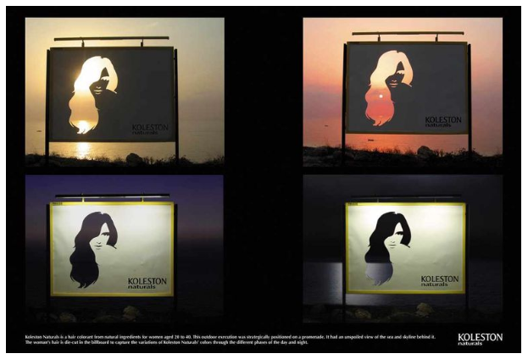
Good explanation
Using negative space creatively
By: Saatchi & Saatchi Indonesia

Slide 21
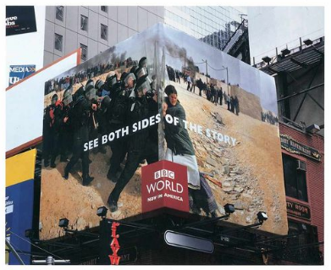
Ads don’t always need to be flat.
By: BBDO New York

Slide 22
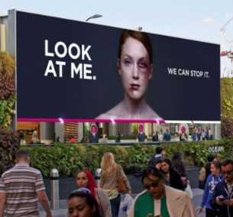
Involving audience with digital ad can be a powerful strategy to reinforce a message
(picture at below is captured by live CCTV)
By: WCRS

Slide 23
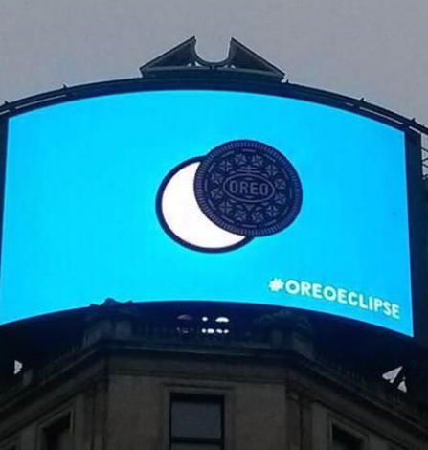
Let your advertisement interact with current events.

Slide 24
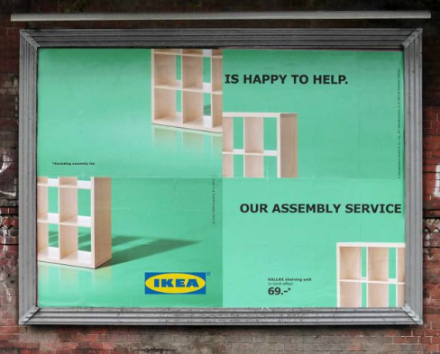
This is promotes new feature of IKEA (assembly service)
By: Thjnk Germany

Slide 25
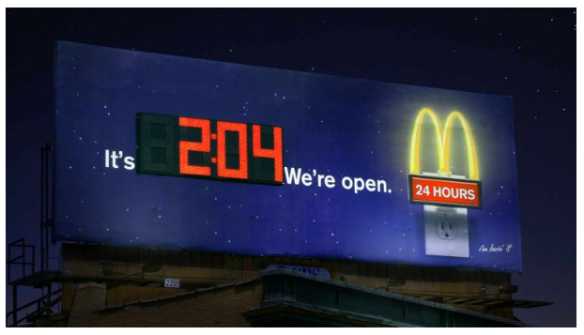
Double function which useful
By: Bernstein-Rein

Slide 26
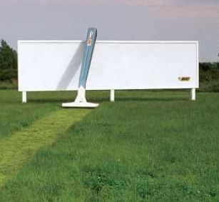
Interact with environment
By: TBWA UK

Slide 27
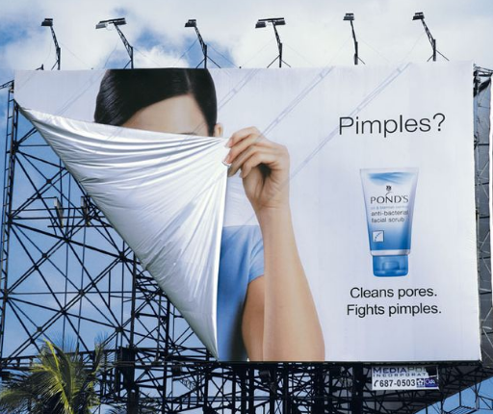
Use some emphaty and let viewers identify themselfes in your design
By: Mike Sicam

Slide 28
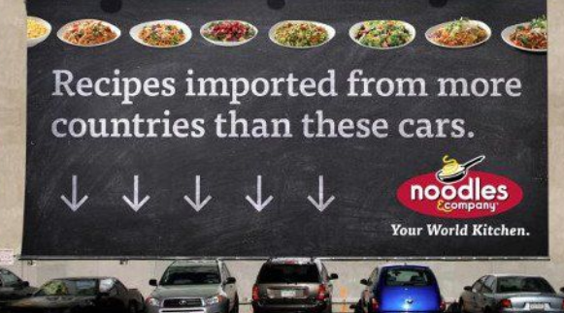
Involve the people
By: TDA_Boulder

Slide 29
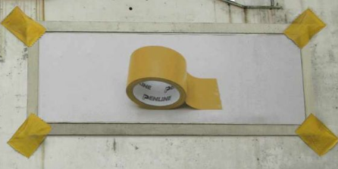
Give a real evidence
By: EURO RSCG

Slide 30
Conclusion
Billboard should be contain 6 words or less, only one at one spot, don’t serve information in detail, be creative, show the message by visual, and more is better.
Avoid self-centered, bad quality billboard, and forget the existing customers.
Make a billboard as simple as possible, large and bold text, stick at one message, be short and sweet, use eye-catching colors, 1 image 1 logo 1 headline, and test your idea

Slide 31
Thank you

