Slide 1
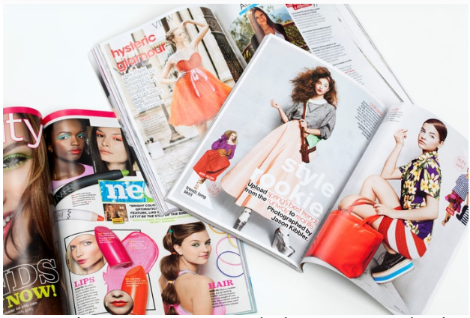
Typology of printed advertisement
Bugi Satrio Adiwibowo, S.E., M.I.Kom.

Slide 2
Printed advertisement
Newspaper
Magazine
Flyer

Slide 3
1. Newspaper
A media to persuade, convey the idealism, and deploy provocative message to people

Slide 4
Newspaper Company provides limited place for advertisement. They are focus on news. Ads should be in line/not conflict with newspaper’s idealism and image

Slide 5
Printing cost depends on: 1. Size of coloumn (inches), 2. Section, 3. Colors, 4. Frequency (weekly/monthly) 5. Local/National

Slide 6
Basic pointers for ads at newspaper By Business town
Headline: Use eye-catching phrase and simple words. Avoid controversial phrases or slang.
Comparison: Use comparative advertising phrases “You’ve tried the others. Now try us!”
Benefits: List the benefit of products. Use ‘you’ not ‘we’
Closing: Provide contact, website, address, etc.

Slide 7
Tips for ads at newspaper
Use bottom section and make it as a coupon to provide discount. Put an expiry date. It also help you to decide the segment and target of customers.
Add URL to drive people go to your website.
Always ask to check the dummy. The quality of paper isn’t really good.

Slide 8
If you don’t have your own poster, Sales Department often offer you free charge of advertisement design by themselves. But, NEVER!
They might would make it simple. Really simple.

Slide 9
Ask the sales whether they are have a typical day.
Wednesday, often, is a food day for most newspaper. If you run food company, Wednesday is the best day to publish an ads.

Slide 10
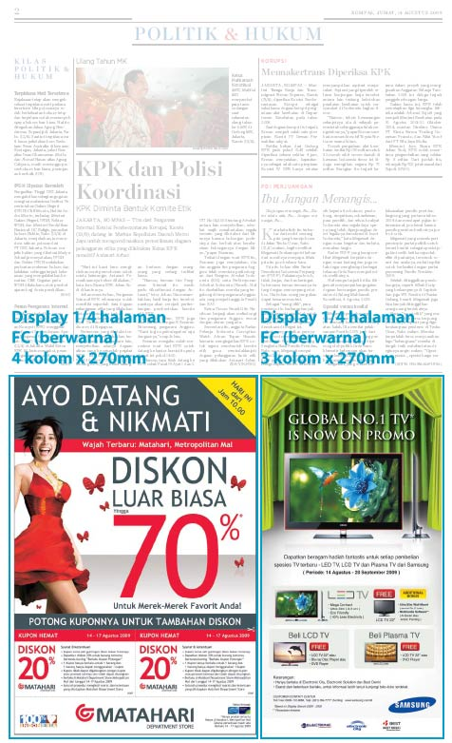
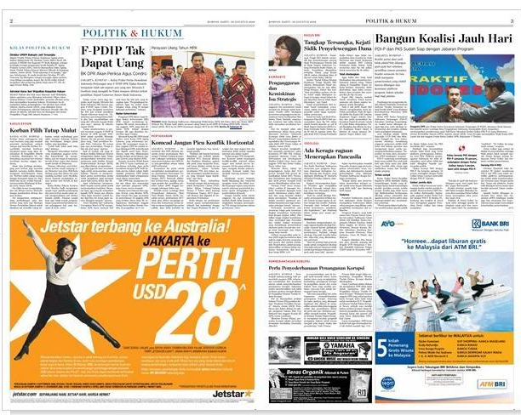

Slide 11
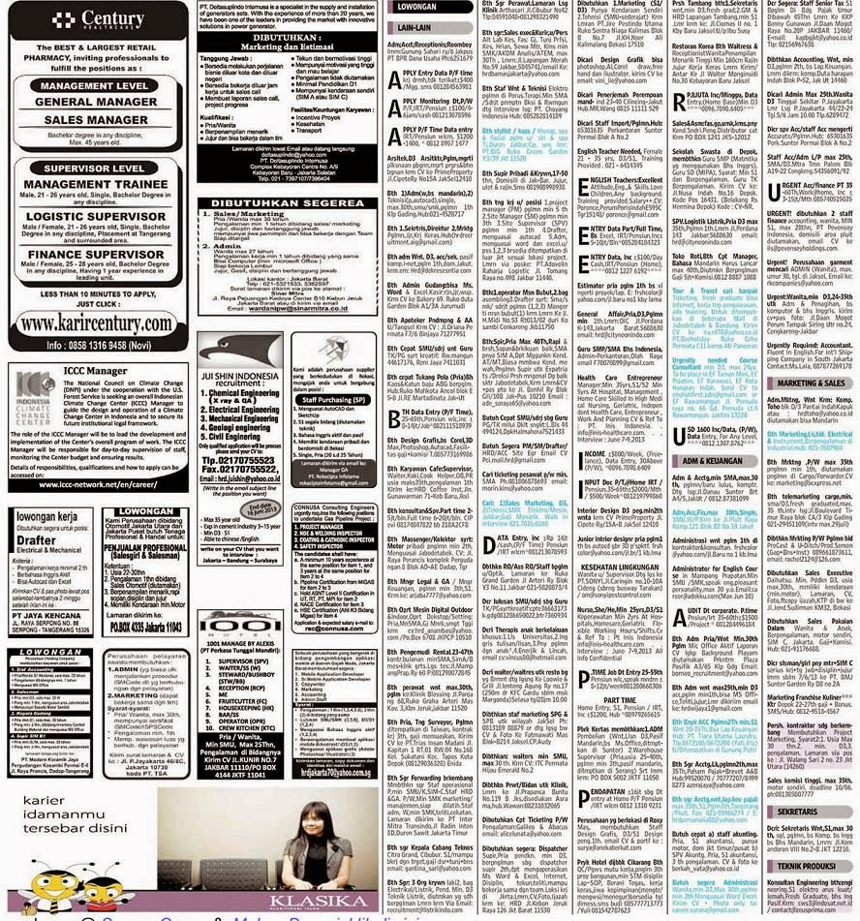
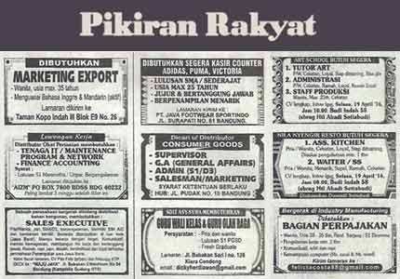

Slide 12
2. magazine
A big number of magazine spreaded away in Indonesia with specific genre off lifestyle, like otomotive, sport, beauty, health, fashion, women, business, etc.
Magazine always provide premium-quality printed picture within.

Slide 13
Tips for writing ads at magazine By BUSINESS TOWN
Get the Consumer’s Attention
Create an eye-catching headline or phrase
Use colorful image and professional photography
Avoid controversial headlines and pictures

Slide 14
2. Make Your Pitch Concise and Simple
List the benefits and reasons why consumer should buy your product
Readers often only do skimming-reading
Be precise and to the point

Slide 15
3. Use Color Whenever Possible
Magazines offer the opportunity to use full color photos/artwork to enhance the meaning of message
4. Make It Easy to Reach and Order
Include contact, website, retail locations at the bottom of ads.

Slide 16
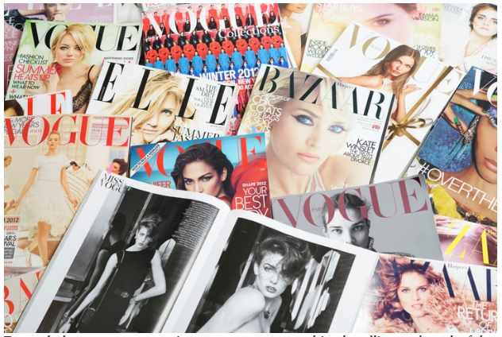

Slide 17
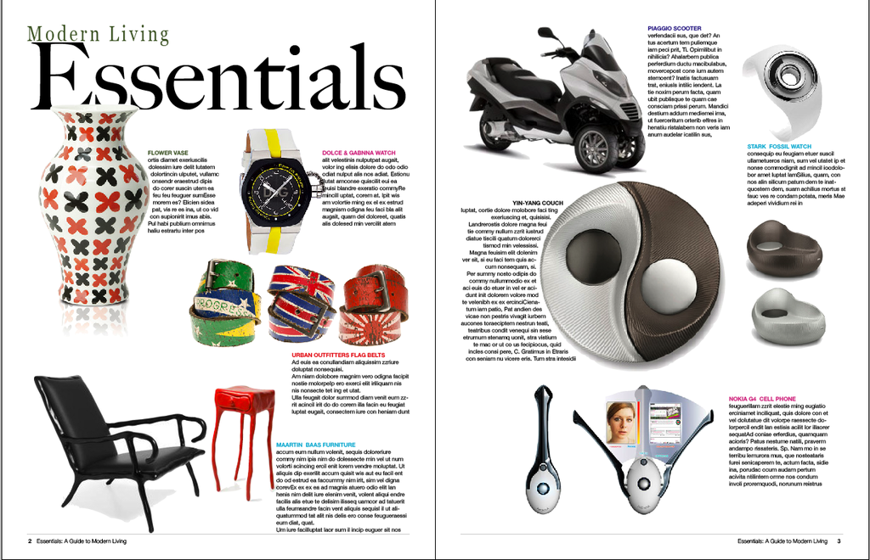

Slide 18
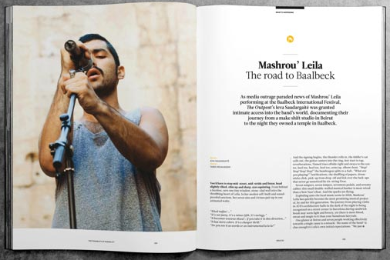

Slide 20
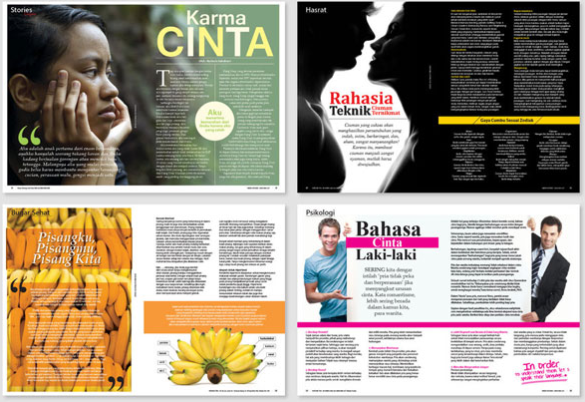

Slide 21
conclusion
Printed Ads generally devided into newspaper, magazine, and flyer
Newspaper is media which concern in news, have limited space for ads, and idealism. Ads at newspaper optionally have headline, comparison, benefits, and closing.
Magazine is media which concern in hobbies, genre, lifestyle, etc. Magazine provides premium-quality paper for ads. So, the aesthetic photo and layout are needs, not to despite the content.

Slide 22
Thank you

