Slide 1
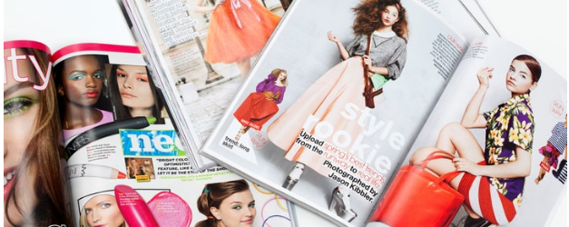
Typology of printed advertisement (flyer)
Bugi Satrio Adiwibowo, S.E., M.I.Kom.

Slide 2
Printed advertisement
Newspaper
Magazine
Flyer

Slide 3
1. Newspaper
A media to persuade, convey the idealism, and deploy provocative message to people

Slide 4
2. magazine
A big number of magazine spreaded away in Indonesia with specific genre off lifestyle, like otomotive, sport, beauty, health, fashion, women, business, etc.
Magazine always provide premium-quality printed picture within.

Slide 6
3. Flyer
Flyers are a great way to advertise by offline
It isn’t really expensive

Slide 7
Tips for writing flyers
Keep It Brief
Use brief, complete, and concise explanation.
For detailed information, reader can contact you from contact informed.

Slide 8
2. Organize Your Info
Use bullet points

Slide 9
3. Use A Catchy Headline
Put a lot thought into headline
It should be interesting
By reading headline, the reader should have idea what you do

Slide 10
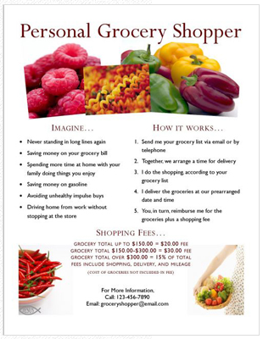
4. List The Benefits
Put at least five benefits you provides

Slide 11
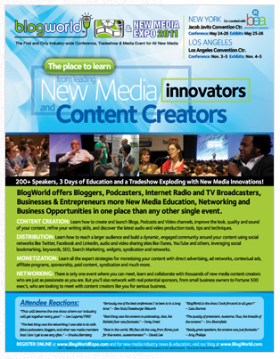
5. Beat the Competition
Find ways to describe you are better than others

Slide 12
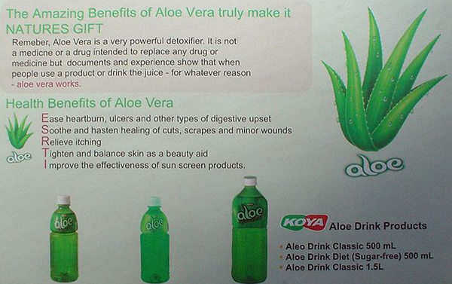
6. Proofread Your Writing (Correction)
Find friends to correct your writing, such as typo, difficult explanation, wrong number, etc.

Slide 13
7. Include a Call to Action
Use active sentences.
Tell the reader to order now, call now, or log onto website.

Slide 14
8. Highlight Special Deals & Offers
Make an offer/discount/promo be prominent

Slide 15
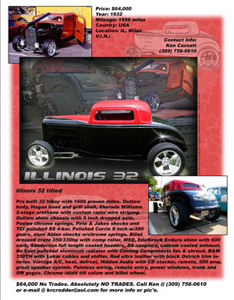
9. Know Your Audience
Analyze the demographics of your audience
Be segmented

Slide 16
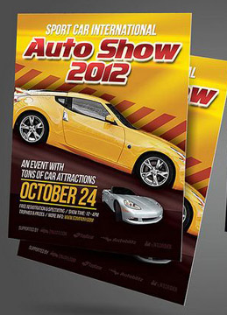
10. Use Only Relevant Info
Make sure reader knows your location, how to get in touch, what type of services you do.

Slide 17
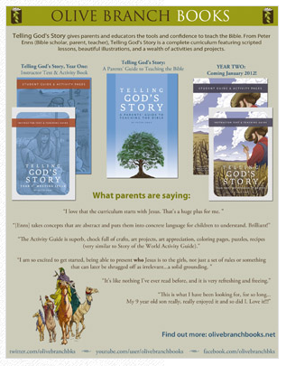
11. Use Striking Testimonials
Write testimonials clearly, professionally, and focus on relevant details.

Slide 18
12. Put Your Contact Info at The Bottom of The Flyer
The last thing readers see is your name and contact info
It will be the thing to stay in their mind

Slide 19
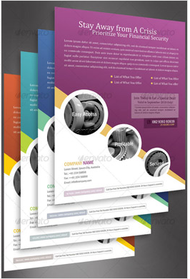
13. Make the Font Legible and Readable
Choose the bold an thick font
Minimum 10-point size

Slide 20
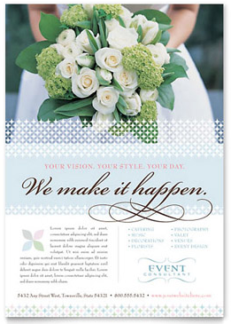
14. Put Yourself in Your Customer’s Shoes
Just imagine you are a customer and what you want from your company

Slide 21
15. Use the Word ‘You’
Use ‘you’ and ‘your’ indicates you are talking directly to reader

Slide 22
conclusion
Printed Ads generally devided into newspaper, magazine, and flyer
Newspaper is media which concern in news, have limited space for ads, and idealism. Ads at newspaper optionally have headline, comparison, benefits, and closing.
Magazine is media which concern in hobbies, genre, lifestyle, etc. Magazine provides premium-quality paper for ads. So, the aesthetic photo and layout are needs, not to despite the content.
Flyer is the most effective offline ads. It should be prominent, complete, concise, and stimulate

Slide 23
Thank you

