Slide 1
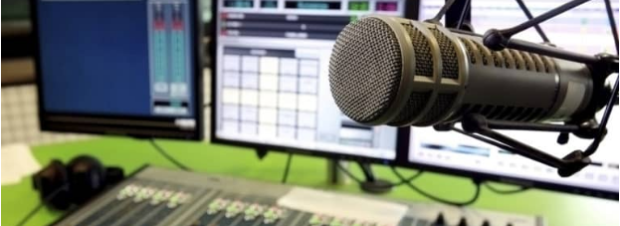
Typology of radio advertisement
Bugi Satrio Adiwibowo, S.E., M.I.Kom.

Slide 2
Advertisement for radio By Strategic Media Inc
Radio advertising allows you to deliver a short and powerful message to your target audience
You might even find popular DJs with large following to take a personal interest
It will give an extra endorsement boost

Slide 3
The radio ads cost depend on:
Time
Frequency (hour/day)
Special announcer
Editing

Slide 4
Pick your day-parts
Usually radio stations have 18 minutes per hours for ads
Not all minutes have the same value, choose time carefully
6 am – 10 am = has the most listeners
10 am – 3 pm = has fewer listeners, mostly lolay listeners
3 pm – 7 pm = as many as 6 am – 10 am
7 pm – 6 am = fanatically loyal listeners

Slide 5
Tips ads for radio
Build the script by yourself. You acknowledge your product the best
Ask the permission to publish the script into another stations
Use one or two key selling features of your product
Make sure your DJs don’t make a sarcastic joke for your product

Slide 6
Writing radio copy
Make sure:
Gets people’s attention
Powerful, simple, easily conveyed
Use speak-to-ear words
Call to action, such as limited-time special offer
Clearly mention location, website, and unique contact number
Plenty repitition

Slide 7
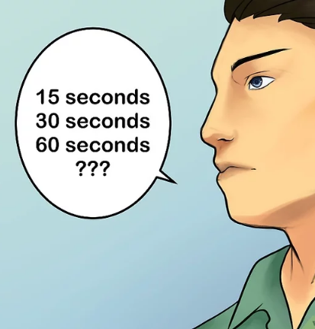
How to write a radio ad
Determining the Ad’s Length
More time, more budget
Make it sufficient
Explain basic info about product (business/event/cost/contact)
15 seconds = 30-40 words
30 seconds = 80 words

Slide 8
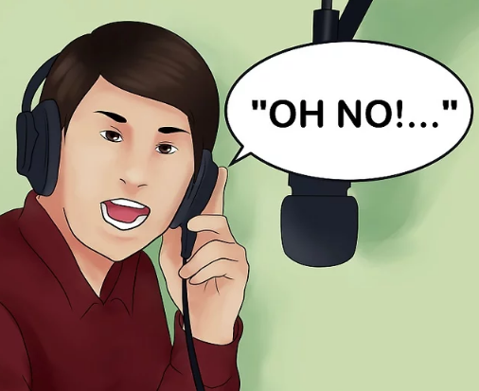
2. Sell the Product/Service with a Dialog
People love to listen in other’s conversation/dialogs
Try to solve others problem
“I have a date to the prom, but no suit!”
“I rent my tux from…. It was fast, easy, and inexpensive”

Slide 9
Thank you

