Slide 1
Typology of online advertisement
Bugi Satrio Adiwibowo, S.E., M.I.Kom.

Slide 2
ONLINE ADVERTISEMENT
Is a form of marketing and advertising which uses the internet to deliver promotional marketing messages to consumers.

Slide 3
ONLINE ADVERTISEMENT
Display Ads
Interstitial
Search Engine Marketing
Social Media Ads
Mobile Ads
Email Ads
Online Classified Ads
Affiliate Marketing
Content Marketing

Slide 4
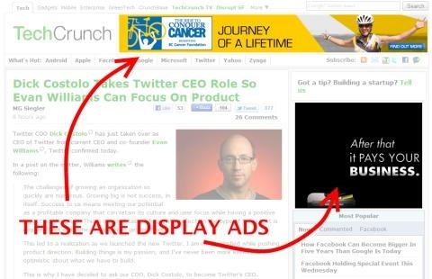
Display ads
Using text, logos, animations, videos, photographs, etc. on the website.

Slide 5
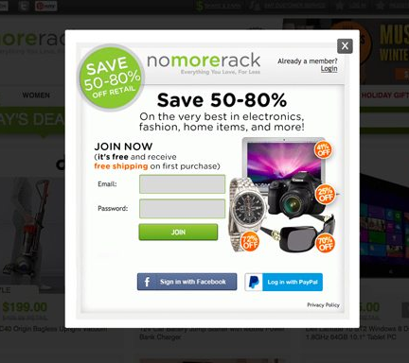
Interstitial
Displays before a user can access requested content, sometimes while the user is waiting for the content to load.

Slide 6
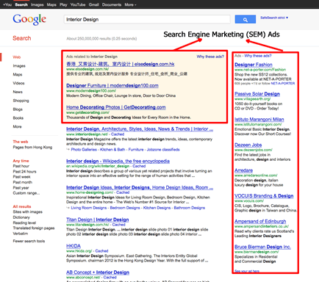
Search engine marketing
Search engine marketing includes all of an advertiser's actions to make a website's listing more prominent for topical keywords.

Slide 7
Social Media Marketing
Social media marketing is commercial promotion by posting frequent updates and providing special offers through social media profiles

Slide 8
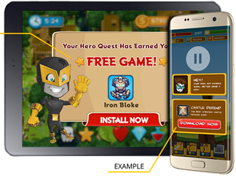
Mobile ads
Mobile advertising may take the form of static or rich media display ads, mobile search ads, advertising within mobile websites, or ads within mobile applications or games

Slide 9
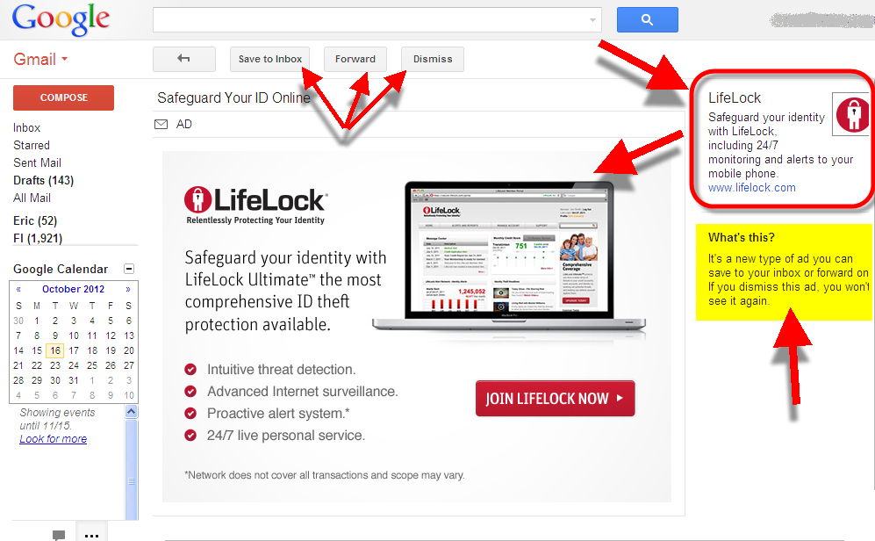
Email ads
Email advertising is ad copy comprising an entire email or a portion of an email message

Slide 10
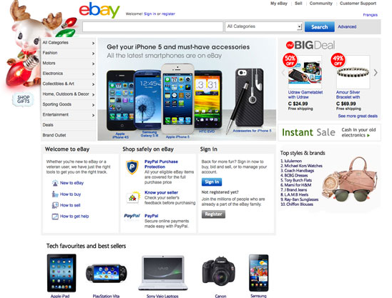
Online classified ads
Advertising posted online in a categorical listing of specific products or services

Slide 11
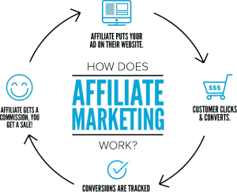
Affiliate marketing
Affiliate marketing occurs when corporate organizes third parties to generate potential customers for them

Slide 12
Content marketing
Any marketing that involves the creation and sharing of media and publishing content in order to acquire and retain customers, such as blogs, news, video, how-to guides and more.

Slide 13
Benefits of online ads
COST
provides a low-cost for advertisers to engage with large established communities
MEASURABILITY
can collect data on their ads' effectiveness, such as the size of the potential audience response, how to reach, etc.

Slide 14
Benefits of online ads
FORMAT
The ability to convey images, video, audio, and links. Unlike many offline ads, online ads also can be interactive
TARGET
Publishers can offer advertisers the ability to reach customizable and narrow market segments for targeted advertising.

Slide 15
Benefits of online ads
COVERAGE
Online advertising can reach nearly every global market, and online advertising influences offline sales
SPEED
Once ad design is complete, online ads can be deployed immediately.

Slide 16
CONCLUSION
Online Ads is a form of marketing and advertising which uses the internet to deliver promotional marketing messages to consumers.
Online Ads are display ads, interstitial, search engine marketing, social media ads, mobile ads, email ads, online classified ads, affiliate marketing, and content marketing.

Slide 17
Conclusion
Benefits of online ads are considerably lower than offline ads, measurable feedback, interactive format, targeted audiences, globally spread, and can run immediately.

Slide 18
Thank you

