Slide 1
Teknik
Public Speaking

Slide 2
Great Public Speaker
Soekarno
Mahatma Gandhi
Abraham Lincoln
Adolf Hitler
Martin Lurther King

Slide 3
Public Speaking tidak lepas dari Tugas Ahli Gizi
Penyuluhan
Seminar
Presentasi rutin

Slide 4
10 besar ketrampilan yang harus dimiliki
Ketrampilan komunikasi
Kejujuran/intregitas
Kemampuan bekerjasama
Etika kerja yang kuat
Kemampuan menganalisa
Kemampuan beradaptasi
Kemampuan interpersonal
Motivasi
Ketrampilan komputer
Teliti

Slide 5
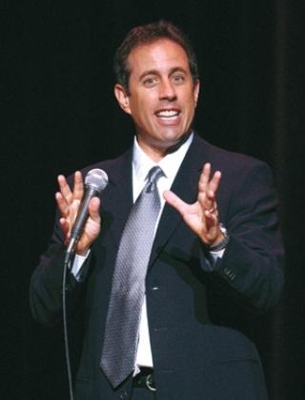
Jerry Seinfeld
“According to most studies, people's number one fear is public speaking. Number two is death. Death is number two. Does that sound right? This means to the average person, if you go to a funeral, you're better off in the casket than doing the eulogy.”

Slide 6
Ada 3 jenis public speaking
Impromptu speech : jenis pidato yang mempunyai waktu persiapan tidak banyak
Manuscript speech : jenis pidato menggunakan naskah
Extemporaneus speech : jenis pidato tanpa menggunakan naskah

Slide 7
Mengapa kita benci Public Speaking?
Kurangnya pengalaman yang positif
Menjadi pusat perhatian
Merasa terisolasi
Diprasangkai oleh penonton
Takut gagal
Semua adalah Public Speaking Anxiety

Slide 8
Public Speaking Anxiety
Not one, but 4 types:
- Pre-preparation Anxiety – Can’t get started
- Preparation Anxiety – During research and preparation
- Pre-performance Anxiety – 24 hours before presentation
- Performance Anxiety – During the actual presentation

Slide 9
Lack of Positive Experience
We tend to remember poignant feelings and emotions more than everyday ones.
How many times have you attempted public speaking?
Reflect on these experiences - how did you prepare for each occasion?
In most cases, it’s not positive experience we are lacking…
– just actual experience.

Slide 10
Being the Center of Attention
Everyone is staring at you! Why?
Because you are the EXPERT on the content that you are delivering.
Being comfortable comes from being confident.
Remember - eye contact is a two way street.

Slide 11
Feelings of Isolation
Are you really alone?
You are in total control of your presentation.
If possible, add audience engagement.

Slide 12
Being Judged By An Audience
You ARE being judged….
How do you judge people initially?
Work backwards.
You will know how you are perceived very quickly
Confidence is key. Knowledge = power.

Slide 13
What Impression Do You Leave in 30 Seconds?
Perceived Race/Ethnicity
Accent/Dialect
Style of Dress
Body Language
Relative Level of Intelligence/Education
Other Physical Traits (i.e. height, weight, intelligence, attractiveness)

Slide 14
A Healthy Fear of Failure Helps!
Audiences want to be entertained or informed. No one asks to be bored.
Audience wants you to be successful in your goals.
What is the worst that can happen?
Figured it out? Now prepare to prevent.
List everything that you can control and plan to manage it.

Slide 15
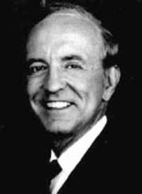
Somers White
“90% of how well the talk will go is determined before the speaker steps on the platform.”

Slide 16
How Can I Become a Better Speaker?
Prepare the right way. Start by answering these questions:
What is the specific purpose of your speech?
What is your topic?
Who is your audience?
What are your time constraints?
Will you be using visual aids?

Slide 17
How to Prepare for Your Speech
Start with structure – Formal Outline, Speakers Outline (smaller and smaller)
Topic selection – how to choose?
Mapping technique
Start broad, work towards narrow
Don’t throw out your notes – prime ground for main points and supporting material.
Are there any topics/subject matter to avoid?

Slide 18
Other Important Factors
Audience demographics
Size
Presentation space
Audience’s current knowledge of topic
Diversity

Slide 19
Time Constraints
How much is too much?
Overinform: Cramming too much material into too short an amount of time
Underinform: Overestimating how much material that you have.
Memorizing – one of the WORST things you can do.
Rehearse….and then rehearse again. Your speech will be ingrained in you.

Slide 20
Organization
Structure: Tell them what you’re going to tell them, tell them, then tell them what you told them.
Make sure everything has a beginning, middle, and end.
Ask yourself if you are meeting audience expectations.
Knowing time also helps you pace yourself!

Slide 21
Penguasaan Materi
Mengetahui informasi yang dibutuhkan
Mengetahui sumber informasi
Memilih informasi
Menyusun struktur presentasi
Metode pengembangan struktur
Problem and Solution
Story telling
Present
Future
Cause and Effect

Slide 22
Visual Element
Visual aids – need to assist, not be the star of the show.
What is the best type of display to help you prove your point?
What method of display is most effective to helping you achieve your goals?
Will your presentation support any kind of technology?

Slide 23
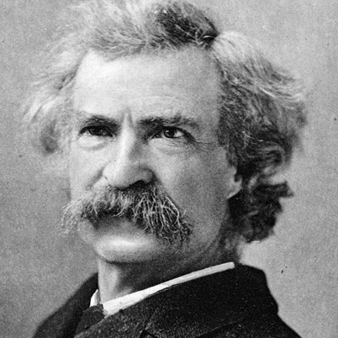
Mark Twain
“It usually takes me more than three weeks to prepare a good impromptu speech.”
“There are only two types of speakers in the world. 1. The nervous and
2. Liars.”

Slide 24
Pre-Performance Tips
Common qualities in speakers:
- Nervousness (shaking, turning red)
- Anxiety (healthy amount is OK)
- Looking down/back of room
- Staying stationary/moving too much
- Speaking at varying volumes

Slide 25
Pre-Performance Tips
The Visual Channel – competence, trustworthiness, and character.
7% words, 38% voice, 55% nonverbal communication
What can you control?
- Dress
- Eye Contact
- Body language
- Vocal Variety

Slide 26
Pre-Performance Tips
Dress code
- First impressions matter – you are judged positively or
negatively by your audience immediately.
- Dress should match tone of speech
- Dress in clothes that make you feel comfortable and
confident.

Slide 27
Pre-Performance Tips
Eye contact
- Two way street – not a “staring contest”.
- Keeps everyone invested and involved.
- Pay equal attention to everyone in the room.
- Works in conjunction with head movement.
- Key is finding the right speed for your comfort.

Slide 28
Pre-Performance Tips
Body Language
- Not an “act”.
- Use gestures that feel natural.
- Be mindful of your hands at all times.
- Movement helps – but decide how much you will move well
in advance.
Best way to prepare – record yourself in a similar environment

Slide 29
Pre-Performance Tips
Vocal Variety
- Voice analysis – loud, silent, animated, steady
- Language needs to be consistent.
- Use of pauses – become comfortable with silence
- Identify and be aware of crutch words

Slide 30
Pre-Performance Tips
Rehearse, don’t memorize!
- Sentence outline – Phrase outline – Keyword outline
- Less is more.
- If you bring it, you will use it.
- Make sure your Speaker Outline is different than your
Formal Outline.
- Determine the “right” amount of time to rehearse.

Slide 31
Pre-Performance Tips
Final Pre-Performance Tips: Night before speech
- Good nights sleep/meals
- Finalize your routine
- Avoid too much caffeine
- What’s done is done - visualize success.

Slide 32
Performance Tips
Record your work
Get to presentation space well in advance.
Know your introduction – smooth sailing after that.
Breathing techniques
Hydrate yourself properly
Bring water, but be careful
If you make a mistake, don’t be afraid to acknowledge it.

Slide 33
Post-Performance Tips
Congratulate yourself for a job well done.
Get objective feedback.
Watch/listen to yourself 24 hours later.
Make notes on how to improve in the future.

Slide 34
Thank You

