Slide 1
RESPIRATORY SYstem
Dr. Kartika LILISANTOSA

Slide 2
ICD-10
A15 Respiratory Tuberculosis
J00-J99 Diseases of the respiratory system
J00-J06 Acute upper respiratory infections
J09-J18 Influenza and pneumonia
J20-j22 Other acute lower respiratory infections
J30-J39 Other diseases of upper respiratory tract
J40-J47 Chronic lower respiratory diseases
J60-J70 Lung diseases due to external agents
J80-J84 Other respiratory diseases principally affecting the interstitium
J85-J86 Suppurative and necrotic conditions of the lower respiratory tract
J90-J94 Other diseases of the pleura
J95 Intraoperative and postprocedural complications and disorders of respiratory system, not elsewhere classified
J96-J99 Other diseases of the respiratory system

Slide 3
A15 Respratory Tuberculosis
A15.0 Tuberculosis of lung
A15.4 Tuberculosis of intrathoracic lymph nodes
A15.5 Tuberculosis of larynx, trachea and bronchus
A15.6 Tuberculous pleurisy
A15.7 Primary respiratory tuberculosis
A15.8 Other respiratory tuberculosis
A15.9 Respiratory tuberculosis unspecified

Slide 4
Tuberculosis
Infectious disease by Mycobacterium tuberculosis
Infected Lung but can also affect the lungs

Slide 5
Mycobacterium tuberculosis
M. tuberculosis is a bacillus has an unusual, waxy coating on its cell surface primarily due to the presence of mycolic acid. This coating makes the cells
Acid-fast stains such as Ziehl-Neelsen
The physiology of M. tuberculosis is highly aerobic and requires high levels of oxygen
M. tuberculosis is characterized in tissue by caseating granulomas containing Langhans giant cells

Slide 6
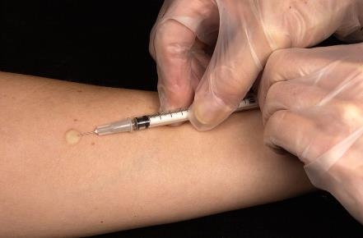
RESPIRATORY TUBERCULOSIS
Spread through air from active TB (when the patient cough, spit, speak, or sneeze)
Symptoms :
Chronic cough with blood containing sputum (hemoptysis)
Fever
Night sweats
Weight loss
Diagnostic:
Chest X-ray
Microscopic examination and culture of body fluids (sputum BTA 3x)
Tuberculin skin test
Interferon gamma release assays (IGRA)

Slide 7
J00-J06 Acute upper respiratory infections
J00 Acute nasopharyngitis [common cold]
J01 Acute sinusitis
J02 Acute pharyngitis
J03 Acute tonsillitis
J04 Acute laryngitis and tracheitis
J05 Acute obstructive laryngitis [croup] and epiglottitis
J06 Acute upper respiratory infections of multiple and unspecified sites

Slide 8
J00 Acute nasopharyngitis [common cold]
= mild upper respiratory viral illness except influenza
Common cold viruses can be spread by three mechanisms:
Direct contact –via hands.
o Indirect contact – viruses may survive on surfaces such as countertops for several hours thus can be transmitted from touching that surface and then touching the mouth, nose, or eyes.
o Inhaling viral particles .
Persons with colds shed viruses the most on the second day of illness, however, low levels of viral shedding may persist for up to two weeks.

Slide 9
J00 Acute nasopharyngitis [common cold]
The diagnosis is based on symptoms and observed signs.
Swelling and congestion of nasal passages
Redness of the throat
Enlarged lymph nodes in the neck
Normal lung exam
Symptomatic therapy is the only thing necessary for treating the common cold as it is a self-limited infection (meaning it will go away with time). Antibiotics are not effective

Slide 10
J09-J11 INFLUENZA
is an infectious disease caused by an influenza virus Type A, Type B, and Type C (family Orthomyxoviridae)
The most common symptoms include: a high fever, runny nose, sore throat, muscle pains, headache, coughing, and feeling tired.
These symptoms typically begin two days after exposure to the virus and most last less than a week. The cough, however, may last for more than two weeks.
Complications of influenza may include viral pneumonia, secondary bacterial pneumonia, sinus infections, and worsening of previous health problems such as asthma or heart failure
A vaccine made for one year may not be useful in the following year, since the virus evolves rapidly

Slide 11
In highly virulent strains, such as H5N1, the hemagglutinin can be cleaved by a wide variety of proteases, allowing the virus to spread throughout the body
influenza does cause tissue damage (H5N1 strain causes severe viral pneumonia in the lugs)
The two classes of antiviral drugs used against influenza are neuraminidase inhibitors (oseltamivir and zanamivir) and M2 protein inhibitors (adamantane derivatives).

Slide 12
J05 Acute obstructive laryngitis [croup] and epiglottitis
= laryngotracheobronchitis
Usually caused by virus parainfluenza and influenza, rarely by bacterial infection like diphtheriae
The infection leads to swelling inside the trachea, which interferes with normal breathing and produces the classic symptoms of "barking" cough, stridor, and a hoarse voice
narrowing of the trachea, called the steeple sign, because of the subglottic stenosis, which resembles a steeple in shape. The steeple sign is suggestive of the diagnosis, but is absent in half of cases
Steroids are given routinely, with epinephrine used in severe cases.^{[3]} Children with oxygen saturations under 92% should receive oxygen,^{[4]} and those with severe croup may be hospitalized for observation.

Slide 13
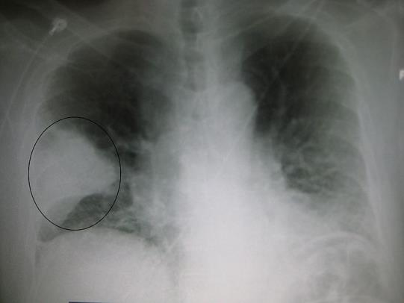
J 12-18 Pneumonia
= IS AN INFLAMMATORY IN THE LUNG AFFECTING ALVEOLI
CAUSED BY BACTERIA, VIRUS, FUNGI
symptoms : productive or dry cough, chest pain, fever, and shortness of breath, sharp or stabbing chest pain during deep breaths, and an increased rate of breathing
Diagnosis is often based on the symptoms and physical examination.^{[7]} Chest X-ray, blood tests, and culture of the sputum

Slide 14
J 20-J22 OTHER ACUTE LOWER RESPIRATORYINFECTIONS
J20 Acute bronchitis
J21 Acute bronchiolitis
J22 Unspecified acute lower respiratory infection

Slide 15
J20 Acute bronchitis
= short-term inflammation of the bronchi (large and medium-sized airways)
90% caused by virus, small number by bacteria (Mycoplasma pneumoniae, Chlamydophila pneumoniae, Bordetella pertussis, Streptococcus pneumoniae, and Haemophilus influenzae)
Symptoms : cough with mucus, wheezing, shortness of breath (dyspnea), fever, and chest discomfort
Diagnosis : symptoms and chest x-ray , sputum and blood test

Slide 16
J21 Acute bronchiolitis
Bronchiolitis is blockage of the small airway in the lungs due to a viral infection (rhinovirus)
usually only occurs in children less than two years of age
Symptoms may include fever, cough, runny nose, wheezing, and breathing problems, nasal flaring, and or the skin between the ribs pulling in with breathing
Diagnosis based on symptoms, chest x ray
The risk of death among those who are admitted to hospital is about 1%.

Slide 17
J40-J47 CHRONIC LOWER RESPIRATORY DISEASES
J40 Bronchitis, not specified as acute or chronic
J41 Simple and mucopurulent chronic bronchitis
J42 Unspecified chronic bronchitis
J43 Emphysema
J44 Other chronic obstructive pulmonary disease
J45 Asthma
J47 Bronchiectasis

Slide 18
Chronic Obstructive Pulmonary Disease (COPD)
Occurs when the airways become inflamed and the air sacs in your ungs are damaged
Chronic bronchitis
Emphysema

Slide 19
J40-42 Chronic Bronchitis
a chronic cough and sputum production for at least 3 months a year for 2 consecutive years
is caused by overproduction and hypersecretion of mucus by goblet cells, increasing airflow obstruction.
can be due to smoke inhalation, a viral or bacterial infection

Slide 20
CHRONIC BRONCHITIS
Mucus metaplasia causes airflow obstruction ->it causes luminal occlusion; the thickening of the epithelial layer intrudes on the airway lumen, and the mucus alters the airway surface tension -> the airway at a greater risk for collapsing and decreases the capacity for airflow and gas exchange
Diagnostic: Chest x ray, spirometry test (lung finction test), sputum, CT scan thorax

Slide 21
J43 Emphysema
Any abnormal accumulation of air or other gas WITHIN TISSUE
Pulmonary interstitial emphysema, air trapped in the stroma (interstitium) of the lung
Subcutaneous emphysema, gas or air trapped in the subcutaneous layer (that is, under the skin)
PULMONARY EMPHYSEMA
CAUSED BY SMOKING, EXPOSURE POLLUTION, GENETICS (ALPHA 1-ANTITRYPSIN DEFICIENCY)
The most common symptoms of COPD are sputum production, shortness of breath (DYSPNEA), and a productive cough
Advanced COPD leads to high pressure on the lung arteries, which strains the right ventricle of the heart.^{[5][24][25]} This situation is referred to as cor pulmonale, and leads to symptoms of leg swelling^{[15]} and bulging neck veins

Slide 22
J45 Asthma
reversible airflow obstruction, and bronchospasm
Symptoms include episodes of wheezing, coughing, chest tightness, and shortness of breath
caused by a combination of genetic and environmental factors.^{[4]} Environmental factors include exposure to air pollution and allergens. Other potential triggers include medications such as aspirin and beta blockers
Diagnostic : pattern of symptoms, spirometry
A triad of atopic eczema, allergic rhinitis and asthma is called atopy

Slide 23
J47 Bronchiectasis
Bronchiectasis is an abnormal, chronic enlargement of the bronchi, the pas- sageways from the trachea to the alveoli that are the air-exchanging parts of the lungs
Failure to clear secretions allows microbes and particles to collect in them, which leads to more secretions and inflammation that further damage the airways, causing more dilation in a vicious cycle
Can be
Localized
diffuse

Slide 24
THANK U

