Slide 1
PENGANTAR SISTEM SIRKULASI DARAH I MATA KULIAH PATOLOGI REKAM MEDIS
Dr. Kartika Lilisantosa

Slide 2
CURRICULUM VITAE
Nama : dr. Kartika Lilisantosa
Tempat/tanggal lahir : Ujung Pandang, 18 Januari 1986
Agama : Katolik
HP : 081345277388
E-mail : kartikalilisantosa@gmail.com
RIWAYAT PENDIDIKAN
S1 Fakultas Kedokteran Universitas Hasanuddin, Makassar tahun 2003-2006
Profesi Kedokteran Universitas Hasanuddin, Makassar tahun 2007-2009
Ophthalmology Residency Training di Rizal Medical Center, Pasig City, Philippines, tahun 2013-2017

Slide 3
KURSUS | TEMPAT | TANGGAL
Workshop Pulmonologi | Makassar | 30 Mei 2009
A New Management in Diabetes Mellitus & Metabolic Polyneuropathy | Makassar | 13 Juni 2009
Deteksi dan Pelaksanaan Dini Gangguan Psikiatri dalam Praktek sehari-hari | Manado | 2 November 2009
Emergency Doctor Course | Jakarta | 8-19 Maret 2010
Advanced Trauma Life Support (ATLS) | Jakarta/ FKUI RSCM | 9-11 Maret 2010
Internal Medicine Emergency Life Support (IMELS) Course | Jakarta/ FKUI RSCM | 12 Maret 2010
In The Pediatric Consideration Course | Jakarta/ FKUI-RSCM | 13 Maret 2010
Manajemen Bencana | Jakarta/ FKUI RSCM | 14 Maret 2010
Pelatihan Advanced Neurology Life Support (ANLS) | Jakarta FKUI RSCM | 15-16 Maret 2010
Advanced Cardiac Life Support (ACLS) | Jakarta RSCM | 17-19 Maret 2010
Improving Physician Competency to Achieve Patient Safety | Jakarta | 20-21 Maret 2010
Dermatologi Kosmetik Perawatan Kulit dan Rambut | Manado | 24 Juli 2010
Workshop Knot and Tying Skill | Surabaya RSUD Dr. Soetomo | 23 Oktober 2010
Workshop Wound Management | Bandung | 5-7 November 2010
Workshop Management luka bakar | Bandung | 5-7 November 2010
Updating Skills and Knowledge in Diagnosis and Management of Emergency Cases: Dressing for Burns | Jakarta | 10 Maret 2011
Basic Course Lectures in Ophthalmology | UP-Philippine General Hospital | 2-27 September 2013
Basic Life Support Training - Healthcare Providers | Pasig City | 17 - 18 Februari 2015
The 2015 DOH Eye Centre Instructional Course on Retina & Glaucoma | Quezon City | 17-18 Juli 2015
Research Protocol Development and Basic Statistics in Health Research Workshop | Makati City | 3 November 2015
Basic Course in Phacoemulsification | UP- Philippine General Hospital | 27-28 Februari 2016
Basic Course in Clinical Diagnostics and Instrumentation | UP- Philippine General Hospital | 21-22 MEI 2016
Good Clinical Practice Workshop and Training | Pasig City, Rizal Medical Center | 13 Agustus 2016
A Case Oriented Approach to Managing Paediatric Eyes | UP- Philippine General Hospital | 7 Mei 2017

Slide 4
REKAM MEDIS
4. RM harus berisi informasi yang membuat dokter keluarga sadar problem yang potential mungkin muncul dimasa mendatang
1. Informasi ada dlm RM harus sistematis dan logis
2. Dapat menggambarkan keadaan pasien secara AKURAT
3. Berisi semua informasi tentang problem kesehatan pasien saat ini dan problem kesehatan pasien di masa lampau, riwayat keluarga dan lingkungan sosial

Slide 5
ISI RM
Permenkes RI No. 269/ Menkes/ PER/III/2008 rekam medis berisi mengenai
Identitas pasien
Tanggal dan waktu
Hasil Anamnesis
Riwayat Penyakit
Hasil Pemeriksaan
Laboratorium
Diagnosis
Perstujuan tindakan medis
Tindakan/ pengobatan
Catatan observasi Klinis dan hasil pengobatan
Resume akhir
Evaluasi hasi pengobatan

Slide 6
Jenis rekam medis
Berdasarkan Permenkes RI No. 269/ Menkes/ PER/ III/ 2008
Rekam medis rawat jalan
Rekam medis gawat darurat
Rekam medis bencana
Rekam medis dokter spesialis
Rekam medis untuk pengobatan massal

Slide 7
Blood
A fluid connective tissue constituting about 7% of our total body weight (+ 5 liters)
Plasma
(The liquid in which peripheral blood cells are suspended
Wter
Electrolyte (Na=, CL-)
Plasma Protein (albumin, fibrinogen, globulins)
Hormones
Fat
Amino acids,
Vitamins
Carbohydrates
Lipoprotein

Slide 9
2018 ICD-10 CM Codes
D 50 – D89 Diseases of the blood and blood-forming organs and certain disorders involving the immune mechanism
D50-D53 Nutritional anemias
D55-D59 Hemolytic anemias
D60-D64 Aplastic and other anemias and other bone marrow failure syndromes
D65-D69 Coagulation defects, purpura, and other hemorrhagic conditions
D70-D77 Other disorders of blood and blood-forming organs
D78 Intraoperative and postprocedural complications of the spleen
D80-D89 Certain disorders involving the immune mechanism

Slide 10
Pathology in red blood cell
D55 – D59 Hemolytic anemias
D55 Anemia due to enzyme disorders
D56 Thalassemia
D57 Sickle-cell disorders
D58 Other hereditary hemolytic anemias
D59 Acquired hemolytic anemia
D50-D53 Nutritional anemias
D50 Iron deficiency anemia
D51 Vitamin B12 deficiency anemia
D52 Folate deficiency anemia
D53 Other nutritional anemias
D60-D64 Aplastic and other anemias and other bone marrow failure syndromes
D60 Acquired pure red cell aplasia (erythroblastopenia)
D61 Other aplastic anemias and other bone marrow failure syndromes
D62 Acute posthemorrhagic anemia
D63 Anemia in chronic diseases classified elsewhere
D64 Other anemias

Slide 11
Pathology in platelet and coagulation
D65-D69 Coagulation defects, purpura, and other hemorrhagic conditions
D65 Disseminated intravascular coagulation (defibrination syndrome)
D66 Hereditary factor VIII deficiency
D67 Hereditary factor IX deficiency
D68 Other coagulation defects
D69 Purpura and other hemorrhagic conditions

Slide 12
PATHOLOGY in white blood cell
D70-D77 Other disorders of blood and blood-forming
D70 Neutropenia
D71 Functional disorders of polymorphonuclear neutrophils
D72 Other disorders of white blood cells
D73 Diseases of spleen
D74 Methemoglobinemia
D75 Other and unspecified of blood and blood-forming organs
D76 Other specified diseases with participation of lymphoreticular and reticulohistiocytic tissue
D77 Other disorders of blood and blood forming organs in diseaseclassified elsewhere

Slide 13
PATHOLOGY in IMMUNE SYSTEM
D80-D89 Certain disorders involving the immune mechanism
D80 Immunodeficiency with predominantly antibody defects
D81 Combined immunodeficiencies
Immunodeficiency associated with other major defects
D83 Common variable immunodeficiency
D84 Other immunodeficiencies
D86 Sarcoidosis
D89 Other disorders involving the immune mechanism, not elsewhere classified

Slide 14
erythr/o- = merah
leuk/o- = putih
Thromb(o) = berkaitan dengan bekuan darah
A- = Tidak adanya
Suffixes (akhiran)
-Aemia=kondisi darah
-blast= embrionik
-Cytosis = kondisi sel-sel

Slide 15
What is anemia
Anemia from the Greek word( ναιμία)(an-haîma) meaning "without blood", is a deficiency of red blood cells (RBCs) and/or hemoglobin.
A (prefix, not, tidak ada), emia (G, halma, darah)
Anemia = kurang darah

Slide 16
ANEMIA
Anemia is a decrease in the total amount of red blood cells (RBCs) or hemoglobin in the blood or a lowered ability of the blood to carry oxygen
Diagnosis is based on a hemoglobin of less than 12 g/dl or the hematocrit is less than 37%
Anemia is the most common blood disorder, affecting about a third of the global population. Iron-deficiency anemia affects nearly 1 billion people. In 2013, anemia due to iron deficiency resulted in about 183,000 deaths – down from 213,000 deaths in 1990. It is more common in women than men, during pregnancy, and in children and the elderly

Slide 17
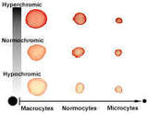
How to classify anemias
Decreased production
Vs RBC loss (increaed destruction or bleeding)
RBC Size
Macrocytic (the RBC is large MCV>94fL) vs microcytic (the RBC is small MCV < 80fL) vs normocytic (the RBC has normal size)
3. Hemoglobin Content
Hypochromic (low MCHC) vs normochromic (normal MCHC)
4. Shape:
Normal or abnormal
Notes:
MCV (mean corpuscular volume) = hematocrit/ RBC count
MCH (Mean corpuscular hemoglobin) = hemoglobin / RBC count
MCHC (mean corpuscular hemoglobin concentration) = hemoglobin/hematocrit

Slide 18
BLOOD COUNT
Hematocrit (Hct) or packed cell volume (PCV): Volume of packed red blood cells per unit of blood expressed as a percentage
Hemoglobin is the red blood cells that gives them their red color and serves to convey oxygen in arterial blood

Slide 19
Reticulocyte = young RBC
Anemia due to hemolysis or bleeding is characterized by the presence of a reticulocytosis
The reticulocyte count is used to assess the appropriateness of the bone marrow response to anemia
The normal reticulocyte count in a patient with a normal Hb and Hct is about 1%

Slide 20
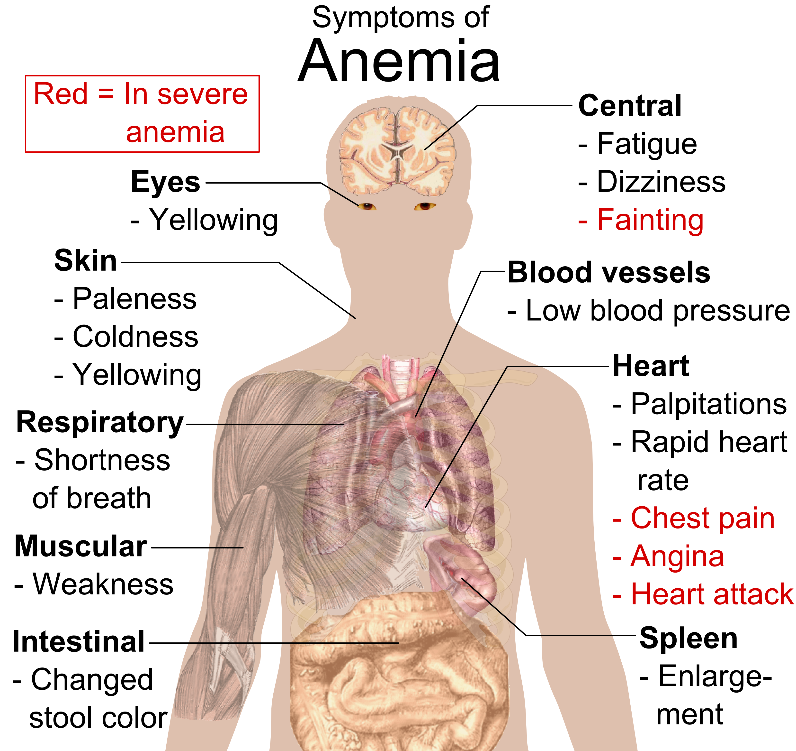

Slide 21
Anemia
Causes of blood loss include trauma and gastrointestinal bleeding, among others
Causes of decreased production include iron deficiency, a lack of vitamin B12, thalassemia, and a number of neoplasms of the bone marrow
Causes of increased breakdown include a number of genetic conditions such as sickle cell anemia, infections like malaria, and certain autoimmune disease

Slide 22
Common causes for various types of anemia
Hypochromic, microcytic
Iron deficiency
Thalassemia syndromes
Sideroblastic anemia
Transferin deficiency
Macrocytic
Megaloblastic anemias (Folic acid/ B12 deficiencies)
Liver Disease
Reticulocytosis
Normal Newborn
Bone marrow failure syndromes
Drugs (AZT, Trimethoprim sulfate)
Normocytic, normal morphology
Hemorrhage or blood loss
Unstable hemoglobins
Infections
Chronic Disease
Normocytic, abnormal morphology
Hemoglobinopathies
Hereditary Spherocytosis
Autoimmune hemolytic anemia

Slide 23
Iron deficiency anemia
The most common type of anemia
Causes
Decrease consumption
Hookworm infestation
Hemorrhage
Laboratory:
Anemia microcytic hypochromic (MCV
Serum ferritin <15 mg/L

Slide 24
Vitamin B12 deficiency anemia
Vitamin B12 is an essential cofactor in DNA and cell metabolism
Causes
Age
Atrophic gastritis
Pernicious anemia
Small intestine disease : Crohn’s disease, celiac disease
Immune system disorders : Graves’ disease or lupus
Laboratory
Anemia macrocytic (MCV>>)
Serum Cobalamin low (<150 ng/L)

Slide 25
Folate deficiency anemia
Megaloblastic anemia without neuropathy
Deciency arises due to
Malabsorption
Drugs and toxins (methotrexate, oral contraceptive, pyrimethamine, sulfasalazine, & trimethoprim)
Dietary deficiency (vegetables, fruit, dairy products)
Prolonged diarrhea
Alcoholism
Laboratory
Macrocytic anemia

Slide 26
Hemolytic anemia
Hemolysis is the destruction or removal of red blood cells from the circulation before their normal life span of 120 days
Symptoms and signs : anemia + jaundice (ikterus/kuning), cholelithiasis (Chole= kantung empedu, lythiasis = batu), or isolated reticulocytosis (peningkatan sel retikulosit)
Can be
Hereditary
Acquaired

Slide 27
Hereditary hemolytic anemia
Enzymopathies :
G6PD deficiency (critical enzyme in the production of glutathione)
Laboratory : Heinz bodies in the peripheral smear
Membranopathies
Hereditary spherocytosis (mutations in the red blood cell membrane skeleton protein genes)
Hemoglobinopathies
Sickle cell anemia
Mutation leading to substitution of valine for glutsmic acid of hemoglobin
Thalassemia
Defect in synthesis of the alpha or beta subunit of the hemoglobin tetramer
Anemia hypochromia and microcytosis, + target cells

Slide 28
Acquired hemolytic anemia
Immune hemolytic anemia
Antibodies to red blood cell surface antifens
Microangiopathic
Mechanical disruption of red blood cell in circulation
Drug induced
Transfusion hemolytic
Infection
Malaria
Clostridium perfringens (intra-abdominal and septic infection)

Slide 29
Aplastic and other anemias and other bone marrow failure syndromes
Aplastic anemia is a form of anemia resulting from a failure of the bone marrow to produce adequate quantities of the essential blood components, including leukocytes and platelets

Slide 30
References
Klasifikasi, Kodifikasi Penyakit dan Masalah Penyakit : Anatomi, Fisiologi, Patologi, Terminologi Medis dan Tindakan pada Sistem Kardiovaskuler, Respirasi, dan Muskuloskeletal (Bahan Ajar Rekam Medis dan Informasi Kesehatan). Pusat Pendidikan Sumber Daya Manusia Kesehatan. Edisi tahun 2017
Resar, LM. Anemia: Pathophysiology & Diagnostic Classification.
Iron Deficiency Anaemia : Assessment, Prevention, and Control. A guide for programme managers. WHO
Hunt A, Harrington D, Robinson S. Vitamin B12 deficiency. BMJ. 6 September 2014
Guidelines & protocols folate deficiency-invetigation & management. January 2012

