Slide 1
CURRICULUM FOR 21st CENTURY
SESSION 10
SRI LESTARI, S.Pd, M.A.
ENGLISH EDUCATION DEPT.

Slide 2
The objectives
01. Students are able to identify skills needed for 21st century.
2. Students are able to discuss the curriculum for 21st century

Slide 3
THE 21st CENTURY STANDARD
Focuses on 21st century skills, content knowledge, and expertise
Builds understanding across and among core subjects as well as 21st century interdisciplinary themes
Emphasizes deep understanding rather than shallow knowledge
Engages students with the real world data, tools, and experts they will encounter in college, on the job, and in life
Allows for multiple measures of mastery

Slide 4
CORE SUBJECTS AND 21st CENTURY THEMES
Global Awareness
Financial, Economic, and Business and Entrepreneurial Literacy
Civic Literacy
Health Literacy
Environmental Literacy
LIFE AND CAREER SKILLS
Flexibility and Adaptability
Initiative and Self-Direction
Social and Cross-Cultural Skills
Productivity and Accountability
Leadership and Responsibility
LEARNING AND INNOVATION SKILLS
Creativity and Innovation
Critical Thinking and Problem Solving
Communication and Collaboration
INFORMATION, MEDIA, AND TECHNOLOGY SKILLS
Information Literacy
Media Literacy
ICT (Information, Communication and Technology) Literacy

Slide 5
WHY IS 21st CENTURY SKILLS IMPORTANT?
Workforce Requirement Survey
BASIC KNOWLEDGE /SKILLS | APPLIED SKILLS
English Language (spoken) Reading Comprehension (in English) Writing in English (grammar, spelling, etc.) Mathematics Science Government/Economics Humanities/Arts Foreign Languages History/Geography | Critical Thinking/Problem Solving Oral Communications Written Communications Teamwork/Collaboration Diversity Information Technology Application Leadership Creativity/Innovation Lifelong Learning/Self Direction Professionalism/Work Ethic Ethics/Social Responsibility

Slide 6
LEARNING SKILLS
21st learning skills
Critical Thinking (and problem solving)
Creative thinking (and innovation)
Collaborating
Communicating

Slide 7
4C’s 21st LEARNING SKILLS
CRITICAL THINKER – Solving problems
COMMUNICATOR – Understanding and communicating ideas
COLLABORATOR – Working with others
CREATOR –Producing high quality work

Slide 8
21st CENTURY TEACHING-LEARNING MODEL
DISCOVERY LEARNING
INQUIRY LEARNING
SELF-DIRECTED LEARNING
COOPERATIVE LEARNING
COLLABORATIVE LEARNING
CONTEXTUAL TEACHING AND LEARNING
PROJECT-BASED LEARNING
PROBLEM-BASED LEARNING
STUDENT-CENTERED LEARNING
ELECTRONIC LEARNING (E-LEARNING)

Slide 9
EXERCISE
How should teachers develop the curriculum to fulfill the 21st century skills?
What should the teachers do in the 21st century class?
How is the teaching and learning activities in the 21st century classroom? Give example.

Slide 10
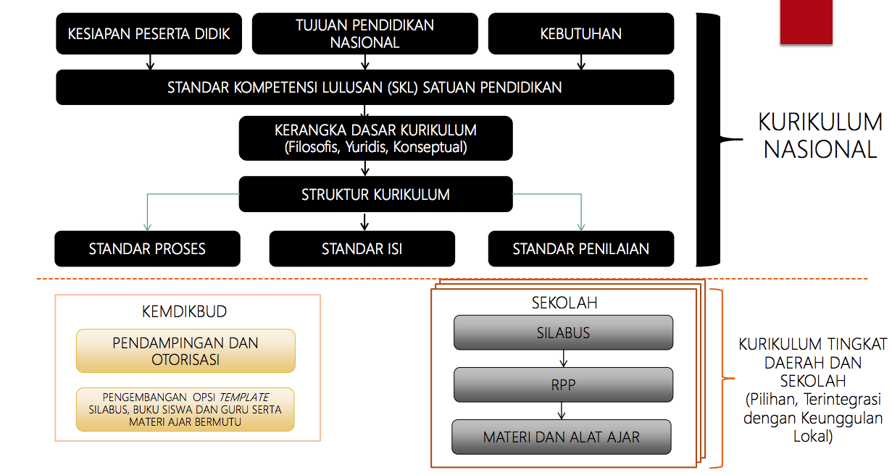
THE NATIONAL CURRICULUM 2013 DEVT PROCESS

