Slide 1
SYLLABUS AND LESSON PLAN
SESSION 11
SRI LESTARI, S.Pd, M.A.
ENGLISH EDUCATION DEPT.

Slide 2
The objectives
01. Students are able to identify tools for teachings and their components
2. Students are able to design a syllabus and lesson plan

Slide 3
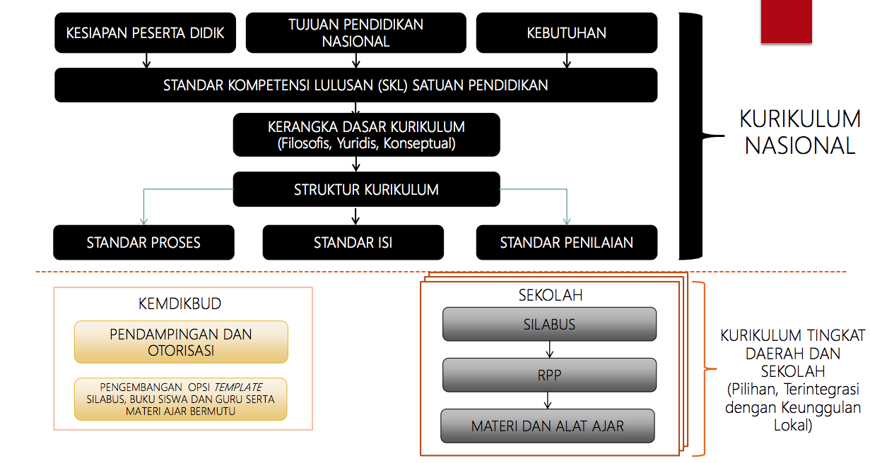
THE NATIONAL CURRICULUM 2013 DEVT PROCESS

Slide 4
WHAT SHOULD TEACHERS DEVELOP?
SYLLABUS
LESSON PLAN
T-L MATERIALS

Slide 5
REGULATION
Permen No 59 tahun 2014 tentang Kurikulum 2013 SMA & Lampiran-lampiran
Permendikbud no 20,21,22,23,24 tahun 2016:
Permendikbud No 20 tahun 2016 tentang Standar Kompetensi Lulusan
Permendikbud No 21 tahun 2016 tentang Standar Isi Pendidikan Dasar dan Menengah
Permendikbud No 22 tahun 2016 tentang Srandar Pendidikan dasar dan Menengah
Permendikbud No. 23 tahun 2016 tentang Standar Penilaian
Permendikbud No 24 tahun 2016 tentang Kompetensi Inti dan Kompetensi Dasar Pelajaran pada Kurikulum 2013
Permendikbud No 37 tahun 2018 tentang perubahan atas permendikbud No 24 tahun 2016

Slide 6
SYLLABUS
Definition; function
Principles of developing syllabus
Steps to develop a syllabus (developing a syllabus)

Slide 7
LESSON PLAN
Definition
Components
Steps to develop a lesson plan (developing a lesson plan)
See permendikbud No 81A tahun 2013 (lampiran IV)

Slide 8
MATERIAL DEVELOPMENT
What is T-L material?
What is the requirements of T-L material?
What are the forms of materials?

