Slide 1
CURRICULUM AND ASSESSMENT
SESSION 12
SRI LESTARI, S.Pd, M.A.
ENGLISH EDUCATION DEPT.

Slide 2
The objectives
01. Students are able to discuss the relationship between curriculum and assessment
2.

Slide 3
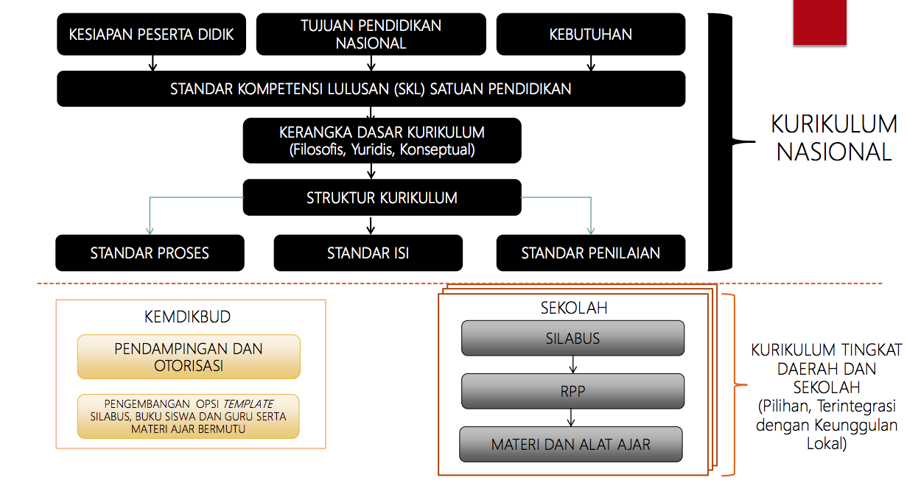
THE NATIONAL CURRICULUM 2013 DEVT PROCESS

Slide 4
ASSESSMENT
Methods or tools to evaluate, measure and document the academic learning progress, skill acquisition, or educational needs
Types: (Permendikbud No 66 & 81 2013)
Pengukuran (measurement) → score
Penilaian (assessment) → progress report
Evaluasi (evaluation) → pass/failed

Slide 5
AUTHETIC ASSESSMENT
Comprehensive assessment to evaluate the input, process and output in the area of knowledge, attitude, and skills
INPUT
PROCESS
OUTPUT

Slide 6
THE RELATIONSHIP BETWEEN C & A
What is the relationship between Curriculum and Assessment?
CURRICULUM
PEDAGOGY
ASSESSMENT

Slide 7
DISCUSSION
Read the opinions from a newspaper (provided by your lecturer)
Identify the problems of curriculum and assessment
Find out the relationship between curriculum and assessment

