Slide 1
NEEDS ANALYSIS IN CURRICULUM DEVELOPMENT
SESSION 13
SRI LESTARI, S.Pd, M.A.
ENGLISH EDUCATION DEPT.

Slide 2
The objectives
01. Students are able to understand the role of needs analysis in curriculum development
2. Students are able to identify the needs of learners to develop a curriculum

Slide 3
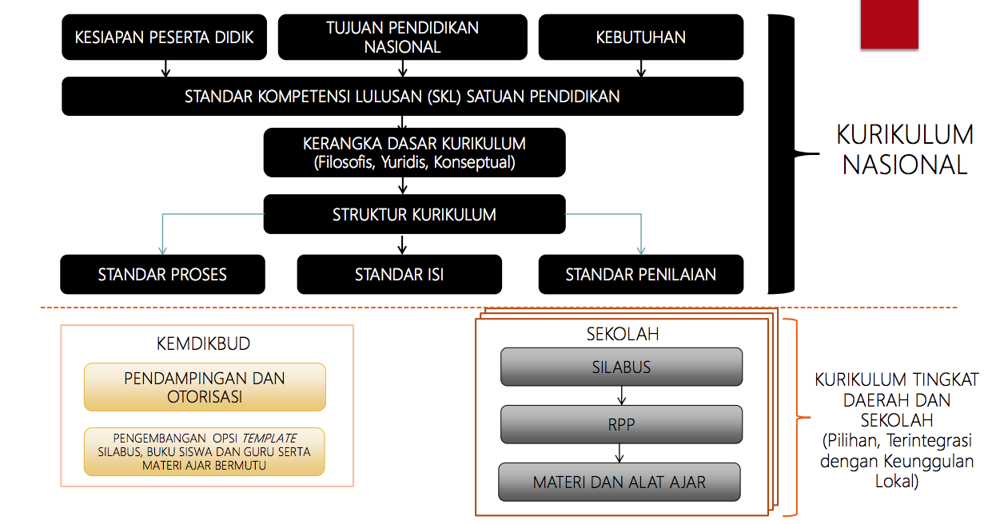
THE NATIONAL CURRICULUM 2013 DEVT PROCESS

Slide 4
NEEDS ANALYSIS
An initial procedure of developing curriculum to collect information from learners’ needs (Richard, 2001: 51)
The systematic collection and analysis of all relevant information necessary to satisfy the language learning requirements of the students within the context of the particular institutions involved in the learning situation (Brown, 1995: 21)

Slide 5
NEEDS ANALYSIS
Provide the basis for planning goals and objectives for a future program, and also for developing syllabus design and teaching materials for the course
Helps teachers create in-class activities in which the students can utilize learned skills and knowledge as tools to meet their real-life needs in meaningful ways
Helps teachers understand the potential difference in learning expectations between themselves and their students (proficiency-oriented curricula)
A LEARNER-CENTERED CURRICULUM

Slide 6
THE PURPOSES of NA (in language teaching)
To find out what language skills a learner needs in order to perform a particular role, such as sales manager, tour guide, or university student
To help determine if an existing course adequately addresses the needs of potential students
To determine which students from a group are most in need of training in particular language skills
To identify a change of direction that people in a reference group feel is important
To identify a gap between what students are able to do and what they needs to be able to do
To collect information about a particular problem learners are experiencing

Slide 7
THE PROCEDURES
Questionnaire
Self-rating
Interview
Meetings
Observation
Taking work’s sample
Task analysis
Case studies

Slide 8
THE STEP-BY-STEP PROCEDURES (1)
literature survey
analysis of a wide range of survey questionnaires
contact with others who had conducted similar surveys
interviews with teachers to determine goals
identification of participating departments
presentation of project proposal to participating departments and identification of liaison person in each department
development of a pilot student and staff questionnaire
review of the questionnaires by colleagues

Slide 9
THE STEP-BY-STEP PROCEDURES (2)
piloting of the questionnaires
selection of staff and students subjects
developing a schedule for collecting data
administration of questionnaires
follow-up interviews with selected participants
tabulation of responses
analysis of responses
writing up of report and recommendations

Slide 10
THE STEP-BY-STEP PROCEDURES (for small group of learners)
1. initial questionnaire 2. follow-up individual and groups interview 3. meetings with students 4. meetings with other teachers 5. ongoing classroom observation 6. tests

Slide 11
THE FRAMEWORK FOR NA
Who are the learners
Age, nationality, background, interest, attitude, etc.
Why are the learners taking the course?
Purposes, target, motivation, etc.
How do the learners learn?
Learning background, methods, level, etc.
What sources are available?
Materials, aids, teachers background, etc.

Slide 12
PRACTICE
Design a need analysis questionnaire or interview questions
Follow the guidance provided by your lecturer
Practice doing a needs analysis process following the procedures above.

