Slide 1
THE FOUNDATIONS OF CURRICULUM DEVELOPMENT
SESSION 4
SRI LESTARI, S.Pd, M.A.
ENGLISH EDUCATION DEPT.

Slide 2
LEARNING OBJECTIVE
Students are able
to understand the foundations of curriculum development
to explain the functions of each foundation for developing curriculum

Slide 3
What to cover
01. What are the functions of foundations in curriculum?
02. What are the foundations of curriculum?

Slide 4
FOUNDATIONS OF CURRICULUM
The foundations of curriculum set the external boundaries of the knowledge of curriculum and define what constitutes valid sources from which to derive the field’s theories, principles, and ideas (Ornstein, 2018:29)

Slide 5
FOUNDATIONS OF CURRICULUM
PHILOSOPHICAL
HISTORICAL
PSYCHOLOGICAL
SOCIAL
GLOBALIZATION & TECHNOLOGY

Slide 6
PHILOSOPHYCAL FOUNDATIONS
Philosophy deals with the larger aspects of life and the way we organize our thoughts and interpret facts
Philosophy provides educators, especially curriculum workers, with a framework or frameworks for organizing schools and classrooms
It helps them determine what schools are for, what subjects have value, how students learn, and what methods and materials to use
As the starting point in curriculum development,
As a function interdependent with other functions in curriculum development

Slide 7
MAJOR PHILOSOPHY
IDEALISM
REALISM
PRAGMATISM
EXISTENSIALISM

Slide 8
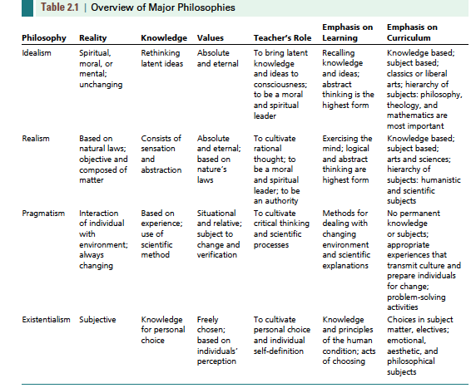

Slide 9
EDUCATIONAL PHILOSOPHY
PERENNIALISM
ESSENTIALISM
PROGRESSIVISM
RECONSTRUCTIONISM
TRADITIONAL PHILOSOPHY
CONTEMPORARY PHILOSOPHY

Slide 10
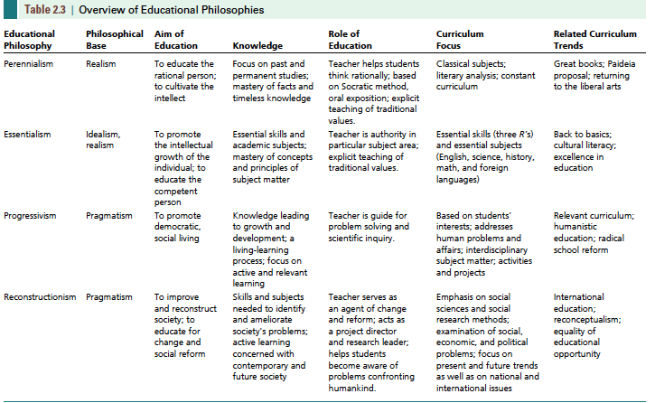

Slide 11
HISTORICAL FOUNDATIONS
The Colonial Period : 1642-1776
The National Period : 1776-1850
19th Century European Educators
The Rise of Universal Education: 1820-1900
The Transitional Period: 1893-1918
The birth of the field of Curriculum: 1918-1949
Current Focus 20th Century

Slide 12
PSYCHOLOGICAL FOUNDATIONS
BEHAVIORISM
COGNITIVE
PHENOMENOLOGY AND HUMANISTIC

Slide 13
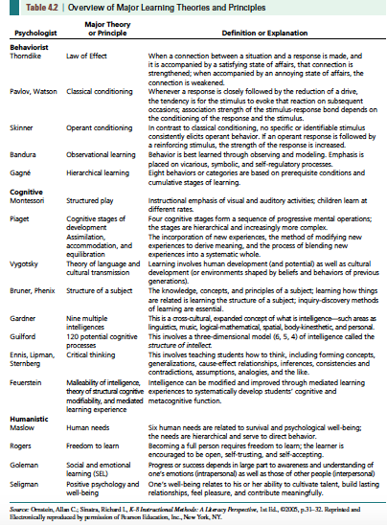

Slide 14
SOCIAL FOUNDATIONS
Society, Education and Schooling → social and developmental theories, changing society; education vs schooling
Moral/Character Education → moral conduct, moral character and performance character
The Culture of the School → conformity, coping and caring
Culture of Classroom → peer group, peer culture, peer and racial groups, social class, academic achievement

Slide 15
REFERENCES
Kelly, A.V.(2009) The Curriculum: Theory and Practice. London: Sage
Marsh, CJ. (2004). Key Concepts for Understanding Curriculum 3rd ed. London: Routledge Falmer
Moore, Alex (2014)Understanding the school Curriculum: Theory, Politics and principles. London: Routledge
Ornstein, A.C & Hunkins, F.P (2018). Curriculum Foundations, Principles and Issue 7th edition. England: Pearson Education Limited

