Slide 1
MODELS FOR CURRICULUM DEVELOPMENT
SESSION 6
SRI LESTARI, S.Pd, M.A.
ENGLISH EDUCATION DEPT.

Slide 2
The objectives
01. Students are able to discuss and compare various models of CD
02. Students are able to explain steps in CD in relations to the models

Slide 3
WHAT IS ‘MODEL’?
something that a copy can be based on because it is an extremely good example of its type (Cambridge Dictionary)
a system or thing used as an example to follow or imitate
patterns as a guideline to action (Oliva, 2012)
Based on the theory of teaching and learning
Outline approaches, methods, and procedures for implementation

Slide 4
CLASSIFICATION
A deductive model vs inductive model
from general to specific; from the needs to instructional objectives)
Starts with the development of curriculum to generalization
A linear vs non-linear model
Standard; sequential steps
A prescriptive vs descriptive model
Prescriptive focuses on conclusions rather than a processes of curriculum

Slide 5
MODELS FOR CURRICULUM DEVELOPMENT
THE TYLER'S MODEL (Ralph Tyler, 1949)
THE TABA’S MODEL (Hilda Taba, 1962)
THE OLIVA’S MODEL (Peter F. Oliva)
The instructional strategies model
The behavioral model

Slide 6
THE RALPH TYLER MODEL
Behavioral approach
Focuses on planning phase
Deductive
General objectives → three sources of objectives: society, learners, subject matters
Filtering philosophical and psychological screens

Slide 7
TYLER’S FOUR RATIONALE
What educational purposes should the school seek to attain?
What educational experiences can be provided that are likely to attain these purposes?
How can these educational experiences be effectively organized?
How can we determine whether these purposes are being attained or not?

Slide 8
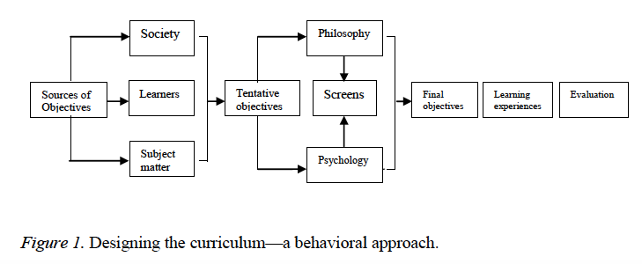
TYLER’S CONCEPTUAL FRAMEWORK

Slide 9
THE TABA MODEL (Hilda Taba)
Designed by the teachers
Begin with specific lesson then merges into a curriculum → teachers create specific teaching-learning units
Inductive

Slide 10
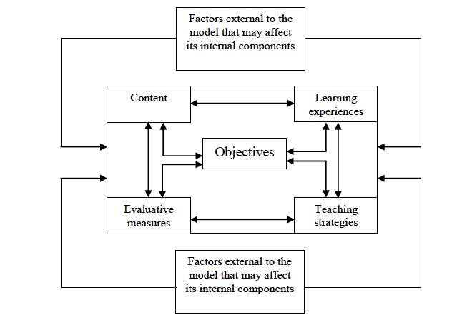
TABA’S CONCEPTUAL FRAMEWORK
(Oliva & Gordon, 2012)

Slide 11
TABA’S FIVE STEPS
Teachers produce learning units for each grade or subjects (analyze of students’ need, formulate objectives, select content, organize content, select activities, organize activities, create evaluation methods)
Develop a test unit to evaluate the effectiveness of units in actual classroom
Revise and adjust elements of units resulting from the evaluation
Curriculum planners create framework and state rationale for units
Implement the finalized unit into all classrooms

Slide 12
THE OLIVA MODEL (Peter F. Oliva)
Deductive
Involve twelve components and two phases (curriculum development and two phases)
the needs of students in particular communities are not always the same as the general needs of students throughout our society
The most comprehensive and detailed

Slide 13
THE TWELVE STEPS
Establishing educational aims and stating general students’ needs
Analyzing needs of local community and students then performing each subjects
Establishing curriculum goals (general expectations of the process)
Establishing curriculum objectives (specific criteria)
Organizing and implementing the curriculum
Formulating instructional goals
Formulating instructional objectives

Slide 14
THE TWELVE STEPS
Selecting instructional strategies
(A) Selecting evaluation methods for measuring students achievement
Implementing instructional strategies
(B) Finalizing the selection of evaluation methods
Implementing the instructional evaluation and adjusting instructional components
Evaluating the curriculum efficacy and adjusting curriculum components

Slide 15
EXERCISE
Compare the models of curriculum development by Tyler, Taba, Oliva, Wheeler, Kerr, and Beauchamp. What are their differences?
Year
Focus/approach
Teacher’s role
Steps/stages

Slide 16
REFERENCES
Lunenburg, F. (2011). Curriculum development: Deductive Models. Schooling Vol 2/1. Sam Houston University.
Lunenburg, F. (2011). Curriculum development?: Inductive learningVol 2/1. Sam Houston University
Moore, Alex (2014). Understanding the school Curriculum: Theory, Politics and principles. London: Routledge
Oliva, P & Gordon. W. (2012).Developing the Curriculum. Pearson Education
Tyler, Ralph. (1949). Basic Principles of Curriculum and Instruction. in Flinders & Thornton.(2004). The Curriculum Studies Reader. London: Routledge

