Slide 1
APPROACH TO CURRICULUM DEVELOPMENT
SESSION 7
SRI LESTARI, S.Pd, M.A.
ENGLISH EDUCATION DEPT.

Slide 2
The objectives
01. Students are able to discuss the approaches to curriculum development
02. Students are able to explain how to develop curriculum using the approach

Slide 3
WHAT IS APPROACHES TO CD?
the strategies employed in organizing curriculum content and learning activities that are presented to the learners.
the ways of attaining a functional curriculum development.
also refers to models of curriculum development
(Offorma, 2014:77)

Slide 4
APPROACHES
TECHNICAL-SCIENTIFIC APPROACHES (Modernist Perspective)
NONTECHNICAL –NONSCIENTIFIC APPROACHES (Postmodernist Perspective)

Slide 5
TECHNICAL-SCIENTIFIC
stresses students learning specific subject matter with specific outputs
applies scientific principles and involves detailed monitoring of the components of curriculum design
systematically outline those procedures that facilitate curriculum development

Slide 6
TECHNICAL-SCIENTIFIC
Bobbit and Charter model
Tyler Model (four basic principles)
Taba Model (Grassroots rationale)
Wiggins and McTighe (Backward-Design Model)

Slide 7
NONTECHNICAL NONSCIENTIFIC APPROACH
suggests that the process of curriculum development is highly objective, universal, and logical
modernist; it rests on a belief in rationality, objectivity, and certainty
the learner is the central focus, not the learner’s output of inert information.
students are always evolving (child-centered)

Slide 8
NONTECHNICAL NONSCIENTIFIC APPROACH
The Deliberation Model
Slattery’s Approach
Doll’s Model

Slide 9
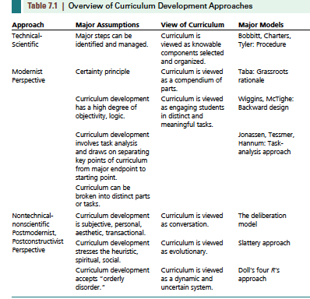

Slide 10
REFERENCES
Moore, Alex (2014). Understanding the school Curriculum: Theory, Politics and principles. London: Routledge
Oliva, P & Gordon. W. (2012).Developing the Curriculum. Pearson Education
Tyler, Ralph. (1949). Basic Principles of Curriculum and Instruction. in Flinders & Thornton.(2004). The Curriculum Studies Reader. London: Routledge
Offorma, G.C. (2014). Approaches to Curriculum Development. in Education in Nigeria: Development and Challenges.

