Slide 1
PRODUCTS AND PROBLEMS OF CURRICULUM DEVELOPMENT IN FORMAL EDUCATION
SESSION 9
SRI LESTARI, S.Pd, M.A.
ENGLISH EDUCATION DEPT.

Slide 2
The objectives
01. Students are able to discuss curriculum development in formal education.
2. Students are able to identify the problems of curriculum development in formal education

Slide 3
CD FOR FORMAL EDUCATION
MACRO CURRICULUM
MESO CURRICULUM
MICRO CURRICULUM

Slide 4
MACRO CURRICULUM
“Kurikulum yang menyeluruh meliputi semua komponen, atau meliputi semua wilayah, atau seluruh siswa pada jenjang pendidikan tertentu.” (Sukmadinata, 2010: 199)
developed by a team of experts
Steps:
Analyzing and developing the standards of graduate competence (SKL)
Formulate vision and mission, and the objectives of education institution
developing subjects to achieve vision, mission and objectives
Identifying and developing teachers and staffs to fulfill the qualifications
Identifying learning facilities

Slide 5
MESO CURRICULUM
Elaborating the macro curriculum into programs
Including institutional context; organizing context; institutional approach and curriculum orientation and organizing structure of curriculum.
For example: deciding standard of competencies and basic competencies of English for junior high school

Slide 6
MICRO CURRICULUM
Institutional level (school level); elaborating the meso curriculum
Also known as ’instructional curriculum’ → planning specific instruction for a classroom activity including the objective, the material, methods, media and evaluation
Developed by teacher annually, per semester, per quarter or per week.

Slide 7
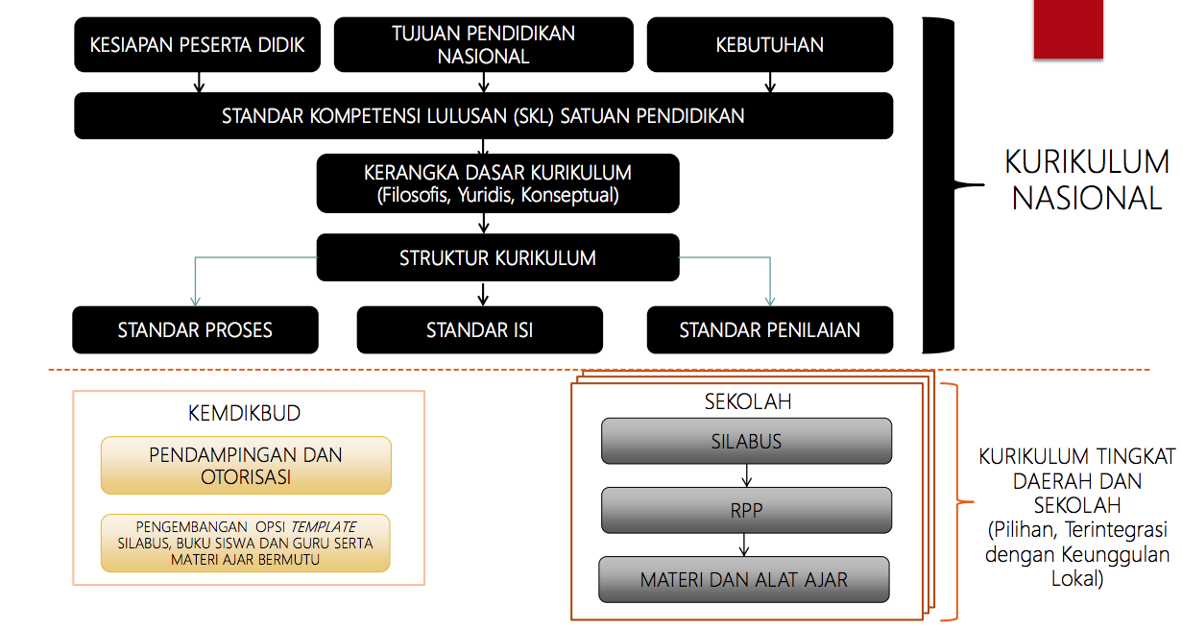
THE NATIONAL CURRICULUM 2013 DEVT PROCESS

Slide 8
CURRICULUM IN FORMAL EDUCATION
The national curriculum (in public and private schools)
The international curriculum (in private schools)
The national plus curriculum (in private schools)
Pioneer of international school standard

Slide 9
GROUP DISCUSSION
Discuss the problems of curriculum development in Indonesia
Compare those three kinds of curriculum in formal education in Indonesia: national, national-plus, and international

Slide 10
REFERENCES
Sukmadinata, Nana. (2010). Pengembangan Kurikulum, Teori dan Praktik. Bandung: Rosda Karya
https://www.slideshare.net/triajeng/pengembngan-kurikulum-makro

