Slide 1
Peraturan Perundang-Undangan
Anggun Nabila, SKM, MKM

Slide 2
Health Policy
Many defintions of health policy:
Basically, it is
An excutable decision (written)
Many forms: regulation, guidelines, standard, etc
As a tool to achieve a health goal/objective
Complex health problems and causes of the problems require a thorough policy analyses and new policy development
Developed countries have a “permanent” health system as a national/global policy
HT

Slide 3
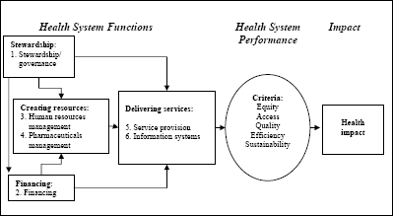
Health System as Health Policy.
Main Policy Indicators: Sistem Performance
Source: WHR 2000
HT

Slide 4
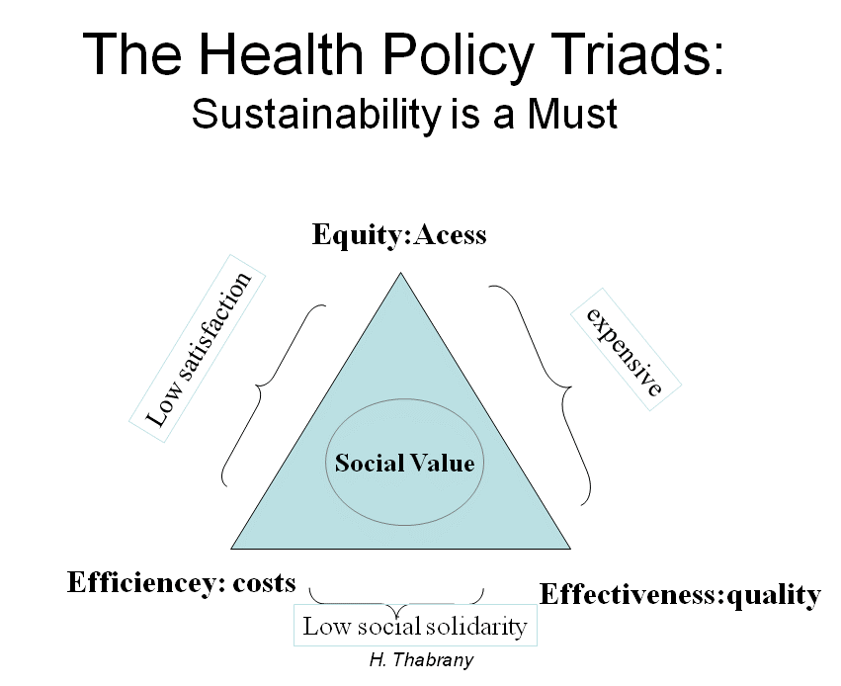

Slide 5
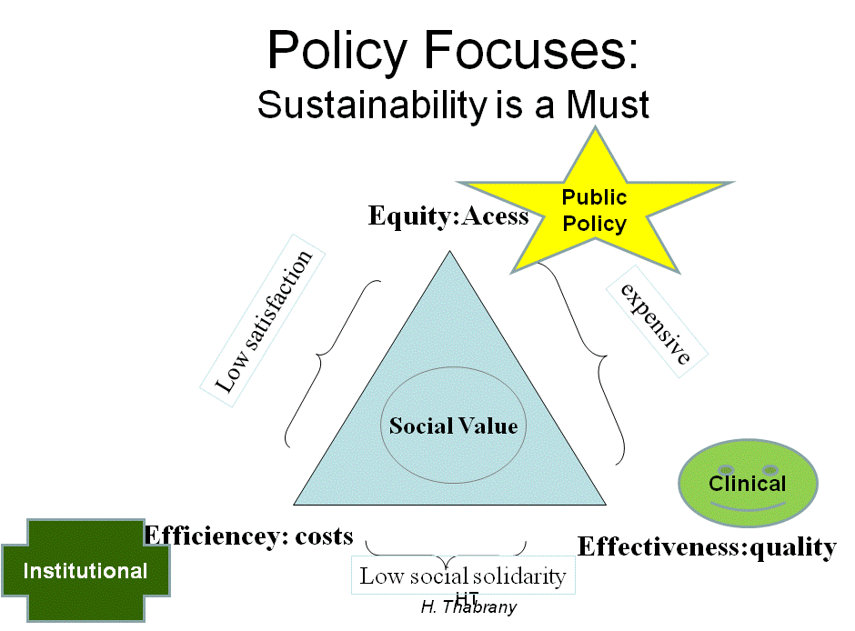

Slide 6
Policy Analyses Should Incorporate
Health Goal, Equity issues; How to measure equity?
Efficiency in using public resources. Even individual resources can be important policy issues
Quality/effectivness of a policy, an intervention/program
Methods of achieving the goal (market mechanism, regulation, combination)
HT

Slide 9
How to Achieve a Health Goal
Two Broad Policies: Market vs Regulation
Market is a natural mechanism to produce equilibrium between supplies and demands
It automatically create efficient and effective products/ services WHEN appropriate
But it FAIL to achive equity
In Health care: efficiency and effectiveness (quality) are not guaranteed in a market model
Regulation: non market intervention
Normally to solve equity problem
It can achieve effectinenes/quality and may be
efficient
HT

Slide 11
Perfectly Competitive Market→→  efficient & Effective, But It Must be:
Limited resources
Free entry and exit
Information symetry
Consumer rational—his/her utility function
Decision by consumer (independent)
Economy of scale
No externality
Term: monopoly, monopsony, natural monopoly
HT

