Slide 1


IDENTIFIKASI DAN STRATEGI BAHAYA KIMIA AKIBAT KEBAKARAN
Ir. MUH. ARIF LATAR, MSc

Slide 2
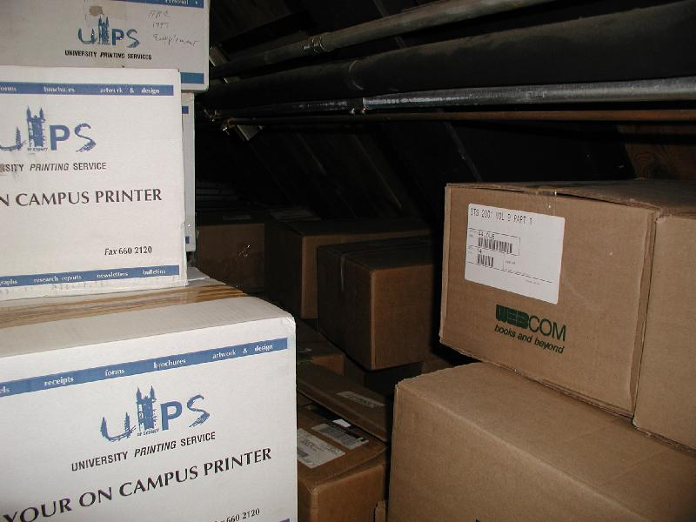

IDENTIFIKASI
  Prinsip Identifikasi Bahaya KIMIA, adalah
untuk mengetahui bahan kimia apa yang dipakai atau di-produksi,
  bagaimana cara bahan kimia ini dapat dapat kontak dengan tubuh dan meyebabkan penyakit atau cedera.
  Bagaimana meyebabkan kebakaran dan ledakan di tempat kerja atau bagaimana suatu tumpahan danbocoran dapat merusak lingkungan

Slide 3
MENURUT KEPMENNAKER NO.KEP.187/MEN/1999, BAB II PSL-4, IDENTIFIKASI BAHAN KIMIA
BERBAHAYA DITEMPAT KERJA DILAKUKAN DG CARA SBB :
Drum , karung & kontainer lain berisi bahan kimia harus sering diperiksa kebenaran pemasangan labelnya, tujuannya adalah untuk mengingatkan pekerja mengenai bahaya potensial bahan kimia
PEMASANGAN LABEL ATAU PENANDAAN PADA KEMASAN
  Label pada kemasan akan mencantumkan :
  Nama dagang atau nama formulasi
  Identitas dari bahan kimia
  Nama, alamt & No Telp dari pemasok
  Nomor izin
  Gambar simbol bahaya
  Waktu kedaluwarsa
  Cara penggunaan
  Cara pembuangan

Slide 4
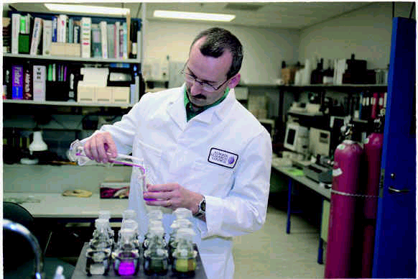
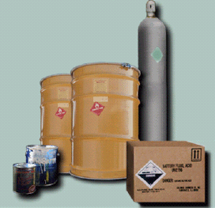
Contoh,
Bahan kimia di tempat kerja dalam bentuk label
 | Potassium Cynide KCN Cas –No.(151-50-8) Bahan sangat beracun Larut dalam air

Slide 5
Lembar Data Keselamatan Bahan (material Safety Data Sheet = MSDS)
MENURUT KEPMENNAKER NO.KEP.187/MEN/1999, BAB II PSL-4 ayat (1),
LEMBAR DATA KESELAMATAN BAHAN SBB ;
Identifikasi bahan dan perusahaan
Komposisi bahan
Identifikasi bahaya
Tindakan pertolongan pertama pada kecelakaan (P3K)
Tindakan penanggulangan kebakaran
Tindakan mengatasi kebocoran dan tumpahan
penyimpanan dan penanganan bahan
Pengendalian pemajaman dan alat pelindung diri
Sifat fisika dan kimia
Stabilitas dan reaktifitas bahan
Informasi toksikologi
Informasi ekologi
Pembuanagan limbah
Pengankutan bahan
Informasi peratran perundang- undangan yang berlaku
Informasi lain yang diperlukan

Slide 6
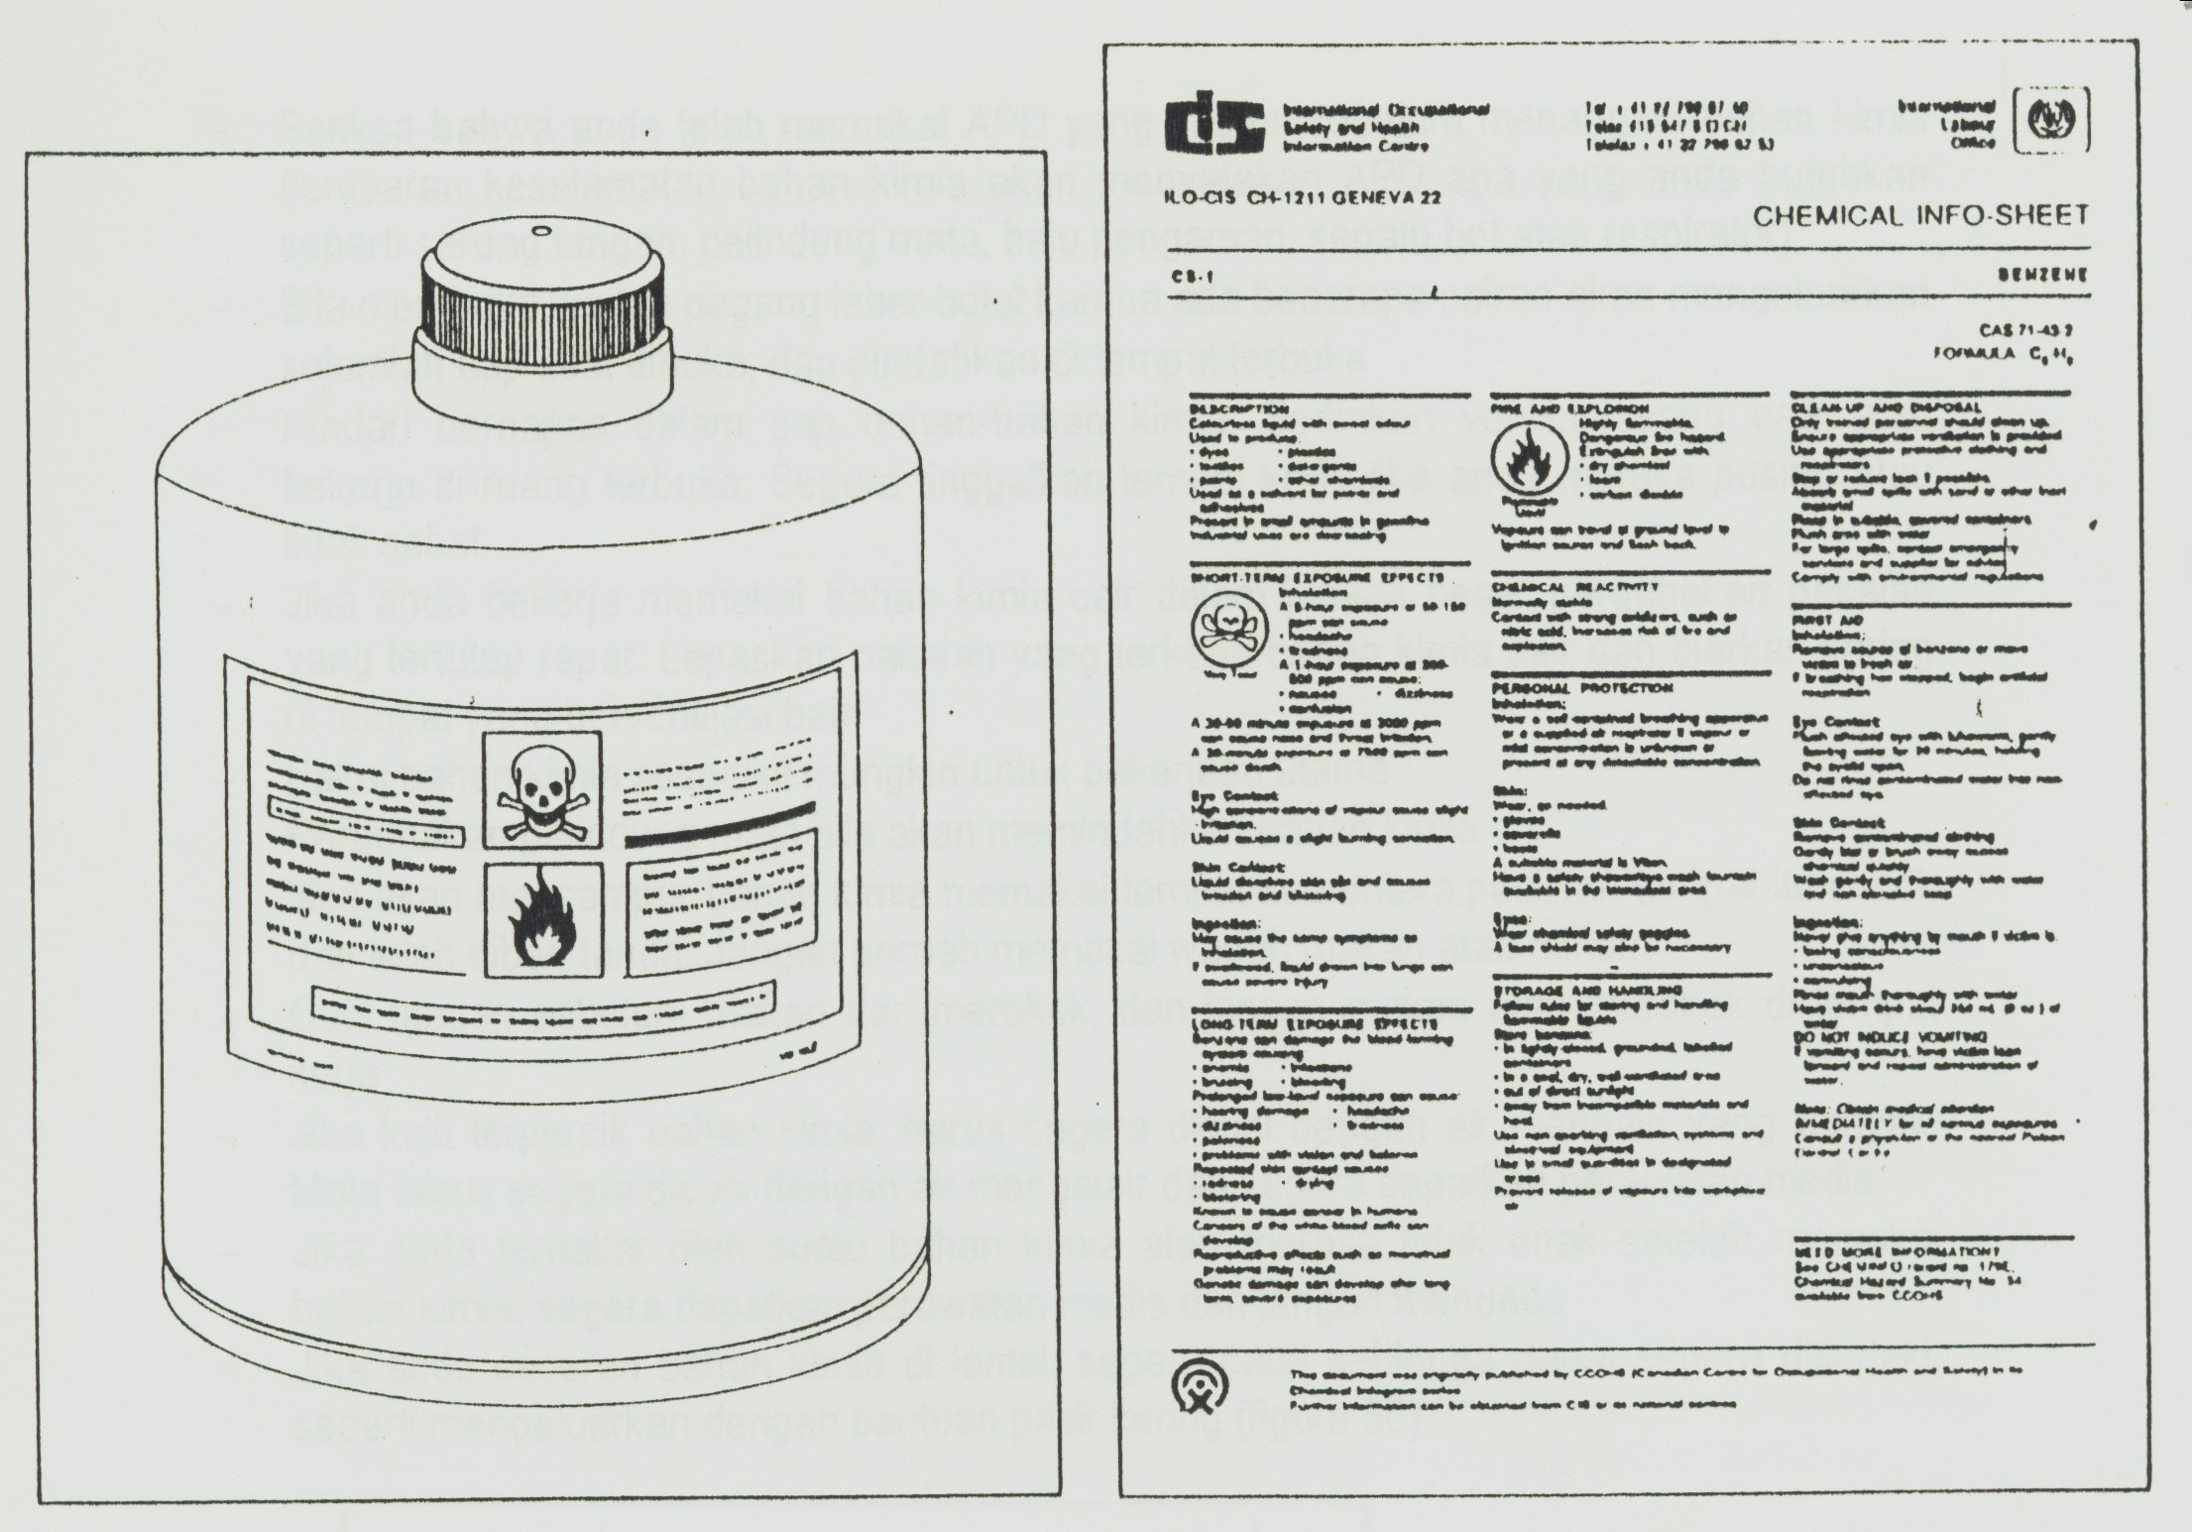
Contoh,
Bahan kimia di tempat kerja dalam bentuk label & MSDS/lembaran keselamatan bahan kimia

Slide 7
BAHAN KIMIA MUDAH MELEDAK , REAKTIF , OKSIDATOR
KRITERIA MUDAH MELEDAK :
Bila bereaksi menghasilkan gas dlm jumlah besar
Tekanan dan suhu meningkat dg cepat
Bejana / wadah akan pecah
KRITERIA REAKTIF :
Bila terkena air, timbul gas panas mudah terbakar
Bila tercampur senyawa asam, timbul gas panas yg mudah terbakar, atau beracun atau korrosif
KRITERIA OKSIDATOR :
Bila terjadi reaksi kimia atau penguraiannya akan menghasilkan gas O₂

Slide 8
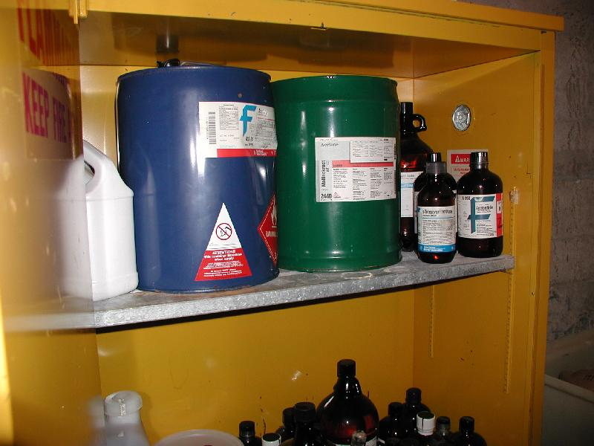
Prevention Strategy
Flammable and Combustible Materials
  Where possible, substitute flammable materials with safer, less/non flammable, non-toxic materials.
Notes:
FLSP page 15

Slide 9
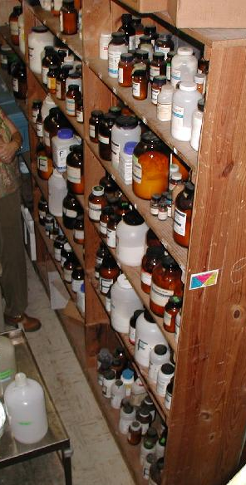
Prevention Strategy
Flammable and Combustible Materials
  Quantities of flammable and combustible liquids located outside of storage cabinets should be restricted to one day’s supply, or to what can be used during a single shift.
Notes:
FLSP page 15

Slide 10
Prevention Strategy
Flammable and Combustible Materials
  Some flammable liquids, such as xylene, toluene, benzene, and gasoline have a tendency to accumulate a static electric charge, which can release a spark that ignites the liquid.
    Always bond metal dispensing and receiving containers together before pouring.
Notes:
FLSP page 15

Slide 11
Prevention Strategy
Flammable and Combustible Materials
  To bond containers, each container is wired together and one container is connected to a good ground point to allow any charge to drain away safely.
  Because there is no easy way to bond plastic containers, their use should be limited to smaller sizes (no more than 4L).
Notes:
FLSP page 15

Slide 12
Prevention Strategy
Flammable and Combustible Materials
  To prevent the accumulation of vapors inside of storage areas, a continuous mechanical ventilation system must be in place.
    Both makeup and exhaust air openings must be arranged to provide air movement directly to the exterior of the building.
    Exhaust ventilation ducts must be exclusive to the system and used for no other purposes.
Notes:
FLSP page 16

Slide 13
Prevention Strategy
Flammable and Combustible Materials
  All nonessential ignition sources must be eliminated where flammable liquids are used or stored.
  Common ignition sources include:
    Open flames from cutting and welding
    Furnaces, matches, heaters, smoking materials
    Static electricity, friction sparks
    Motors, switches, circuit breakers
Notes:
FLSP page 16

Slide 14
Prevention Strategy
Flammable and Combustible Materials
  Materials that contribute to a flammable liquid fire should not be stored with flammable liquids. For example,
    Oxidizers
    Organic peroxides
Notes:
FLSP page 16

Slide 15
Prevention Strategy
Flammable and Combustible Materials
  If a spill occurs:
    Limit spread by diking with suitable absorbent material.
    Minimize vapors by covering surface of spill with same absorbent material.
    Notify supervisor immediately. Call 911 to summon Fire Department if necessary.
    Contact EHSS for assistance and guidance.
    Ensure all sources of ignition are off or controlled.
    Begin cleanup right away.
Notes:
FLSP page 16

Slide 16
Prevention Strategy
Compressed Gas Cylinders
  Gases in these cylinders can pose fire or explosion hazards, may be toxic, or can displace oxygen in the area.
  Perform a visual inspection of the cylinder and refuse delivery if the cylinder appears to be damaged or defective in any way.
  Cylinders must be stored in compatible groups, with flammables separated from oxidizers and corrosives.
Notes:
FLSP page 17

Slide 17
Prevention Strategy
Compressed Gas Cylinders
  Oxygen cylinders must be at least 20 feet from flammable and combustible materials.
    Separation can be by barrier that has a fire-rating of at least ½ hour, such as concrete block or sheet metal, that is at least 5 feet in height.
Notes:
FLSP page 17

Slide 18
Prevention Strategy
Compressed Gas Cylinders
  Gas cylinders, or any other hazardous material, cannot be stored in public hallways or unprotected areas.
  Nonflammable cylinders must be at least 5 feet from exits or unprotected openings such as windows.
  Flammable cylinders must be at least 25 feet from exits and windows.
Notes:
FLSP page 17

Slide 19
Prevention Strategy
Compressed Gas Cylinders
  Keep valves closed and put caps on cylinders when not in use.
  Never store gas cylinders near radiators or other heat sources (including direct sunlight).
  Contact EHSS Fire Safety for bulk storage rooms or new installations of storage areas.
Notes:
FLSP page 17

Slide 20
Prevention Strategy
Fire Protection Systems
  Not all buildings on campus are equipped with building fire alarms. A list of buildings with alarms can be found on our website.
    www.ehss.vt.edu/OSD/Programs/FireAndLife/fire_and_life_safety.htm
Notes:
FLSP page 18

Slide 21
Prevention Strategy
Fire Protection Systems
  If your building is not equipped with a fire alarm system, occupants will need to communicate to others in the building by yelling “FIRE” as they exit the building, or by other means as defined in the building’s Emergency Action Plan.
Notes:
FLSP page 18

Slide 22
Prevention Strategy
Fire Protection Systems
  Automatic fire alarm systems are installed to facilitate notification of building occupants of a fire emergency.
  Various types of smoke and heat detectors, along with manual pull stations, are linked to the alarm system.
    When activated, the fire alarm system sends a signal to Virginia Tech Police Dispatch and sounds an audible and/or visual alarm in the building.
Notes:
FLSP page 18

Slide 23
Prevention Strategy
Fire Protection Systems
  Manually activated pull stations are located along building exit routes.
  All buildings equipped with fire alarms will have manual pull stations (i.e. red boxes).
Notes:
FLSP page 18

Slide 24
Prevention Strategy
Fire Protection Systems
  Fire suppression systems are more commonly known as “sprinkler systems”.
  Several types are present in campus buildings.
    The most common type uses water and is designed to extinguish small fires and/or reduce the spread of fire to provide building occupants time to evacuate.
Notes:
FLSP page 18

Slide 25
Prevention Strategy
Fire Protection Systems
  Fire suppression systems are interconnected to the building fire alarm.
  When a sprinkler head is activated, it automatically activates the building fire alarm.
  The building fire alarm can also be activated by smoke detectors or manually without the sprinklers going off. This is how a fire drill is conducted.
Notes:
FLSP page 18

Slide 26
Prevention Strategy
Fire Protection Systems
  Other types of fire suppression systems include dry pipe water and wet chemical systems.
  These systems are found:
    where hazardous materials are located,
    in commercial kitchen hood exhaust systems,
    in areas where freezing is a concern.
Notes:
FLSP page 19

Slide 27
Prevention Strategy
Fire Protection Systems
  Each existing commercial cooking appliance, such as a grill, deep fryer, or any other appliance that produces grease-laden vapors, is required to have an approved commercial kitchen exhaust hood and duct system that is protected with an automatic fire suppression system.
Notes:
FLSP page 19

Slide 28
Prevention Strategy
Fire Protection Systems
  These commercial kitchen systems must be appropriate for the hazard.
  The sprinkler heads within the hoods require regular maintenance and cleaning to remove deposits of residue and grease from the system.
Notes:
FLSP page 19

Slide 29
Prevention Strategy
Fire Protection Systems
  Fire extinguishers can play an important role in the fire protection program. How successfully they can function, however, depends upon the following conditions having been met:
    Extinguisher is properly located, is the proper type for the fire, and is in working order.
    The fire is discovered while still small enough to be extinguished, and someone is ready, willing, and able to use the extinguisher.
Notes:
FLSP page 19

Slide 30
Prevention Strategy
Fire Protection Systems
  Consider the following factors when selecting portable fire extinguishers :
    Nature of flammables and combustibles in area,
    Potential severity of any resulting fire,
    Effectiveness and ease of use of the extinguisher,
    Personnel available to operate the extinguisher, their physical abilities and emotional reactions,
    Environmental conditions,
    Suitability of extinguisher for its environment.
Notes:
FLSP page 19

Slide 31
Prevention Strategy
Fire Protection Systems
  Consider the following factors when selecting portable fire extinguishers:
    Anticipated adverse chemical reactions between extinguishing agent and burning materials,
    Health and operational concerns,
    Upkeep and maintenance requirements for the extinguisher.
Notes:
FLSP page 19

Slide 32
Prevention Strategy
Building and Renovation Projects
  The Commonwealth of Virginia Department of General Services, Division of Engineering and Buildings (DEB) recently instituted a new building permit policy that affects all state agencies.
  Under this policy, we are required to issue building permits for all renovations and construction projects costing less than $500,000.
Notes:
FLSP page 20

Slide 33
Prevention Strategy
Building and Renovation Projects
  The Director of Physical Plant has been designated as the Agency Representative to issue permits and ensure that the university meets all legally mandated Virginia Uniform Statewide Building Code (VUSBC) requirements.
Notes:
FLSP page 20

Slide 34
Prevention Strategy
Miscellaneous Requirements
  Landscaping must not:
    Impede fire vehicle or emergency responder access to a building.
    Obstruct access to fire hydrants, fire department connections or other fire sprinkler test valves and other emergency devices.
    Obstruct or cause a tripping hazard for occupants evacuating a building.
    Obstruct exits from doors, windows, or other designated evacuation points from a building.
Notes:
FLSP page 20

Slide 35
Prevention Strategy
Miscellaneous Requirements
  Unless the condition is allowed by the Virginia building code, or has been approved by the Virginia Tech Building Code Official:
    Holes in fire-rated walls or smoke barriers will not be permitted.
    Doors, windows, hatches, visual panels, etc. may not breach a firewall or smoke barrier.
Notes:
FLSP page 20

Slide 36
Prevention Strategy
Miscellaneous Requirements
  Cables, equipment cords, etc. may not be placed in or run through any permitted opening in a rated fire wall or smoke barrier, such as through a door or within ventilation ductwork.
Notes:
FLSP page 20

Slide 37
Prevention Strategy
Miscellaneous Requirements
  All wood and metal shavings must be cleaned and removed from the building at the end of the job or the workday.
  All shops with machinery that produces hazardous shavings or dust must have an approved dust collection system.
    This system must be in operation any time the equipment is in use.
Notes:
FLSP page 20

Slide 38
Prevention Strategy
Miscellaneous Requirements
  Lint catchers in clothes dryers should be emptied after each load.
  Check the area behind the washer and dryer periodically for lint or trash buildup and clean as necessary.
  Dryer vents must exhaust to the exterior of the building.
Notes:
FLSP page 21

Slide 39
Prevention Strategy
Miscellaneous Requirements
  For automotive and industrial shops, at the end of the work day or as necessary:
    Clean all work areas of oil to prevent buildup.
    Return all oils and flammables to their proper storage cabinet/area.
    Turn off all power equipment or unplug.
    Turn off all fuel valves and power to such systems.
Notes:
FLSP page 21

Slide 40
Prevention Strategy
Miscellaneous Requirements
  Parts washers may use flammable solvents. Check the MSDS for the product and follow guidelines, or find a less hazardous substitute.
  Spray finishing with flammable materials is only allowed in approved paint booths, or with procedure approval by the EHSS Fire Safety Engineer.
Notes:
FLSP page 21

Slide 41
Prevention Strategy
Miscellaneous Requirements
  For Art Departments:
    Flammable liquids used to create, or in the display of artwork, may only be used with written approval from EHSS Fire Safety Engineer.
    Electrical wiring and devices used in art creations or displays must meet National Electric Code requirements for temporary wiring.
Notes:
FLSP page 21

Slide 42
Fire Emergency Training
Inform employees of the following:
  Fire hazards in their work area.
  Protection measures specific to them.
  Fire Prevention Plan requirements.

Slide 43
Related Training
Portable Fire Extinguisher Training
Public Assembly Attendee Emergency Procedures Training
Compressed Gas Cylinder Awareness
Electrical Safety
Contact EHSS at 231-2341 to schedule these classes.

