Slide 1
Vitamin and Energy Metabolism
PERTEMUAN 6
NADIYAH, S.Gz., M.Si
LARAS SITOAYU, S.Gz., MKM
PROGRAM STUDI KESEHATAN MASYARAKAT

Slide 2
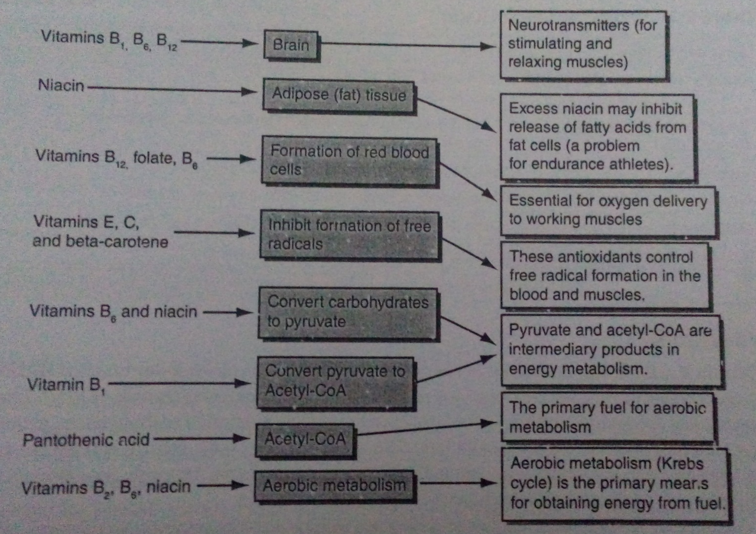
Relationship of vitamins to energy metabolism

Slide 3
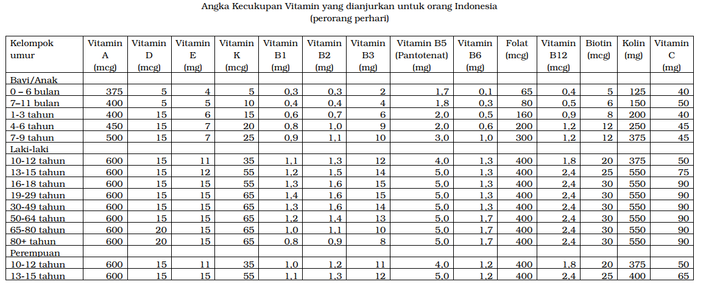

Slide 5
Vitamin B1
Alternative name | Thiamin
Dietary Reference Intake (AKG) | Adult males: mg/day Adult females:
Functions | Carbohydrate metabolism, nervous system function
Good food sources | Whole-grain cereals, beans, enriched grains
Deficiency | Confusion, anorexia, weakness, calf pain, heart disease
Toxicity | None known

Slide 6
Vitamin B2
Alternative name | Riboflavin
Dietary Reference Intake (AKG) | Adult males: mg/day Adult females:
Functions | Energy metabolism, protein metabolism, skin health, eye health
Good food sources | Fresh milk and other dairy products, eggs, dark green leafy vegetable, whole-grain cereals, enriched grains
Deficiency | Inflamed tongue; cracked, dry skin at corners of mouth, nose and eyes; bright light sensitivity, weakness; fatigue
Toxicity | None known

Slide 7
Niacin
Alternative name | Niacinamide, nicotinic acid, nicotinamide
Dietary Reference Intake (AKG) | Adult males: mg/day Adult females:
Functions | Energy metabolism, glycolysis, fat synthesis
Good food sources | Foods high in tryptophan (a amino acid that can be converted to niacin), milk, eggs, chicken Foods high in niacin: whole grain foods, lean meat, fish, poultry, enriched grains.
Deficiency | Anorexia, skin rash, dementia, weakness, lethargy. Disease; pellagra
Toxicity | Tolerable upper intake levels: Adult: 20-35 mg/day Symptoms: flushing, burning, tingling sensations of extremities, hepatitis, and gastric ulcers with chronic high intake

Slide 8
Vitamin B6
Alternative name | Pyridoxine, pyridoxal, pyridoxamine
Dietary Reference Intake (AKG) | Adult males: mg/day Adult females:
Functions | Protein metabolism, protein synthesis, metabolism of fat and carbohydrate, neurotransmitter formation, glycolysis
Good food sources | High protein foods (meats), whole-grain cereals, enriched cereals, eggs
Deficiency | Nausea, mouth sores, muscle weakness, depression, convulsions, impaired immune system
Toxicity | Tolerable upper intake levels: Adult: 60-100 mg/day Symptoms: peripheral neuritis (loss of sensation in limbs),loss of balance and coordination.

Slide 9
Vitamin B12
Alternative name | Cobalamin
Dietary Reference Intake (AKG) | Adult males: mcg/day Adult females:
Functions | Protein metabolism, protein synthesis, metabolism of fat and carbohydrate, neurotransmitter formation, glycolysis
Good food sources | Foods of animal origin (meat, fish, poultry, eggs, milk, cheese) and fortified cereals
Deficiency | Pernicious anemia (more likely caused by malabsorption of the vitamin than by dietary inadequacy, although vegans are at risk) Symptoms: weakness, easy fatigue, neurological disorder.
Toxicity | Tolerable upper intake levels not established

Slide 10
Folic Acid
Alternative name | Folate
Dietary Reference Intake (AKG) | Adult males: mcg/day Adult females:
Functions | Methionine (essential amino acid) metabolism, formation of DNA, formation of red blood cells, normal fetal development
Good food sources | Green leafy vegetables, beans, whole-grain cereals, oranges, bananas
Deficiency | Megaloblastic anemia, neural tube defects (a sa result of low intake during pregnancy) Symptoms: weakness, easy fatigue, neurological disorders.
Toxicity | Tolerable upper intake levels: Adult: 600-1000 mcg/day Symptoms: none established

Slide 11
Biotin
Alternative name | None
Dietary Reference Intake (AKG) | Adult males: mcg/day Adult females:
Functions | Glucose and fatty acid synthesis, gluconeogenesis, gene expression
Good food sources | Egg yolks, legumes, dark green leafy vegetables (also produced by intestinal bacteria)
Deficiency | Rar; if it occurs, due to high egg white intake Symptoms: anorexia, depression, muscle pain, dermatitis
Toxicity | Tolerable upper intake levels not established

Slide 12
Pantothenic Acid
Alternative name | Panthothenate
Dietary Reference Intake (AKG) | Adult males: mg/day Adult females:
Functions | Energy metabolism as part of coenzyme A, gluconeogenesis, synthesis of acetylcholine
Good food sources | Present in all but processed and refined foods
Deficiency | Unknown in human
Toxicity | Tolerable upper intake levels not established. Symptoms: unknown.

Slide 13
Vitamin C
Alternative name | Ascorbic Acid, Ascorbate, dehydroascorbate, L-ascorbate
Dietary Reference Intake (AKG) | Adult males: mg/day Adult females:
Functions | Collagen formation, iron absorption, epinephrine formation
Good food sources | Fresh fruits (particularly citrus and cherries) and vegetables
Deficiency | Scurvy Symptoms: bleeding gums, deterioration of muscles and tendons, sudden death
Toxicity | Tolerable upper intake levels Adults: 1,2 to 2,0 g/day Increased risk of kidney stone formation with chronic intake of 1 g/day or more

Slide 14
Vitamin A
Alternative name | Retinol (precursor: beta-carotene)
Dietary Reference Intake (AKG) | Adult males: mcg/day Adult females:
Functions | Maintaining healthy epithelial (surface) cells, eye health, immune system health
Good food sources | Retinol: liver, butter, cheese, egg yolks, fish liver oils, Beta-carotene: dark green and brightly pigmented fruits and vegetables
Deficiency | Dry skin, headache, irritability, vomiting, bone pain, night blindness, increases risk of infection, blindness
Toxicity | Tolerable upper intake levels Adults: 1,7 to 3,0 mg/day Symptoms: liver damage, bone malformations, death

Slide 15
Vitamin D
Alternative name | Cholecalciferol, calcitriol, calciferol
Dietary Reference Intake (AKG) | Adult males: mg/day Adult females:
Functions | Absorption of calcium and phosphorus. Healthy skin
Good food sources | UV light exposure, fatty fish (salmon, sardines, tuna), fish liver oil, lesser amounts in eggs, and canned fish, fortified milk and margarine.
Deficiency | Rickets (children), osteomalacia (adults), increased risk of stress fractures, increased risk of osteoporosis
Toxicity | Tolerable upper intake levels Adults: 100 mcg/day Symptoms: nausea, diarrhea, loss of muscle function, organ damage, skeletal damage

Slide 16
Vitamin E
Alternative name | Tocopherol, alpha-tocopherol, gamma-tocopherol
Dietary Reference Intake (AKG) | Adult males: mg/day Adult females:
Functions | Antioxidant protection of cell membranes
Good food sources | Polyunsaturated and monounsaturated vegetable and cereal oils and margarines (corn, soy, safflower, olive); lesser amounts in fortified cereals and eggs
Deficiency | Rare, if it occurs, possible increased risk of cancer and heart disease
Toxicity | Tolerable upper intake levels Adults: 600 – 1000 mg/day

Slide 17
Vitamin K
Alternative name | Phylloquinone, menoquinone, antihemorrhagic vitamin
Dietary Reference Intake (AKG) | Adult males: mg/day Adult females:
Functions | Formation of blood clots, enhancement of osteocalcin function to aid in bone strengthening.
Good food sources | Phylloquinone: a variety of vegetable oils and dark green laefy vegetables (cabbage, spinach) Menoquinone: formed by bacteria that line the gastrointestinal tract
Deficiency | Rare, if it occurs, results in hemorrhage
Toxicity | Not established

