Slide 1
Workers’ Meal Planning
Pertemuan 7
Gizi Kerja
Nadiyah
Laras Sitoayu
Mily Elvandari

Slide 2
Calculating Energy Needs
Dietary Reference Intake (DRI) Method: Estimated Energy Requirement for Adults
Males
662 – 9,53 (age) + PA x (15,91 x Weight in kg + 53,9 x height in m)
PA (physical activity):
Sedentary = 1,0
Low active = 1,11
Active = 1,25
Very active = 1,48
Females
354 – 6,91 (age) + PA x (9,36 x weight in kg + 726 x height in m)
PA (physical activity):
Sedentary = 1,0
Low active = 1,12
Active = 1,27
Very active = 1,45
Source: Institute of Medicine, Dietary Reference Intakes for Energy, Carbohydrate, Fiber, Fatty Acids, Cholesterol, Protein, and Amino Acids (Macronutrients). Foods and Nutrition Board, DC: National Academies Press; 2005)

Slide 3
Tambahan untuk hamil dan menyusui

Slide 4
Tingkat Aktivitas

Slide 5
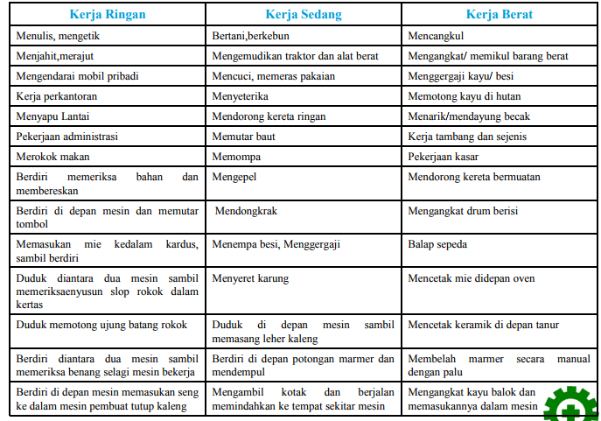
Contoh Penggolongan Pekerjaan

Slide 6
How about You ?
Calculate your energy requirement
Your Height?
Your Weight?
Your Age?
Your activity level?
then, observe the food service held in one of the offices, do the analysis it is correct or not ?

Slide 7
Persentase Kalori per Hari (untuk tiap kali makan)
Waktu | % | Kkal*
Breakfast | 20% | 400
Snack | 10% | 200
Lunch | 30% | 600
Snack | 10% | 200
Dinner | 20% | 400
Snack | 10% | 200
Total | 100% | 2000*
Work Time (40%)
*Asumsi kebutuhan total per hari 2000 kkal

Slide 8
Snack 200 kkal
Susu tanpa lemak 1 gelas atau
yogurt non fat 2/3 gelas 75 kcal
Biskuit 3 keping besar 125 kcal

Slide 9
Lunch 600 kkal
Sumber karbohidrat (Nasi) 2P
Sumber Protein hewani (Daging) 1 P
Sumber Protein Nabati (Tempe) 1 P
Sayur A S
Sayur B 1P
Buah 1P
Minyak 1P

Slide 10
Standar Diet (dalam satuan penukar)
Komposisi standar:
protein 10-15%, lemak 20-25%,
KH 60-70%
S: Sekehendak
Disesuaikan dengan kebiasaan makan individu, tanpa merubah total jumlah penukar sehari

Slide 11
Easy Portion Size
Use Your Hand

Slide 12
Indeks Kegiatan Kerja Tubuh

