Slide 1
Pengendalian Pencemaran Udara
By
Ahmad Irfandi, SKM., MKM

Slide 2
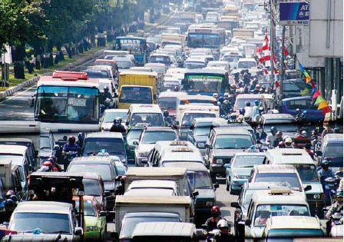
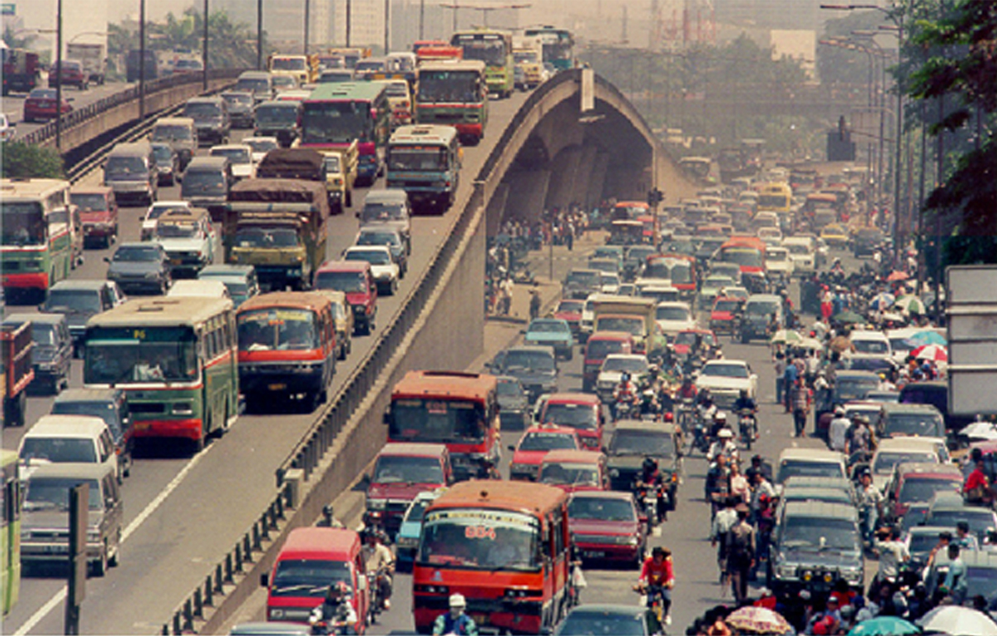
Sumber Transportasi

Slide 6
Defenisi Pencemaran Udara
Pencemaran udara adalah masuknya atau dimasukkannya zat, energi, atau kompnen lain ke dalam udara ambien oleh kegiatan manusia, sehingga mutu udara ambien turun sampai tingkat tertentu yang menyebabkan udara ambien tidak memenuhi fungsinya. (PP No. 41 Tahun 1999)

Slide 7
POLUTAN UDARA DAN SUMBERNYA

Slide 8
AMBIENT AIR CONTAMINANTS
Criteria Pollutants
Carbon Monoxide (CO)
Nitrogen Dioxide (NO₂)
Sulfur Dioxide (SO₂)
Ozone (O₃)
Lead (Pb)
Particulate Matter
Particulate Matter Less than 10 microns (PM₁₀)
Particulate Matter Less than 2.5 microns (PM_{2.5})
Total Suspended Particulate (TSP) - historic PM contaminant
Air Toxics
Volatile Organic Compounds (VOC’s)
Semi-volatile Organic Compounds (SVOCs)
Herbicides and pesticides
Notes:
3
4
These threats considered the presence of war-damaged industrial facilities throughout the US Sector in Bosnia-Herzegovina and included such potential environmental health concerns as contaminated water supplies, air and soil from power plants, industrial facilities, agricultural and mining operations and U.S. military activities (Slide 4).

Slide 9
POLUTAN UDARA
Carbon Monoxide (CO)
Nitrogen Dioxide (NO₂)
Sulfur Dioxide (SO₂)
Ozone (O₃)
Lead (Pb) and other Metals
Particulate Matter (PM₁₀, PM_{2.5}, TSP)
Volatile Organic Compounds (VOCs)
Semi-volatile Organic Compounds (SVOCs)
Herbicides and pesticides

Slide 10
CRITERIA POLLUTANTS MAJOR SOURCES
CO
- Majority from mobile sources
- Incinerators, wood-burning stoves
- Fires (incomplete combustion of carbon fuels)
PM₁₀ and PM_{2.5}
- Fossil fuel combustion sources, construction activities
- Natural windblown dust (fugitive dust, dry goods in bulk)
- Factories, power plants, fires
Pb
- Gasoline combustion
- Mining and production of lead products
Notes:
+ Major sources of criteria pollutants are included on these next two slides. This is not a complete list for each pollutant, just good general examples.
(In this case, I would just read the slide).
+ CO
- Majority from mobile sources
- Incinerators, wood-burning stoves
- Fires (incomplete combustion of carbon fuels)
+ PM₁₀ and PM_{2.5}
- Fossil fuel combustion sources, construction activities
- Natural windblown dust (fugitive dust, dry goods in bulk)
- Factories, power plants, fires
+ Pb
- Gasoline combustion
- Mining and production of lead products
NEXT SLIDE

Slide 11
CRITERIA POLLUTANTS MAJOR SOURCES
NO₂
- Found in many urban/industrial atmospheres
- Fossil fuel combustion
- Mobile sources
O₃
- Photochemical reaction with sources of VOCs & NO₂
SO₂
- Combustion of fossil fuels (oil, coal)
- Steel mills, refineries, pulp & paper mills
Notes:
+ Major sources of criteria pollutants are continued here
+ NO₂
- Found in many urban/industrial atmospheres
- Fossil fuel combustion
- Mobile sources
+ O₃
- Photochemical reaction with sources of VOCs & NO₂
- Not emitted directly from a source
+ SO₂
- Combustion of fossil fuels (oil, coal)
- Steel mills, refineries, pulp & paper mills
NEXT SLIDE

Slide 12
SOURCES OF OTHER POLLUTANTS
Air Toxics
- Wide variety of industrial & mobile sources
RCRA Pollutants
- Hazardous waste incinerators
- Boilers/furnaces burning hazardous waste
- Organic chemical industry
- Tanks/surface impoundments
- Landfills
Notes:
+ The sources for other types of pollutants are listed here.
+ As you can see form the list here, a majority of the sources of these pollutants is from industrial operations and waste handling as a result of industrial operations (landfills, incinerators and etc.)
NEXT SLIDE

Slide 13
SUMBER POLUTAN UDARA
Transportasi
Pembakaran Bahan Bakar
Proses Industri
Sampah Padat dan Incenerator
Dll.

Slide 14
Masalah di Negara Berkembang diperparah oleh:
Cepatnya pertambahan kendaraan bermotor
Tingginya intensitas polusi kendaraan
Inefisiensi kendaraan tua
Rendahnya perawatan
Lemahnya pengujian emisi
Rendahnya kualitas BBM
Besarnya populasi terpajan di jalanan (pedagang, pengguna jalan)

Slide 15
PENCEMARAN UDARA DI PERKOTAAN: Fokus perhatian
Dampak Kesehatan Manusia
Risiko tertinggi: timbal, partikel debu
Polutan lain: CO, SO₂, NOx, ozone, senyawa-senyawa kimia beracun
Dampak Lingkungan
Kerusakan alam dan bangunan fisik, kerugian harta benda, kebisingan, perubahan iklim

Slide 16
POPULATION AT RISK AND HEALTH EFFECTS

Slide 17
Susceptible Populations (Humans))
Young
Aged
Pre-existing respiratory/cardiovascular
diseases
Smokers
Heavy exercisers
Occupationally exposed personnel

Slide 18
AIR POLLUTION AND MORBIDITY

Slide 19
DAMPAK OZONE
Dampak terhadap paru-paru manusia.
Pajanan O₃ dalam dosis rendah dapat mengganggu fungsi paru-paru anak-anak dan orang dewasa.
FEV1 menurun hingga 3% ketika O₃ di udara meningkat sampai 120 ppb.
Ditemukan hubungan antara O3 dengan frekuensi harian serangan, kunjungan ke UGD, rawat inap di rumah sakit, dan kematian karena asthma.
Peningkatan rawat inap di rumah sakit karena penyakit-penyakit saluran pernafasan hingga 35% ketika terjadi peningkatan konsentrasi O₃ sebesar 100 ppb per jam.

Slide 20
Nitrogen Dioxide
Animal toxicological studies show that exposures to greater than or equal to 0.50 ppm NO₂ can result in destruction of cilia, disruption of alveolar tissue, and obstruction of respiratory bronchioles.
Such studies also show that NO₂ may cause or aggravate respiratory infections.

Slide 21
Sulfur Dioxide
The principal effect of SO₂ is the alteration of the mechanical function of the upper airway. This includes an increase in nasal flow resistance and a decrease in nasal mucus flow rate.
Exposing strenuously exercising soldiers to relatively low levels of SO₂ (0.25 and 0.50 ppm) can produce acute bronchial constriction on inhalation.
Some of the health effects attributed to SO₂ most likely result from its conversion to fine-particle sulfate aerosols such as H₂SO₄ (sulfuric acid).

Slide 22
Lung of a rat after exposure to diesel exhaust
Exposed to Diesel Exhaust
Expose to Clean Air
Compared to the normal pink lung, it has been blackened by soot
National Institute for Environmental Studies, Japan

Slide 23
DAMPAK KESEHATAN PARTIKEL DEBU
Partikel debu (PM) berhubungan dg berbagai penyakit saluran pernafasan
Menurunkan umur harapan hidup sampai 1 tahun
Peningkat kematian penderita penyakit paru-paru dan jantung
Peningkat angka kematian bayi di daerah tinggi polusi
WHO 2004

Slide 24
Carbon Monoxide
The immediate effect of CO is that it chemically binds with hemoglobin in the blood to form carboxyhemoglobin (COHb).
Carbon monoxide’s affinity for hemoglobin is 200 times greater than that of oxygen, and it tends to remain more tightly bound.
Carbon monoxide is highly toxic at concentrations > 1,000 ppm, leading to death from asphyxiation because the body, particularly the brain, is deprived of sufficient O₂.

Slide 25
DAMPAK CO
CO 0,005% (~50 ppm) 1 jam = COHb 30% kepala pening/berdenyut
CO 0,01% (~100 ppm) 2 jam = COHb 40%
nafas sesak, muntah, denyut nadi
meningkat, gangguan mental dan
kewaspadaan
CO 0,1% (~1000 ppm) 1 jam = COHb 80% meninggal setelah pingsan

Slide 26
Dampak Pb pada Anak
Otak (IQ, kewaspadaan, perilaku agresif)
Susunan syaraf
Gangguan pendengaran
Gangguan pertumbuhan
Pembentukan sel darah merah
Gangguan ginjal (semua umur)
Gangguan sistem reproduksi (dewasa)
Notes:
Lead is a poison that affects multiple organ systems that include the brain, nervous system, bone marrow and kidneys.

Slide 27
Dampak Kesehatan Polusi Udara
Lebih dari 4000 kematian prematur dan 1,5 juta serangan asthma pertahun di Jakarta
Rata-rata 3 - 6 poin IQ berkurang pada anak-anak kota Bangkok, Cairo, Manila...
Rata-rata umur harapan hidup berkurang 8,6 bulan di Uni Eropa akibat PM
PM meningkatkan kematian kardiovaskuler dan respiratory diseases
ISPA selalu pada peringkat 1 dari 10 penyakit terbanyak di Indonesia

Slide 28
PENGENDALIAN PENCEMARAN UDARA
Monitoring udara ambient dan indoor
Monitoring dampak kesehatan pencemaran udara
Penghapusan BBM bertimbal di seluruh Indonesia
Kendaraan pengguna BBM tanpa timbal dilengkapi dengan catalytic-converter
Manajemen transportasi kota
Inspection and maintenance
Vehicle technology

Slide 29
TERIMA KASIH

