Slide 1
Aplikasi Pengendalian Pencemaran Udara
By
Ahmad Irfandi, SKM., MKM

Slide 5
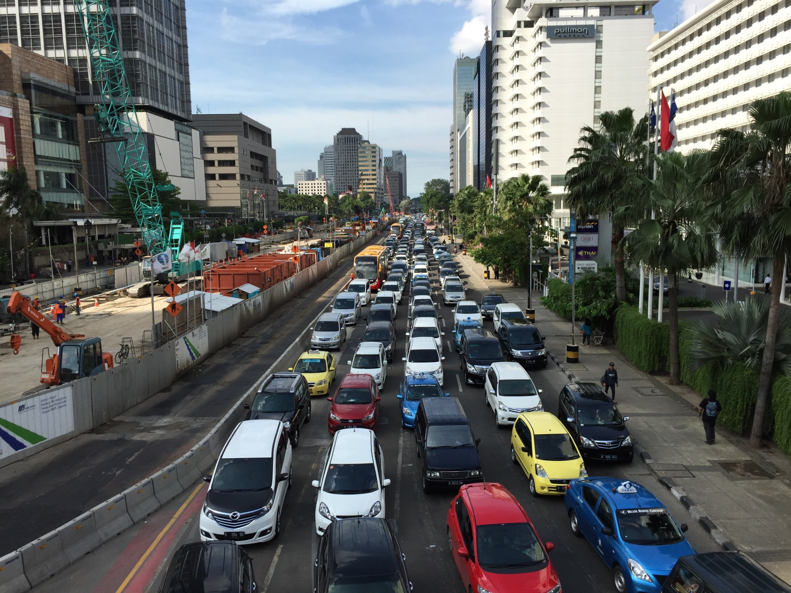
Thamrin Road
5

Slide 6
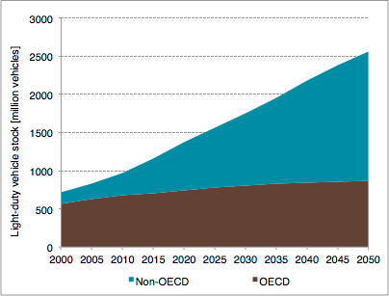
Global Passenger Vehicles will Triple in Number by 2050
2050 3x v.2005 __
2030 2x v.2005 __
6

Slide 7
Half of deaths from motor vehicle air pollution occur in Asia
Data from Global Road Safety Facility, The World Bank, Institute for Health Metrics and Evaluation. (2014). Transport for Health (pp. 1–39). Seattle, WA: IHME; Washington, DC: The World Bank.
Notes:
When we look at the health impacts of air pollution specifically, half of all deaths occur in Asia with nearly three-quarters of those in China and India alone.

Slide 8
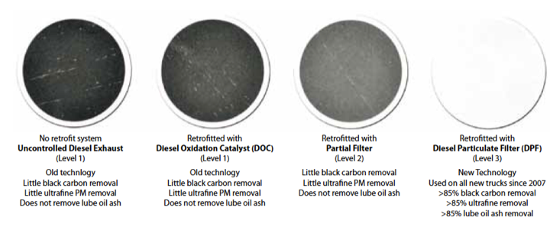
The Evolution of the Soot-Free Engine
8

Slide 9
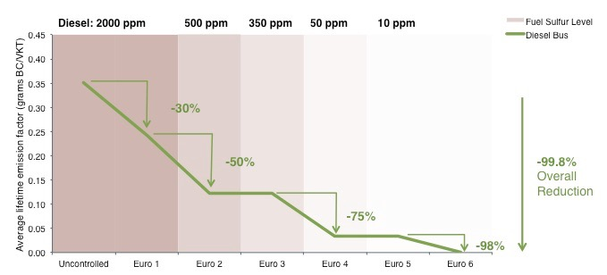
Urban Bus Fleets: Stages of Change
Stages of Black Carbon Emissions Control Based on European Regulatory Approach to Urban Bus Fleets
Source: COPERT Emissions Model

Slide 10
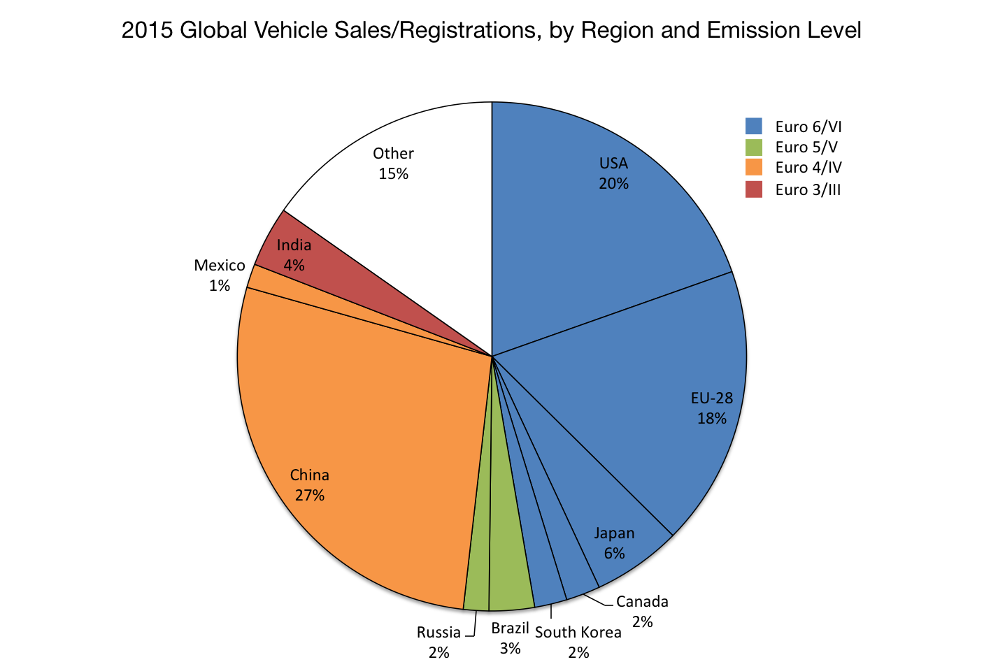
Top Vehicle Markets in 2015
10

Slide 11
The Clean Air Action Plan Development Process
Assessment
Action Plan Development
Implementation and enforcement
Review and improvement
Stakeholder participation & communication are part of the whole CAAP development process
Notes:
Key features of CAAP:
Instruments and strategies to comply with air quality and emission standards;
Adoption and implementation of control measures;
Continuous improvement after compliance; and
Anticipation of future trends such as national policies and international commitments,

Slide 12
Steps
Set up the institutional coordination mechanism
Assess current and projected scenario
  Major emission sources, pollutants of concern
Identify measures to address current and future scenarios
  Cost-effectiveness, feasibility of implementation, potential risks, co-benefits
Prioritize measures for implementation
Track and report progress (3-year review)

Slide 13
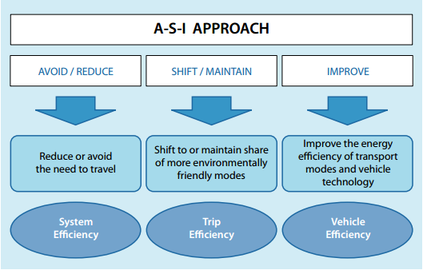
Control measures – Avoid – Shift – Improve
Integrated land-use
planning & transport
demand management
Shift from car trips to
walking and cycling trips and public transport (BRT)
Improving fuel quality and vehicle quality through technology upgrades

Slide 14
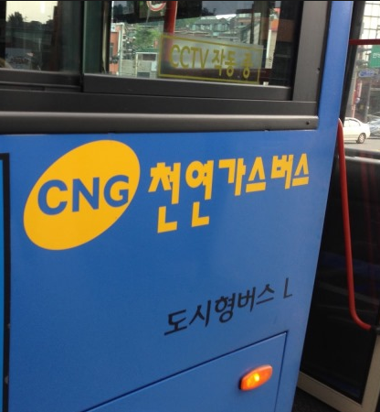
Control measures
Transport
S. Korea national program to replace diesel buses with CNG in 2000
Seoul converted 100% diesel transit buses to CNG in 2010
Government provided a procurement subsidy
  ※ PM₁₀ trend in Seoul (㎍/㎥)
  65 (2000) → 58 (2005) → 49 (2010)→ 41 (2012) → 46 (2015)

Slide 15
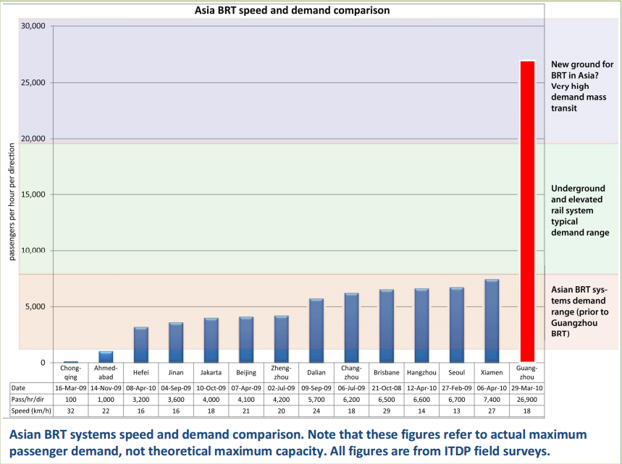
Guangzhou BRT case: Go multi-modal!

Slide 16
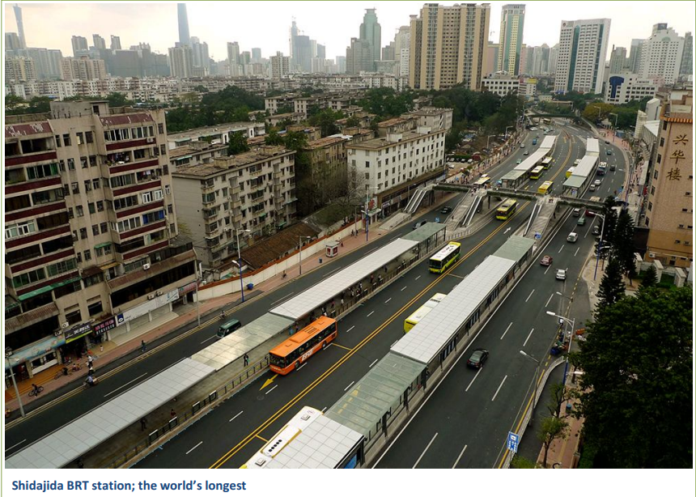
2010. ITDP

Slide 17
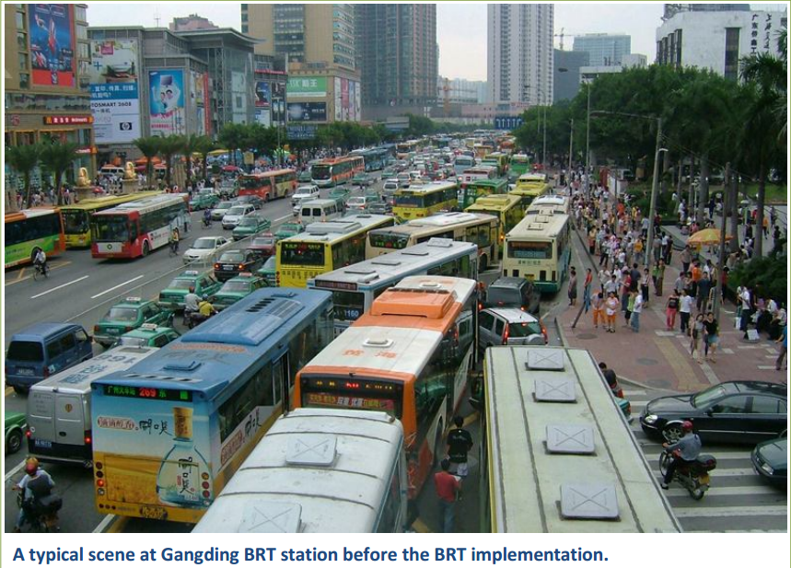
2010. ITDP

Slide 18
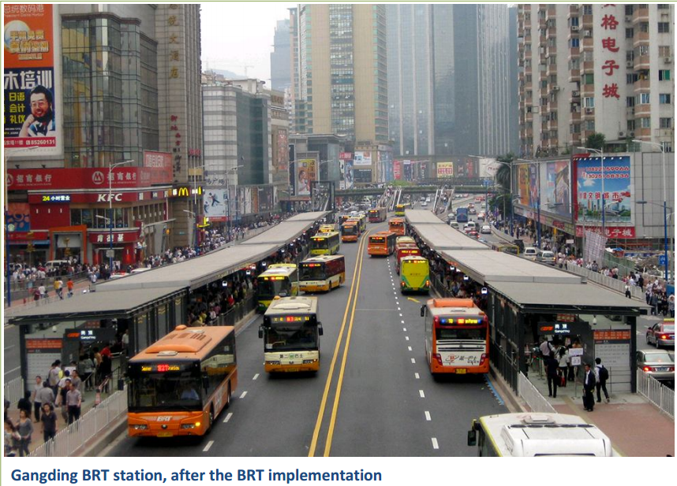
2010. ITDP

Slide 19
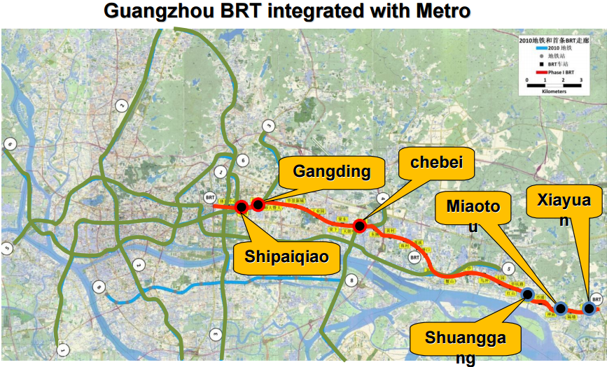
2010. ITDP

Slide 20
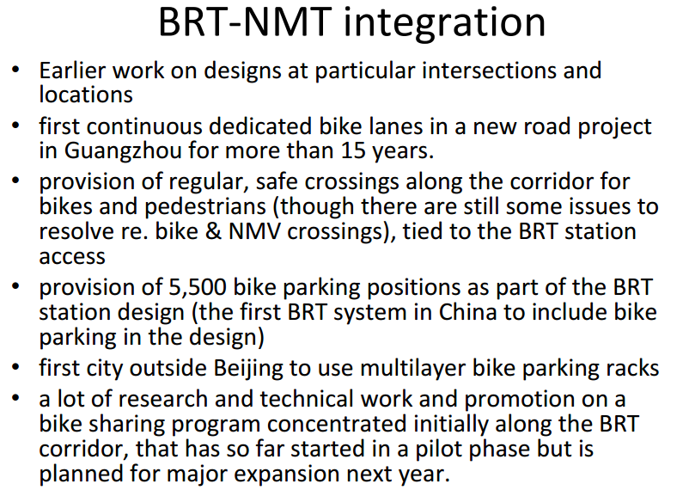
2010. ITDP

Slide 21
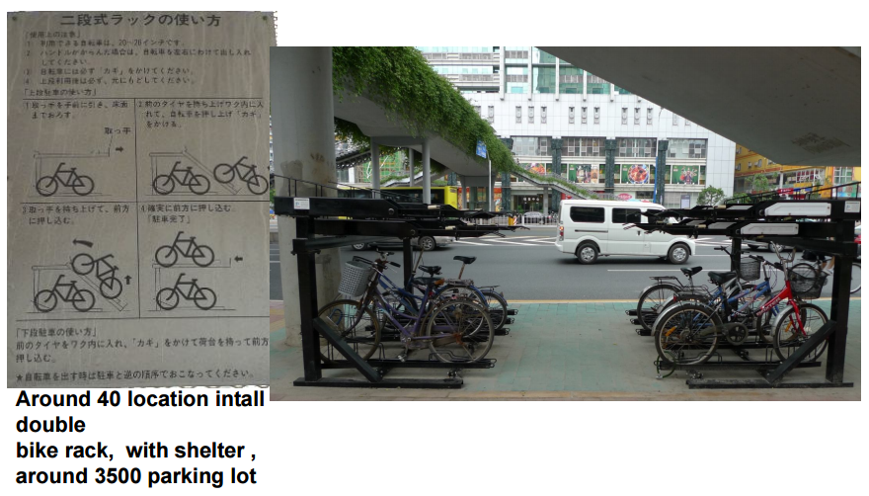
2010. ITDP

Slide 22
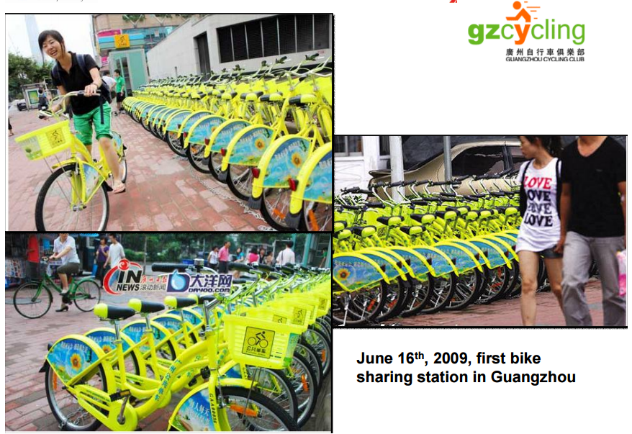
2010. ITDP

Slide 23
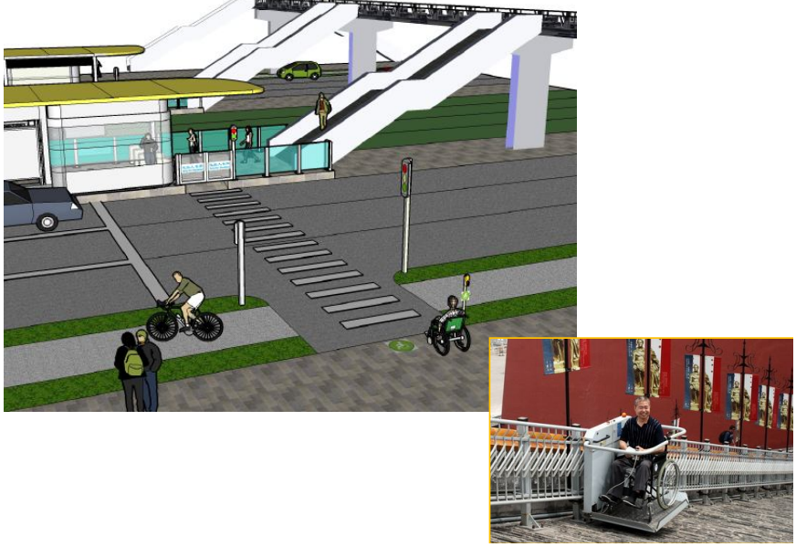
BRT-walking integration
2010. ITDP

Slide 24
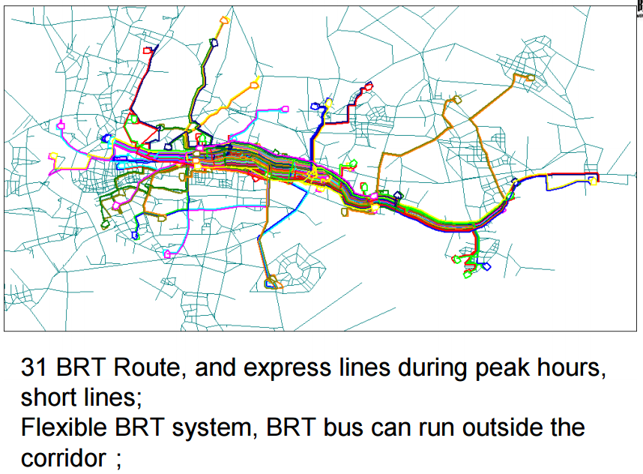

Slide 25
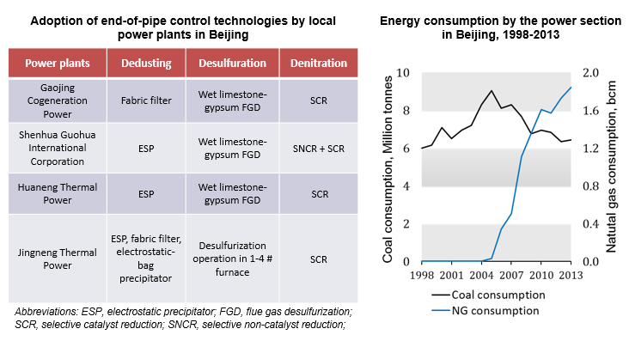
Policies and control measures
Industrial sources (Beijing case)
2016. Beijing EPB

Slide 26
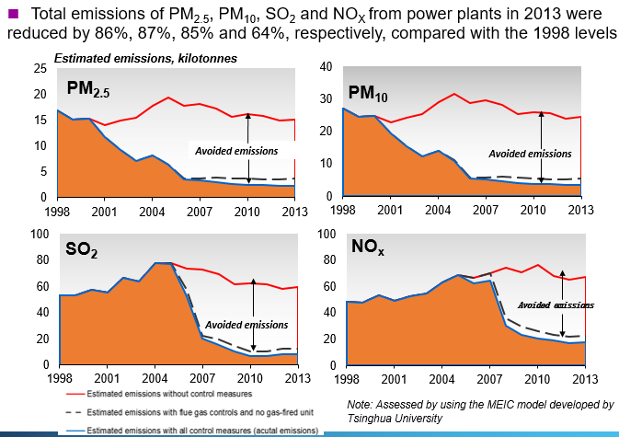
Beijing case – emissions reduced from power plants
2016. Beijing EPB

Slide 27

Policies and control measures
Area sources
Clean cooking programs
  Strengthen and expand the LPG retail distribution network
  Ensure well-targeted subsidies
  Expand biogas programs in suitable areas, in line with community resources
  Remove barriers to clean biomass cookstove market
2013. World Bank. Indonesia: Toward Universal Access to Clean Cooking

Slide 28
National Policy Solutions for Indonesia
Investments in clean fuel infrastructure
  Expand and complete CNG filling station projects
  Shift fuel imports to 10ppm sulfur content
  Establish and implement fiscal plan for national refinery upgrades
Emission Standards for New Vehicles
  Rapidly adopt Euro 4/VI
  Establish a policy roadmap to Euro 6/VI
Programs to identify, scrap, and replace the oldest vehicles, especially diesel
28

Slide 29
Local Policy Solutions for Jakarta
Near-term
  Remove “Euro 3 diesel” from Regional Regulation 5/2014 definition of “Environmentally Friendly Fuels. Add “Euro 6 diesel”
  Enforce fuel quality standards for compressed natural gas
  Stage 1 and Stage II Evaporative Emission Controls
  Fiscal policies to reduce price advantage of diesel fuel.
Medium-Term
  Accelerated Euro 4/VI and Euro 6/VI adoption, following Beijing
  Targeted CNG investments and low sulfur fuel imports to Jakarta.
  Fiscal policies to promote low sulfur fuel purchases
  In-Use Vehicle Emission Control Programs
    Vehicle scrappage program
    Low emissions zone
    Vehicle inspection and emissions enforcement
29
http://www.theicct.org/opportunities-reduce-vehicle-emissions-jakarta

Slide 30
THANKYOU

