Slide 1
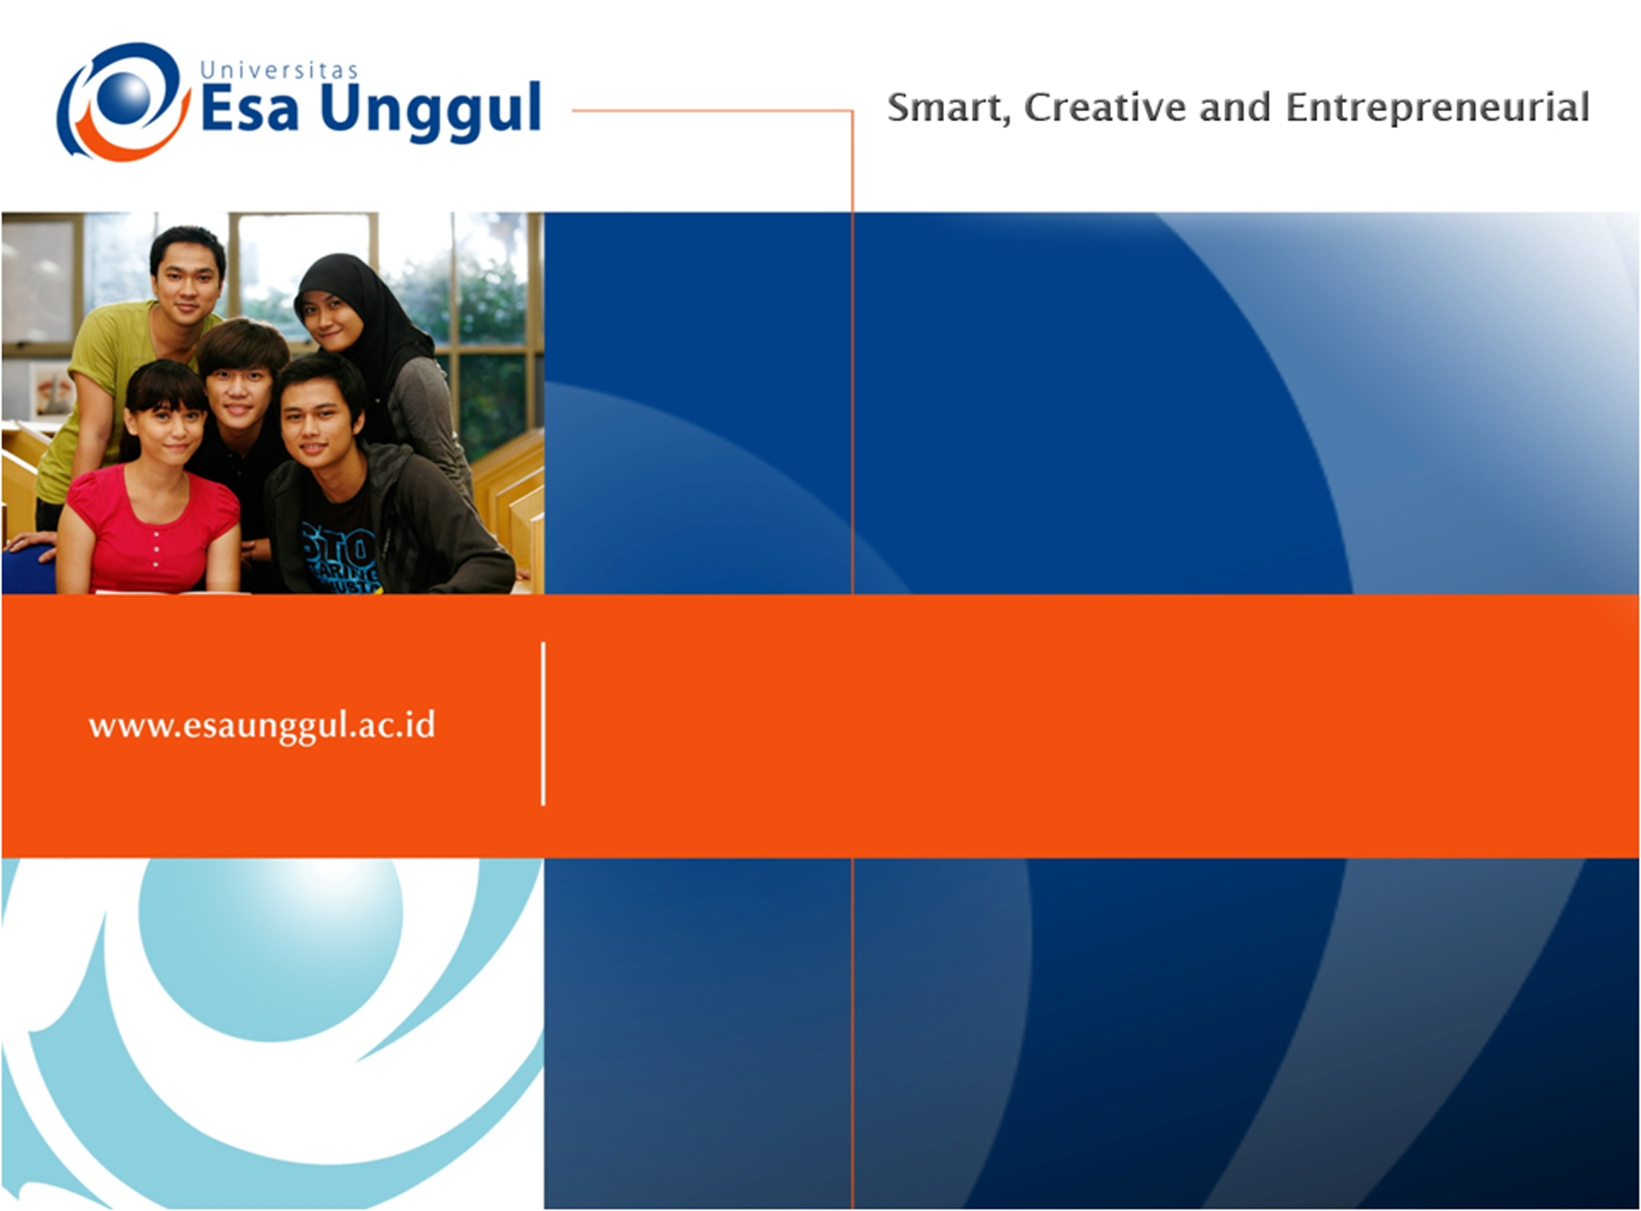
ISU TERKINI “RADIASI ULTRA VIOLET”
Pertemuan 9
AHMAD IRFANDI, SKM, MKM
Kesmas/FIKES

Slide 2
Pendahuluan
Sinar matahari adalah salah satu sumber energi terbesar di bumi
Pada sekarang ini sinar matahari banyak digunakan sebagai solar cell
Namun pemanasan global yg terjadi belakangan ini mengakibatkan rusaknya lapisan ozon bumi
Akibatnya sinar UV banyak masuk ke bumi
Sinar UV memiliki dampak positif dan negative bagi tubuh manusia

Slide 3
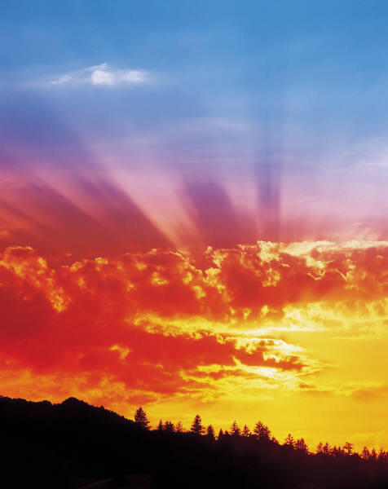
What do you know about the Sun?
Notes:
Ask the question and give student time to think about an answer. You might have them talk to a neighbor to generate ideas. After sufficient wait time move to the next slide. Ask students to share their ideas about the sun.

Slide 4
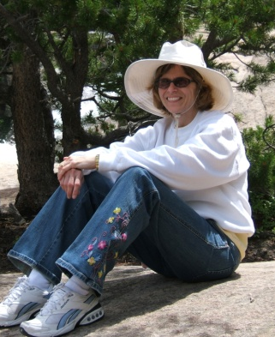

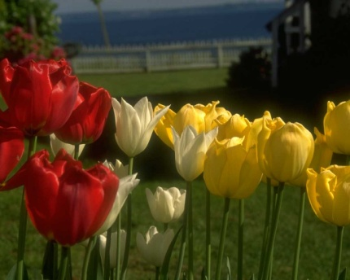
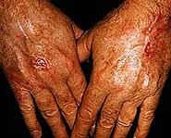
The Sun
Helpful
Harmful
Keeps Us Warm
Causes Sunburns
Helps Plants Grow
Makes Our Skin Wrinkle
Notes:
Give students ample time to generate ideas.
Listen to all student responses and then let the students know that you have pictures of a few things that show what we know about what our sun can do. Continue to move the slides forward until all four examples are on the screen. Ask students to look at the four pictures that you have selected and to put then into two categories. After students have shared their ideas for categories, move to the next slide…helpful and harmful…and ask students why you have selected these categories, fill in any background information for students for them to understand why the sunburn and wrinkles are not good for our skin (for background information go to the SunWise web site: http://www2.epa.gov/sunwise/health-effects-uv-radiation).

Slide 5
Manfaat dan kerugian Sinar UV
Manfaat
Menjaga kita agar tetap hangat
Sintesis vit. D
Membantu pertumbuhan tanaman
Membunuh kuman
Kerugian
Berefek terhadap sistem kekebalan tubuh
Menyebabkan kanker kulit
Membuat kulit berkerut
Menyebabkan kerusakan mata

Slide 6
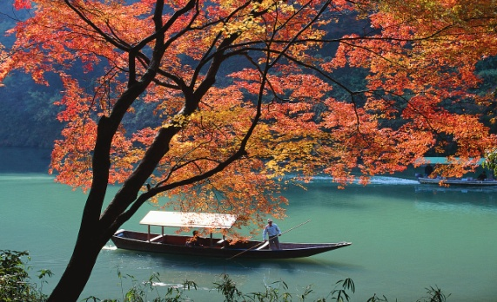
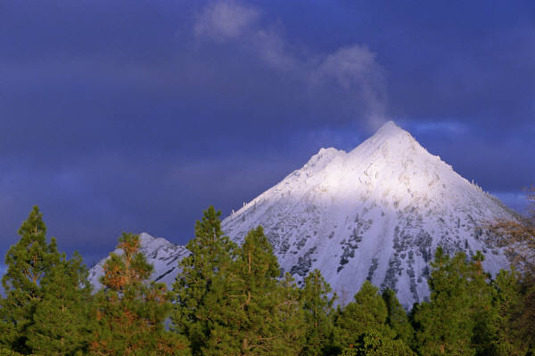
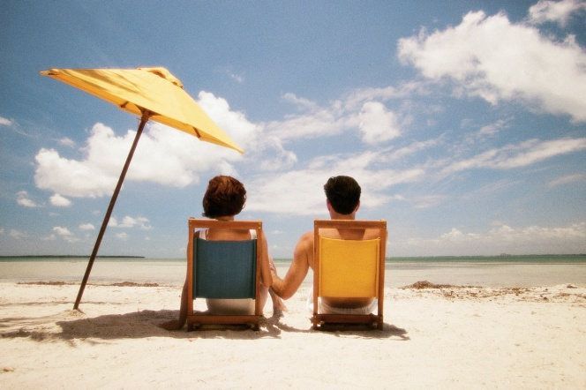
Level radiasi UV sangat tergantung pada:
Waktu penyinaran perhari
Waktu penyinaran selama setahun
Garis lintang
Ketinggian
Kondisi cuaca
Ozon stratosferik

Slide 7
How do we measure UV radiation levels?
11+
We use the UV Index Scale.
Reported on a scale of 1 -11+.
10
9
8
7
6
Take special care when the UV Index is 5-6 or higher.
5
4
3
2
1
UV
Introduction
index
Notes:
The UV Index is a prediction (based on a mathematical equation http://www2.epa.gov/sunwise/calculating-uv-index) of the UV level at noon. It can be used as a tool (much like a thermometer is a tool for temperature) for reminding people how to protect themselves from overexposure to UV radiation. The higher the UV Index level, the greater the possibility of damage to the skin and eyes in less time. Ask students to think back to the pictures of people being SunWise you used when asking them to form a definition. What were some of the ways that people were taking special care to protect themselves from the UV radiation levels? Students should remember the use of sunglasses, wide brimmed hats and clothing.
For additional information about the UV Index go to the SunWise website (http://www2.epa.gov/sunwise/uv-index)

Slide 8
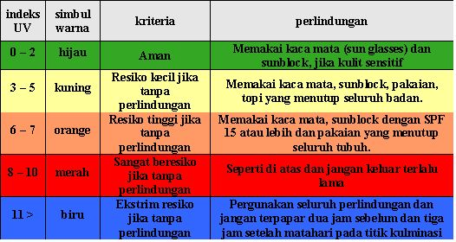
Penjelasan Warna

Slide 9
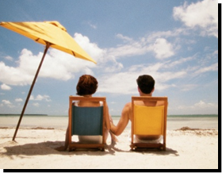
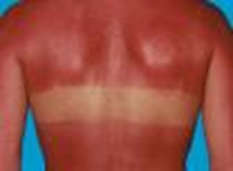
Tidak ada yg sehat dari berjemur
Sinar UV A→ penuaan kulit
Sinar UV B→ penyebab kulit terbakar
Jenis kulit mempengaruhi derajat beberapa orang yg terbakar
Gunakan suscreen dengan SPF 15 atau lebih
SPF 30 TIDAK dua kali lebih protektif daripada SPF 15

Slide 10
Sinar matahari
Menghasilkan cahaya tetapi juga menghasilkan radiasi UV
Radiasi UV tdk bisa dilihat atau dirasakan
Radiasi UV ini dapat menyebabkan perubahan warna pada kulit, kerusakan pada mata, dan efek kesehatan burruk lainnya

Slide 11
Hal2 yg dapat menyebabkan paparan UV menurrut WHO
Jumlah waktu yg dihabiskan dibawah sinar matahari khususnya tengah hari
Perlindungan pribadi dari matahari
Perlindungan anak-anak
Studi menunjukkan kebanyakan orang menerima 5-15% sinar UV (dengan rata-rata kurang dari 10%)

Slide 12
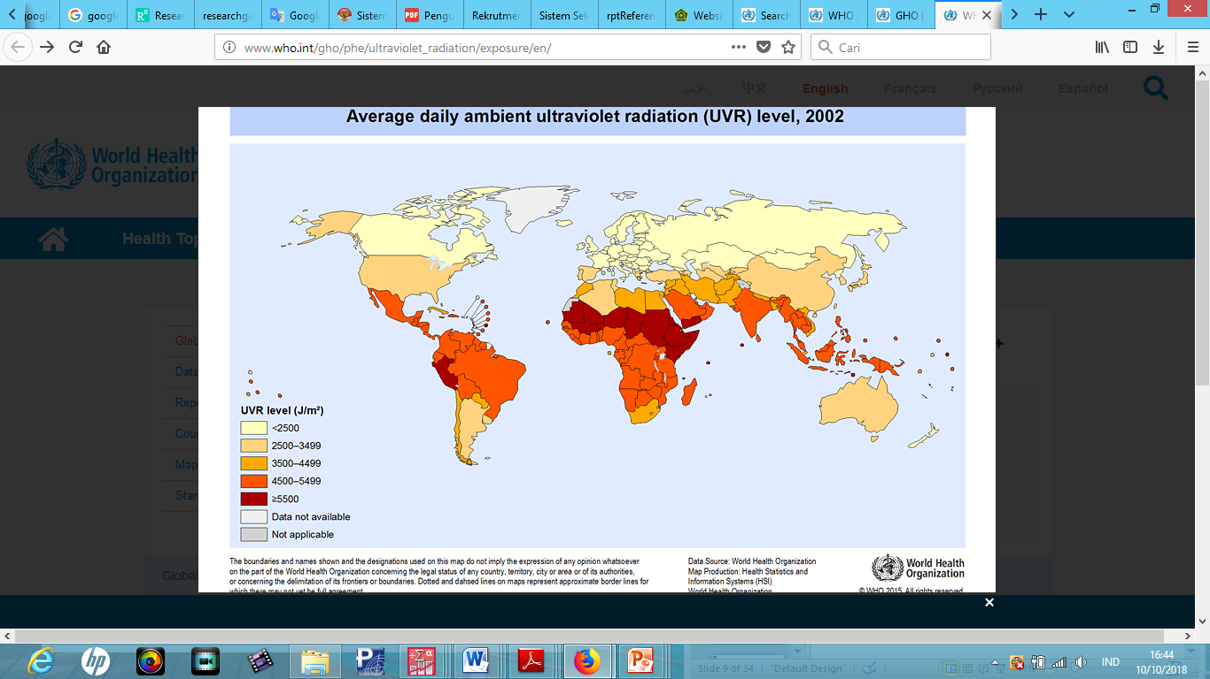

Slide 13
Data Kematian akibat Radiasi UV
http://apps.who.int/gho/data/node.main.165?lang=en

Slide 14
Dampak Negatif Radiasi Sinar UV
Banyak studi epidemiologi menyebutkan bahwa radiasi matahari sebagai penyebab kanker kulit
Kelompok yg paling rentan terhadap kanker kulit adalah orang kulit putih terutama keturunan Celtic
Kanker kulit meningkat pada populasi barat selama dekade terakhir

Slide 15
TERIMAKASIH

