Slide 1
Pembiayaan &Penganggaran Kesehatan Anggun Nabila, SKM, MKM

Slide 2
4 strategic policies to improve HF
What are you going to buy ?
Financing Public Health
Containing health care cost inflation
UHC: the fallacy of the “magic cube” (SHI) vs the “flying spider web” (tax based)

Slide 3
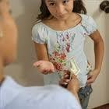
1. What to buy ??
Nanda Putri :
“Mom I am going to the mall, give me 2 millions”
Mother:
“What are you going to buy ?
Knowing clearly what we are going to pay for is the basic fundamental and first step in health financing system

Slide 4
Are we going to buy “financial risk protection” ?
➔ go for insurance (e.g. JKN/BPJS)
➔ Cover curative individual clinical services
Are we going to buy “health risk reduction” ?
➔ go for tax based financing (e.g. BOK, APBN/APBD)
➔ PH interventions
Are we going to buy both ?

Slide 5
Mostly “merit goods” & “private goods” Government : steering & monitoring Financing: insurance, OOP, tax (for the poor)
Mostly “public goods”
Need strong role of government: execution Tax based financing (insurance does not fit)
* Through organized community effort
* Individual clinical services
PUBLIC HEALTH
CLINICAL MEDICINE
[UKM]
Tax based financing
[UKP]
JKN/insurance or OOP
Health Promotion
Rehabilitation
Specific protection
Dissability limitation
Laevell &
Early D/ Prompt Th/
Clark (1965)
Ascobat Gani 08/03
Promosi kesehatan, KB, immunisasi, sanitation, lingkungan, gaya hidup, regulasi, mobilisasi masy, lintas sektor
Pelayanan medis primer, sekunder, tertier (termasuk promotif/preventif perorangan)

Slide 6
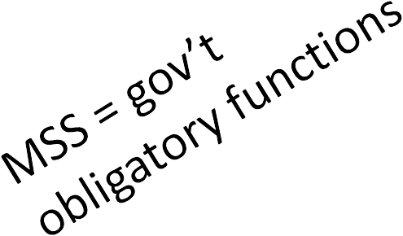
no | MSS (definition, indicator, performance standard)
1 | Health promotion at schools
2 | Health promotion at Puskesmas
3 | Public health promotion and community empowerment
4 | Health services package for pregnant women at Puskesmas
5 | Health services package for child delivery at Puskesmas
6 | Neonatal services by Puskesmas
7 | Child health services at Puskesmas
8 | Health screening/surveilance for elementary school
9 | Screening and adolescence health (15- 19 yrs) at Puskesmas
10 | Screening and reproductive health for adult population including FP
11 | Screening for aging population (> 60 yrs) at Puskesmas
12 | Exam for suspect tb at Puskesmas and district hospital
13 | Test for suspect HIV at Puskesmas and district hospital
14 | Environmental health activity at elementary school by Puskesmas
15 | Environmental health program at traditional market by Puskesmas
16 | Early Warning and Response against disaster less then 24 hours for cases with outbreak risk

Slide 7
Financing PH
Most PH interventions (listed in MSS) are Public goods and Merit Goods
No or little Marginal Cost
Non excludable (free rider phenomena)
Non rivalry (no competition to consume)
Large externality
Most people do not want to pay
Price mechanism would not work
People don’t see financial risk
Insurance is not appropriate ➔  would not work

Slide 8
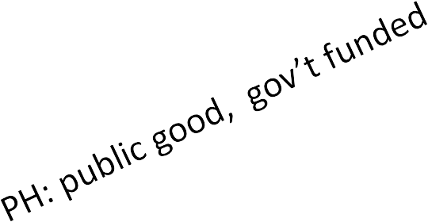
Regulation on Health Financing
UU-36 (Health Law 2009)
Pembiayaan pelayanan kesehatan masyarakat merupakan barang publik (public good) yang menjadi tanggung jawab pemerintah, sedangkan untuk pelayanan kesehatan perorangan pembiayaannya bersifat privat, kecuali pembiayaan untuk masyarakat miskin dan tidak mampu menjadi tanggung jawab pemerintah. ➔ UKM: tax based Pembiayaan pelayanan kesehatan perorangan diselenggarakan melalui jaminan pemeliharaan kesehatan dengan mekanisme asuransi sosial yang pada waktunya diharapkan akan mencapai universal health coverage sesuai dengan Undang- Undang Nomor 40 Tahun 2004 tentang Sistem Jaminan Sosial Nasional (SJSN) dan Undang-Undang Nomor 24 Tahun 2011 tentang Badan Penyelenggara Jaminan Sosial. ➔ UKP: askes

Slide 9
UHC: The fallacy of the “magic cube”
What is universal coverage ?
[WHO: WHR-2010]
Universal coverage (UC), or universal health coverage (UHC), is defined as ensuring that all people can use the promotive, preventive, curative, rehabilitative and palliative health services they need, of sufficient quality to be effective, while also ensuring that the use of these services does not expose the user to financial hardship.
This definition of UC embodies three related objectives:
Tax financing
JKN
equity in access to health services - those who need the services should get them, not only those who can pay for them;
that the quality of health services is good enough to improve the health of those receiving services; and
financial-risk protection - ensuring that the cost of using care does not put people at risk of financial hardship.
JKN
S
D

Slide 10
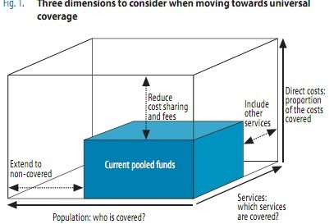
Thee dimensions of UHC
% population with health insurance
Comprehensive health services
No cost sharing
The fallacy:
Provide financial protection
But not risk reduction
Missing from the cube:
Access to PH program
Supply side: access and quality
INEQUITY >>
FAIRNESS <<

Slide 11
* AG 2010
* SEARO 2011
DEPARTED FROM THE ISSUE OF HEALTH RISK
5 dimension of UHC
Medical Care Benefit package
BPJS
Demand
(protection against financial risk)
% pop covered
% of cost sharing
BOK etc Supply (access and utilization)
Access to Public Hlth interventions
Access to medical care
Protection against health risk
Ascobat, 2010

Slide 12
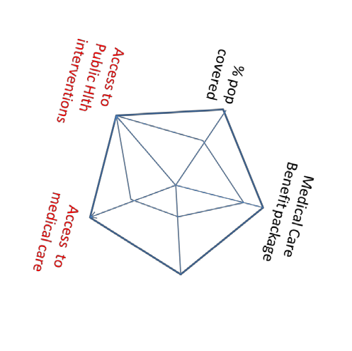
Health y Indonesia Program
Strentthen HealthServices
Health Paradigm
NHI (JKN)
Risk Reduction
Access
Quality
Financial protection
PH programs
Promotion
Prevention
Infrastrucure
WHF
Treatment
(1st, 22nd, 3rd)
% of cost sharing

Slide 13
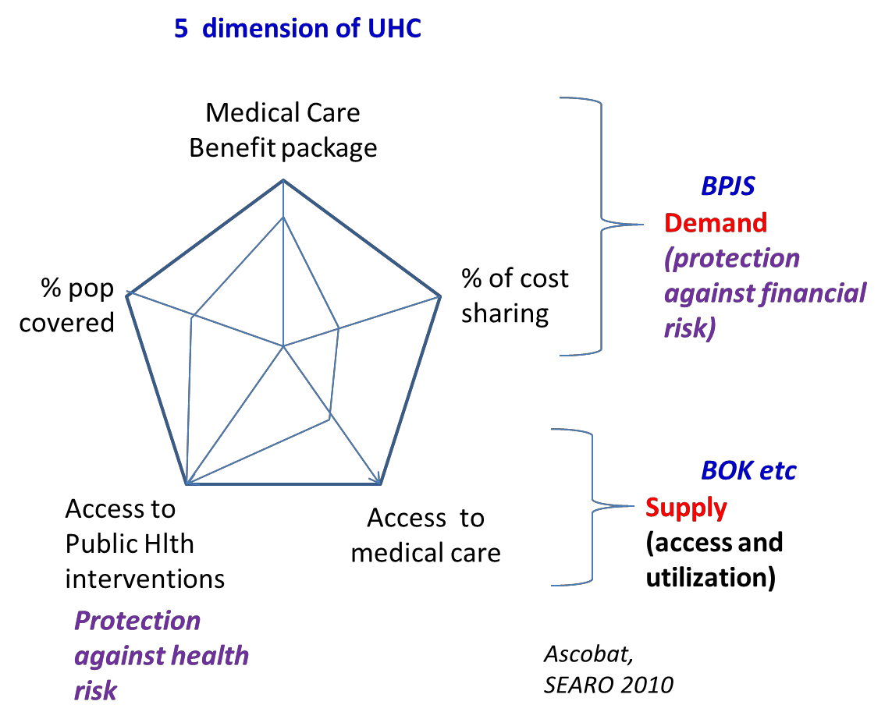
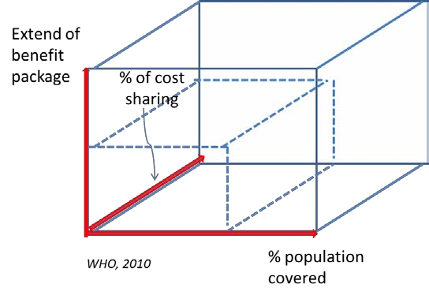
Three dimensions of UHC

