Slide 2
Sustainable Development Goals
Technology
vis-à-vis
Cap-Tec

Slide 3
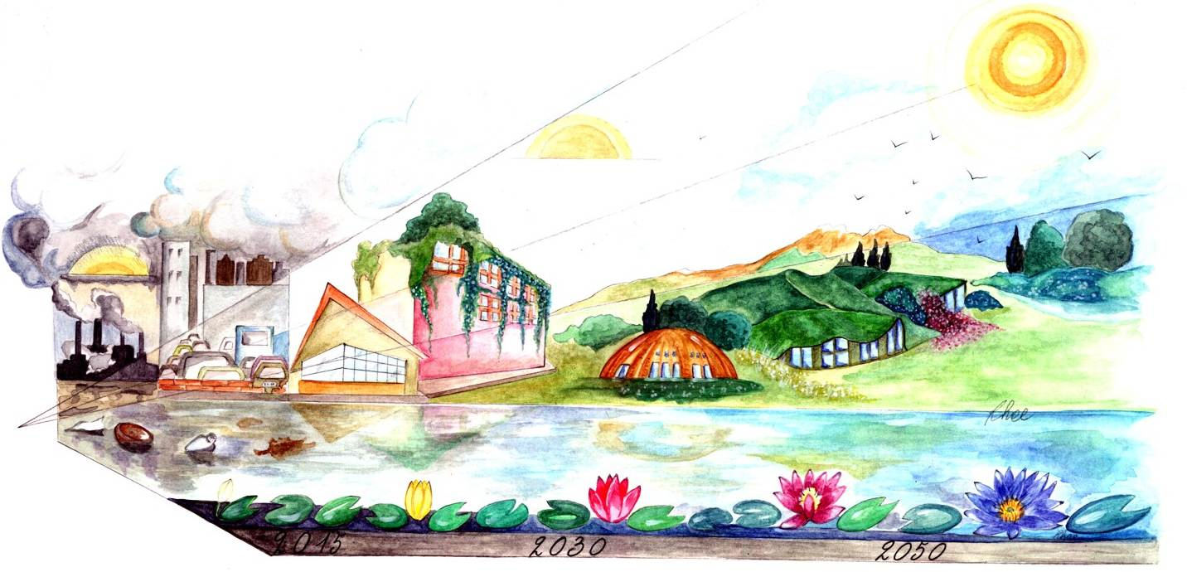
The Future We Want
A water secure world is achievable
Notes:
Post 2015 Agenda, Rio+20 United Nations Conference on Sustainable Development outcome document, vision 2050. SDG’s development and formulation for 2030, WWDR 2015. Backdrop of the WWD celebrations and annual campaign.

Slide 4
OWG proposal for SDG’s
17 SDGs (Goals), 169 Targets
One explicit SDG 6 on water and sanitation with 8 Targets,
Preamble and another 5 SDGs with 7 Targets directly or indirectly linked to water-related issues
OWG, 2014. Proposal of The Open Working Group for Sustainable Development Goals, 19 Jul 2014, http://sustainabledevelopment.un.org/owg.html
Notes:
The experience of the MDG’s shows that a thematically broader goal for water is called for in the post-2015 development agenda. Chapeau: Paragraph 7. Rio+20 outcome reaffirmed the need to be guided by the purposes and principles of the Charter of the United Nations, with full respect for international law and its principles. It reaffirmed the importance of freedom, peace and security, respect for all human rights, including the right to development and the right to an adequate standard of living, including the right to food and water, the rule of law, good governance, gender equality, women’s empowerment and the overall commitment to just and democratic societies for development.

Slide 5
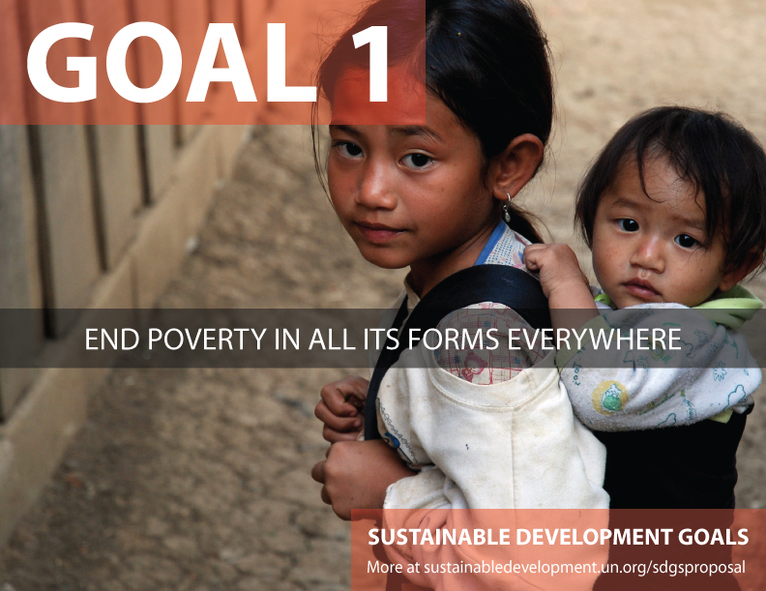
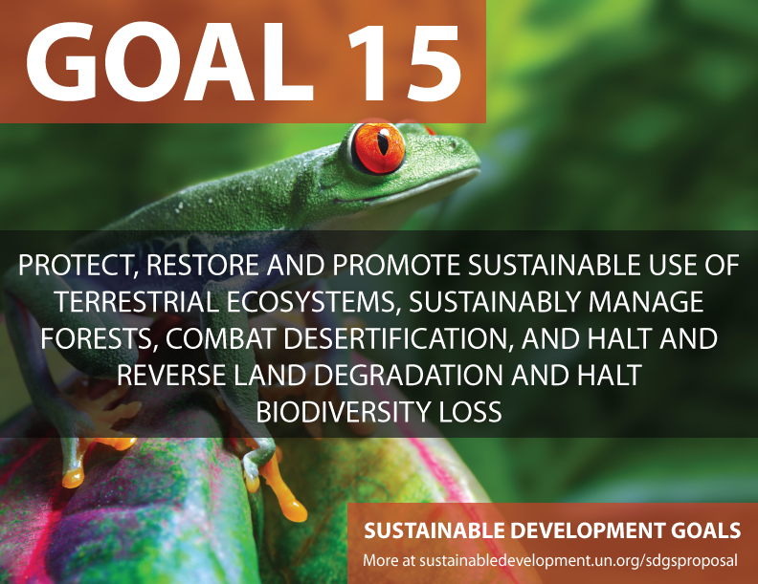
OWG proposal for SDG’s
Notes:
1.5 by 2030 build the resilience of the poor and those in vulnerable situations, and reduce their exposure and vulnerability to climate-related extreme events and other economic, social and environmental shocks and disasters
3.3 by 2030 end the epidemics of AIDS, tuberculosis, malaria, and neglected tropical diseases and combat hepatitis, water-borne diseases, and other communicable diseases
3.9 by 2030 substantially reduce the number of deaths and illnesses from hazardous chemicals and air, water, and soil pollution and contamination
11.5 by 2030 significantly reduce the number of deaths and the number of affected people and decrease by y% the economic losses relative to GDP caused by disasters, including water-related disasters, with the focus on protecting the poor and people in vulnerable situations
12.4 by 2020 achieve environmentally sound management of chemicals and all wastes throughout their life cycle in accordance with agreed international frameworks and significantly reduce their release to air, water and soil to minimize their adverse impacts on human health and the environment
15.1 by 2020 ensure conservation , restoration and sustainable use of terrestrial and inland freshwater ecosystems and their services, in particular forests, wetlands, mountains and drylands, in line with obligations under international agreements
15.8 by 2020 introduce measures to prevent the introduction and significantly reduce the impact of invasive alien species on land and water ecosystems, and control or eradicate the priority species

Slide 6
OWG proposal for SDG’s
Proposed goal 6. Ensure availability and sustainable management of water and sanitation for all
6.1 by 2030, achieve universal and equitable access to safe and affordable drinking water for all
6.2 by 2030, achieve access to adequate and equitable sanitation and hygiene for all, and end open defecation, paying special attention to the needs of women and girls and those in vulnerable situations
6.3 by 2030, improve water quality by reducing pollution, eliminating dumping and minimizing release of hazardous chemicals and materials, halving the proportion of untreated wastewater, and increasing recycling and safe reuse by x% globally
Goal 6

Slide 7
OWG proposal for SDG’s
Proposed goal 6. Ensure availability and sustainable management of water and sanitation for all
6.4 by 2030, substantially increase water-use efficiency across all sectors and ensure sustainable withdrawals and supply of freshwater to address water scarcity, and substantially reduce the number of people suffering from water scarcity
6.5 by 2030 implement integrated water resources management at all levels, including through trans-boundary cooperation as appropriate
6.6 by 2020 protect and restore water-related ecosystems, including mountains, forests, wetlands, rivers, aquifers and lakes
Goal 6

Slide 8
OWG proposal for SDG’s
Means of implementation
6a By 2030, expand international cooperation and capacity - building support to developing countries in water- and sanitation-related activities and programmes, including water harvesting, desalination, water efficiency, wastewater treatment, recycling and reuse technologies“
6b Support and strengthen the participation of local communities in improving water and sanitation management
Goal 6

Slide 9
OWG proposal for SDG’s
Finance
Technology
Capacity building
Trade
Policy and instituional coherence
Multi-stakeholder partnerships
Data, monitoring and accountability
Notes:
Currently the negotiations are very focused on monitoring, indicators and coming up is means of implementation including financing development

Slide 10
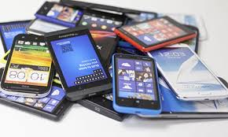
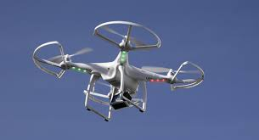
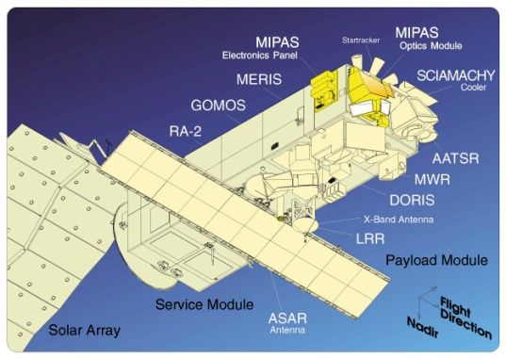
Technological advances
Peter H. Diamandis and Steven Kotler
Abundance: The Future is Better Than You Think
Notes:
https://www.youtube.com/watch?v=a7qU4zJfW2c

Slide 11
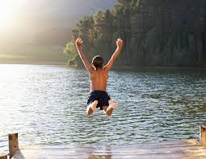
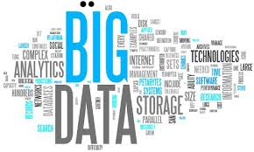
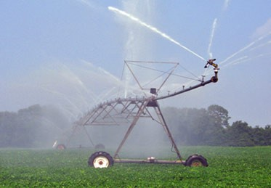
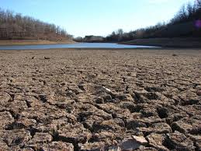
Big data and sustainable water management

Slide 12
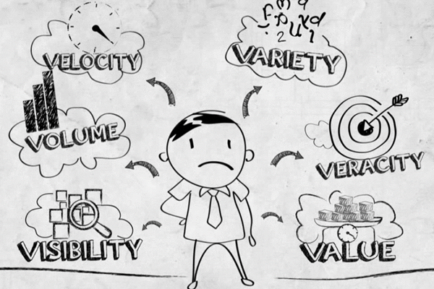
Big data and sustainable water management
Notes:
Does any of this resonate with our business “the water business”. The 6V’s.

Slide 13
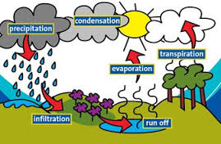
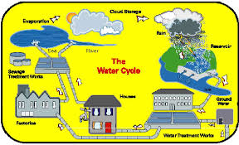
Big data and sustainable water management
“To measure is to know and to know is to measure”
Notes:
The water cycles natural or hydrological and human diversionary cycle

Slide 14
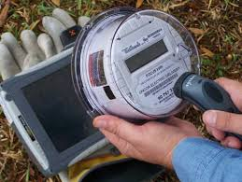
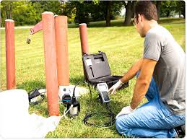
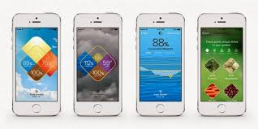
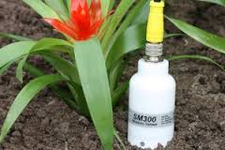
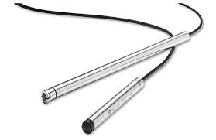
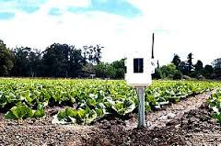
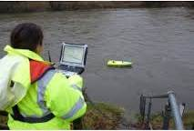
Plethora of technologies
Notes:
Not an attempt to create an inventory: Smart metering, river flow gauging systems, real time telemetry, ground water measurement probes, soil moisture measuring systems, mobile technology and hand held devices, drones, earth observation

Slide 15
Challenges and opportunities
Water connects hence a dedicated water goal is needed and inter-linked indicators to go with it
Work on indicators, data collection and reporting is critical for technical proofing of the water goal and associated targets
A broader water agenda means a broader monitoring framework - capacity development -
Technology as a means to quench the big data requirement
Cap-Tec

