Slide 1
WEEK 1
INTRODUCTION OF KNOWLEDGE MANAGEMENT

Slide 2
1.1 The Reason why we need Knowledge

Slide 3

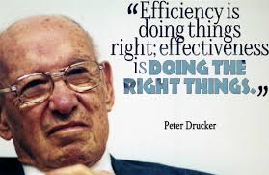
Peter Drucker :
Business Paradigm is shifting from Resources Based Organization to Human Based Organization
Business Paradigm is shifting again from Human Based Organization to Knowledge Based Organization

Slide 4
What are the consequences?
Decision making process based on feeling and intuition should be diminished
Decision making process should be based on data, information, and knowledge
Knowledge Management (KM) become more strategic
Human Capital Management, replacing Human Resources Management
Management Information Systems (digitalization) can become a power full tool in supporting business process
Intangible assets valuation and management will increase corporate value

Slide 5
1.2 The New Focus on Knowledge as a Competitive Resources

Slide 6
Competitive Resources
Knowledge Creation
Continuous Innovation
Competitive Advantage
The knowledge worker is the single greatest asset.
Knowledge workers is a knowledge executive who knows how to allocate knowledge to productive use, just as the capitalist knew how to allocate capital to productive use

Slide 7
1.3 Tacit vs Explicit Knowledge

Slide 8
Knowledge Hierarchy

Slide 10
Knowledge Revisited
Tacit
What an individual knows or has gained through years of experience
Difficult to quantify or articulate
Explicit
Formal and systematically organized information
Can be easily articulated and communicated
Increases proportionally with the individual’s commitment to learning
Can be in the form of a book or a manual or an audio-visual
Notes:
Page 27 and 28 – cognitive dimension

Slide 12
1.4 SECI Model on Knowledge

Slide 14
SECI MODEL

Slide 15
1.5 The Knowledge Management Landscape

Slide 16
IMPORTANT DIMENSIONS OF KNOWLEDGE
  1. Knowledge is a firm asset
    Intangible
    Creation of knowledge from data, information, requires organizational resources
    As it is shared, experiences network effects
  2. Knowledge has different forms
    May be explicit (documented) or tacit (residing in minds)
    Know-how, craft, skill
    How to follow procedure
    Knowing why things happen (causality)
Notes:
This slide and the next begin to answer the question “What is knowledge” as it pertains to the organization. Ask the students why it is important to define and describe knowledge. Ask students to provide examples of knowledge, given an example industry, that illustrate that it is a “firm asset”. (E.g. For an electrical appliances firm, knowing how to make the most efficient and cheapest air conditioner). Ask students to explain each element of the dimensions, providing examples. For example, what is meant by “knowledge is intangible?,” “Give me an example of explicit knowledge.” etc.

Slide 17
  3. Knowledge has a location
    Cognitive event
    Both social and individual
    “Sticky” (hard to move), situated (enmeshed in firm’s culture), contextual (works only in certain situations)
  4. Knowledge is situational
    Conditional: Knowing when to apply procedure
    Contextual: Knowing circumstances to use certain tool
Notes:
This slide continues the discussion from the previous slide, in answering the question “What is knowledge” as it pertains to the organization. Ask students to further explain or give examples for each characteristic. For example, “What is an example of knowledge with a social basis?” “What is an example of knowledge that is sticky; what is sticky about it?”

Slide 18
ORGANIZATIONAL LEARNING
  Process in which organizations learn
    Gain experience through collection of data, measurement, trial and error, and feedback
    Adjust behavior to reflect experience
      Create new business processes
      Change patterns of management decision making
Notes:
This slide introduces the concept of organizational learning, which describes the process of gathering, creating, and applying knowledge. Most students will be surprised that organizations learn, and others will provide many examples of organizations which refused to learn anything.
In organizational learning, knowledge becomes the driver of new behavior – decision making, new products and services, new business processes. This might be seen also as organizations sensing and responding to their environment. Give the students examples of organizations, such as a school, hospital, bank, clothing manufacturer, and ask them to provide examples of how that business might demonstrate organizational learning. How well do students think the Big Three automakers in the U.S. learned in the past twenty years?

Slide 19
KNOWLEDGE MANAGEMENT: Set of business processes developed in an organization to create, store, transfer, and apply knowledge
KNOWLEDGE MANAGEMENT VALUE CHAIN:
  Each stage adds value to raw data and information as they are transformed into usable knowledge
  1. Knowledge acquisition
  2. Knowledge storage
  3. Knowledge dissemination
  4. Knowledge application
Notes:
This slide defines the term knowledge management and describes the process from acquiring knowledge to applying it as a value chain, and is followed by slides detailing each stage. Each stage of the chain adds more value to the raw data and information. Ask the students to differentiate between the stages, and how each stage could incorporate more value? For example, how does knowledge once it is stored incorporate more value than the previous stage, knowledge that is being acquired?

Slide 20
Knowledge management value chain
  1. Knowledge acquisition
    Documenting tacit and explicit knowledge
      Storing documents, reports, presentations, best practices
      Unstructured documents (e.g., e-mails)
      Developing online expert networks
    Creating knowledge
    Tracking data from Transaction Processing System (TPS) and external sources
Notes:
This slide describes the first stage of the knowledge value chain, knowledge acquisition and details different ways knowledge can be gathered. Use the example of a specific type of business or organization, such as a paper manufacturer or university, and have the students describe how that business might acquire or create knowledge. For example, what types of knowledge would a paper manufacturer be interested and how would they gather or create that?

Slide 21
Knowledge management value chain:
  2. Knowledge storage
    Databases
    Document management systems
    Role of management:
      Support development of planned knowledge storage systems
      Encourage development of corporate-wide schemas for indexing documents
      Reward employees for taking time to update and store documents properly
Notes:
This slide discusses the second stage of the knowledge value chain, knowledge storage, describing the ways in which knowledge is stored as well as the importance of management in creating and maintaining repositories of knowledge. Give the students an example company, such as a medical practice, and ask what type of knowledge they would need and how it should be stored (e.g. medical records of patients).

Slide 22
Knowledge management value chain:
  3. Knowledge dissemination
    Portals
    Push e-mail reports
    Search engines
    Collaboration tools
    A deluge of information?
      Training programs, informal networks, and shared management experience help managers focus attention on important information
Notes:
This slide discusses the third stage of the knowledge value chain and describes various ways that knowledge can be disseminated within the organization. Ask the students for examples of how they received knowledge from a job they have had or a university or college they have attended. What type of knowledge was transferred and what means were used? Were these methods of dissemination adequate or do they see more effective ways to disseminate the same information? How can a company or its employees have “too much information?”

Slide 23
Knowledge management value chain:
  4. Knowledge application
    To provide return on investment, organizational knowledge must become systematic part of management decision making and become situated in decision-support systems
      New business practices
      New products and services
      New markets
Notes:
This slide discusses the last stage of the knowledge value chain, knowledge application, and emphasizes the need to see and evaluate knowledge in terms of organizational capital and return on investment. Ask the students if they have any examples from their own experience in education or work of how new knowledge can result in a new business practice, new product, or new market.

Slide 24
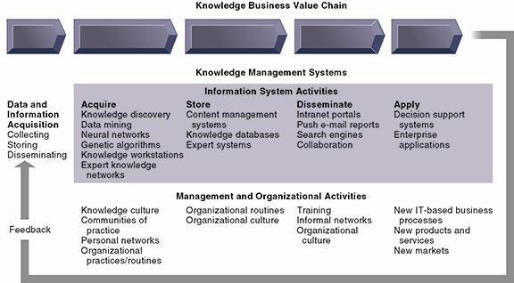
The Knowledge Management Value Chain
Knowledge management today involves both information systems activities and a host of enabling management and organizational activities.
Notes:
This graphic details the stages of the knowledge management value chain, separating the information system activities from the management/organizational activities involved at each stage. It also describes two very other important requirements for the value chain, the initial data and information acquisition that forms the basis for creating knowledge, and feedback from the knowledge application stage that can result in new opportunities for data and knowledge creation.

Slide 25
NEW ORGANIZATIONAL ROLES AND RESPONSIBILITIES
  Chief knowledge officer executives
  Dedicated staff / knowledge managers
  Communities of practice (COPs)
    Informal social networks of professionals and employees within and outside firm who have similar work-related activities and interests
    Activities include education, online newsletters, sharing experiences and techniques
    Facilitate reuse of knowledge, discussion
    Reduce learning curves of new employees
Notes:
This slide discusses the new types of organizational roles that managers can develop in order to facilitate the knowledge value chain. Why might a chief knowledge officer, a senior executive position, be valuable to a company? Ask students why a CKO and COP may or may not be important to the various stages of the value chain – data acquisition, knowledge creation, storage, dissemination, and application, as well as feedback.

Slide 26
3 MAJOR TYPES OF KNOWLEDGE MANAGEMENT SYSTEMS
  1. Enterprise-wide knowledge management systems
    General-purpose firm-wide efforts to collect, store, distribute, and apply digital content and knowledge
  2. Knowledge work systems (KWS)
    Specialized systems built for engineers, scientists, other knowledge workers charged with discovering and creating new knowledge
  3. Intelligent techniques
    Diverse group of techniques such as data mining used for various goals: discovering knowledge, distilling knowledge, discovering optimal solutions
Notes:
This slide introduces the three main categories of information system used to manage knowledge. These categories are different in terms of the constituencies they server, the purpose for which they are used and what they emphasize.

Slide 27
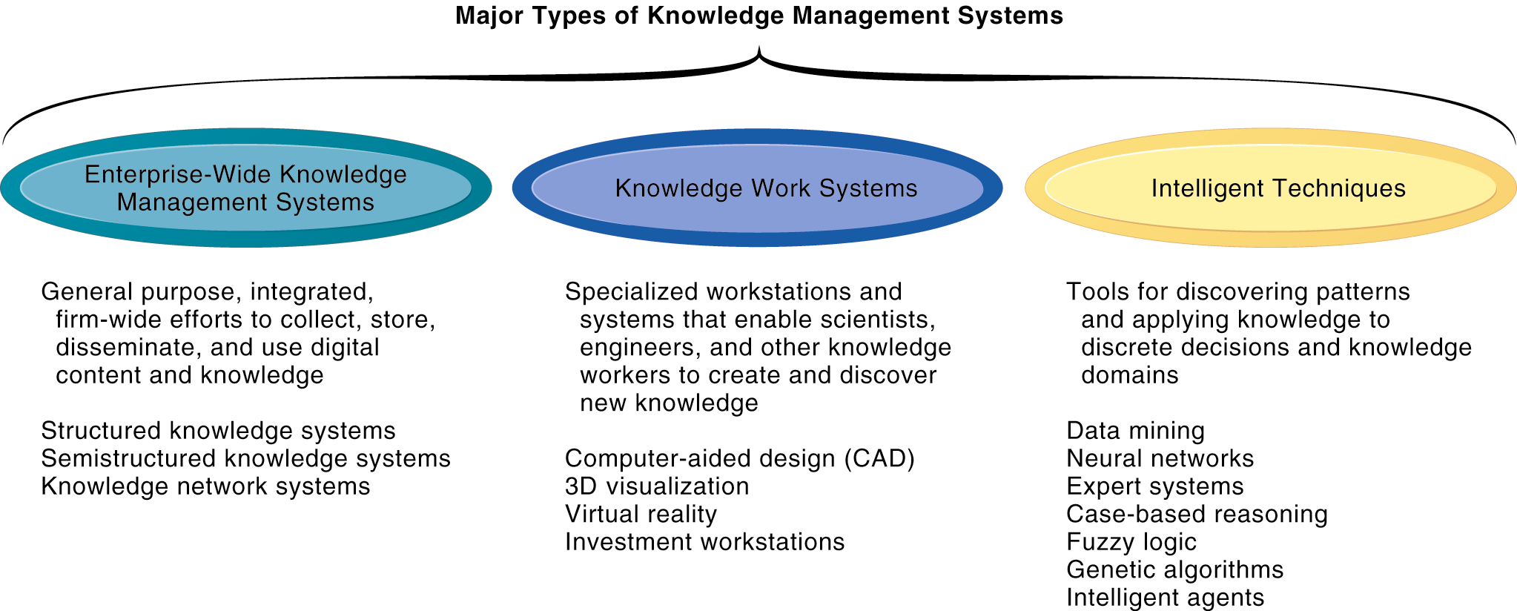
Major Types of Knowledge Management Systems
There are three major categories of knowledge management systems, and each can be broken down further into more specialized types of knowledge management systems.
Notes:
This graphic illustrates the three major types of knowledge management systems, giving the purpose of the system and examples of the type of system. Ask the students how they would categorize a system that catalogs and stores past advertising campaigns? What about software that helps a research biologist input and analyze lab findings?

Slide 28
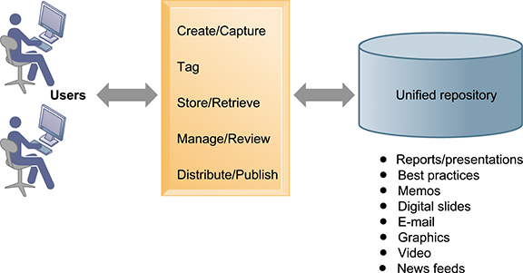
An Enterprise Content Management System
An enterprise content management system has capabilities for classifying, organizing, and managing structured and semi structured knowledge and making it available throughout the enterprise
Notes:
This graphic illustrates the functions of an enterprise content management system. Users interact with the system to both input knowledge, manage it, and distribute it. These management systems can house a wide variety of information types, from formal reports to graphics, as well as bring in external content resources such as news feeds. Ask students what types of documents would need to be stored by a hospital, bank, law firm, etc.

Slide 29
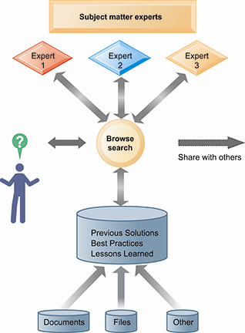
An Enterprise Knowledge Network System
A knowledge network maintains a database of firm experts, as well as accepted solutions to known problems, and then facilitates the communication between employees looking for knowledge and experts who have that knowledge.
Solutions created in this communication are then added to a database of solutions in the form of FAQs, best practices, or other documents.
Notes:
This graphic illustrates the various elements that form a knowledge network system. The user can search for accepted solutions in FAQ or best practices document or contact an expert in the relevant subject matter. Ask the students to provide examples of undocumented, unstructured knowledge they acquired, either in a classroom setting or at work, that would be valuable to peers. What kind of tools would enable sharing this information?

Slide 30
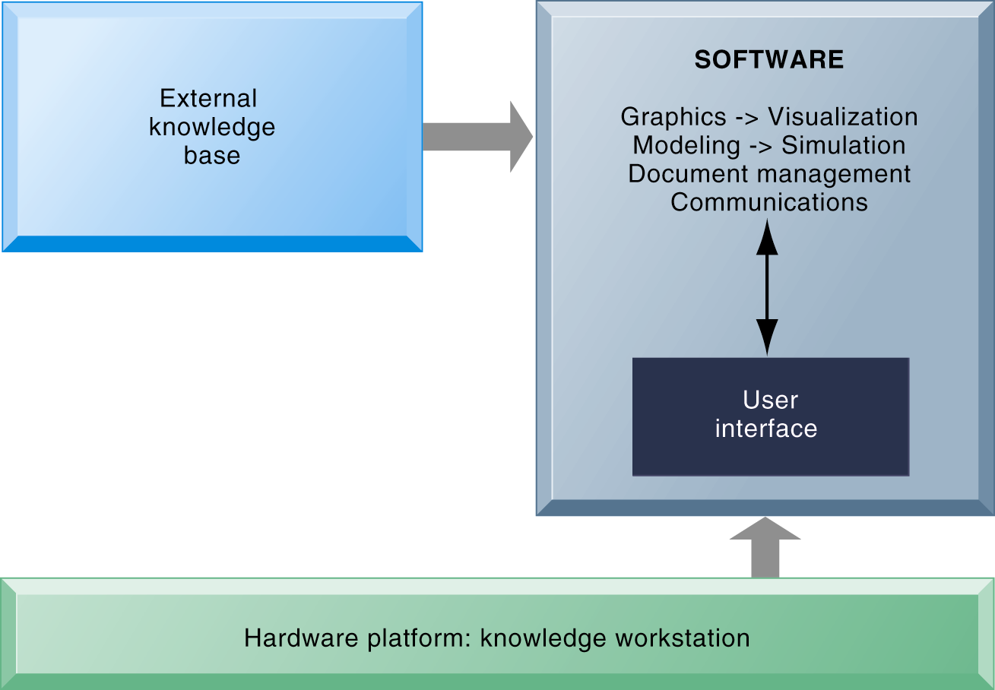
Knowledge Work Systems
Requirements of Knowledge Work Systems
Knowledge work systems require strong links to external knowledge bases in addition to specialized hardware and software.
Notes:
This graphic illustrates the main components of a knowledge work station: having the need for both specialized software and hardware, access to external information, and an easy-to-use interface. What types of external knowledge might be valuable to an engineer, a financial analyst, a medical researcher?

Slide 31
Intelligent Techniques
Intelligent techniques: Used to capture individual and collective knowledge and to extend knowledge base
  To capture tacit knowledge: Expert systems, case-based reasoning, fuzzy logic
  Knowledge discovery: Neural networks and data mining
  Generating solutions to complex problems: Genetic algorithms
  Automating tasks: Intelligent agents
Artificial intelligence (AI) technology:
  Computer-based systems that emulate human behavior
Notes:
This slide introduces the third of the three main types of knowledge management systems: Intelligent techniques, and categorizes them according to the type of knowledge involved. AI technology is used in some techniques as part of the logical computerized routine. The text discusses AI systems being able to learn languages, and emulate human expertise and decision making. What might be some of the benefits and drawbacks to AI technology? Are there any ethical considerations?

