Slide 1
WEEK 2
KNOWLEDGE MANAGEMENT
AND
ORGANIZATIONAL LEARNING

Slide 2
2.1 RBV and KBV
Resources Based View (RBV)
and
Knowledge Based View (KBV)

Slide 3
Porter’s Framework: Explaining the Profitability of a Business
Competitive Positioning
Achieving sustainable
competitive advantage
Industry Structure
Factors affecting
industry profitability
Strategy Formulation
and Implementation
Defining and executing
the managerial tasks

Slide 4
The Resource-Based View: Elements of Competitive Advantage

Slide 5
Resource and Knowledge Based View of the Firm
Two perspectives
The internal analysis of phenomena within a company
An external analysis of the industry and its competitive environment
Three key types of resources
Tangible resources
Intangible resources
Organizational capabilities

Slide 6
Types of Resources
Tangible Resources
Relatively easy to identify, and include physical and financial assets used to create value for customers
Financial resources
Firm’s cash accounts
Firm’s capacity to raise equity
Firm’s borrowing capacity
Physical resources
Modern plant and facilities
Favorable manufacturing locations
State-of-the-art machinery and equipment

Slide 7
Types of Resources
Tangible Resources
Relatively easy to identify, and include physical and financial assets used to create value for customers
Technological resources
Trade secrets
Innovative production processes
Patents, copyrights, trademarks
Organizational resources
Effective strategic planning processes
Excellent evaluation and control systems

Slide 8
Types of Resources
Difficult for competitors (and the firm itself) to account for or imitate, typically embedded in unique routines and practices that have evolved over time
Human
Experience and capabilities of employees
Trust
Managerial skills
Firm-specific practices and procedures
Intangible Resources

Slide 9
Types of Resources
Difficult for competitors (and the firm itself) to account for or imitate, typically embedded in unique routines and practices that have evolved over time
Intangible Resources
Innovation and creativity
Technical and scientific skills
Innovation capacities
Reputation
Effective strategic planning processes
Excellent evaluation and control systems

Slide 10
Types of Resources
Competencies or skills that a firm employs to transform inputs to outputs, and capacity to combine tangible and intangible resources to attain desired end
Outstanding customer service
Excellent product development capabilities
Innovativeness of products and services
Ability to hire, motivate, and retain human capital
Organizational Capabilities

Slide 11
Firm Resources and Sustainable Competitive Advantages
Is the resource or capability…
Valuable
Rare
Difficult to imitate
(In-Imitable)
Difficult to substitute
(Non-Substitutable)
Implications
Neutralize threats and exploit opportunities
Not many firms possess
Physically unique
Path dependency
Causal ambiguity
Social complexity
No equivalent strategic resources or capabilities

Slide 12
Is the Resource Valuable?
Organizational resources can be a source of competitive advantage only when they are valuable
Enable a firm to formulate and implement strategies that improve its efficiency or effectiveness

Slide 13
Is the Resource Rare?
Organizational resources also possessed by competitors are not sources of competitive advantage
Common strategies based on similar resources give no one firm an advantage
Competitive advantages are gained only from uncommon resources, resources that are rare to other competitors

Slide 14
Can the Resource be Imitated?
Difficulty in imitating resources is key to value creation because it constrains competition
Profits generated from inimitable resources are more likely to be sustainable
Physical uniqueness
Path dependency
Causal ambiguity
Social complexity

Slide 15
Are Substitutes Readily Available?
There must be no strategically equivalent valuable resources that are themselves not rare or inimitable
Substitutability may take at least two forms
Competitor may be able to substitute a similar resource that enables it to develop and implement the same strategy
Very different firm resources can become strategic substitutes (such as e-business as a substitute for physical retail facility)

Slide 16
Criteria for Sustainable Competitive Advantage and Strategic Implications
Is a resource or capability…
Valuable Rare Difficult Without Implications
to Imitate Substance for Competitiveness
No No No No Competitive disadvantage
Yes No No No Competitive parity
Yes Yes No No Temporary competitive
advantage
Yes Yes Yes Yes Sustainable competitive
advantage

Slide 17
2.2 Knowledge Management

Slide 18
What is Knowledge Management
Knowledge management, or KM, is the process through which organizations generate value from their intellectual property and knowledge-based assets
KM involves the creation, dissemination, and utilization of knowledge
It is also viewed as the intersection between People, Processes and Technology

Slide 19
Knowledge and Productivity
Six major factors determine knowledge-worker productivity
Knowledge-worker productivity demands that we ask the question: "What is the task?”
It demands that we impose the responsibility for their productivity on the individual knowledge workers themselves. Knowledge Workers have to manage themselves. They have to have autonomy.
Continuing innovation has to be part of the work, the task and the responsibility of knowledge workers.

Slide 20
Knowledge and Productivity
Knowledge work requires continuous learning on the part of the knowledge worker, but equally continuous teaching on the part of the knowledge worker.
Productivity of the knowledge worker is not—at least not primarily—a matter of the quantity of output. Quality is at least as important.
Finally, knowledge-worker productivity requires that the knowledge worker is both seen and treated as an "asset" rather than a "cost." It requires that knowledge workers want to work for the organization in preference to all other opportunities. (Drucker, 1999)

Slide 21
Importance of Knowledge
Why do you study?
Some companies thrive on knowledge (3M, Accenture, Microsoft, Apple). New products materialize new knowledge.
Some successful companies get overrun by competition because they neglected to advance product knowledge.
The same applies to individual professionals.
Knowledge rocks! Without knowledge you wont’ be able to “get” any information (for text: knowledge of language, reading, concepts...).

Slide 22
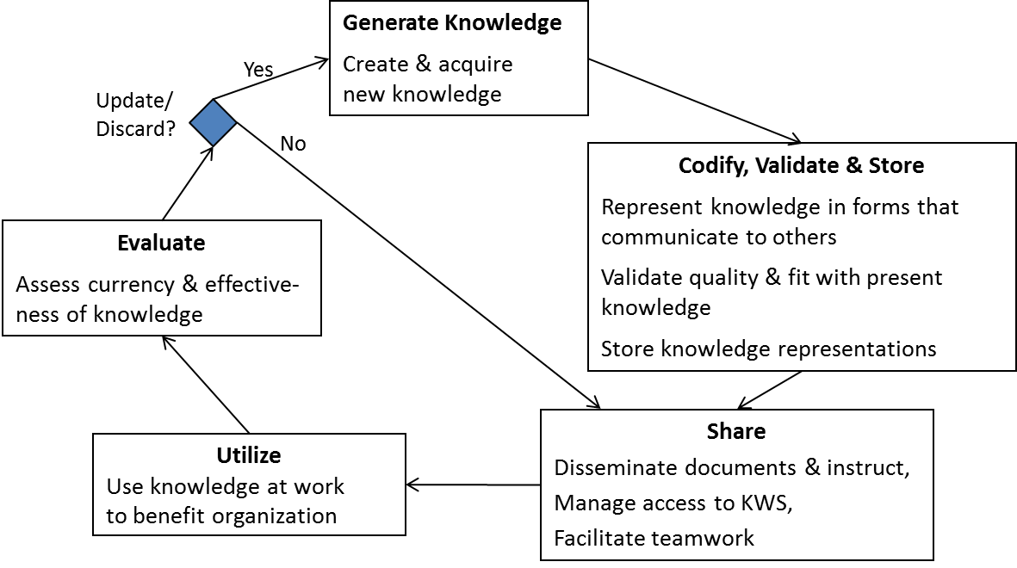
Knowledge Management Process
A sequence of activities from knowledge generation to discarding. The process is circular and it keeps repeating.

Slide 23
2.3 Organizational Learning

Slide 24
Organizational Learning (OL)
Definition of OL:
“It involves the ways firms build, supplement and organize knowledge and routines around their activities and within their culture and adapt develop organizational efficiency by improving the use of the broad skills of their workforce” (Dogsdon, 1993).

Slide 25
Definition of OL:
“It is an org. which facilitates the learning of all its members and continuously transforms itself”.
“It creates the environment in which people spend most of their lives and subsequently, has major impact on their behavior”.
OL does not simply engage in a lot of training.

Slide 26
“learning organization (LO)”
refers to a very significant movement in organization development and was popularized by Peter Senge in his landmark book "The Fifth Discipline: The Art and Practice of Learning Organization”.

Slide 27
Continues
Also (Mark Addleson 1997) defines learning organization as
"an organization that builds collaborative relationships in order to draw strength from the diverse knowledge, experience, capabilities, and ways of doing things that people and communities have and use."

Slide 28
Continues
According to Peter Senge "learning organizations are: organizations where people continually expand their capacity to create the results they truly desire, where new and expansive patterns of thinking are nurtured, where collective aspiration is set free, and where people are continually learning to see the whole together".(Senge 1990).

Slide 29
Characteristics of LO:
1. Learning Culture - an organizational climate that nurtures\fosters learning.
There is a strong similarity with those characteristics associated with innovation.
Future, external orientation.
Free exchange and flow of information.
Commitment to learning, personal development.
Valuing people.
Climate of openness and trust.
Learning from experience.

Slide 30
Characteristics of LO:
2 -Processes - processes that encourage interaction across boundaries.
These are infrastructure, development and management processes, as opposed to business operational processes
Strategic and Scenario Planning.
Competitor Analysis.
Information and Knowledge Management.
Capability Planning.
Team and Organization development.
Performance Measurement.
Reward and Recognition Systems.

Slide 31
Characteristics of LO:
3 -Tools and Techniques - methods that aid individual and group learning, include a wide range of learning and creativity skills such as:
Inquiry - interviewing, seeking information
Creativity - brainstorming, associating ideas
Making sense of situations - organizing information and thoughts
Making choices - deciding courses of action
Observing outcomes - recording, observation
Reframing knowledge - embedding new knowledge into mental models, memorizing.

Slide 32
Characteristics of LO:
4 - Skills and Motivation - to learn and adapt.
Collective (i.e. team and organizational) learning require skills for sharing information and knowledge, particularly implicit knowledge, assumptions and beliefs that are traditionally "beneath the surface". Key skills here are:
Communication, especially across organizational boundaries.
Listening and observing.
Monitoring and supporting colleagues.
Taking a holistic perspective - seeing the team and organization as a whole.
Coping with challenge and uncertainty.

Slide 33
Features of LO
It has a climate in which individual members are encouraged to learn and develop.
Extends this culture to include customers and other significant stakeholders.
Makes HRD strategy central to bus. policy.
A continuous process of org. transformation.

Slide 34
Organizational Learning (OL)
What OL includes?
1- R&D activities.
2- Formal & informal education of employees.
3- Involves the means that org. uses to disseminate information throughout its ranks and the way that this information is processed & stored.

Slide 35
Organizational Learning (OL)
What it should result?
1- Technological innovation.
2- Efficiency improvement.
3- Increase reliability & corp. adaptability.
The conclusion:
1- Higher level of competitiveness.
2- OL is a required element for long-term success.

Slide 36
Organizational Learning (OL)
In case of low level of OL, it leads to:
1- Stagnant organization that cannot adjust to environment changes or competitive challenges.
2- Limits the firm ability to reduce costs.
3- Limits the firm ability to change markets or product lines.

Slide 37
Factors contribute to OL
Corporate strategy: how org. is structured to learn from mistakes.
Resource allocation: exploration and exploitation.
Recognition for the employees’ motivation for learning.

Slide 38
Exploration & Exploitation in OL
Exploration: Means seeking new ideas.
Exploitation: Means incorporating the new ideas into what a business does.
The corporate culture & procedures reflect reality on OL.

Slide 39
Elements of LO
There are two elements (Narver & Slater, 1995):
1- Facilitative leadership.
2- Organizational structure conducive to learning.

Slide 40
OL from external relationships
Using facilities & R&D services of others through mutual collaboration.

Slide 41
Characteristics of LO members
Living with change and challenge.
Internal harmony: compromise is possible, no right or wrong.
Managing diversity within org.

Slide 42
Building Learning Organizations
Adaptive learning and Generative learning
Need to adapt to the changing environment
Total quality movement (TQM) in Japan has migrated to a generative learning model
Look at the world in a new way
Changing roles of the leader
Migrating from decision makers to designers, teachers and stewards
Building a shared vision
Encouraging ideas, Requesting support, Moving beyond blame, Effective communication
Learning tools
Learning laboratory

Slide 43
Organizational Culture and Knowledge
Knowledge culture systematically supports the entire knowledge process. Examples: Accenture, 3M, Microsoft…
Beliefs and behaviors related to knowledge at Accenture:
Beliefs & practices on generation & sharing of knowledge: Knowledge should be continually created and shared.
Beliefs on role of knowledge in business: knowledge should contribute directly to profit objectives.
Assumptions about purpose KWS: KWS should enable storing and efficient access to knowledge content, and contribute directly to profitability.

Slide 44
Knowledge Culture
Knowledge culture may be facilitated by teamwork – important in knowledge creation and particularly sharing. May help uncovering tacit knowledge.

Slide 45
Organizational Knowledge Management Model
Leadership
KM Process
Culture
Share
Apply
Organization
Group
Individual
Create
Organize
Identify
Adapt
Collect
Business
Process
Performance
Measurement
Technology
Source: Adapted from Arthur Andersen and the American Productivity and Quality Center

Slide 46
Organizational Learning Process
Diffusion -
Tacit, Explicit
Incentives
Identification
Creation
Integration
Modification
Metrics
Action
Source:
Reinhardt and Pawlowsky
also see: Tools in Organizational Learning
http://duplox.wz-berlin.de/oldb/forslin.html
Notes:
Overall focus is on learning actionable knowledge
Organizations successful at KM Generate and Generalize knowledge
Generate - Create new knowledge and Identify knowledge that exists inside and outside the organization
Generalize - Transfer Knowledge from person to person, group to group, organization to organization
Diffusion - tacit/explicit - Tacit - Dialogue, Explicit - someone creates an external representation of their understanding (Word, e-mail, PowerPoint)
Integration - Knowledge transfer only matters to the receiver. Person knowledge is transferred to must be open to new ideas, able to challenge assumptions to integrate into their mental model.
Modification - Knowledge is never received “pure”, typically the receiver takes out the pieces that work for him/her.
Action - Important experiential knowledge is built through action. Wouldn’t expect someone to be able to <choose example> by reading a book or paper. Need tacit knowledge built up in action.
Need metrics to determine success in each area and to provide incentive. Not measured it won’t get done.
Focus of this MSR is on metrics and incentives for the diffusion process.
Examine available tools and develop tools for each area. (I.e. Expert Finder (identification), CVW - diffusion, Invention Machine (integration), PowerSim (Action)

Slide 47
Six Principals of Effective Learning
Effective Learning Requires:
Understanding
1) Mental models, paradigms, context, observation, assumptions, opinion, fact, truth
2) Systems Thinking - Variation
Skills
3) Ability to challenge assumptions
4) Listen to Understand
Process
5) Complete observe, assess (reflection, gain understanding), design (develop theory, prediction, vision), implement (test), cycle
6) Teach others
Notes:
Focused on teaching others because good indicator of all other principles and gives a notion of tacit diffusion. Paper is available online.

Slide 48
Knowledge Management: Incentive-based Approaches
Receiver
Positive Incentives
Knowledge Gained
Can teach others what is learned
Teacher
Positive Incentives
“Knowledge Transfer Champion” prestige
Can improve knowledge
Negative Incentives
Time
Unqualified teacher
Negative Incentives
Time
Students not willing to learn
Notes:
What do we mean by Knowledge Transfer Events?

