Slide 1
WEEK 3
INFORMATION TECHNOLOGY IN KNOWLEDGE BASED ENTERPRISES

Slide 2
3.1. Industry 4.0

Slide 3

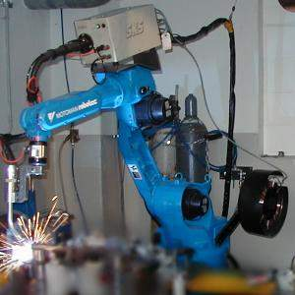
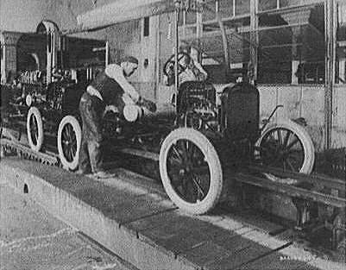
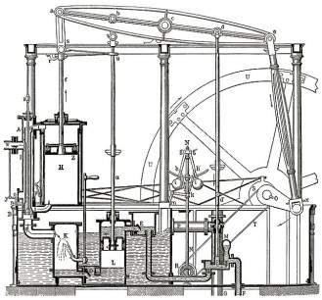
Industrial Evolution
4. Industrial revolution
Based on cyber-physical-
systems
3. Industrial revolution
Through the use of electronics
and IT further progression in
autonomous production
2. Industrial revolution
Introducing mass production
lines powered by electric
energy
Level of Complexity
1. Industrial revolution
Introducing mechanical
production machines powered
by water and steam
Industry 1.0
Industry 2.0
Industry 3.0
Industry 4.0
End of the
18th century.
Beginning of the
20th century
Beginning of the
70th
Today

Slide 4
Building blocks of Industry 4.0
Industry 4.0
Autonomous Robots
Simulation
Horizontal and vertical system integration (Block Chain)
Artificial Intelligent
Internet of Things
Augmented reality
Big data analytics
Cloud System Storage

Slide 5
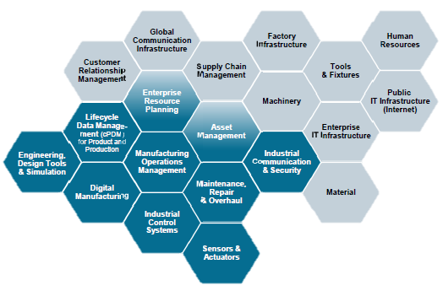
Impacting all aspect of value chain

Slide 6
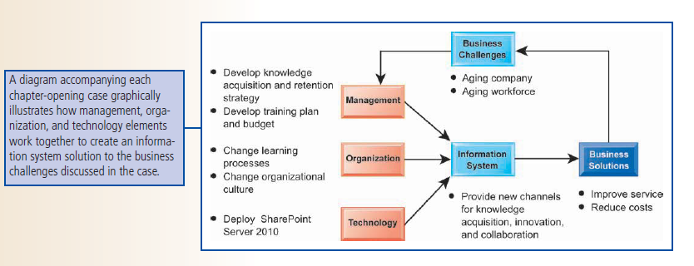

Slide 7
3.2. IT in Knowledge Management

Slide 8
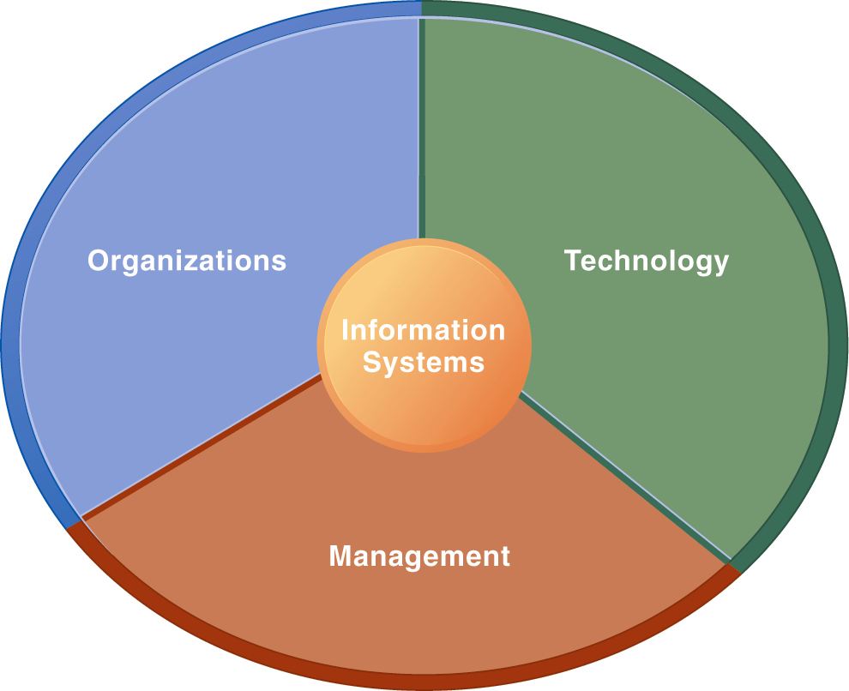
Dimensions of IS
Information Systems Are More Than Computers
Using information systems effectively requires an understanding of the organization, management, and information technology shaping the systems. An information system creates value for the firm as an organizational and management solution to challenges posed by the environment.

Slide 9
Organizational Dimension of IS
  Structure: different levels and specialties
  Business process: Organization coordinate its work through its hierarchy and business process
  Culture and Political: ways of doing things, part is embedded in IS.

Slide 10
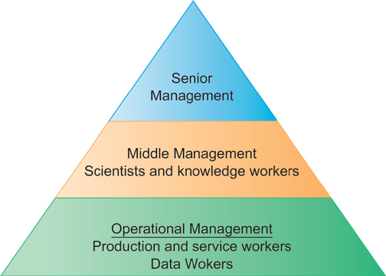
Levels in a Firm
Business organizations are hierarchies consisting of three principal levels: senior management, middle management, and operational management. Information systems serve each of these levels. Scientists and knowledge workers often work with middle management.

Slide 11
2) Management Dimension
  Make decisions, formulate action plan and solve organizational problem
  Managers set organizational strategy for responding to business challenges
  In addition, managers must act creatively:
    Creation of new products and services
    Occasionally re-creating the organization

Slide 12
3) Technology Dimension
  Computer hardware : the physical equipment used for input, processing, and output activities in an information system
  Software: instructions that control and coordinated hardware components
  Data management technology: software governing the organization data on physical storage media
  Networking and telecommunications technology : both physical devices and software, links from various location
  IT infrastructure: platform that the firm can built on its IS

Slide 13
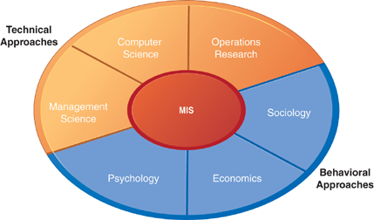
Contemporary Approaches to Information Systems
The study of information systems deals with issues and insights contributed from technical and behavioral disciplines.

Slide 14
Technical Approach
Emphasizes mathematically based models
    Computer science theories of computation ,data storage
    management science: models of decision making and practices
    operations research: optimizing selected parameters of organization
Behavioral Approach
Behavioral issues such strategic business integration, implementation...
    Psychology: how decision makers use formal information
    Economics: how IS change the control and cost structures
    Sociology: how system affect individuals and groups

Slide 15
Enterprise Knowledge Management
An alternative view
single corporate data model
open architectures
standard protocols
merging of internet, intranet, extranet
integration of internal and external data
crossing functional boundaries

Slide 16
The Knowledge Management Investment
Sales of enterprise content management software for knowledge management expected to grow 15 percent annually through 2012
Information Economy
  55% U.S. labor force: knowledge and information workers
  60% U.S. GDP from knowledge and information sectors
Substantial part of a firm’s stock market value is related to intangible assets: knowledge, brands, reputations, and unique business processes
Knowledge-based projects can produce extraordinary ROI
Notes:
This slide emphasizes the role of knowledge today in the U.S. economy. Ask students to give examples of knowledge and information sectors (finance, publishing, etc.). It may come as a surprise to students that more than half the value of all stocks listed on the New York Stock Exchange is attributed to intangible assets like knowledge and know-how.

Slide 17
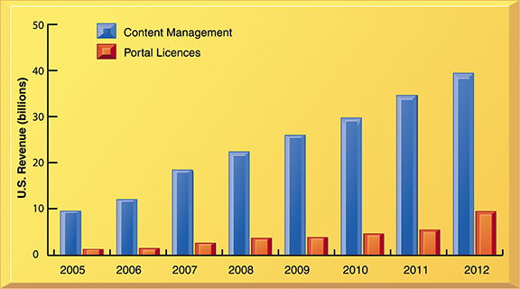
U.S. Enterprise Knowledge Management
Software Revenues, 2005-2012
Enterprise knowledge management software includes sales of content management and portal licenses, which have been growing at a rate of 15 percent annually, making it among the fastest-growing software applications.
Notes:
This graph illustrates the growth of sales of knowledge management software in the U.S. along with sales predictions through 2012 – making this type of software among the fastest-growing types of software applications. This is a good indicator of the increasing importance companies are placing on knowledge and its contribution to their bottom line.

Slide 18
Role of IT in Implementation
18
“The biggest contributor to this brilliant growth of the knowledge management system is information technology.”
Lee et al. also say, “...there are negative perspectives about information technology.”
According to a managing partner at a KM consultancy firm based in New York, “The biggest misconception that IT leaders make is that knowledge management is about technology...Usually people begin a KM project by focusing on the technology...But the key is people...”

Slide 19
Three major types of knowledge management systems:
  1. Enterprise-wide knowledge management systems
    General-purpose firm-wide efforts to collect, store, distribute, and apply digital content and knowledge
  2. Knowledge work systems (KWS)
    Specialized systems built for engineers, scientists, other knowledge workers charged with discovering and creating new knowledge
  3. Intelligent techniques
    Diverse group of techniques such as data mining used for various goals: discovering knowledge, distilling knowledge, discovering optimal solutions
Notes:
This slide introduces the three main categories of information system used to manage knowledge. These categories are different in terms of the constituencies they server, the purpose for which they are used and what they emphasize.

Slide 20
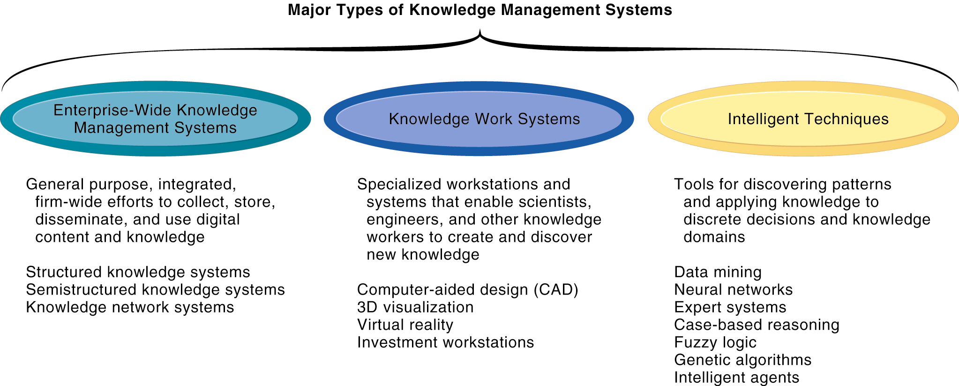
Major Types of Knowledge Management Systems
There are three major categories of knowledge management systems, and each can be broken down further into more specialized types of knowledge management systems.
Notes:
This graphic illustrates the three major types of knowledge management systems, giving the purpose of the system and examples of the type of system. Ask the students how they would categorize a system that catalogs and stores past advertising campaigns? What about software that helps a research biologist input and analyze lab findings?

Slide 21
3.3. Enterprise Wide Knowledge Management System

Slide 22
Three major types of knowledge in enterprise
  Structured documents
    Reports, presentations
    Formal rules
  Semistructured documents
    E-mails, videos
  Unstructured, tacit knowledge
80% of an organization’s business content is semistructured or unstructured
Notes:
This slide describes the three major kinds of knowledge that can be found in an enterprise, and indicates that less formal knowledge may be just as critical as formal knowledge for organizations to store and share. Ask the students for other examples of semistructured and unstructured knowledge. Ask students for an example of tacit knowledge that is more important than structured knowledge such as a report.

Slide 23
1. Enterprise-wide content management systems
  Help capture, store, retrieve, distribute, preserve
    Documents, reports, best practices
    Semistructured knowledge (e-mails)
  Bring in external sources
    News feeds, research
  Tools for communication and collaboration
Notes:
This slide discusses the purpose and features of enterprise-wide content management systems. The text discusses the example of Central Vermont Public Service, which uses OpenText LiveLink Enterprise Content Management to organize both structured and unstructured content such as e-mails, spreadsheets, word processing documents, and PDFs. In addition to helping make better business use of the information, the system also helps the organization comply with federal and state regulations for records management.

Slide 24
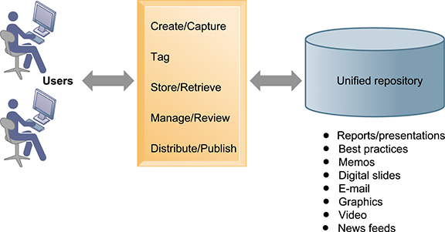
An Enterprise Content Management System
An enterprise content management system has capabilities for classifying, organizing, and managing structured and semi structured knowledge and making it available throughout the enterprise
Notes:
This graphic illustrates the functions of an enterprise content management system. Users interact with the system to both input knowledge, manage it, and distribute it. These management systems can house a wide variety of information types, from formal reports to graphics, as well as bring in external content resources such as news feeds. Ask students what types of documents would need to be stored by a hospital, bank, law firm, etc.

Slide 25
Enterprise-wide content management systems
  Key problem – Developing taxonomy
    Knowledge objects must be tagged with categories for retrieval
  Digital asset management systems
    Specialized content management systems for classifying, storing, managing unstructured digital data
    Photographs, graphics, video, audio
Notes:
This slide continues the discussion of enterprise-wide content management systems. One need when collecting and storing knowledge and documents is describing a knowledge object so that it can be found later by users. Companies must decide and implement classification schemes, or taxonomies, to define categories meaningful to users, and then knowledge objects must be assigned a classification (“tagged”) so that it can be retrieved. Ask students why different companies might need different taxonomies? Why is it a critical task and a difficult task in preparing for a successful content management system?
Some content management systems specialize in managing digital media storage and classification. What types of firms may need these digital asset management systems? (Publishers, advertisers, broadcasters, entertainment producers, etc.)

Slide 26
2. Knowledge network systems
  Provide online directory of corporate experts in well-defined knowledge domains
  Use communication technologies to make it easy for employees to find appropriate expert in a company
  May systematize solutions developed by experts and store them in knowledge database
    Best-practices
    Frequently asked questions (FAQ) repository
Notes:
Enterprise content management systems can include or consist of capabilities for the creation and management of unstructured knowledge – knowledge network systems. Ask the students to give examples of unstructured knowledge, given a type of industry or company: a law firm, an advertising firm, a school. What might be the difficulties in establishing a knowledge network system in a company? Contrast this network (crowd centered) approach to a top down structured knowledge management system.

Slide 27
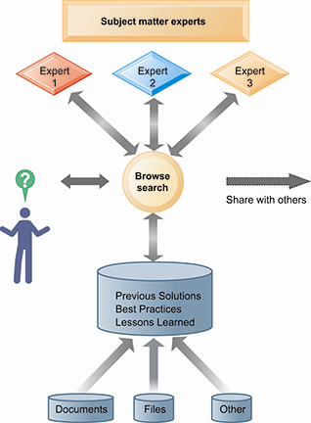
An Enterprise Knowledge Network System
A knowledge network maintains a database of firm experts, as well as accepted solutions to known problems, and then facilitates the communication between employees looking for knowledge and experts who have that knowledge.
Solutions created in this communication are then added to a database of solutions in the form of FAQs, best practices, or other documents.
Notes:
This graphic illustrates the various elements that form a knowledge network system. The user can search for accepted solutions in FAQ or best practices document or contact an expert in the relevant subject matter. Ask the students to provide examples of undocumented, unstructured knowledge they acquired, either in a classroom setting or at work, that would be valuable to peers. What kind of tools would enable sharing this information?

Slide 28
Major knowledge management system vendors include powerful portal and collaboration technologies
  Portal technologies: Access to external information
    News feeds, research
    Access to internal knowledge resources
  Collaboration tools
    E-mail
    Discussion groups
    Blogs
    Wikis
    Social bookmarking
Notes:
Enterprise-wide content systems include capabilities for collaboration and learning management. Ask students to provide examples of other types of collaboration tools (chat/IM, video conferencing). Ask students how a blog and wiki would help a company in terms of collaboration. Have any of the students used or created a wiki? Ask students if they have used social bookmarking personally and to describe how it works. Ask them how social bookmarking would be valuable as a collaboration tool for a business. Are there any potential problems in using social bookmarking (tagging).

Slide 29
Learning management systems
  Provide tools for management, delivery, tracking, and assessment of various types of employee learning and training
  Support multiple modes of learning
    CD-ROM, Web-based classes, online forums, live instruction, etc.
  Automates selection and administration of courses
  Assembles and delivers learning content
  Measures learning effectiveness
Notes:
This slide discusses learning management systems, which enable companies to track and manage employee learning. Ask students what are the benefits and drawbacks of using an LMS with centralized reporting.

Slide 30
3.4. Knowledge Work Systems

Slide 31
Knowledge work systems
  Systems for knowledge workers to help create new knowledge and ensure that knowledge is properly integrated into business
Knowledge workers
  Researchers, designers, architects, scientists, and engineers who create knowledge and information for the organization
  Three key roles:
    Keeping organization current in knowledge
    Serving as internal consultants regarding their areas of expertise
    Acting as change agents, evaluating, initiating, and promoting change projects
Notes:
This slide discusses the second main type of knowledge management system, the knowledge work system, and identifies the importance of knowledge workers to an organization and its knowledge creation. Ask the students why each of the three roles listed is important to an organization. Can all companies benefit from knowledge workers, or only design, science, and engineering firms?

Slide 32
Requirements of knowledge work systems
  Substantial computing power for graphics, complex calculations
  Powerful graphics, and analytical tools
  Communications and document management capabilities
  Access to external databases
  User-friendly interfaces
  Optimized for tasks to be performed (design engineering, financial analysis)
Notes:
This slide continues the discussion of knowledge work systems, emphasizing the need of knowledge workers to have highly specialized knowledge work systems. Ask students to describe the reasons that these characteristics are important for a knowledge work system. What other types of information systems would a knowledge worker rely on, if any? (office systems, productivity systems, scheduling systems).

Slide 33
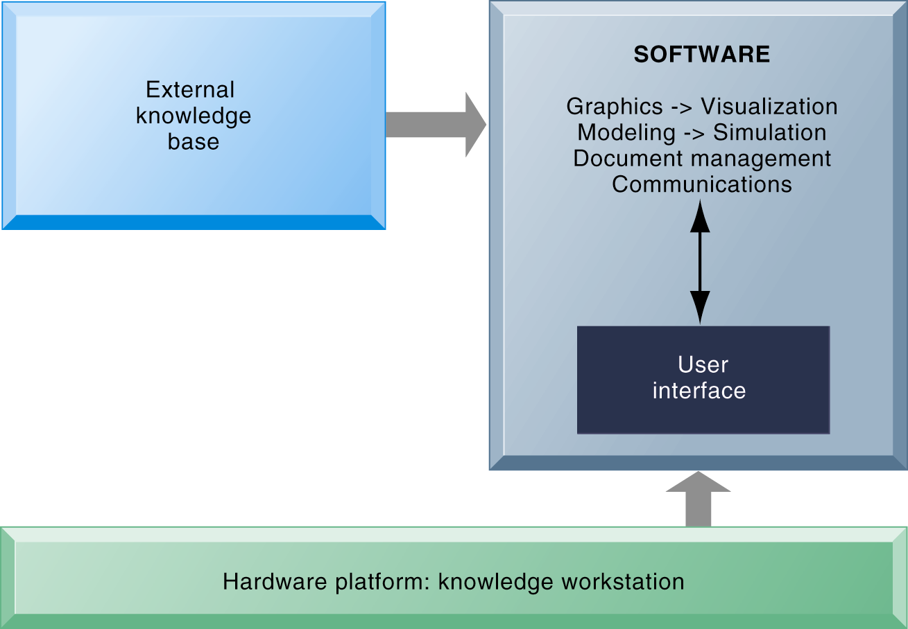
Knowledge Work Systems
Requirements of Knowledge Work Systems
Knowledge work systems require strong links to external knowledge bases in addition to specialized hardware and software.
Notes:
This graphic illustrates the main components of a knowledge work station: having the need for both specialized software and hardware, access to external information, and an easy-to-use interface. What types of external knowledge might be valuable to an engineer, a financial analyst, a medical researcher?

Slide 34
Examples of knowledge work systems
  CAD (computer-aided design): Automates creation and revision of engineering or architectural designs, using computers and sophisticated graphics software
  Virtual reality systems: Software and special hardware to simulate real-life environments
    E.g. 3-D medical modeling for surgeons
    VRML: Specifications for interactive, 3D modeling over Internet
  Investment workstations: Streamline investment process and consolidate internal, external data for brokers, traders, portfolio managers
Notes:
This slide describes three types of knowledge work systems: CAD systems, virtual reality systems, and investment work stations. Ask students what the business value of providing a financial analyst, engineer, or researcher with an improved, specialized work station would be. Can the value of implementing or upgrading work systems be quantified into a monetary value? The text discusses virtual reality systems as an aid in medicine and engineering. What other industries might benefit from the use of virtual reality systems by their knowledge workers?

Slide 35
3.5. Intelligent Techniques

Slide 36
Intelligent Techniques
Intelligent techniques: Used to capture individual and collective knowledge and to extend knowledge base
  To capture tacit knowledge: Expert systems, case-based reasoning, fuzzy logic
  Knowledge discovery: Neural networks and data mining
  Generating solutions to complex problems: Genetic algorithms
  Automating tasks: Intelligent agents
Artificial intelligence (AI) technology:
  Computer-based systems that emulate human behavior
Notes:
This slide introduces the third of the three main types of knowledge management systems: Intelligent techniques, and categorizes them according to the type of knowledge involved. AI technology is used in some techniques as part of the logical computerized routine. The text discusses AI systems being able to learn languages, and emulate human expertise and decision making. What might be some of the benefits and drawbacks to AI technology? Are there any ethical considerations?

Slide 37
Expert systems:
  Capture tacit knowledge in very specific and limited domain of human expertise
  Capture knowledge of skilled employees as set of rules in software system that can be used by others in organization
  Typically perform limited tasks that may take a few minutes or hours, e.g.:
    Diagnosing malfunctioning machine
    Determining whether to grant credit for loan
Notes:
This slide describes expert systems, one type of intelligent technique. Ask students why expert systems are best used in highly structured decision-making situations. Ask students to provide an example of a decision that could not be solved by an expert system. Choice of music, potential spouses or mates, new product decisions, or designing a new marketing campaign might be good examples of poorly structured decision situations.

Slide 38
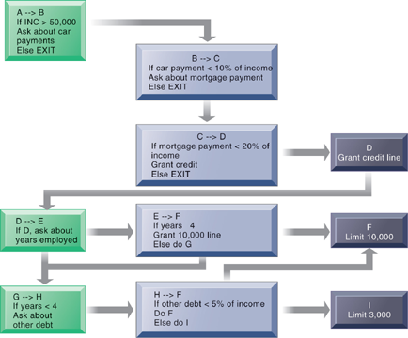
Rules in an Expert System
An expert system contains a number of rules to be followed. The rules are interconnected; the number of outcomes is known in advance and is limited; there are multiple paths to the same outcome; and the system can consider multiple rules at a single time. The rules illustrated are for simple credit-granting expert systems.
Notes:
This graphic illustrates the use of If/Then rules in an expert system. Ask students to demonstrate an understanding of if/then rules, by analyzing a common decision as a series of if/then statements; for example, the decision to accept an invitation to socialize on a weeknight, or the decision of what to make for dinner.

Slide 39
How expert systems work
  Knowledge base: Set of hundreds or thousands of rules
  Inference engine: Strategy used to search knowledge base
    Forward chaining: Inference engine begins with information entered by user and searches knowledge base to arrive at conclusion
    Backward chaining: Begins with hypothesis and asks user questions until hypothesis is confirmed or disproved
Notes:
This slide continues the discussion of expert systems and describes how they work. Their key elements are their knowledge base and their inference engine. Ask students to demonstrate an understanding of the difference between forward chaining and backward chaining. For example, given a hypothesized expert system to determine what to make for dinner, what would an inference engine with forward chaining begin with? (Example, is there chicken? Is there beef? Is there broccoli, etc.? What are all the ingredients available and what could be made from them?) What would an inference with backward chaining begin with? (We are making chicken with broccoli. Do we have the ingredients?)

Slide 40
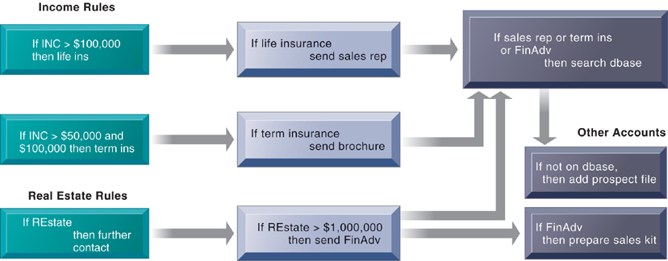
Inference Engines in Expert Systems
An inference engine works by searching through the rules and “firing” those rules that are triggered by facts gathered and entered by the user. A collection of rules is similar to a series of nested IF statements in a traditional software system; however the magnitude of the statements and degree of nesting are much greater in an expert system
Notes:
This graphic illustrates the types of rules that might be used by salespeople to determine whether or not to add a client to a prospect database. Ask students to demonstrate, using this chart, what would happen to a client that was determined to have an income of $80,000 and was given Financial Advice.

Slide 41
Successful expert systems
  Countrywide Funding Corporation in Pasadena, California, uses expert system to improve decisions about granting loans
  Con-Way Transportation built expert system to automate and optimize planning of overnight shipment routes for nationwide freight-trucking business
Most expert systems deal with problems of classification
  Have relatively few alternative outcomes
  Possible outcomes are known in advance
Many expert systems require large, lengthy, and expensive development and maintenance efforts
  Hiring or training more experts may be less expensive
Notes:
This slide continues the discussion of expert systems, citing two examples of successful systems, and discussing the types of problems that benefit from expert systems as well as the potential drawbacks to implementing expert systems. Could an expert system be used to diagnose a medical condition? What might be the drawbacks to using an expert system for medical diagnosis? What happened to Country Wide Funding in the financial meltdown of 2008? It is possible that a functioning expert system can be programmed to make some bad decisions very rapidly.

Slide 42
Case-based reasoning (CBR)
  Descriptions of past experiences of human specialists, represented as cases, stored in knowledge base
  System searches for stored cases with problem characteristics similar to new one, finds closest fit, and applies solutions of old case to new case
  Successful and unsuccessful applications are grouped with case
  Stores organizational intelligence: Knowledge base is continuously expanded and refined by users
  CBR found in
    Medical diagnostic systems
    Customer support
Notes:
This slide discusses a second type of intelligent technique, case-based reasoning. What would be the difference in how a CBR system would be used in medical diagnosis versus an expert system? Ask students which of the two techniques would be better at medical diagnosis and why?

Slide 43
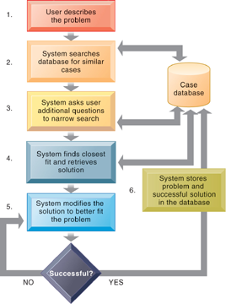
How Case-Based Reasoning Works
Case-based reasoning represents knowledge as a database of past cases and their solutions. The system uses a six-step process to generate solutions to new problems encountered by the user.
Notes:
This graphic demonstrates the six main steps in case based reasoning. Ask the students to compare expert systems with CBR. What are the benefits and drawbacks in CBR as a technique? What types of problems lend themselves to CBR?

Slide 44
Fuzzy logic systems
  Rule-based technology that represents imprecision used in linguistic categories (e.g., “cold,” “cool”) that represent range of values
  Describe a particular phenomenon or process linguistically and then represent that description in a small number of flexible rules
  Provides solutions to problems requiring expertise that is difficult to represent with IF-THEN rules
    Autofocus in cameras
    Detecting possible medical fraud
    Sendai’s subway system use of fuzzy logic controls to accelerate smoothly
Notes:
This slide discusses a third type of intelligent technique – fuzzy logic. The text discusses the use of fuzzy logic to control room temperature automatically using imprecise values for temperature, humidity, outdoor wind, and outdoor temperature, in order to evaluate current room conditions and respond appropriately. Ask students what might be the imprecise values used in the fuzzy logic for camera autofocus, medical fraud detection, and subway acceleration. Could fuzzy logic be used in medical diagnosis? How would this work?

Slide 45
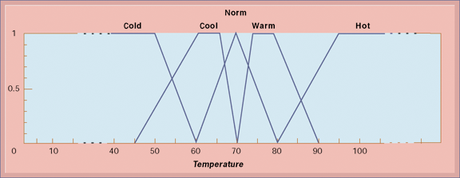
Fuzzy Logic for Temperature Control
The membership functions for the input called temperature are in the logic of the thermostat to control the room temperature. Membership functions help translate linguistic expressions such as warm into numbers that the computer can manipulate.
Notes:
This graphic illustrates how a fuzzy logic system for room air conditioning might represent the imprecise values for temperature. Ask students what the benefit is of using imprecise values?

Slide 46
Neural networks
  Find patterns and relationships in massive amounts of data that are too complicated for human to analyze
  “Learn” patterns by searching for relationships, building models, and correcting over and over again model’s own mistakes
  Humans “train” network by feeding it data inputs for which outputs are known, to help neural network learn solution by example
  Used in medicine, science, and business for problems in pattern classification, prediction, financial analysis, and control and optimization
  Machine learning: Related AI technology allowing computers to learn by extracting information using computation and statistical methods
Notes:
This slide discusses a fourth intelligent technique, neural networks. Ask students whether neural networks could be used in medical diagnosis? How would this work? To some extent, data mining techniques have replaced neural networks in situations requiring pattern recognition. For instance credit card companies sift through mountains of transaction data to identify which charging patterns are unlikely for each and every charge card customer.

Slide 47
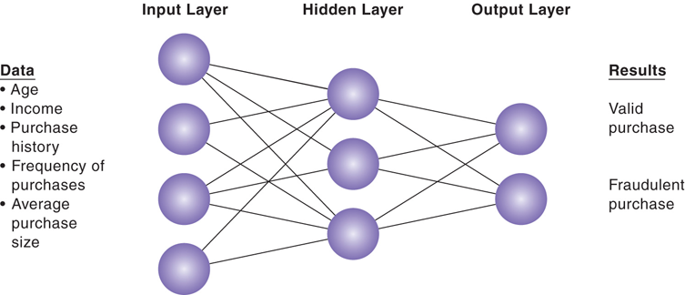
How a Neural Network Works
A neural network uses rules it “learns” from patterns in data to construct a hidden layer of logic. The hidden layer then processes inputs, classifying them based on the experience of the model. In this example, the neural network has been trained to distinguish between valid and fraudulent credit card purchases.
Notes:
This graphic illustrates how a neural network works – by using an internal, hidden layer of logic that examines existing data and assigning a classification to that set of data. For example, given one or more specific combinations of age, income, purchase history, frequency of purchases, and average purchase size, a neural network might determine that a new credit card purchase was likely to be fraudulent. What are the benefits and drawbacks of using this type of technique?

Slide 48
Genetic algorithms
  Useful for finding optimal solution for specific problem by examining very large number of possible solutions for that problem
  Conceptually based on process of evolution
    Search among solution variables by changing and reorganizing component parts using processes such as inheritance, mutation, and selection
  Used in optimization problems (minimization of costs, efficient scheduling, optimal jet engine design) in which hundreds or thousands of variables exist
  Able to evaluate many solution alternatives quickly
Notes:
This slide discusses a fifth type of intelligent technique – genetic algorithms. Ask students whether genetic algorithms might be useful in medical diagnosis. Why or why not? Ask students to differentiate between the various intelligent techniques discussed this far – expert systems, CBR, fuzzy logic, neural networks, and genetic algorithms.

Slide 49
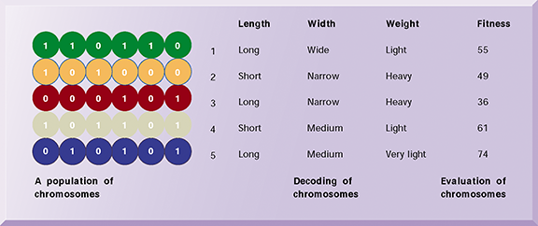
The Components of a Genetic Algorithm
This example illustrates an initial population of “chromosomes,” each representing a different solution. The genetic algorithm uses an iterative process to refine the initial solutions so that the better ones, those with the higher fitness, are more likely to emerge as the best solution.
Notes:
This graphic illustrates the components of a genetic algorithm – “chromosomes”, each with a variety of characteristics that can be compared for overall fitness in a given situation. Ask students what types of problems genetic algorithms are suited for.

Slide 50
Hybrid AI systems
  Genetic algorithms, fuzzy logic, neural networks, and expert systems integrated into single application to take advantage of best features of each
  E.g., Matsushita “neurofuzzy” washing machine that combines fuzzy logic with neural networks
Notes:
This slide discusses hybrid AI systems, which combine two or more of the techniques previously discussed. Would a hybrid AI system be better suited for medical diagnosis than a purely CBR or expert system?

Slide 51
Intelligent agents
  Work in background to carry out specific, repetitive, and predictable tasks for user, process, or software application
  Use limited built-in or learned knowledge base to accomplish tasks or make decisions on user’s behalf
    Deleting junk e-mail
    Finding cheapest airfare
  Agent-based modeling applications:
    Systems of autonomous agents
    Model behavior of consumers, stock markets, and supply chains; used to predict spread of epidemics
Notes:
This slide discusses the use of intelligent agents to carry out repetitive tasks for a user or system. Shopping bots discussed in an earlier chapter are an example of an intelligent agent. As an example of agent-based modeling, Procter & Gamble used agent-based modeling to improve coordination among supply-chain members.

Slide 52
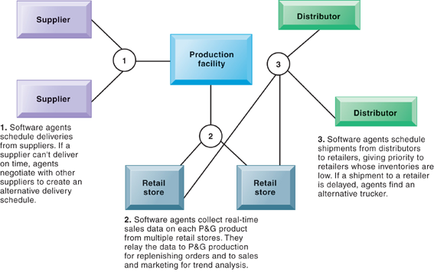
Intelligent Agents in P&G’s Supply Chain Network
Intelligent agents are helping Procter & Gamble shorten the replenishment cycles for products such as a box of Tide.
Notes:
This graphic illustrates Procter & Gamble’s use of intelligent agents in its supply chain network. Given that intelligent-agent modeling mimics the behavior of a number of “actors” in a given situation, what other types of situations might benefit from this type of analysis?

