Slide 1
WEEK 4
KNOWLEDGE MANAGEMENT
CYCLES AND MODEL

Slide 2
4.1. Developing Knowledge Management Systems

Slide 3
CHALLENGES IN BUILDING KM SYSTEMS
Culture — getting people to share knowledge
Knowledge evaluation — assessing the worth of knowledge across the firm
Knowledge processing — documenting how decisions are reached
Knowledge implementation — organizing knowledge and integrating it with the processing strategy for final deployment

Slide 4
KM System Development Life Cycle
Evaluate existing infrastructure
Form the KM team
Knowledge capture
Design KM blueprint (master plan)
Test the KM system
Implement the KM system
Manage change and reward structure
Post-system evaluation

Slide 5
1. Evaluate Existing Infrastructure
System justification:
Will current knowledge be lost through retirement, transfer, or departure to other firms?
Is the proposed KM system needed in several locations?
Are experts available and willing to help in building a KM system?
Does the problem in question require years of experience and cognitive reasoning to solve?

Slide 6
System Justification (cont.)
When undergoing knowledge capture, can the expert articulate how problem will be solved?
How critical is the knowledge to be captured?
Are the tasks nonalgorithmic?
Is there a champion in the house?

Slide 7
2. KM Team Formation
Identify the key stakeholders in the prospective KM system.
Team success depends on:
Caliber of team members
Team size
Complexity of the project
Leadership and team motivation
Promising more than can be realistically delivered

Slide 8
3. Knowledge Capture
Explicit knowledge captured in repositories from various media
Tacit knowledge captured from company experts using various tools and methodologies
Knowledge developers capture knowledge from experts in order to build the knowledge base
Knowledge capture and transfer often carried out through teams, not just individuals

Slide 9
4. Design of the KM Blueprint
The KM system design (blueprint) addresses several issues:
System interoperability and scalability with existing company IT infrastructure
Finalize scope of proposed KM system with realized net benefits
Decide on required system components
Develop the key layers of the KM architecture to meet company requirements. Key layers are:
User interface
Authentication/security layer
Collaborative agents and filtering
Application layer
Transport Internet layer
Physical layer

Slide 10
5. Testing the KM System
Verification procedure: ensures that the system is right
Validation procedure: ensures that the system is the right system
Validation of KM systems is not foolproof

Slide 11
6. Implementing the KM System
Converting a new KM system into actual operation
This phase includes conversion of data or files
This phase also includes user training
Quality assurance is paramount, which includes checking for:
Reasoning errors
Ambiguity
Incompleteness
False representation (false positive and false negative)

Slide 12
7. Manage change and reward structure
Change management / continuous improvement
Based on existing condition and dynamic business environment
Reward structure based on contribution and performance

Slide 13
8. Post-system evaluation
Review the systems effectiveness
Improve the system

Slide 14
4.2. Knowledge Management Cycles

Slide 15
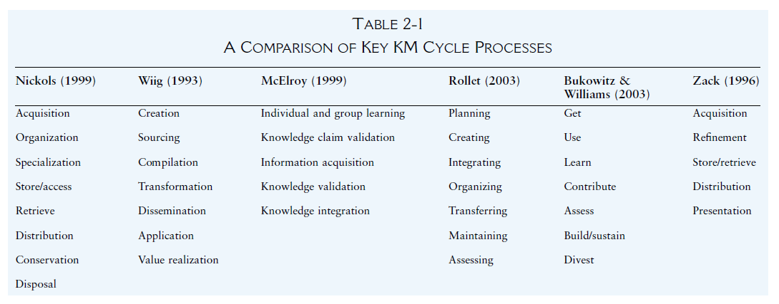
Knowledge Management Cycles

Slide 16
Knowledge Cycle
Innovation Cycle KM Cycle
Collect
Codify
Identify
Classify
Embed
Product/
Process
Knowledge
Repository
Organize/
Store
Create
Share/
Disseminate
Diffuse
Use/Exploit
Access

Slide 17
Knowledge Management Cycle
Creation
Acquisition
Integration
Learning
Categorization
Utilization
Storage
Dissemination

Slide 18
Ernst & Young’s Framework for KM
Input, Purge
Archive, Abstract
Index, Catalog
Coordinate
Content
Storage
Deploy
On-demand
Repeatable
Event-based
Subscription
Commercialize
Monitor usage
Measure satisfaction
Acquire
Engagement based
Non engagement based
External
Add Value
Identify needs
Research
Develop proprietary
Package
Provide Infrastructure
Organization - Culture - Technology - Public Relations
Source: Ernst & Young, and “A Note on Knowledge Management,” Harvard Business School 9-398-031, 1997

Slide 19
1. Two Dimensions of Knowledge Creation
Epistemological
Dimension
Explicit
Knowledge
Current
Focus
Tacit
knowledge
Ontological
Dimension
Individual Group Organization Inter-organization
Knowledge Level
Source: Adapted from Knowledge-Creating Company, p. 57.

Slide 20
2. Knowledge Acquiring
Process of acquiring knowledge from experts and building knowledge base
Narrow perspective
Knowledge acquisition, representation, validation, inference, maintenance
Broad perspective
Process of developing and maintaining intelligent system

Slide 21
3. Knowledge Categorization
Knowledge of products/services
Knowledge of processes/procedures
Knowledge of production technology
Knowledge of customers and markets
Knowledge of your competitors
Knowledge of your own people
Meta-knowledge

Slide 22
4. KM Enabling Storage Technologies
Groupware
Data warehouse and data mining
Expert systems and knowledge based systems
Intranet
Electronic Performance Support Systems
CBT, WBT
Problem/Solution Database (Case-Based Reasoning Systems)

Slide 23
5. Knowledge Transfer/Dissemination
Information
Tradition
Transfers articulated information
Transfers unarticulated and articulated abilities
Independent of the individual
Dependent and independent
Static
Dynamic
Quick
Slow
Codified
Uncodified
Easy mass distribution
Difficult mass distribution
Source: The New Organizational Wealth, p. 45

Slide 24
Knowledge Transfer Via Teams
Initial knowledge
Outcome is realized
Team performs
a job
Outcome compared to action
New knowledge reusable by same team on next job
New experience/ knowledge gained
Knowledge captured and codified in a form usable by others

Slide 25
6. Knowledge Sharing / Utilization
Compensation
Recognition
Ability utilization
Creativity
Good work environment
Autonomy
Job security
Moral values
Advancement
Variety
Achievement
Independence
Social status
Personality
Organizational culture
Vocational reinforcers
Knowledge sharing
Attitude
Company strategies and policies
Work Norms

Slide 26
7. Knowledge Integration
Knowledge integration is the process by which an organization announces new knowledge claims to its operating environment and retires old ones. It produced organizational knowledge to knowledge workers or accommodate newly minted knowledge.

Slide 27
4.3. Knowledge Management Model

Slide 28
1. SECI MODEL
To
Tacit knowledge Explicit knowledge
Tacit
knowledge
Explicit
knowledge
Socialization Externalization
Internalization Combination
From
1 + 1
3
Source: Knowledge-Creating Company, p. 62.

Slide 29
Four Modes of Knowledge Conversion
Socialization:
A process of sharing experiences
Apprenticeship through observation, imitation, and practice
Externalization:
A process of articulating tacit knowledge into explicit concepts
A quintessential knowledge-creation process involving the creation of metaphors, concepts, analogies, hypothesis, or models
Created through dialogue or collective reflection
Internalization:
A process of embodying explicit knowledge into tacit knowledge
Learning by doing
Shared mental models or technical know-how
Documents help individual internalize what they experience
Combination:
A process of systemizing concepts into a knowledge system
Reconfiguration of existing information and knowledge

Slide 30
2. Knowledge Spiral
Dialogue
(Collective Reflection)
Socialization Externalization
Internalization Combination
Linking
Explicit
Knowledge
Field
Building
Learning by Doing
Source: Knowledge-Creating Company, p. 71.

Slide 31
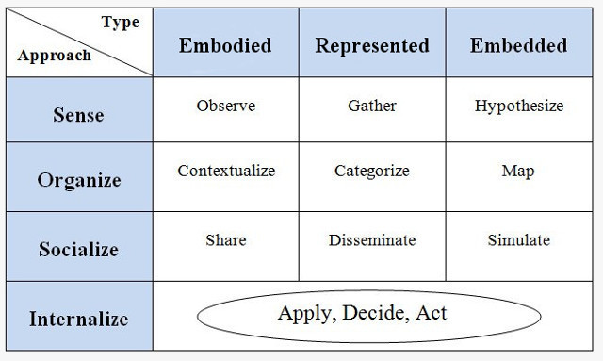
3. The KM Matrix Model by Gamble and Blackwell

Slide 32
This KM model presents a general theoretical framework, as well as specific guidelines for implementation.
The KM process is split into four stages. First management must locate the sources of knowledge. Then they must organize this knowledge so as to assess the firm's strengths and weaknesses and determine its relevance and reusability. This is followed by socialization, where various techniques are used to help share and disseminate it to whomever needs it in the organization. Finally, the knowledge is internalized through use.

Slide 33
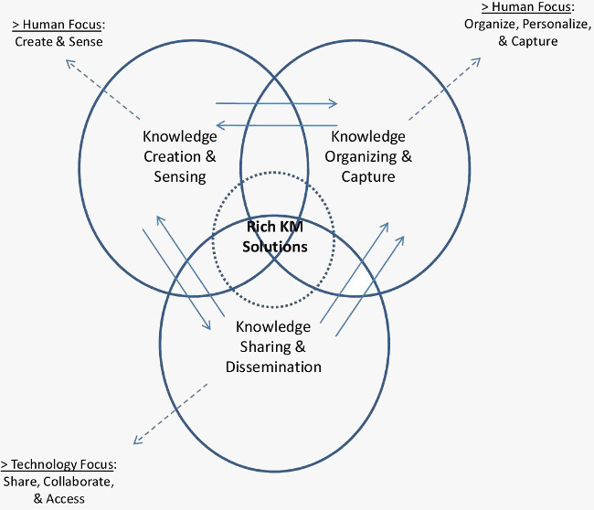
4. The Knowledge Management Process Model by Botha et al

Slide 34
The model further shows which of the three categories are more people oriented and which are more technology focused. Whether or not knowledge sharing should be largely technology focused is certainly debatable and it is something that I will address in future sections.
This is largely how organizations tend to approach the issue i.e. as a technological rather than organizational and social challenge.

