Slide 1
WEEK 5
KNOWLEDGE MANAGEMENT
SOLUTIONS

Slide 2
Chapter Objectives
Understand the concept of knowledge management
Examine knowledge management solutions
Describe four levels of knowledge management solutions:
KM infrastructure
KM mechanisms and technologies
KM systems
KM processes

Slide 3
Knowledge Management
Knowledge management can be defined as performing the activities involved in discovering, capturing, sharing, and applying knowledge so as to enhance, in a cost-effective fashion, the impact of knowledge on the unit’s goal achievement.

Slide 4
Knowledge Resources
The term knowledge resources refers not only to the knowledge currently possessed by the individual or the organization but also to the knowledge that can potentially be obtained (at some cost if necessary) from other individuals or organizations

Slide 5
Knowledge Management Solutions
Knowledge management solutions refer to the variety of ways in which KM can be facilitated
KM infrastructure
KM mechanisms and technologies
KM systems
KM processes

Slide 6
Knowledge Management Systems
Knowledge management systems are the integration of technologies and mechanisms that are developed to support KM processes

Slide 7
An Overview of Knowledge Management Solutions
KM Processes
KM Systems
KM Mechanisms and Technologies
KM Infrastructure

Slide 8
Overview of Knowledge Management Solutions
Knowledge Discovery
Knowledge Capture
Knowledge Sharing
Knowledge Application
KM Processes
Combination
Socialization
Internalization
Externalization
Exchange
Direction
Routines
Knowledge Discovery Systems
Knowledge Capture Systems
Knowledge Sharing Systems
Knowledge Application Systems
KM Systems
KM Mechanisms
Analogies and metaphors
Brainstorming retreats
On-the-job training
Face-to-face meetings
Apprenticeships
Employee rotation
Learning by observation
….
Decision support systems
Web-based discussion groups
Repositories of best practices
Artificial intelligence systems
Case-based reasoning
Groupware
Web pages
…
KM Technologies
KM Infrastructure
Organization Culture
Organization
Structure
IT
Infrastructure
Common Knowledge
Physical Environment

Slide 9
5.1 KNOWLEDGE MANAGEMENT INFRASTRUCTURES

Slide 10
Knowledge Management Infrastructure
Organizational Culture
Organizational Structure
Communities of Practice
Information Technology Infrastructure
Common Knowledge

Slide 11
Organizational Culture
Organizational culture reflects the norms and beliefs that guide the behavior of the organization’s members
Attributes of an enabling organizational culture include understanding of the value of KM practices, management support for KM at all levels, incentives that reward knowledge sharing, and encouragement of interaction for the creation and sharing of knowledge

Slide 12
Organizational Structure
Hierarchical structure of the organization affects the people with whom individuals frequently interact, and to or from whom they are consequently likely to transfer knowledge
Organizational structures can facilitate KM through communities of practice
Organization structures can facilitate KM through specialized structures and roles that specifically support KM

Slide 13
Information Technology Infrastructure
The IT infrastructure includes data processing, storage, and communication technologies and systems
One way of systematically viewing the IT infrastructure is to consider the capabilities it provides in four important aspects:
Reach
Depth
Richness
Aggregation

Slide 14
Common Knowledge
Common knowledge also refers to the organization’s cumulative experiences in comprehending a category of knowledge and activities, and the organizing principles that support communication and coordination
Common knowledge helps enhance the value of an individual expert’s knowledge by integrating it with the knowledge of others

Slide 15
Physical Environment
Physical environment includes the design of buildings and the separation between them; the location, size, and type of offices; the type, number, and nature of meeting rooms
A 1998 study found that most employees thought they gained most of their knowledge related to work from informal conversations around water coolers or over meals instead of formal training or manuals

Slide 16
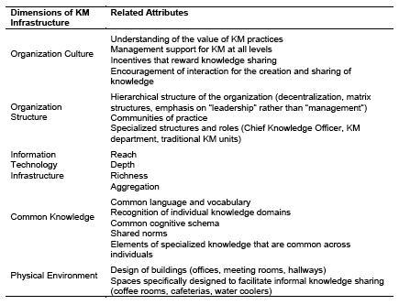
Knowledge Management Infrastructure

Slide 17
5.2 KNOWLEDGE MANAGEMENT MECHANISMS & TECHNOLOGIES

Slide 18
Knowledge Management Technologies
Technologies that support KM include artificial intelligence (AI) technologies encompassing those used for knowledge acquisition and case-based reasoning systems, electronic discussion groups, computer-based simulations, databases, decision support systems, enterprise resource planning systems, expert systems, management information systems, expertise locator systems, videoconferencing, and information repositories encompassing best practices databases and lessons learned systems

Slide 19
Knowledge Management Technologies
Technologies supporting direction include experts’ knowledge embedded in expert systems and decision support systems, as well as troubleshooting systems based on the use of technologies like case-based reasoning
Technologies that facilitate routines are expert systems, enterprise resource planning systems, and traditional management information systems

Slide 20
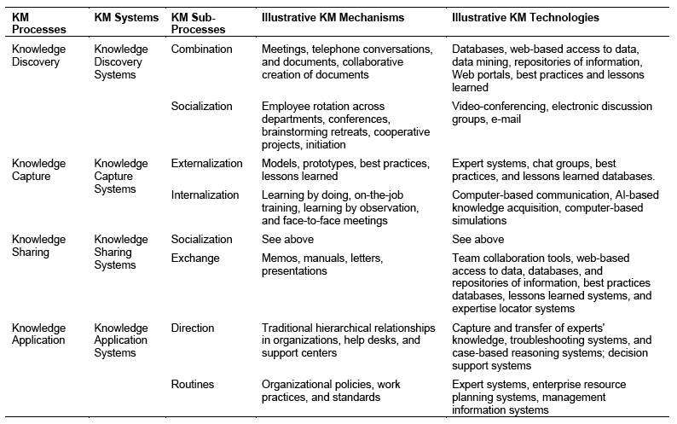
KM Processes, Mechanisms, and Technologies

Slide 21
5.3 KNOWLEDGE MANAGEMENT SYSTEMS

Slide 22
Knowledge Management Systems
KM systems utilize a variety of KM mechanisms and technologies to support the KM processes
Knowledge Management Discovery Systems
Knowledge Management Capture Systems
Knowledge Management Sharing Systems
Knowledge Application Systems

Slide 23
Knowledge Discovery Systems
Knowledge discovery systems support the process of developing new tacit or explicit knowledge from data and information or from the synthesis of prior knowledge
Support two KM sub-processes
combination, enabling the discovery of new explicit knowledge
socialization, enabling the discovery of new tacit knowledge

Slide 24
Knowledge Capture Systems
Knowledge capture systems support the process of retrieving either explicit or tacit knowledge that resides within people, artifacts, or organizational entities
Technologies can also support knowledge capture systems by facilitating externalization and internalization

Slide 25
Knowledge Sharing Systems
Knowledge sharing systems support the process through which explicit or implicit knowledge is communicated to other individuals
Discussion groups or chat groups facilitate knowledge sharing by enabling individuals to explain their knowledge to the rest of the group

Slide 26
Knowledge Application Systems
Knowledge application systems support the process through which some individuals utilize knowledge possessed by other individuals without actually acquiring, or learning, that knowledge
Mechanisms and technologies support knowledge application systems by facilitating routines and direction.

Slide 27
5.4 KNOWLEDGE MANAGEMENT PROCESSES

Slide 28
Knowledge Management Processes
Discovery
Combination
Socialization
Sharing
Socialization
Exchange
Application
Direction
Routines
Capture
Externalization
Internalization

Slide 29
Knowledge Discovery
Knowledge discovery may be defined as the development of new tacit or explicit knowledge from data and information or from the synthesis of prior knowledge
Combination
Socialization

Slide 30
Knowledge Capture
Knowledge capture is defined as the process of retrieving either explicit or tacit knowledge that resides within people, artifacts, or organizational entities.
Knowledge captured might reside outside the organizational boundaries, including consultants, competitors, customers, suppliers, and prior employers of the organization’s new employees

Slide 31
Externalization and Internalization
Externalization involves converting tacit knowledge into explicit forms such as words, concepts, visuals, or figurative language
Internalization is the conversion of explicit knowledge into tacit knowledge. It represents the traditional notion of “learning”

Slide 32
Knowledge Sharing
Knowledge sharing is the process through which explicit or tacit knowledge is communicated to other individuals
Effective Transfer
Knowledge is shared and not recommendations based on knowledge
It may take place across individuals, groups, departments or organizations

Slide 33
Direction & Routines
Direction refers to the process through which individuals possessing the knowledge direct the action of another individual without transferring to that person the knowledge underlying the direction
Routines involve the utilization of knowledge embedded in procedures, rules, and norms that guide future behavior

Slide 34
Conclusions
Described the key aspects of knowledge management
Provided a working definition of knowledge management
Examined knowledge management solutions at four levels
KM infrastructure
KM mechanisms and technologies
KM systems
KM processes

