Slide 1
WEEK 7
IMPLEMENTATION KNOWLEDGE MANAGEMENT

Slide 2
APO KM Tools and Techniques

Slide 3
Objectives
To present and discuss some of the key KM methods, tools, technologies and techniques to be considered for selection within a KM Implementation initiative, especially in Small and Medium Enterprises.
To give more in-depth knowledge so as to assist the National Productivity Organizations (NPO) trainers to become "KM Consultants".
To provide a framework, simple method, and some very practical tools to get started quickly and produce some “Quick Wins”

Slide 4
Agenda
Introduction
APO KM Framework
Mapping KM Tools & Techniques to APO KM Framework
Twenty Essential KM Tools & Techniques
Six Highly Recommended Tools

Slide 5
APO KM Framework

Slide 6
Mapping KM Tools & Techniques to APO KM Framework
5.Tools to
Apply Knowledge
1.Tools to Identify
Knowledge
2.Tools to Create
Knowledge
4.Tools to Share
Knowledge
3.Tools to Store
Knowledge

Slide 7
Twenty Essential KM Tools & Techniques
Brainstorming
Learning’s ideas capture
Peer Assist
Learning Reviews
After Action Reviews
Expert Locator
Communities of Practice
Storytelling
Virtual Work Spaces
Physical Work Spaces
Document Libraries
Knowledge Bases
Knowledge Assessment
Blogs
Social Network services
Voice & VOIP
Advanced Search
Knowledge Clusters
Taxonomy
Knowledge Cafe

Slide 8
1. Brainstorming

Slide 9
What is Brainstorming?
Brainstorming is a simple way of helping a group of people generate new and unusual ideas
It is split into two main phases:
Divergent thinking - generation of ideas
Convergent thinking - selection of ideas
There are some important rules that make brainstorming effective
9

Slide 10
Why use this tool?
It is a powerful means to generate new and unusual ideas
It helps people feel involved in the problem solving process
It is very simple to learn
10

Slide 11
How to do it
Agree who will facilitate the activity
Make sure everyone is aware of the basic guidelines
Ideally, give everyone sticky notes and pens
Write the problem on a flipchart, so that everyone can see it
Ask everyone if they understand the problem - clarify if necessary
If necessary, have a group discussion about the criteria that will be used for idea selection
Ask everyone to write down their ideas (one per sticky note) and hand them to the facilitator, who sticks them on the chart
When the group has run out of ideas, ask them to:
Look for duplicate ideas and combine them
Vote for their favourite ideas - usually by putting a dot on the ideas - based upon the agreed criteria
Pick the highest rated ideas and discuss how they could be implemented
11

Slide 12
Guidelines for brainstorming
Divergent Stage
Defer judgment
Go for quantity
Seek wild and unusual ideas
Combine and associate
Write everything down
Convergent Stage
Improve ideas as you go
Use affirmative judgment
Be deliberate
Seek novelty
Check with your objectives
12

Slide 13
When to use … (and when not)
Brainstorming is useful when you need to generate a large number of options or ideas
It is not appropriate when a problem is known to have a single correct answer that requires careful analysis to determine
13

Slide 14
Where to use
It can be used in any situation where a group (two or more people) can find a space to work together
It can also be used across the internet
14

Slide 15
2. Learning’s and Ideas capture

Slide 16
Mobile & Wireless tools to capture

Slide 17
2. Learning’s and Ideas capture
What is Learnings and Ideas capture?
Why capture Learnings and Ideas?
How to use Learnings and Ideas capture
Personal capture tools
Collective capture tools
Examples
References & links

Slide 18
2. Learning’s and Ideas Capture
What is Learnings and Ideas capture?
Why capture Learnings and Ideas?
How to use Learnings and Ideas capture
Personal capture tools
Collective capture tools
Examples

Slide 19
‘The problem is not a shortage of new learning’s and ideas, but that we do not effectively capture these learning’s and ideas - and that we do not systematically do anything with them'

Slide 20
'The very process of writing down explicitly what you think you have learned, or a new idea, is a fundamental process of knowledge organization that will develop further and refine the tacit knowledge in the individual to the next higher level.'

Slide 21
Personal Capture Tools
Own Memory (vulnerable as the only method)
Notepad (useful but can be fragmented)
Personal paper based organisers (adding more structure)
Personal Digital Assistant (PDA) notes and don’t forget (more structure and electronic storage and dissemination)
Personal Computer – email, notes, documents, databases (more structure and electronic storage and dissemination)
Blogs and K-logs (Knowledge Blogging) - a very powerful way to capture both spontaneous and structured learning’s, ideas and insights
Camera (pictures to add more information and context)
Camcorder (videos to add more information and context)
Voice recorder (to capture speech)
Scanner (to capture documents to computer)
Google Knols (units of knowledge) for writing and sharing articles

Slide 22
Collective Capture Tools
Corporate Communities of Practice, Network Forums and discussion forums
Electronic chat rooms
Corporate Intranet(s)
Internet and Websites
Team (Collective) k-logs (team blogs)
Wiki's
Social Networks (Facebook, Linkedin etc)
Corporate telephone system
Audio conferencing
Video conferencing (and PC based video conferencing)

Slide 23
What to Capture?
The date and time
The person capturing the learning/idea
The situation
The Project or work (code)
The Client or customer (code)
The Location
The context
The new learning or idea or insight
The next step/action

Slide 24
Learning before, during and after
BP’s Knowledge Management Framework
Learning Review
Learn
during
Using
Knowledge
Peer Assist
Learn
before
Learn
after
After Action Review
APO KM Tools and Techniques
Notes:
24

Slide 25
3. Peer Assist

Slide 26
Peer Assist
3. Peer Assist
It is a technique used by a project team to solicit assistance from peers and subject matter experts regarding a significant issue the team is facing.
The purpose is to shorten the learning curve of the project team.
APO KM Tools and Techniques

Slide 27
Peer Assist
Peers Assist
The project leader normally initiates the assistance when assistance is required in the project.
There is no fixed timetable as to when the peers can be called in. Some Peer Assists are called early in a project and some are called later. It depends on the needs of the project team and the complexity of the project.
APO KM Tools and Techniques

Slide 28
4.Learning Review

Slide 29
Learning Reviews
4. Learning Review
It is a technique used by a project team to aid team and individual learning during the work process.
It can be conducted after any identifiable event. An event can be either an entire small action or a discrete part of a larger action e.g. a project-planning meeting.
The purpose is to continuously while carrying out the project.
APO KM Tools and Techniques

Slide 30
Learning Reviews
The learning review revolves around the following four simple questions:
What was supposed to happen?
What actually happened?
Why was there a difference?
What have we learned?
APO KM Tools and Techniques

Slide 31
5. After Action Review

Slide 32
After Action Review (AAR)
5. After Action Review
It is a technique to evaluate and capture lessons learned upon the completion of a project.
Learn from project success and failures to improve future projects.
APO KM Tools and Techniques

Slide 33
After Action Review (AAR)
The following questions can be used to conduct the AAR:
What was expected to happen?
What actually happened?
What went well and why?
What can be improved and how?
What are the lessons that can be used in the future?
APO KM Tools and Techniques

Slide 34
6. Expertise Locator

Slide 35
Expertise Locator (Who’s Who)
6. Expertise Locator
What is Expertise Locator?
Why Expertise Locator? / Why for SMEs?
How Expertise Locator looks like?
How to build and use Expertise Locator?
When to use / not use?
APO KM Tools and Techniques
Notes:
35

Slide 36
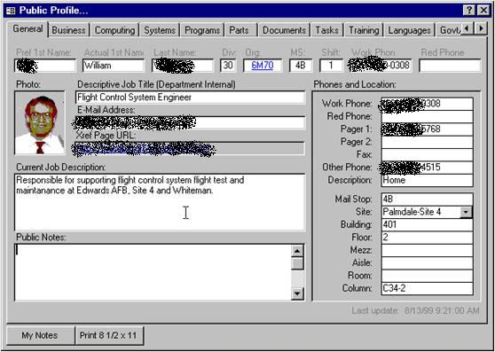
Expertise Locator (Who’s Who)
What is Expertise Locator?
Expertise Locator (Expert Locator, Who’s Who) is an IT tool to connect people who need knowledge and people who own the knowledge.
It also helps building a new team/project by finding right people.
It can be simple electronic yellow pages or a combination of IT and people (often called Knowledge Brokers) who support finding and connecting people.
APO KM Tools and Techniques
Notes:
36

Slide 37
Expertise Locator (Who’s Who)
Why Expertise Locator?
Knowing who knows what is often more valuable than knowing how to do.
To quickly solve any problem that you cannot solve by your own,
to form a good team with right experts,
to generate new ideas…
there are many critical situations when you need to find right people.
Expertise Locator helps finding and connecting right people.
Why for SMEs?
To find right people among many SMEs, especially in the Knowledge Cluster (refer “Knowledge Cluster” section.)
To support retaining and transferring key expertise owned by veteran people.
APO KM Tools and Techniques
Notes:
37

Slide 38
Expertise Locator (Who’s Who)
How Expertise Locator looks like?
It depends on types of knowledge/expertise a firm want to find and connect, but typical EL includes…
- name, photo
contact
experienced work/project
key competences
education/training
human network
APO KM Tools and Techniques
Notes:
38

Slide 39
Expertise Locator (Who’s Who)
How to build and use Expertise Locator?
<Usage>
When you want to find someone who has certain knowledge, you access Expertise Locator and insert key words to find the right person.
<Building>
1. Define Objectives of KM
2. Designing User’s Interface
3. Registering User’s Expertise
4. Maintain the system
APO KM Tools and Techniques
Notes:
39

Slide 40
Expertise Locator (Who’s Who)
When to use / not use?
If everyone in the organization know who knows what, there is no reason to build Expertise Locator. Just ask right questions to the right people when needed.
When one of the key problems in the organization is one does not know who knows what, it may be the opportunity to consider building Expertise Locator.
Again, to find the right people in Knowledge Cluster with many SMEs would be a good opportunity to use Expertise Locator among SMEs.
APO KM Tools and Techniques
Notes:
40

Slide 41
7. Communities of Practice

Slide 42
Communities of Practice
7. Communities of Practice
What are Communities of Practice?
Why CoPs for SMEs?
How to nurture CoPs?
Key Enablers
APO KM Tools and Techniques
Notes:
42

Slide 43
Communities of Practice
What are Communities of Practice?
Definition:
CoPs are groups of people who share a concern or a passion for something they do, and learn how to do it better as they interact regularly. In the context of KM, CoPs are formed -intentionally or spontaneously, to share and create common skills, knowledge and expertise among employees.
Characteristics:
The size varies from 2-3 people to thousands of people, and members of expertise could be either homogeneous or heterogeneous. The following three elements are crucial when one designs CoPs.
The domain: CoP has an identity defined by a shared domain of interest.
The community: A Platform that enables frequent interactions to share and develop common knowledge is essential for CoP.
The practice: Members develop a shared repertoire of resources: experience, tools, ways of addressing recurring problems -in short, a shared practice.
APO KM Tools and Techniques
Notes:
43

Slide 44
Communities of Practice
Why CoP for SMEs?
To effectively share and develop skills and knowledge among employees without huge investment
To solve problems effectively by sharing knowledge.
To give opportunities to exchange best-practices on a common subject
To increase employee’s satisfaction and retain valuable workforce
Share common skills and knowledge across your company
To accelerate innovation by forming CoP with people from various backgrounds
APO KM Tools and Techniques
Notes:
44

Slide 45
Communities of Practice
How to nurture Communities of Practice?
1. Find opportunities around strong needs: CoPs work well when strong need for sharing common interest/passion/knowledge exist. Find opportunities to connect people and share knowledge that make a difference.
2. Invite passionate people and take in their thoughts: To design a good CoP, you need key people who play a role of steward in the CoP. He/she is usually very passionate and knowledgeable on the subject. Then you discuss the CoP design with them with the following focuses:
- What is the strategic context of the COP?
- What is the key knowledge to share and create?
- Who are potential participants benefiting from and contributing to the COP?
- What are key activities that sustain vigor of the COP?
- Where can community members physically (and virtually) interact?
- What are key values for both the organization and participants?
3. Launch the COP with socializing events: Development of any COP always start at people’s social relationship. One easy way is to use existing social network, which is often becomes a core group of the CoP.
4. Create results through activities and share the stories: You need key activities that sustain vigor as well as produce results of the community.
APO KM Tools and Techniques
Notes:
45

Slide 46
Communities of Practice
Key Enablers
Stewards:
Key people who have passionate for the area and are willing to take care of the COP are the most important component of any CoPs.
Incentives:
Spontaneous motivation for continuous participation is essentially needed to sustain active CoPs.
Physical/virtual spaces:
CoPs need spaces where members can interact.
Information Technology:
Some CoPs do not require any IT, whereas IT is a key platform to share knowledge.
Management’s support:
Management’s support not only allows participants to understand the importance of CoP activities but gives sufficient resources.
APO KM Tools and Techniques
Notes:
46

Slide 47
8. Storytelling

Slide 48
8. Storytelling
What is storytelling?
Why use storytelling?
When to use?
How to use?

Slide 49
Storytelling
What is storytelling?
Why use storytelling?
When to use?
How to use?
APO KM Tools and Techniques
Notes:
49

Slide 50
Storytelling
What is storytelling?
Storytelling is conveying of events in words and sounds often by improvisation or embellishment. In the context of KM, storytelling has been used as a powerful way to share and transfer knowledge, especially experiential and tacit knowledge.
It is literally about telling a story; a person who has knowledge tells stories of his/her experience in front of people who want the knowledge. Though the method is quite simple, storytelling is able to share deep knowledge when it is appropriately done. It has a strong power to share one’s experience and lessons learned since effective stories can convey rich contexts along with contents.
APO KM Tools and Techniques
Notes:
50

Slide 51
Storytelling
Why use storytelling?
1. Transfer tacit part of knowledge:
Because it conveys much richer contexts through stories than other means of KM, storytelling by a vastly-experienced person in any field has the power to transfer his or her experiential knowledge.
2. Nurture good human relationship:
When someone tells his/her story, the action also conveys significant volume of the storyteller’s personal information through the story itself, facial expressions, tone of voice etc. This aspect nurtures trust among the storyteller and audiences that often becomes a seed bed for a community of the practice, which enables further sharing and creating of knowledge.
3. Bring out passion of audiences:
Great part of storytelling is that it is able to address logical as well as emotional part of brain. As a result, good storytelling can change people’s mindset and behavior to share and create more knowledge than before.
APO KM Tools and Techniques
Notes:
51

Slide 52
Storytelling
When to use?
Many organizations utilize storytelling to transfer experts’ knowledge to younger people.
Some organizations use storytelling to share lessons learned from project to colleagues who were not participating in the project.
Since storytelling session may rouse participants’ interest and let audiences find other people with common interest, designing following systems to discuss the topic such as communities of practices or virtual collaboration spaces which sustain and increase the advantage created through the storytelling session.
APO KM Tools and Techniques
Notes:
52

Slide 53
Storytelling
How to use?
Step 1: Identify key area of knowledge to transfer and share in your firm.
Step 2: Find the right person who has rich experience and ask him/her to tell the story. The storyteller’s eagerness and eloquence are keys for success.
Step 3: Market the storytelling session to candidate participants.
Step 4: Hold the session. It is may be effective to create informal atmosphere by changing layouts, serving refreshments, holding icebreaker etc. You may want to hold a small social gathering after the session to help networking.
Step 5: Leverage the output of the storytelling session. This step is critical to maximize the effectiveness of storytelling.
- Capture and share the movie of the session among employees.
- Form a community of the topic among the storyteller and participants who have interest. The storyteller often becomes the owner of the community.
- Hold sessions regularly to give employees chances to both participate and tell a story.
APO KM Tools and Techniques
Notes:
53

Slide 54
9. Collaborative Virtual Work Space

Slide 55
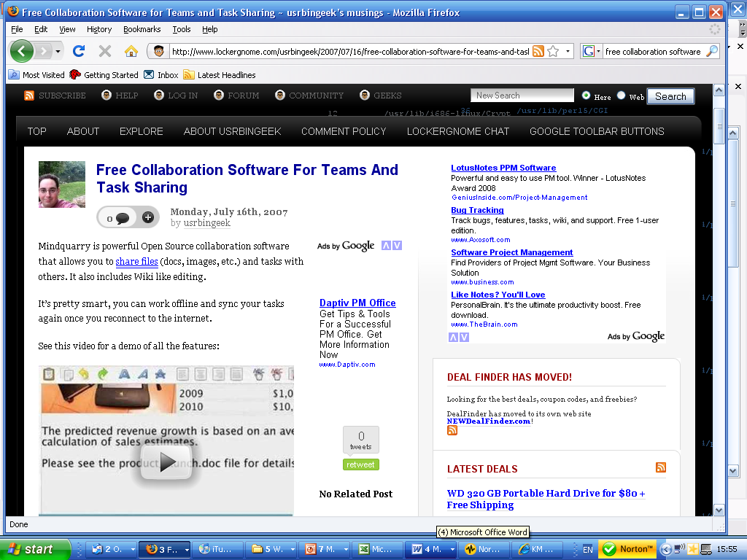
Collaborative Virtual Workspaces

Slide 56
What is it?
Collaborative virtual work spaces enable people to work together, irrespective of where they are physically located
They involve a combination of document sharing, collaborative editing, and audio/video conferencing
Although suppliers offer software packages that contain all these elements, many users assemble their own collection of tools to meet their specific needs
56

Slide 57
Why use this tool?
It allows organisations to access the best skills, anywhere in the world
It can dramatically reduce travel costs
It allows people to work when and where is most effective for them, as well as giving them access to information when they need it
57

Slide 58
How to use
Start with the people. The tools will tend to amplify existing work practices. Therefore, before introducing virtual tools, it is important that any work group, or team, reviews its work practices and reflects on how it would work ideally.
Make sure the technology is up to the job. Poor quality equipment, e.g. slow internet links, or poor quality audio / video will create a negative experience for users, and will discourage them from future use.
Train users at the appropriate time. Training is important for successful implementation. However, it should be provided as close to the intended use of the tools, as possible.
Start with human-centred tools. Audio and video conferencing build on natural human behaviour. They also offer immediate benefits that - if the quality is good enough - save people time and stress.
Introduce collaborative content creation in association with the audio/video conferencing, so that it builds on top of the existing experience, and allows the more experienced users to offer immediate assistance to their colleagues.
58

Slide 59
When to use … (and when not)
Virtual workspaces are rapidly becoming an essential part of many organisations’ work practices. And, this trend is likely to continue. It is therefore important to identify the situations where this approach may be inappropriate. The key situations would include:
Poor internet connections. Although various software tools enable people to work in poorly connected environments, if the connection proves to be too much of a barrier, the frustration caused to the users may outweigh the benefits of virtual working.
The task requires direct physical collaboration. Although fashion design is increasingly being supported through virtual tools, there will be a range of tasks that genuinely require physical co-location.
Security and privacy are paramount. In situations where privacy is absolutely essential, for example the relationship between doctor and patient, co-location may be essential.
59

Slide 60
Example
A powerful collaboration suite can be assembled through combining Skype (for audio video conferencing) with the Google Docs collaborative editing system. The resulting combination allows teams to jointly author documents, discuss action plans and capture their key knowledge in a wiki. The total package is available for free, and needs relatively low speed internet connections.
Moving up one level, in both cost and capabilities Adobe Connect Pro. This integrated suite enables teams to create documents, and discuss their decisions, but also offers additional features such as screen sharing, team break-out rooms, voting, and meeting management. The entire system runs on the Flash plug-in and is therefore available on the vast majority of PCs, without any further installation required.
Teleplace is an example of the state-of-the-art in virtual collaboration. The system provides a very powerful three-dimensional world that supports the full range of collaboration, in an immersive environment. Although the system is very simple to use, it is also likely to require more training for the users to fully exploit the power.
60

Slide 61
10. Collaborative Physical Work Space

Slide 62
Collaborative Physical Workspace
10. Collaborative Physical Workspaces
Why Physical Workspace as a KM tool?
Example 1: Open space for ad-hoc/informal interactions
Example 2: Space for team collaboration
Example 3: Space for prototyping
Tips for Physical Workspace Design
APO KM Tools and Techniques
Notes:
62

Slide 63
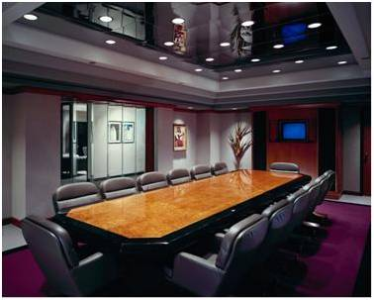
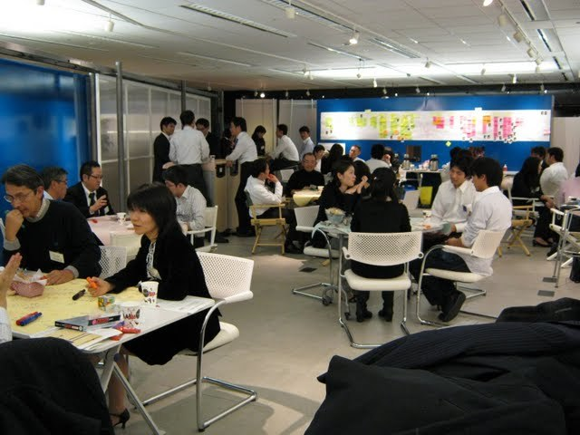
Collaborative Physical Workspace
Why Physical Workspace as a KM tool?
When we share or create knowledge, we usually interact with other people through face-to-face communication –we discuss, dialogue, or simply just ask a question. Physical workspace is where such human interactions take place – and it can support knowledge sharing/creation if it is well-designed.
Do you think you can have creative discussion in this room?
What about this space?
APO KM Tools and Techniques
Notes:
63

Slide 64
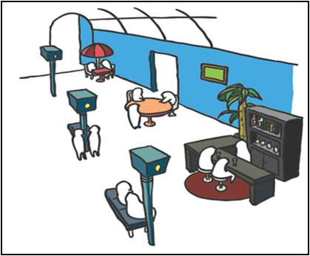
Collaborative Physical Workspace
Example1: Open space for ad-hoc/informal interactions
Sometimes, unexpected interactions generate unexpected (good) results. Good open space encourages such ad-hoc, informal interactions among employees, or even between staff and customers.
The key for encouraging such ad-hoc interactions through physical space is to create reasons for employees to come to commons: could be coffee and snacks, magazines and books, or mail boxes and printers to pick up letters and copies.
APO KM Tools and Techniques
Notes:
64

Slide 65
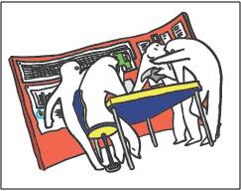
Collaborative Physical Workspace
Example2: Space for team collaboration
A meeting room is not necessarily a good place for team collaboration. Any good collaborative space has a lot of small, but well-thought devices.
For instance, walls of a room can support collaboration significantly by putting information to visualize contexts of the project. You do not have to invest in IT, but just simply use papers and magnets to turn walls into collaborative tools.
APO KM Tools and Techniques
Notes:
65

Slide 66
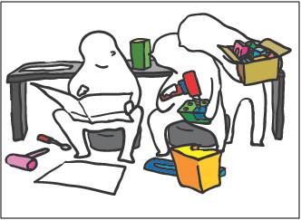
Collaborative Physical Workspace
Example3: Space for prototyping
Ideas can only turn into value when they are put into actions. Does your organization have a physical space for that?
Space for prototyping is where people can experiment their ideas. If you are in manufacturing industry, probably you need some equipment for quick and dirty prototyping in the room.
APO KM Tools and Techniques
Notes:
66

Slide 67
Collaborative Physical Workspace
Tips for Physical Workspace Design
Producing creative workspace does not always lead knowledge creation, unless members who use the space understand and become enthusiastic about the concept of how to work in the environment.
Thus, you need to discuss how they want to work and how physical space can support the way of work among members who use the space.
One good start would observe how employees are actually working to find opportunities to support their behaviors that can lead more knowledge creation and sharing.
APO KM Tools and Techniques
Notes:
67

Slide 68
11. Document Libraries

Slide 69
Google Docs

Slide 70
Document Libraries
What are Document Libraries?
Why use Document Libraries?
How to use Document Libraries
Examples

Slide 71
12. Knowledge Bases & Wiki’s

Slide 72
Knowledge Bases

Slide 73
Knowledge Bases
What is a Knowledge Base?
Difference between a knowledge base and a database?
Knowledge Bases and Wikis
Structured and unstructured Knowledge Bases
Why use a Knowledge Base?
How & When to use a Knowledge Base
Examples
References & links

Slide 74
Wikipedia

Slide 75
13. APO Knowledge Assessment Tool

Slide 76
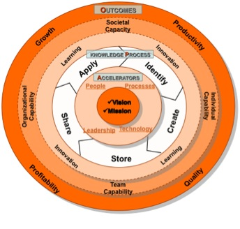
APO Knowledge Assessment Tool
APO Knowledge Assessment Tool
It is a tool designed to help organizations conduct an initial and rapid assessment of its readiness for KM.
The APO KM Assessment Tool is based on the APO KM Framework.
APO KM Tools and Techniques
Notes:
76

Slide 77
APO Knowledge Assessment Tool
APO Knowledge Assessment Tool
There are seven audit categories in the APO KM Assessment Tool based on the key elements of the Framework:
KM Leadership
Process
People
Technology
Knowledge Processes
Learning and Innovation
KM Outcomes
APO KM Tools and Techniques
Notes:
77

Slide 78
14. Blogs

Slide 79
Blogs

Slide 80
What is a Blog?
A blog is a very simple 'journal style' website that contains a list of entries. The entries are typically short articles, or stories, often relating to current events, and potentially containing photographs, videos and audio recordings, as well as text.
The content of a blog may be created by a single author, or, in the case of some of the more popular blogs, a whole collection of writers.
Although any web site could call itself a blog, there are several features that are generally found in blogs. These are:
The content is essentially linear. Stories, and items, are added to a growing list, and readers can scroll through the list to see how the author(s) thoughts have developed.
The blog has a focus. This is interpreted very liberally - people's blogs wander across a whole range of topics.
The blog usually has a mechanism through which readers can comment on items.
The blog publishes an electronic index that allows people to automatically be aware when something new has been added.
80

Slide 81
Why use this tool?
Blogging offers at least three distinct benefits:
The software used to host blog sites is usually very easy to use. This means that people can create simple websites in just a few minutes.
The process of writing blog entries is one of the easiest ways of engaging in knowledge capture, and sharing.
The simplicity of the blog sites, coupled with the ability for readers to be automatically notified of new entries, makes the process of knowledge distribution very simple.
In essence, blogs offer an easy way for individuals, teams, and entire organisations, to capture and publish information about specific topics. And, to make this information available, automatically, to as wide an audience as they want.
81

Slide 82
How to use
Decide who you are writing for, and what tone you wish to adopt. For instance, do you wish to be very formal, or more informal? It is well worth reading a number of blogs to see the range of ways in which people communicate.
Decide what topic(s) your blog will cover.
Agree who will write entries.
Decide how you wish to promote your blog. One of the simplest ways is to start adding relevant comments on other people's blogs, with links back to your own articles.
Create the blog. If you are in a larger organisation, you may wish to discuss the options with your IT department.
Create your first entries.
Keep going. Blogs are all about the ongoing creation of useful content.
82

Slide 83
When to use … (and when not)
Blogging is a useful and appropriate tool for communicating with a wider audience. They have also been used as personal journals, without any intended audience beyond the author.
Over time, the contents of a blog can build up to become a very useful, searchable knowledgebase.
A blog should not be used for information that needs to be revised frequently. A Wiki is a more appropriate tool for that problem.
83

Slide 84
Example
There are, quite literally, millions of blogs.
Try looking at some of the entries listed in All Tops to get an idea of a different range of blogs that are popular.
84

Slide 85
15. Social Networking

Slide 86
Social Networks - Facebook

Slide 87
What is Social networking?
A social network is a group of people who share a common area of interest.
Social network services are online systems that support social networking. The core services they offer usually include:
Finding people who have similar interests or needs
Aggregating people into groups, or subgroups, and being able to communicate with those groups
Sharing content such as documents, links to relevant websites, or even streaming video
87

Slide 88
Why use this tool?
Social networks can be very powerful knowledge sharing tools. A well targeted network can provide its members with access to highly relevant knowledge, connections and advice.
In a business setting, the knowledge sharing allows companies to have a much closer relationship with customers, and potential customers.
Internet-based social networking has opened up a totally new way of managing customer relationships.
88

Slide 89
How to use
Steps for getting involved in a social network would therefore look like this:
Identify the topics you wish to network on.
Search the major social networks to see if there are any existing groups. We recommend exploring Facebook and LinkedIn as good starting points. If you want to use social networking as part of your strategy to service your customers more effectively, you are likely to both join relevant existing networks, and to start a new one specifically dedicated to your business.
Join a network, and read through some of the previous discussions, in order to understand the tone and level. Many social network sites have different discussion areas depending upon, for example, people's level of expertise.
Once you feel comfortable in a network, join in the discussions, and start to make connections.
If you want to start your own network, because your specific areas of interest are not being well covered, it is often easiest to simply propose the new network within the discussion areas of your existing network. If enough people share your interest, it is usually very simple to create a new space.
Content is king. Your new network needs to be valuable to its members. This means that you, and your colleagues, need to work hard at finding relevant content, encouraging discussion, and welcoming new members.
89

Slide 90
When to use … (and when not)
Social networks offer cheap and effective tools for knowledge sharing. If knowledge is important to your organisation, there is almost certainly a network that you should be part of.
In addition, the networks offer new ways to build deeper relationships with current and future customers.
However, social networks, by their very nature, are designed to encourage discussion. If customers like your products, they will talk about them, and if they don't, they will probably shout about them. Many companies have been shocked at the strength of feeling that can be generated through social networking sites.
90

Slide 91
Example
The Ecadamy was one of the earliest social networks dedicated to business and business relationships.
The network provides a useful example of what can be achieved through professional networks.
91

Slide 92
16. Video and VOIP

Slide 93
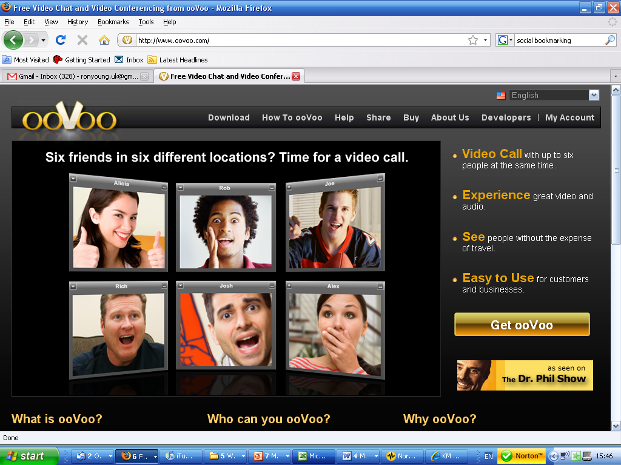
VOIP - Videoconferencing

Slide 94
What is it?
In very simple terms, the internet is now capable of sending both audio and video signals between computers, using nothing more than a broadband connection, and some low cost equipment such as a webcam, and a headset. This capability is often referred to as VOIP. You can read more about it in this Wikipedia article.
The adoption of broadband has lead to the creation of a number of companies that offer various VOIP services. In general, they all offer, instant messaging, voice transmission, and many of them provide video calls as well.
The cost of the service varies from company to company. However, almost all of the providers offer free computer-to-computer audio, and many of them provide free one-to-one video calls.
94

Slide 95
Why use this tool?
VOIP offers a free, or very low cost, means of calling people anywhere in the world - provided that they have a suitable internet connection.
When combined with video calling, the service offers a significantly richer form of communication.
The addition of screen sharing allows people to deliver presentations, and e-learning, at very low cost, and with surprisingly high levels of interaction.
95

Slide 96
How to use
Select the service you wish to use. Skype is probably the most popular provider, and is available on many different operating systems and devices. It is certainly possible to be subscribed to several different services, at the same time.
Make sure that your computer is suitable. Typically, this means having a webcam and a pair of headphones. Webcams that support 640 by 480 pictures provide significantly better image quality, and are recommended.
Register with your selected service(s). This is normally no more than a few minutes work.
Download and install the software.
Make a test call.
Publicise your new service to your colleagues.
96

Slide 97
When to use … (and when not)
Given the cost advantages of VOIP, combined with the benefits of video calling, the key question should probably be "when wouldn't one use VOIP"? There are several times when it would make sense to use an existing telephone, or video conferencing, system.
Legality – there are a number of countries in the world that are currently protecting the existing -- government-owned -- telephone provider. In those countries, it may be illegal to use VOIPs.
Call quality – in general the quality of calls via the Internet is at least as good as those via the traditional telephone system, and often significantly better. However, quality varies over time.
Video quality – VOIP video quality can also vary over time. So, if the quality of the image is important to you, for instance if you're giving a presentation to a large audience, you may choose to use one of the dedicated videoconferencing systems that can guarantee image quality -- for a price!
Firewalls – your organisation may use firewalls to limit the access of software both into and out of your organisation. It is therefore possible that the VOIP software may not work at all.
Mobility – in general, VOIP is associated with computers. If you are choosing to travel without a computer, or, you don't have Internet access, you will need to fall back on the traditional telephone service.
97

Slide 98
Links
The following organisations represent a subset of companies who offer VOIP services:
Skype
ooVoo
Apple
Google
Yahoo
98

Slide 99
17. Advanced Search Tools

Slide 100
Advanced Search

Slide 101
What is it?
Almost everyone who has used the world wide web will, at some point, have used a search engine.
However, very few users take advantage of the advanced search tools that are offered by most of the search engines.
Understanding these tools can result in a significant improvement in the quality of search results.
101

Slide 102
Why use these tools?
Getting the right information can be a hit or miss affair.
Knowing how to use the search tools, to narrow down the options, is an important skill for any knowledge worker.
102

Slide 103
How to use
The advanced commands will differ between the search engines. However, the basic principles are common. For simplicity, we are using Google to demonstrate the main tools that we recommend:
To search for the exact phrase, put the text in double quotes. For example, "Association of South East Asian Nations" will only find documents with that exact phrase.
To limit your search to a specific web site, use the word site:. For example to search for GDP figures within the ASEAN site, you would enter GDP site:aseansec.org
To exclude certain words from a search, put a minus sign in front of the word. For example, if you want to search for Lotus, but not lotus cars, you would enter lotus –cars.
You can search for phrases that contain some words you are not worried about, by replacing them with the * symbol. The * will then match any word. For example, a search for How to * a car will produce information on how to drive, wash, sell, make or donate a car.
103

Slide 104
When to use … (and when not)
Advanced search tools are powerful, and easy to use.
You should consider using them if:
You are having difficulty finding the information you are looking for
You want to make sure that you are retrieving as complete a set of data as possible
104

Slide 105
18. Knowledge Clusters

Slide 106
Knowledge Clusters
What are Knowledge Clusters?
Why use Knowledge Clusters?
How to develop a Knowledge Clusters
Examples

Slide 107
19. Taxonomy

Slide 108
Taxonomy
19. Taxonomy
A taxonomy is a technique that provides the structure to organize information, documents, and libraries in a consistent way.
It assists people to navigate, store and retrieve needed data and information across the organization in an efficient way.
APO KM Tools and Techniques

Slide 109
Taxonomy
Example of a Taxonomy
APO KM Tools and Techniques

Slide 110
20. Knowledge Cafe

Slide 111
Knowledge Café’s
What is a Knowledge Cafe?
Why use Knowledge Café’s?
How to use Knowledge Café’s
Examples

Slide 112
Six Highly Recommended KM Tools and Techniques
Knowledge Worker Competency Plan
Knowledge Mapping
Knowledge Portal
KM Maturity Model
Video Sharing
Mentor / Mentee Scheme

Slide 113
21. Knowledge Worker Competency Plan

Slide 114
Knowledge Worker Competency Plan
What is a Knowledge Competency Plan?
Why develop Knowledge Competencies ?
How to develop Knowledge Competencies
Examples

Slide 115
22. Knowledge Mapping

Slide 116
Knowledge Mapping
What is a Knowledge Map?
Why develop Knowledge Maps ?
Examples

Slide 117
23. Knowledge Portal

Slide 118
Knowledge Portal
What is a Knowledge Portal?
Why develop Knowledge Portals ?
Examples

Slide 119
24. KM Maturity Model

Slide 120
KM Maturity Model
What is a KM Maturity Model?
Why develop KM Maturity Models ?
Examples

Slide 121
25. Video Sharing

Slide 122
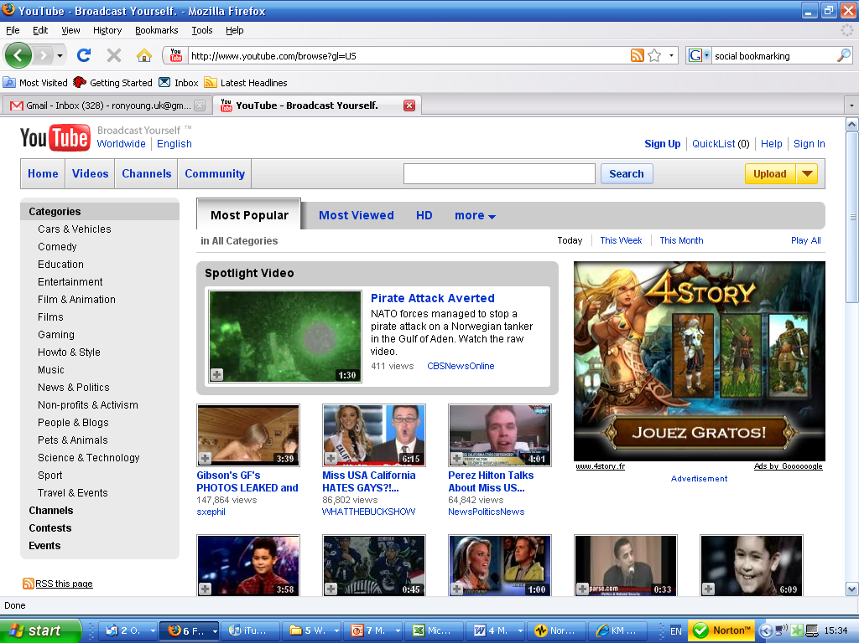
Video Sharing - YouTube

Slide 123
Video Sharing
What is Video Sharing?
Why Video Share ?
Examples

Slide 124
26. Mentor / Mentee Scheme

Slide 125
Mentor / Mentee Scheme
What is a Mentor / Mentee Scheme?
Why conduct a Mentor / Mentee Scheme ?
Examples

