Slide 1
PROSES PENELITIAN

Slide 2
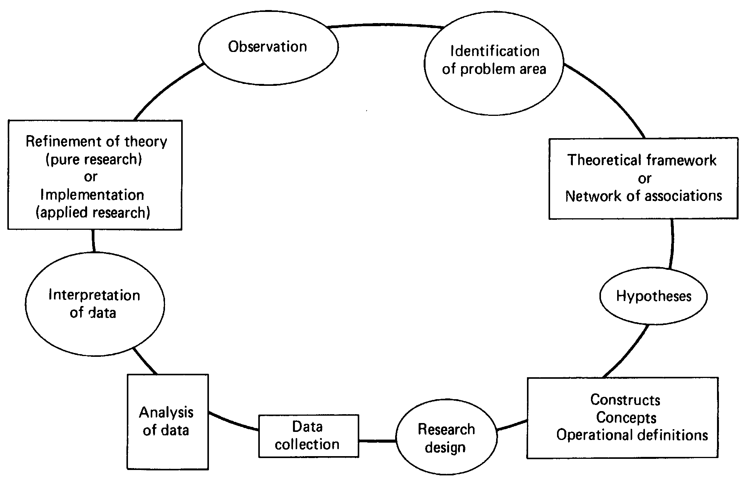
The Hypothetico-Deductive Method

Slide 3
Observation
Identification of problem area
Theoritical framework or Network of associations
Refinement of Theory
(pure research)
Or
Implementation (applied research)
hypotheses
Interpretation of Data
Analysis of Data
Construct Concepts Operational definitions
Data Collection
Research Design

Slide 4
Pengumpulan
Data Awal
Observasi
Topik Penelitian
Perumusan Masalah
Tidak
Kerangka
Teori
Hipotesis
Desain
Risert
Laporan
YA
Presentasi Laporan Hasil Penelitian
Data
Logika
Deduktif
Pengambilan Keputusan Manajerial

Slide 5
Topik Penelitian
BROAD AREA
Variabel Penelitian
Kerangka Teori
Rumusan Masalah
Pengumpulan Data
Metode Analisis
Pengolahan Data
Interpretasi Hasil
FOCUS

