Slide 1
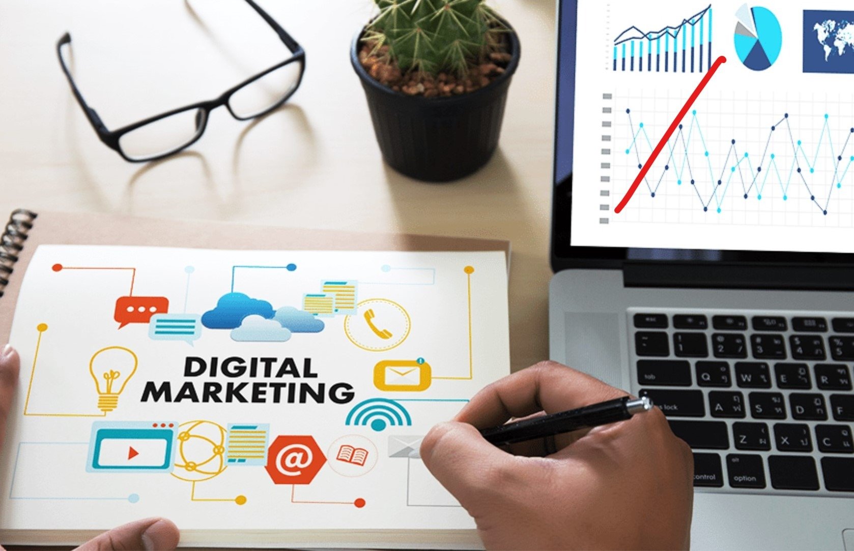
Digital Marketing
Prepared for
Magister Management Class
Esa Unggul University
Prepared by
Diana Fajarwati

Slide 2
About Me
Diana Fajarwati
Major Working Experience
2008 – Now : Prompt Research
2014 – Now : The Partner Consulting
Education
2007 : S2 Marketing UI
2016 – Now : Doctoral Program di Strategic Management UI

Slide 3
Lecturer Planning
Marketing Management Material conduct in 14 sessions
The methods : lecturer presentation; case study analysis; student presentation; practical exercise
Making group with 2 members
Time Planning
60 minute : 2 groups presentation, including Q&A
90 minute : Main presentation, Case Analysis and Q&A

Slide 4
Syllabus
The first half of semesters will explore the digital marketing concepts
1
Marketing in Digital World
4
Digital Tools for Effectively Distribution
7
Digital Analytic for Marketing Professional #1
What is Digital Marketing
History of Digital Marketing
The Changes of Consumer Behavior
Basic Concept: Place
Digital Concept: New Retail
Digital Concept: 3D Printer
Pengumpulan data-data sosial media
Kerangka analisa
Visualisasi data
2
Digital Tools for Developing Innovative Product
5
Digital Tools for Setting Right Price
8
Marketing in an Analog World
Basic Concept: Product
Digital Concept: Customer Co-Creation
Digital Concept: Doppelgänger Brand
Basic Concept: Price
Digital Concept: Pay what you want
Digital Concept: Pricing comparison tools
Analog vs Digital
4 cara dunia analog mempengaruhi digital
Transformasi analog ke digital
3
Digital Tools for Persuading Costumers
6
Digital Analytic for Marketing Professional #1
Basic Concept: Promotion
Digital Concept: Authenticity
Digital Concept: User-Generated Content
Memahami berbagai web analytics
Kerangka analytic dan memilih web analytic yang tepat

Slide 5
Syllabus
…… while the second half of semester will exercise some online tools
9
Set Up Market Research
4
Search Engine Marketing
7
E-Commerce/ Marketplace
Web analytic type and usage
Exercise : Google Analytics
Concept of SEO
Exercise : creating keyword, text search
E-commerce concept
Exercise : Lazada account
10
Email Marketing
5
Video Marketing
8
Wrap Up
Why company need e-mail marketing to growth the business
Exercise : MailChimp
Element and content of attractive video marketing
Exercise : creating YouTube account
Summary all the subject
Finale assignment
3
Display Marketing
6
Social Media Marketing
Introduction wordpress, wix, weeby
Exercise ; creating own website
Different form of social media, the rule of engagement
Exercise : Facebook Marketing

Slide 6
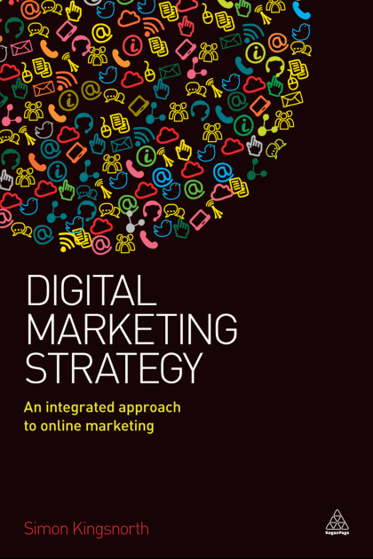
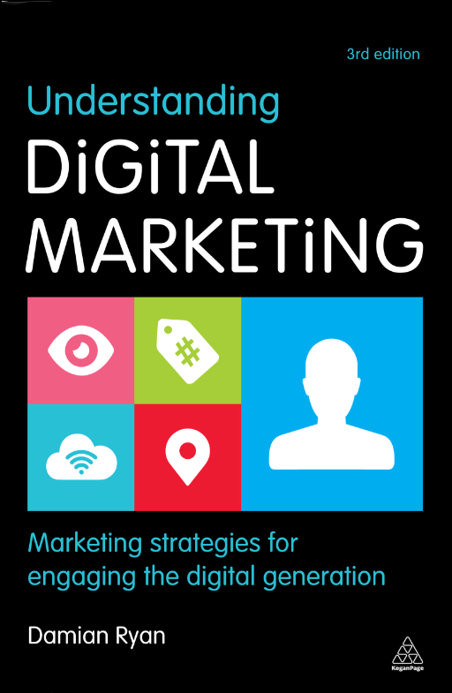
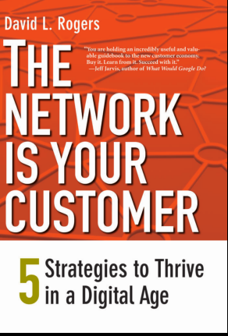
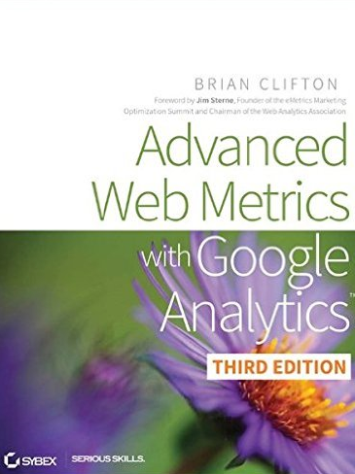
Book References

Slide 7
Section 1 Marketing in a Digital World
Digital Marketing
Prepared for
Magister Management Class
Esa Unggul University
Prepared by
Diana Fajarwati

Slide 8
Syllabus
The first half of semesters will explore the digital marketing concepts
1
Marketing in Digital World
4
Digital Tools for Effectively Distribution
7
Digital Analytic for Marketing Professional #1
What is Digital Marketing
History of Digital Marketing
The Changes of Consumer Behavior
Basic Concept: Place
Digital Concept: New Retail
Digital Concept: 3D Printer
Pengumpulan data-data sosial media
Kerangka analisa
Visualisasi data
2
Digital Tools for Developing Innovative Product
5
Digital Tools for Setting Right Price
8
Marketing in an Analog World
Basic Concept: Product
Digital Concept: Customer Co-Creation
Digital Concept: Doppelgänger Brand
Basic Concept: Price
Digital Concept: Pay what you want
Digital Concept: Pricing comparison tools
Analog vs Digital
4 cara dunia analog mempengaruhi digital
Transformasi analog ke digital
3
Digital Tools for Persuading Costumers
6
Digital Analytic for Marketing Professional #1
Basic Concept: Promotion
Digital Concept: Authenticity
Digital Concept: User-Generated Content
Memahami berbagai web analytics
Kerangka analytic dan memilih web analytic yang tepat

Slide 9
What is Marketing ?
“Process by which individuals and groups obtain what they need and want through creating and exchanging products and value with others”
Kotler 1991
Simply put:
Marketing is the delivery of customer satisfaction at a profit.

Slide 10
What is Digital Marketing ?

Slide 11
Digital Marketing ≠ Online Marketing
Digital marketing is often confused with online marketing.
Online marketing stressing on the web presence : SEO; email marketing; CRM
As we moved into the 21st century most businesses had, or were in the final throws of, developing a web presence
The Digital Marketing Driver Factors :
Social Media growing
Exploitation of digital device (included touch screen; Bluetooth; sensor) >> beyond online system
Broadband speed and usage
Analytic capability >> understand the consumer behavior real time
The rise of millennial generation
Digital is now much broader than the online channels of 15 years ago and must be embedded into everything we do

Slide 12
The History of Digital Marketing
Web 1.0 : 1990
Static content
Few interaction and no real communication
web crawler > beginning SEO
Web 2.0 : 1999
Google started to growth >> launched Blogger
Introduction google ad word
Cookies
Web 3.0 : 2007
Social Media Era
FB; Twitter; IG; Pinterest; Skype was born
Industry 4.0 : 2012
The rise of digital device : sensor
Personalizing experience

Slide 13
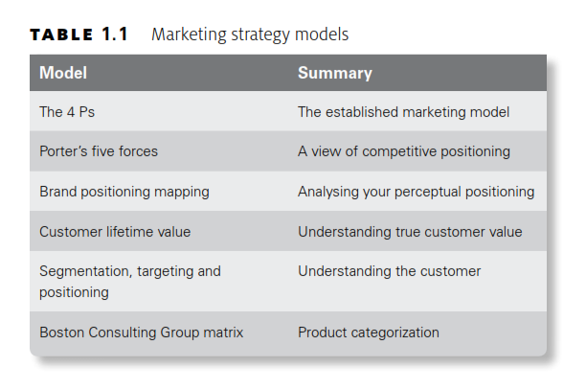
Marketing Strategy Model

Slide 14
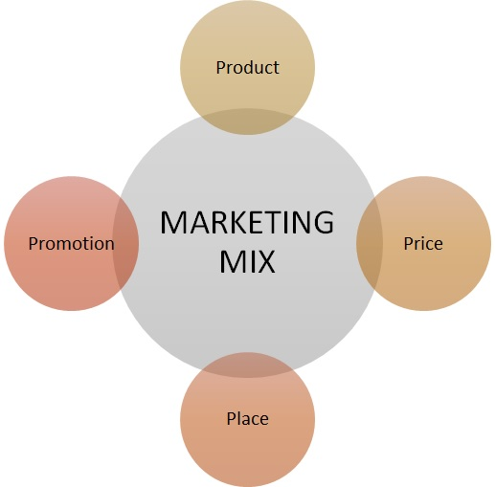
The 4Ps of Marketing

Slide 15
Product
Key Consideration :
Whether your product can/will sell online
What channels are open to you for your product or proposition?
Are there opportunities to make it flexible to be more appropriate for the online or mobile audiences?
Does it provide real value for the consumer and is it differentiated from your competitor offerings?
Are there features of it that can be added or should be excluded for the digital customer and is it fair to do this?

Slide 16
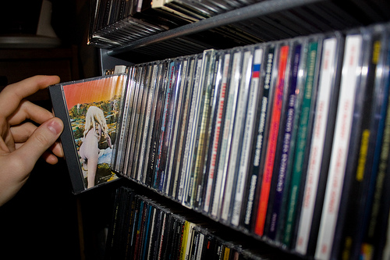
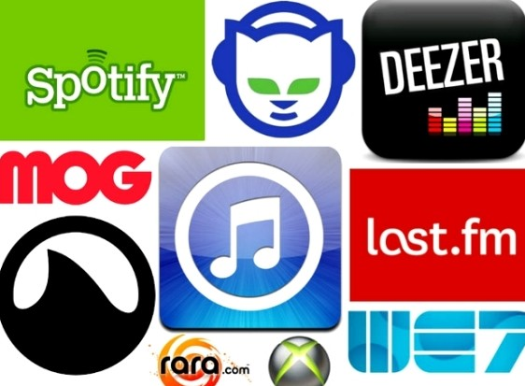
Music, distributed through 3 channels
Streaming
CD Music
Download
The Marketers should understand different motivations and usage habits for these products is vital to getting your marketing right in the digital age

Slide 17
Price
Understanding price elasticity and competitive positioning
Discounts and offers are certainly not new to digital marketing
Some consideration on Pricing in Digital Era :
Fast price comparison
Cashback and voucher sites have certainly changed consumer behaviours
Affiliate marketing programmers.
promote your products through a third-party website in exchange for paying a commission or fee to the website when an action is taken.

Slide 18
Place
Location, location, location
You may not have a physical shop but your online shop must be easy to find
relates back to SEO, paid search and most other digital acquisition channels
Once someone arrives is it easy to navigate and find the information and products that they want?
Do you have the items in stock and is your site working correctly to dispatch them?

Slide 19
Promotion
Promotion is what most people think of when they hear the word marketing.
Above-the-line: TV; radio; press; display advertising; outdoor
Below-the-line: SEO; direct mail; paid search; e-mail; direct selling.
These days promotion has moved far beyond simple advertising and into dialogue.
TV advert or press advertisement may have 30 seconds to get a point across, digital will often have 100 characters or less than one second.
This therefore creates a real need for impact messaging and, more importantly than anything else, a test-and-learn philosophy

Slide 20
Porter’s five forces

Slide 21
Brand or perceptual positioning map

Slide 22
Customer lifetime value
Average margin per customer:
repeat purchases;
cross-selling and up-selling;
returns and refunds;
pricing and discounts;
operating costs;
conversion rates;
segmentation.
Two variables to measure CLV :
Length of customer lifetime:
CRM programs;
member-get-member schemes;
loyalty schemes;
service levels.

Slide 23
Boston Consulting Group matrix
Which products you should be selling through which methods and channels, which will influence your overall digital strategy

Slide 24
02. aligning with your business strategy

Slide 25
No digital strategy can work independently of the organization
“Align digital strategy with business strategy”

Slide 26
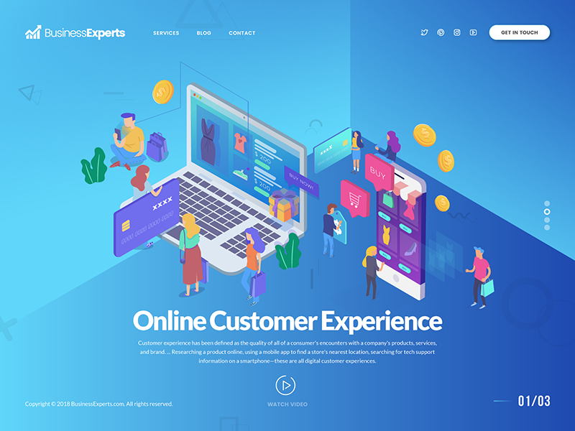
Consumer Centricity
Putting the customer decision ahead at the financial decision

Slide 27
Business Model
Your business model could be one of many and ensuring your digital strategy fits into this is crucial.
Creating an aggressive e-commerce strategy for a relationship-based B2B business would not be a good fit
Mass market B2C
E-commerce
Creating awareness through above-the-line advertising, acquiring visitors and converting them into customers.
B2B
The B2B model includes organizations such as wholesalers or technology resellers that are selling directly to other businesses
CRM
niche B2C
This model is a direct-to-consumer business that has a highly targeted service.
Freemium
product or service for free and offering a more interesting, deeper experience for a price.

Slide 28
Global Strategy
Should understand :
Culture
Language
Payment

Slide 29
Research & Insight
Research driving force behind any strategy to understand what the data & vital for success of the strategy
Data can not tell what has not happened yet
Data is digital and so is not tracking anything outside the digital marketing

Slide 30
03. Barriers and Consideration

Slide 31
1. Technology
Business do not need to make significant technology, many technology available in market with efficient price
Business do not adopt new technology due to limited skill, budget, resource, business priorities

Slide 32
2. Skill
2 methods teaching skill gap
Upskill the people – training
Hiring the people who have the skills - recruitment

Slide 33
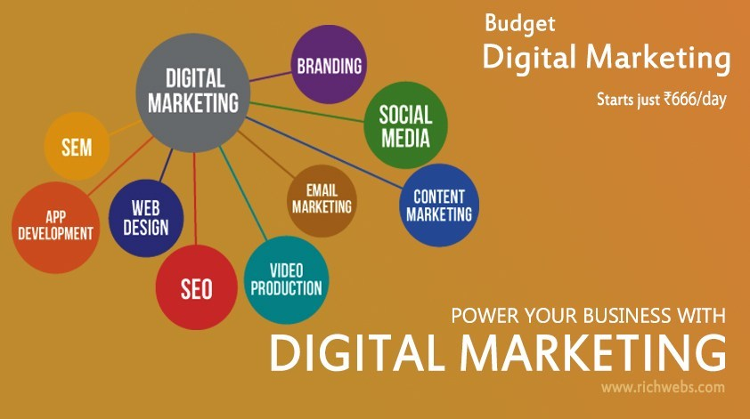
3. Budget & Resources
Investing in new technology or running multiple expensive, IT Project

Slide 34
4. Business Priorities
Managing Highlighting changing consumer behavior
Managing Quick wins

Slide 35
Regulation
Privacy and data protection
E-mail regulation
Viral marketing regulation

Slide 36
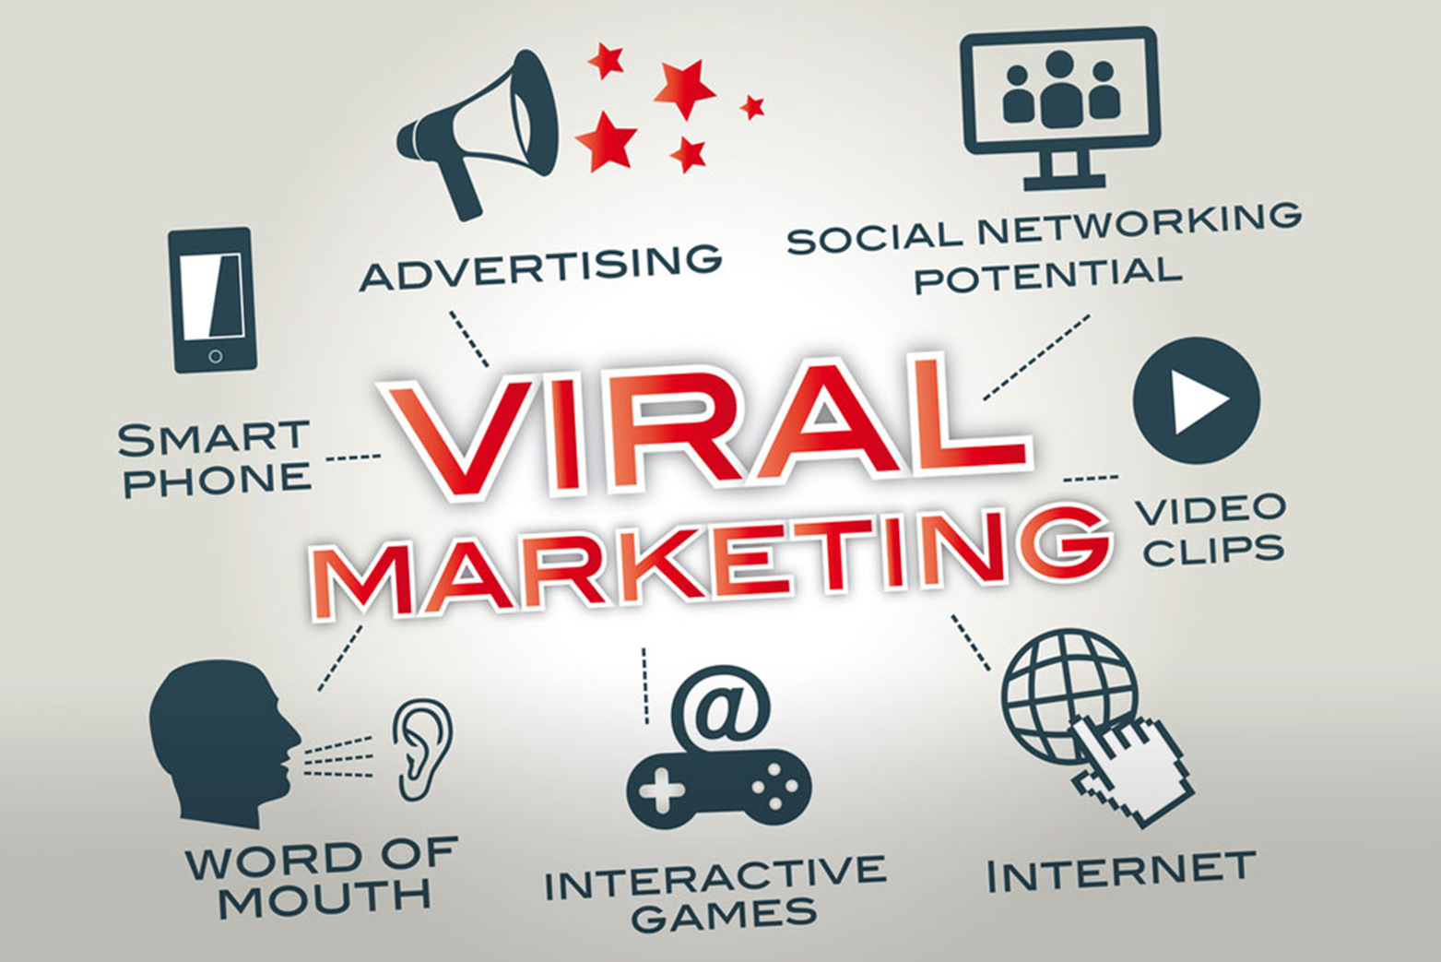
Viral Marketing
Charity
Simplicity
Uniqueness
Selfness
Vanity
Social media

Slide 37
Thank You !
End

Slide 38
Thank You

