Slide 1
Digital Marketing E-MAIL MARKETING
Section 10
Prepared for
Magister Management Class
Esa Unggul University
Prepared by
Diana Fajarwati
KHI, 4 Mei 2019

Slide 2
Syllabus
…… while the second half of semester will exercise some online tools
9
Set Up Market Research
12
Search Engine Marketing
15
E-Commerce/ Marketplace
Web analytic type and usage
Exercise : Google Analytics
Concept of SEO
Exercise : creating keyword, text search
E-commerce concept
Exercise : Lazada account
10
Email Marketing
13
Video Marketing
16
Wrap Up
Why company need e-mail marketing to growth the business
Exercise : MailChimp
Element and content of attractive video marketing
Exercise : creating YouTube account
Summary all the subject
Finale assignment
11
Display Marketing
14
Social Media Marketing
Introduction wordpress, wix, weeby
Exercise ; creating own website
Different form of social media, the rule of engagement
Exercise : Facebook Marketing

Slide 3
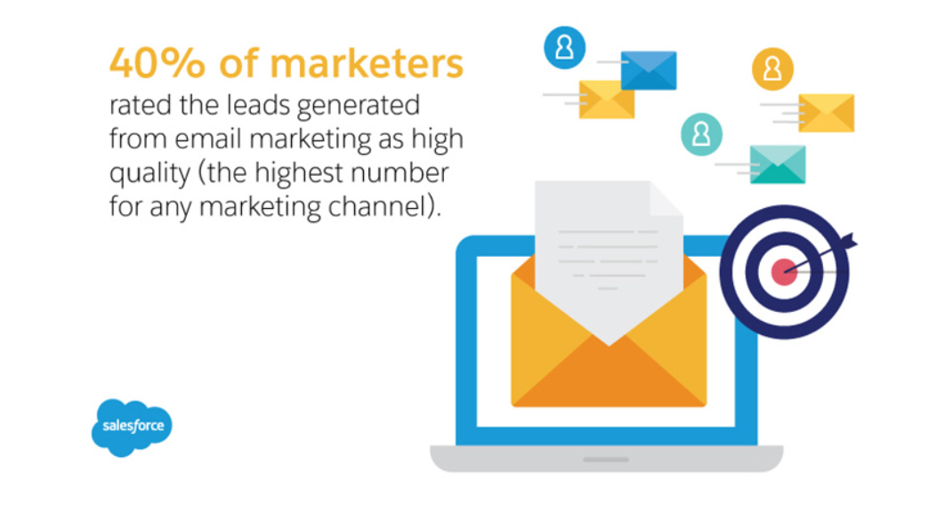

Slide 4
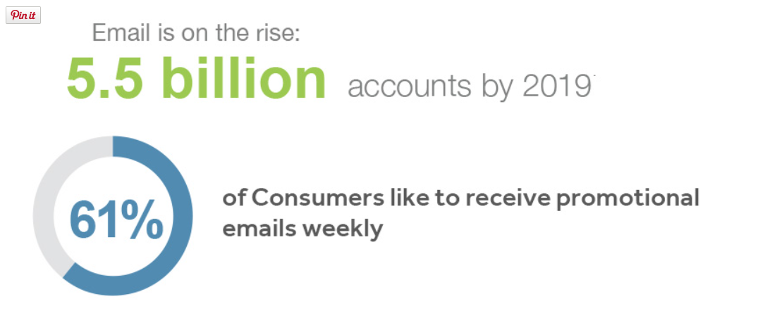

Slide 5
Why Email Marketing ?
It doesn't clog your company mail server.
It's extremely cost-effective and sometimes even FREE
Outbound emails can be scheduled and sent automatically
Take advantage of email message templates for a professional look
Manage your contacts, distribution lists, and subscription links
Edit your content directly or insert content from external feeds
Easy to read, up-to-the-minute reports

Slide 6
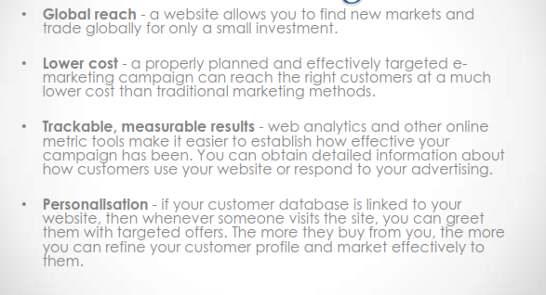
Benefits of E-mail Marketing

Slide 7
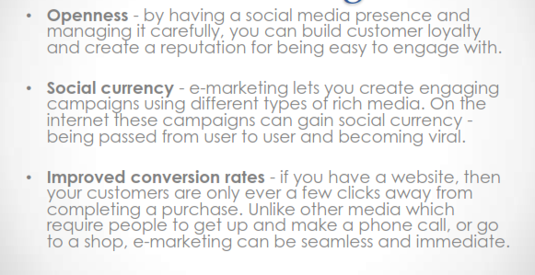
Benefits of E-mail Marketing

Slide 8
Types of Campaign
There are 2 Types of Campaign

Slide 9
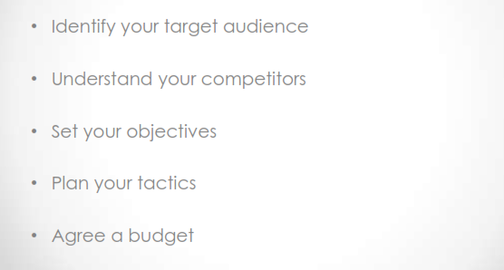
Develop an e-marketing plan

Slide 10
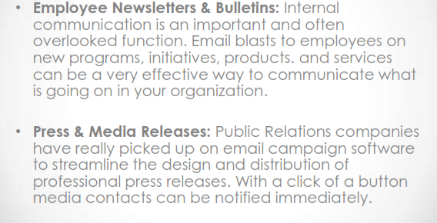
Types of e-mail Marketing

Slide 11
Types of e-mail Marketing

Slide 12
Types of e-mail Marketing

Slide 13
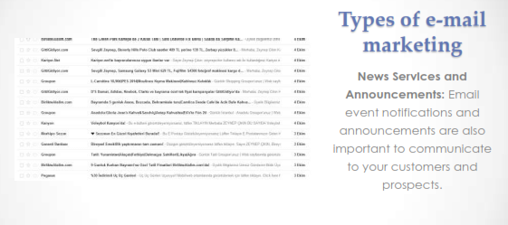
Types of e-mail Marketing

Slide 14
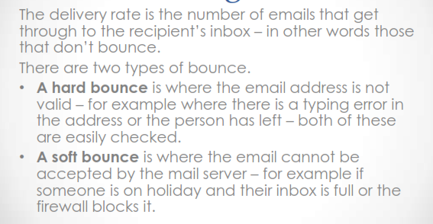
Measuring success

Slide 15
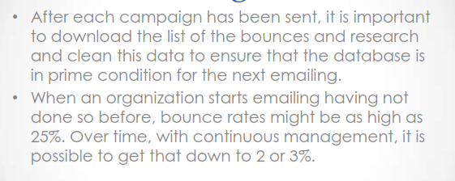
Measuring success

Slide 16
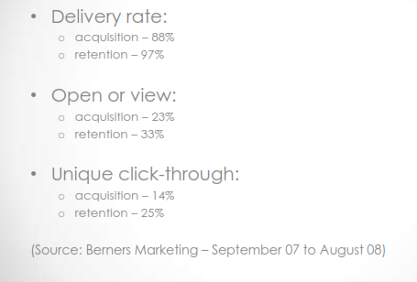
Measuring success

Slide 17
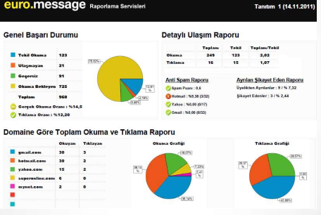
Reporting

Slide 18
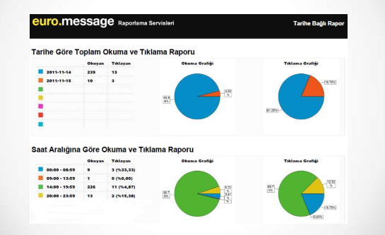

Slide 19
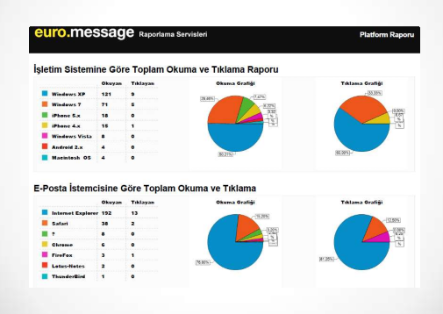

Slide 20
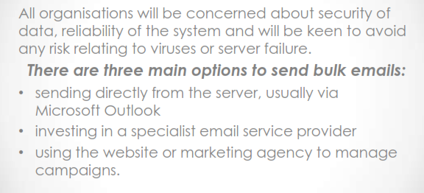
Selecting an email system

Slide 21
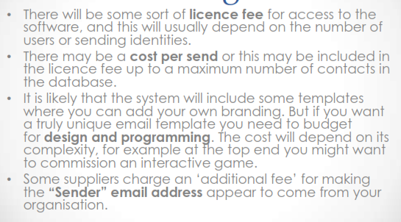
Evaluating Costs

Slide 22
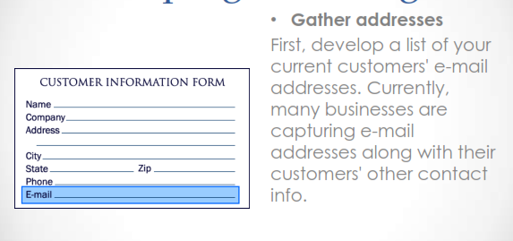
Developing a mailing list

Slide 23
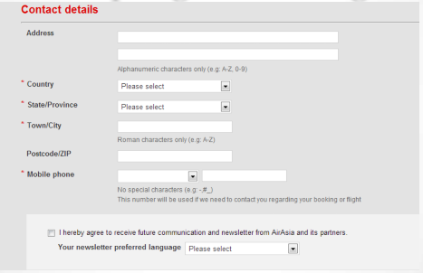
Developing a mailing list

Slide 24
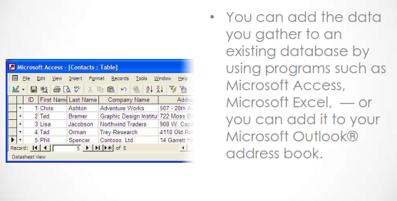
Developing a mailing list

Slide 25
Thank You !
End

