Slide 1
Digital Marketing VIDEO MARKETING
Section 13
Prepared for
Magister Management Class
Esa Unggul University
Prepared by
Diana Fajarwati

Slide 2
Syllabus
…… while the second half of semester will exercise some online tools
9
Set Up Market Research
12
Search Marketing
15
E-Commerce/ Marketplace
Web analytic type and usage
Exercise : Google Analytics
Concept of SEO, SMO
Exercise : creating keyword, text search
E-commerce concept
Exercise : Lazada account
10
Email Marketing
13
Video Marketing
16
Wrap Up
Why company need e-mail marketing to growth the business
Exercise : MailChimp
Element and content of attractive video marketing
Exercise : creating YouTube account
Summary all the subject
Finale assignment
11
Display Marketing
14
Social Media Marketing
Introduction wordpress, wix, weeby
Exercise ; creating own website
Different form of social media, the rule of engagement
Exercise : Facebook Marketing

Slide 4
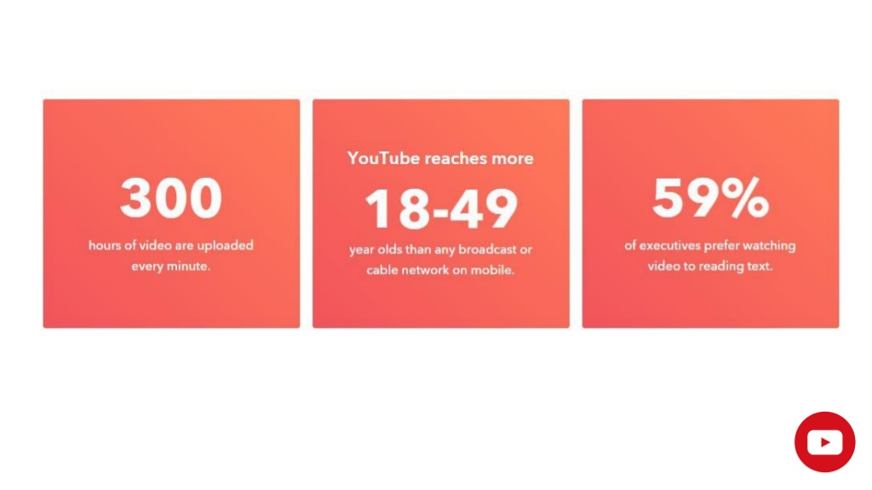

Slide 5
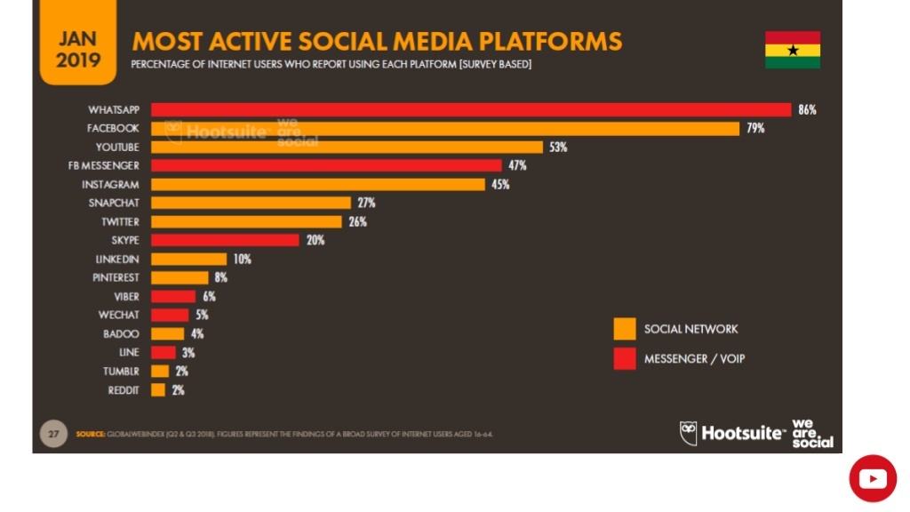

Slide 6
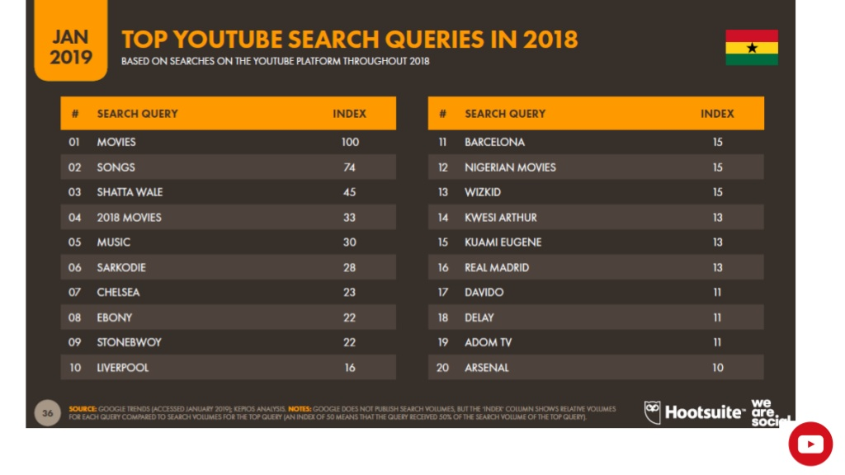

Slide 7
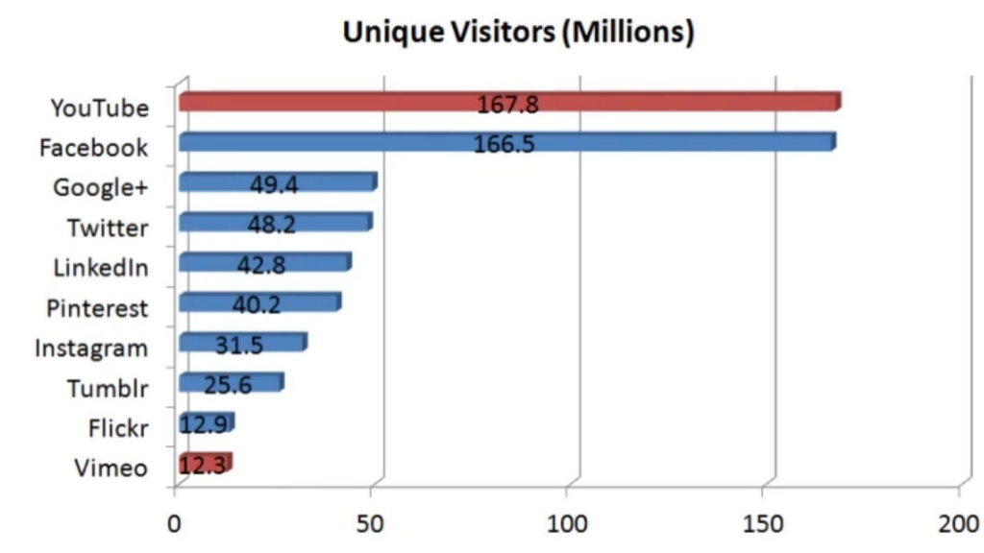

Slide 17
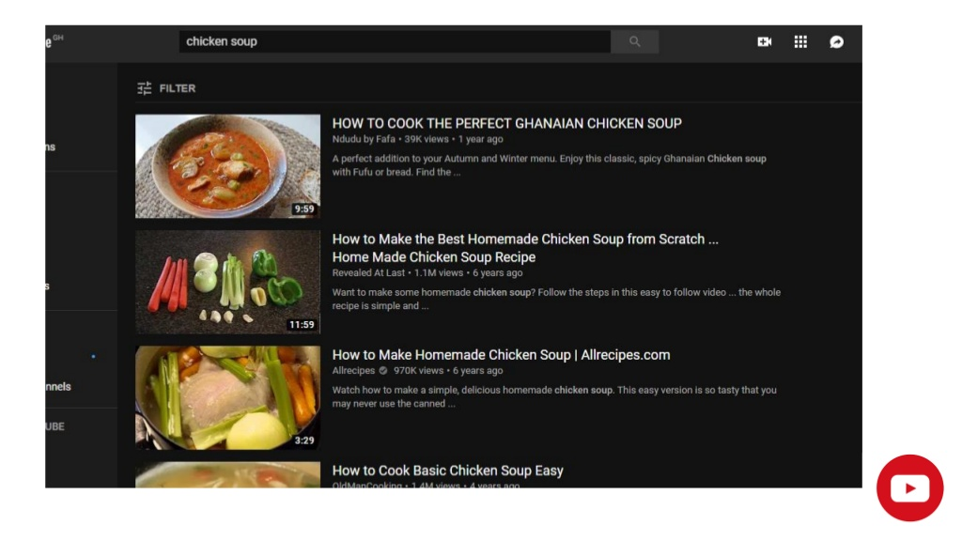

Slide 18
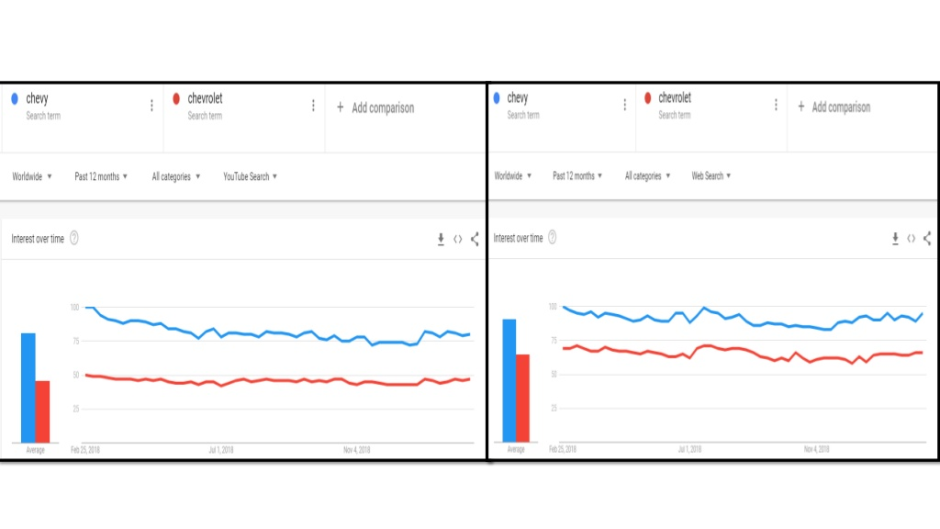

Slide 22
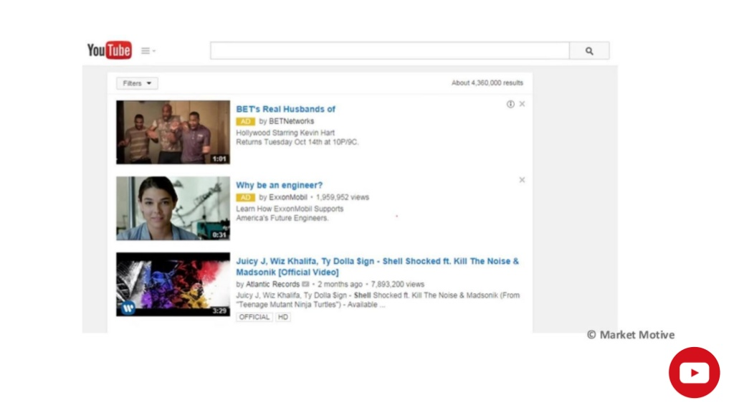

Slide 24
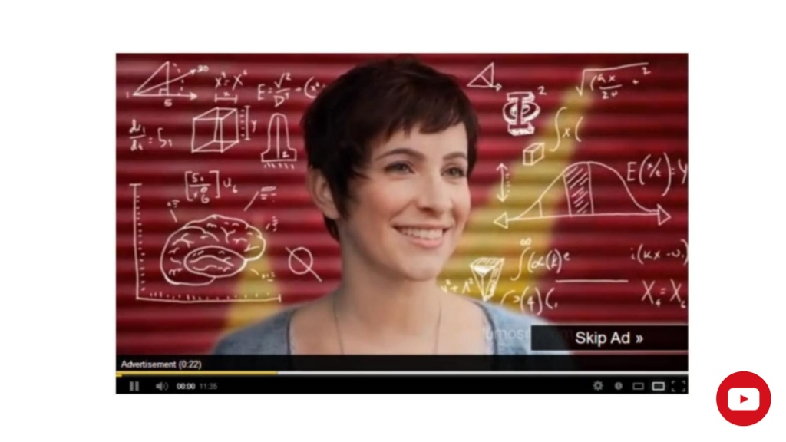

Slide 25
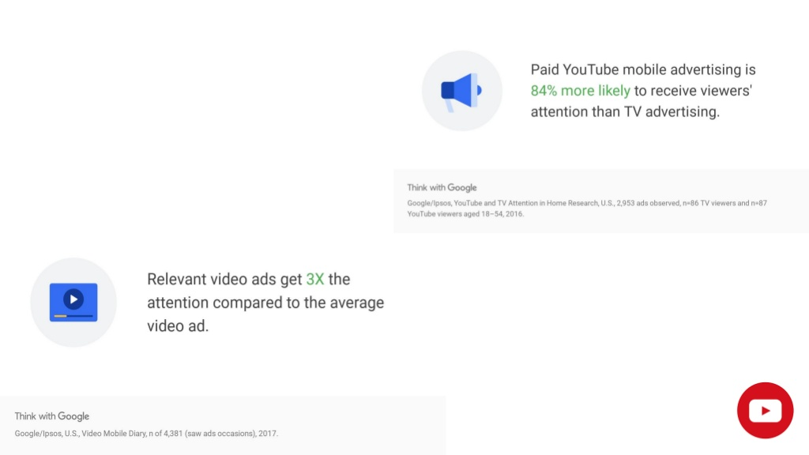

Slide 26
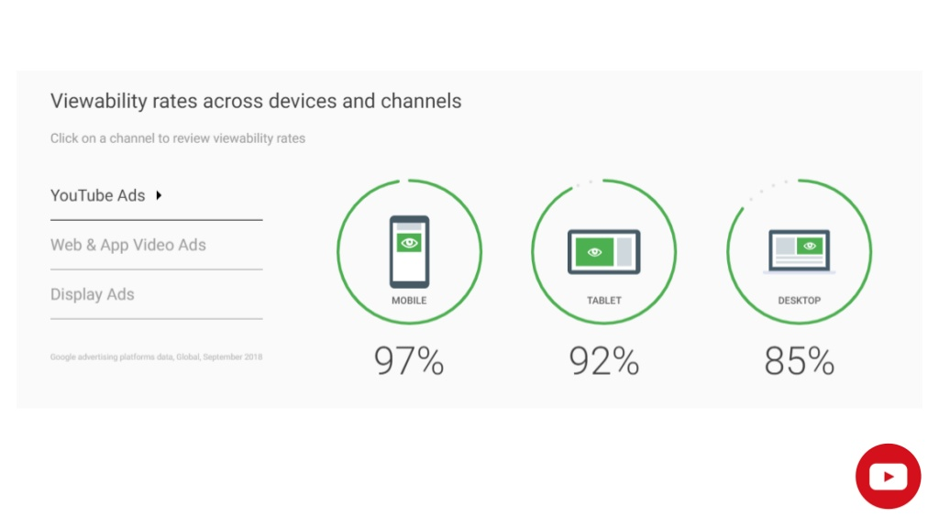

Slide 27
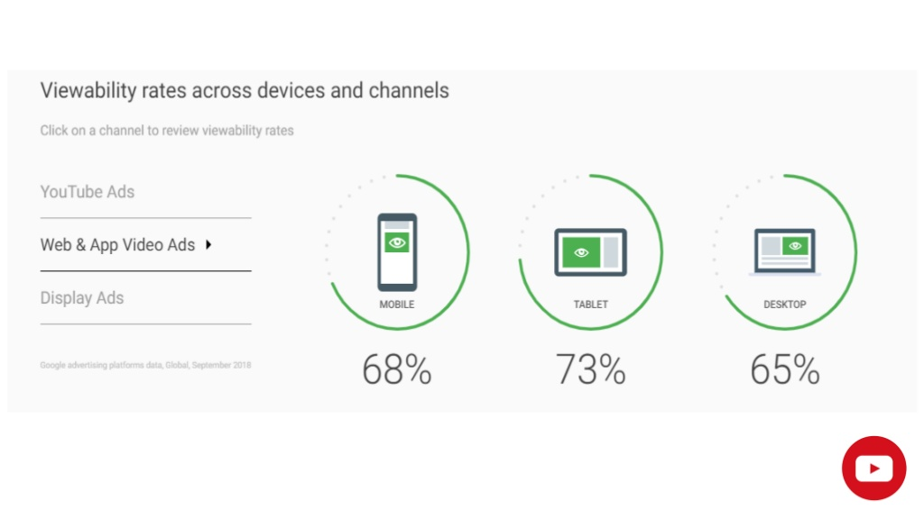

Slide 28
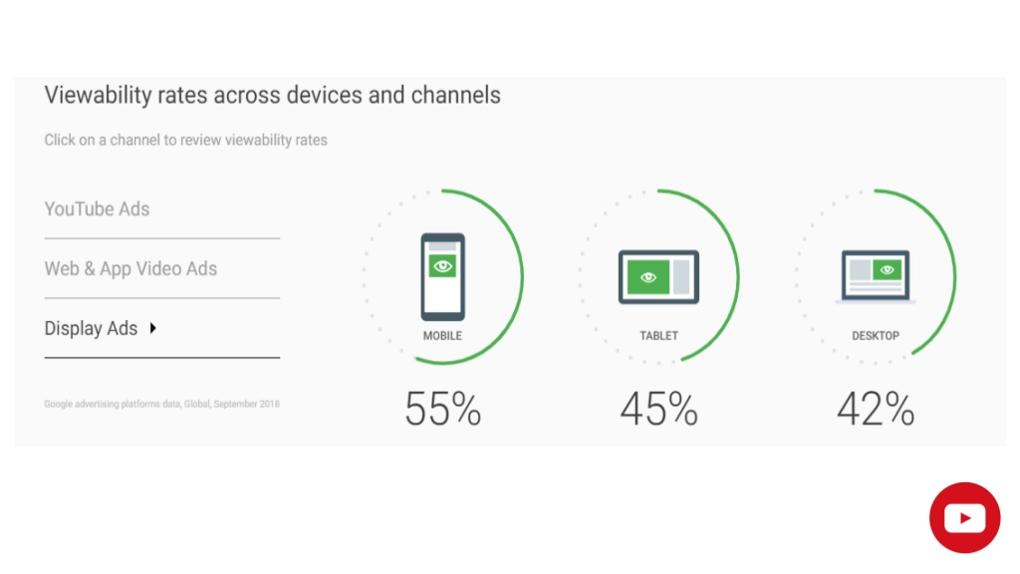

Slide 33
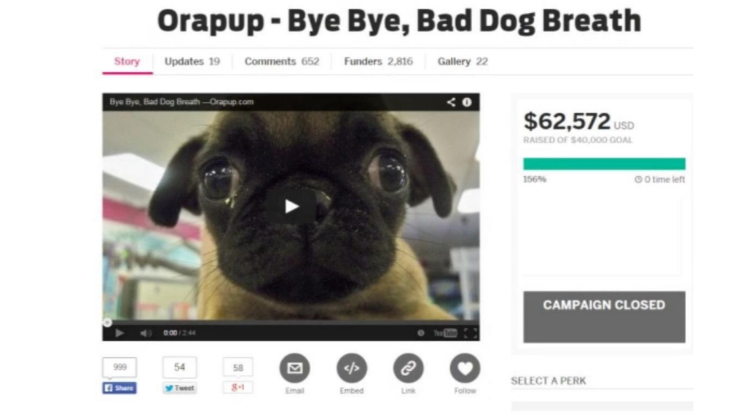

Slide 34
Thank You !
End

