Slide 1
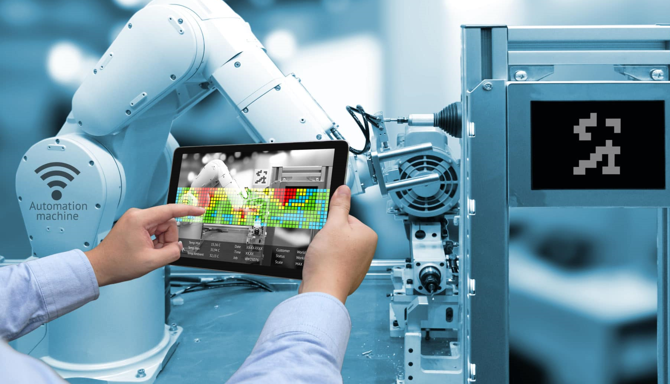
Section 2 Digital Tools for Developing New Product
Digital Marketing
Prepared for
Magister Management Class
Esa Unggul University
Prepared by
Diana Fajarwati

Slide 2
Syllabus
The first half of semesters will explore the digital marketing concepts
1
Marketing in Digital World
4
Digital Tools for Effectively Distribution
7
Digital Analytic for Marketing Professional #1
What is Digital Marketing
History of Digital Marketing
The Changes of Consumer Behavior
Basic Concept: Place
Digital Concept: New Retail
Digital Concept: 3D Printer
Pengumpulan data-data sosial media
Kerangka analisa
Visualisasi data
2
Digital Tools for Developing Innovative Product
5
Digital Tools for Setting Right Price
8
Marketing in an Analog World
Basic Concept: Product
Digital Concept: Customer Co-Creation
Digital Concept: Doppelgänger Brand
Basic Concept: Price
Digital Concept: Pay what you want
Digital Concept: Pricing comparison tools
Analog vs Digital
4 cara dunia analog mempengaruhi digital
Transformasi analog ke digital
3
Digital Tools for Persuading Costumers
6
Digital Analytic for Marketing Professional #1
Basic Concept: Promotion
Digital Concept: Authenticity
Digital Concept: User-Generated Content
Memahami berbagai web analytics
Kerangka analytic dan memilih web analytic yang tepat

Slide 3
Basic Concept :
?
What is a product?
How are digital tools changing this part of the marketing mix?
?
Two key product concepts:
Product Development and Brand Management.
How new digital tools are impacting the way in which products are developed and branded.

Slide 4
Product
Promotion
Price
Place

Slide 5
Product
Promotion
Product is anything that fulfill Consumer Need
Price
Place

Slide 6
Positioning can be functional or symbolic

Slide 7
Key Concept
Product Quality
Product Line
Product Service Support

Slide 8
Key Concepts
PRODUCT DEVELOPMENT
BRAND MANAGEMENT

Slide 9
Product Development
Innovation are critical factors for Product Development
2 Type of Innovation
1. DISTRUPTIVE INNOVATION

Slide 10
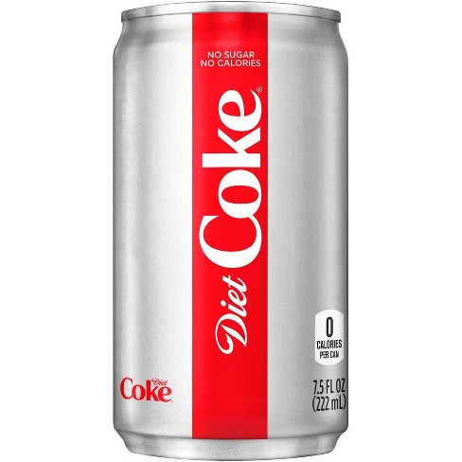
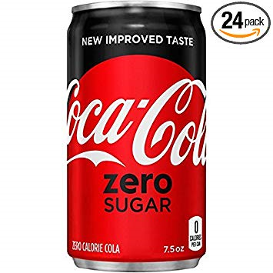
2. INCREMENTAL INNOVATION
Need a cross functional team Collaboration

Slide 11
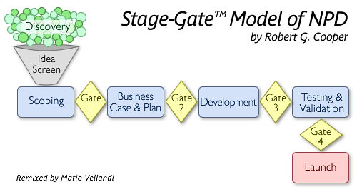
STAGE – DATE MODEL OF NPD

Slide 12
BRAND MANAGEMENT CONCEPT
Brand
Name, symbol or design that differentiates a firm’s product from its competitor’s products

Slide 13
STRONG BRANDS
Higher Prices
Greater Loyalty
Higher Profitability
“BRAND EQUITY”

Slide 14
WHAT’S CHANGING
Firm-centered approach is starting to break down due to the rise of these new digital tools.

Slide 15
Digital Marketing IQ
What is who has more Facebook followers, Coca-Cola or Cristiano Ronaldo?
It is Cristiano Ronaldo. He has 115 million followers, while Coca-Cola only has 98 million.
What percentage of customers always or sometimes read online reviews before visiting a business? Is it more than 50% or less than 50%
It is more than 50%, actually
In the US, which form of technology are people more likely to use to engage in online search, a computer or a smartphone?
it is a smartphone
Do you happen to know what is My Starbucks Idea?
It's actually an online platform in which people can submit ideas to Starbucks.

Slide 16
DIGITAL CONCEPT # 1 CO-CREATION

Slide 17
Digital Concept : Co-Creation
Why are a growing number of firms involving customers in the design and development of their products?

Slide 18
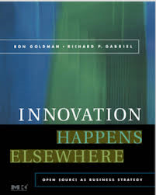
"Innovation happens everywhere, but there is simply more elsewhere than here" Ron Goldman & Richard Gabriel
Notes:
Ron Goldman and Richard Gabriel. These gentlemen are two former executives from the computer company Sun Microsystems,
Now if you think about it that's true for just about anything-
happiness, sadness, eating, sleeping;
that there's more activity happening elsewhere than here

Slide 19
CUSTOMER CO-CREATION
Customers Contribution to help enhance new product development

Slide 21
3 Issue in CO-CREATION
Step Involved
Customer Motivation
Different Type

Slide 22
Step CO-CREATION

Slide 23
Motivation to ENGAGE
Social Recognition
Financial Reward
☺
$

Slide 24
Different Types Co-Creation
Collaborating
Customer-Led
Co-Designing
SELECTION ACTIVITY
Tinkering
Firm-Led
Submitting
Customer-Led = votes, points
Fixed
Open
CONTRIBUTION ACTIVITY

Slide 25
DIGITAL CONCEPT #2: DOPPELGANGER BRANDS

Slide 26
Doppelganger Brand Image (DBI)
Dopple
(double)
+
Ganger
(Walker)

Slide 27
BASIC IDEA
Developing an appealing and distinctive brand image is an important part of any firm's product strategy.
Most branding efforts focus on intangible features brands that gives an emotional appeal.

Slide 28
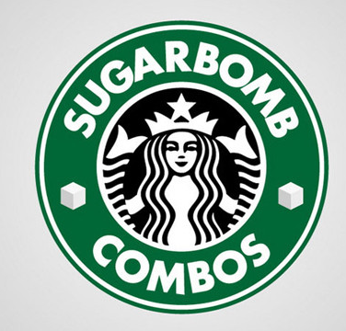
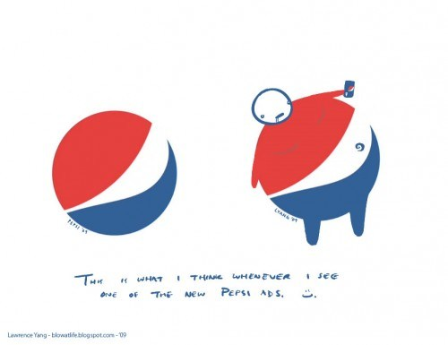
Example DBI

Slide 29
Doppelganger Brand Image (DBI)
A collection of disparaging images and stories about a brand circulated in popular culture by a loosely organized network of anti-brand activist, bloggers and opinion leaders

Slide 30
3 Issue DBI
1. Motivation to Create a DBI
2. Brand Susceptible to a DBI
Most are focuses agents well-known brand
High degree of familiarity
Location of DBI
Social Media
Blogger
website

Slide 31
Thank You !
End

