Slide 1
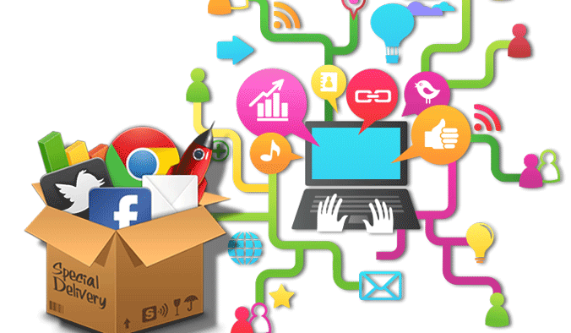
Section 3 Digital Tools for Persuading Customers
Digital Marketing
Prepared for
Magister Management Class
Esa Unggul University
Prepared by
Diana Fajarwati

Slide 2
Syllabus
The first half of semesters will explore the digital marketing concepts
1
Marketing in Digital World
4
Digital Tools for Effectively Distribution
7
Digital Analytic for Marketing Professional #1
What is Digital Marketing
History of Digital Marketing
The Changes of Consumer Behavior
Basic Concept: Place
Digital Concept: New Retail
Digital Concept: 3D Printer
Pengumpulan data-data sosial media
Kerangka analisa
Visualisasi data
2
Digital Tools for Developing Innovative Product
5
Digital Tools for Setting Right Price
8
Marketing in an Analog World
Basic Concept: Product
Digital Concept: Customer Co-Creation
Digital Concept: Doppelgänger Brand
Basic Concept: Price
Digital Concept: Pay what you want
Digital Concept: Pricing comparison tools
Analog vs Digital
4 cara dunia analog mempengaruhi digital
Transformasi analog ke digital
3
Digital Tools for Persuading Costumers
6
Digital Analytic for Marketing Professional #1
Basic Concept: Promotion
Digital Concept: Authenticity
Digital Concept: User-Generated Content
Memahami berbagai web analytics
Kerangka analytic dan memilih web analytic yang tepat

Slide 3
Basic Concept :
?
What is a promotion?
How are digital tools changing this part of the marketing mix?
?
Two key promotion concepts:
Advertising & Persuasion

Slide 4
Product
Promotion
Price
Place

Slide 5
Product
Promotion
Promotion covers the methods of communication that a marketer uses to provide information about its product
Goal = Get Customer to buy the product
Information can be both verbal and visual
Price
Place

Slide 6
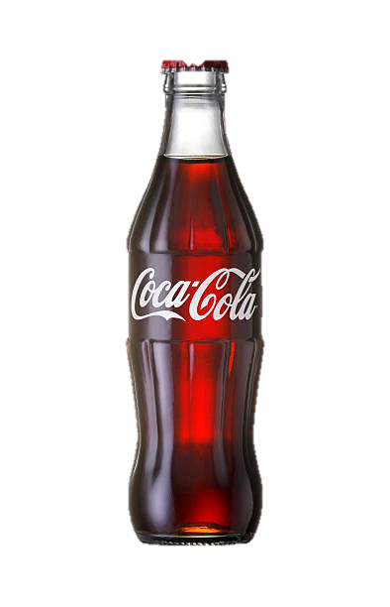
COKE
100 years of effective promotion
$3.3 Billion in advertising in 2013
One of the world’s meet recognized brands

Slide 7
KEY CONCEPT
Advertising
Persuasion

Slide 8
ADVERTISING
Most Popular Promotion technique
TV accounts for most of the budget

Slide 9
PERSUASION
Primary goal of most promotional campaigns is to persuade customers to buy a firm’s products instead of its competitors
PERSUASION TACTICS
Celebrity endorsements
Humor
Scientific claims

Slide 10
PERSUASION THEORY
Elaboration Likelihood Model (ELM)
Central Route which is cognitive in nature
Peripheral Route which is more emotional in nature

Slide 13
CURRENT ASSUMPTION
Convince customers that a product is appealing
Firm just need to find the right message (or message provider)

Slide 14
WHAT’S CHANGE
Historically
Ad Agency Television
Top down ---- Little customer involvement
Gain attention for brand
Persuading customer to purchase
Notes:
That's the traditional model.
Now this top down approach is starting to break down due
to the rise in digital tools.
For example, Jones Soda has built a successful franchise,
and here's a bottle of Jones Soda,
not through television advertising.
In fact it spends no money on advertising at all,
has a very small advertising budget.
Instead its entire promotional campaigns are created
by its customers.
This includes television ads that are shown
on YouTube, for example.

Slide 15
IMPACT OF DIGITAL TOOLS
Moving from Managed Message designed to persuade to Authentic Message designed to Narrate

Slide 16
Marketing IQ : Promotion
How much they know about promotion side of digital Marketing
True, or false, due to the increase in digital advertising, firms spent less on Superbowl television commercials last year that in prior years. Is that true, or false?
That would be false. I think, they definitely spend more on Super Bowl commercials
In 2017, firms spent a record $385 million on Super Bowl ads
In the US, which is larger, the amount spent on television advertising, or online advertising?
it's actually more online advertising.
online they spend $77 billion, versus for television it's $72 billion.
Which of the following companies was the first to run an ad on Instagram? Is it A, Audi, B, BMW, C, Michael Kors, or D, Victoria's Secret?
C, Michael Kors

Slide 17
DIGITAL CONCEPT # 1 AUTHENTICITY
Notes:
When you think of digital marketing, you probably don’t think about authenticity. However, in today’s digital world, false claims are quickly uncovered and often result in substantial embarrassment and potential financial loss for the firms making such claims. As a result, a growing number of firms are realizing that representing themselves and their products in a genuine manner is good business practice in a digital age. This video lecture will introduce this concept, provide several examples of authentic promotional campaigns, and discuss how firms can enhance their authenticity.

Slide 18
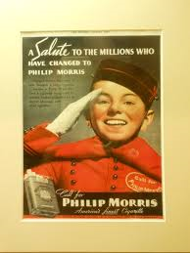
DIGITAL AUTHENTICITY
early cigarette ads routinely made claims about the health benefits of smoking

Slide 19
BASIC IDEA
A growing number of firms are realizing that representing themselves and their products in a genuine manner is good business practice in a digital age

Slide 20
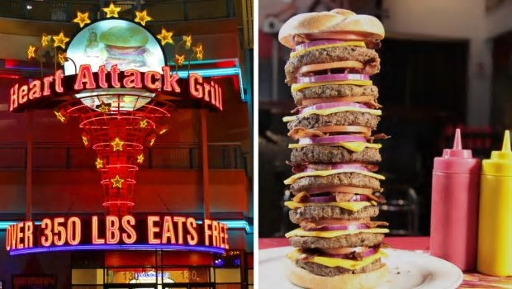
Example
“…. Our menu is purposely designed to be offensive. It’s absolutely as unhealthy as possible”
Notes:
any customer who weights over 350 pounds eats for free.
And multiple customers having heart attacks, while eating in the restaurant.
This offensive approach has been extremely popular with his clientele,
has provided this restaurant with tremendous amount of free publicity.

Slide 21
DEFINITION OF DIGITAL AUTHENTICITY
The degree to which a product’s online promotion provides customers with a genuine portrayal of its origins, features and benefits (as well as its limitations)
Tells a stiory rather than making a claim

Slide 22
3 Issue of Digital Authenticity
What makes a promotion authentic ?
What is the role of the customer in the process ?
What are the benefit of being authentic ?

Slide 23
WHAT MAKES A PROMOTION AUTHENTICS ?
Tells a compelling story
If claims are made, these claims are typically more authentic if they come from the actual users rather than paid spokes people.
authentic promotions are genuine, and often have an element of uniqueness

Slide 24
DIGITAL CONCEPT # 2 USER GENERATED CONTENT (UGC)

Slide 25
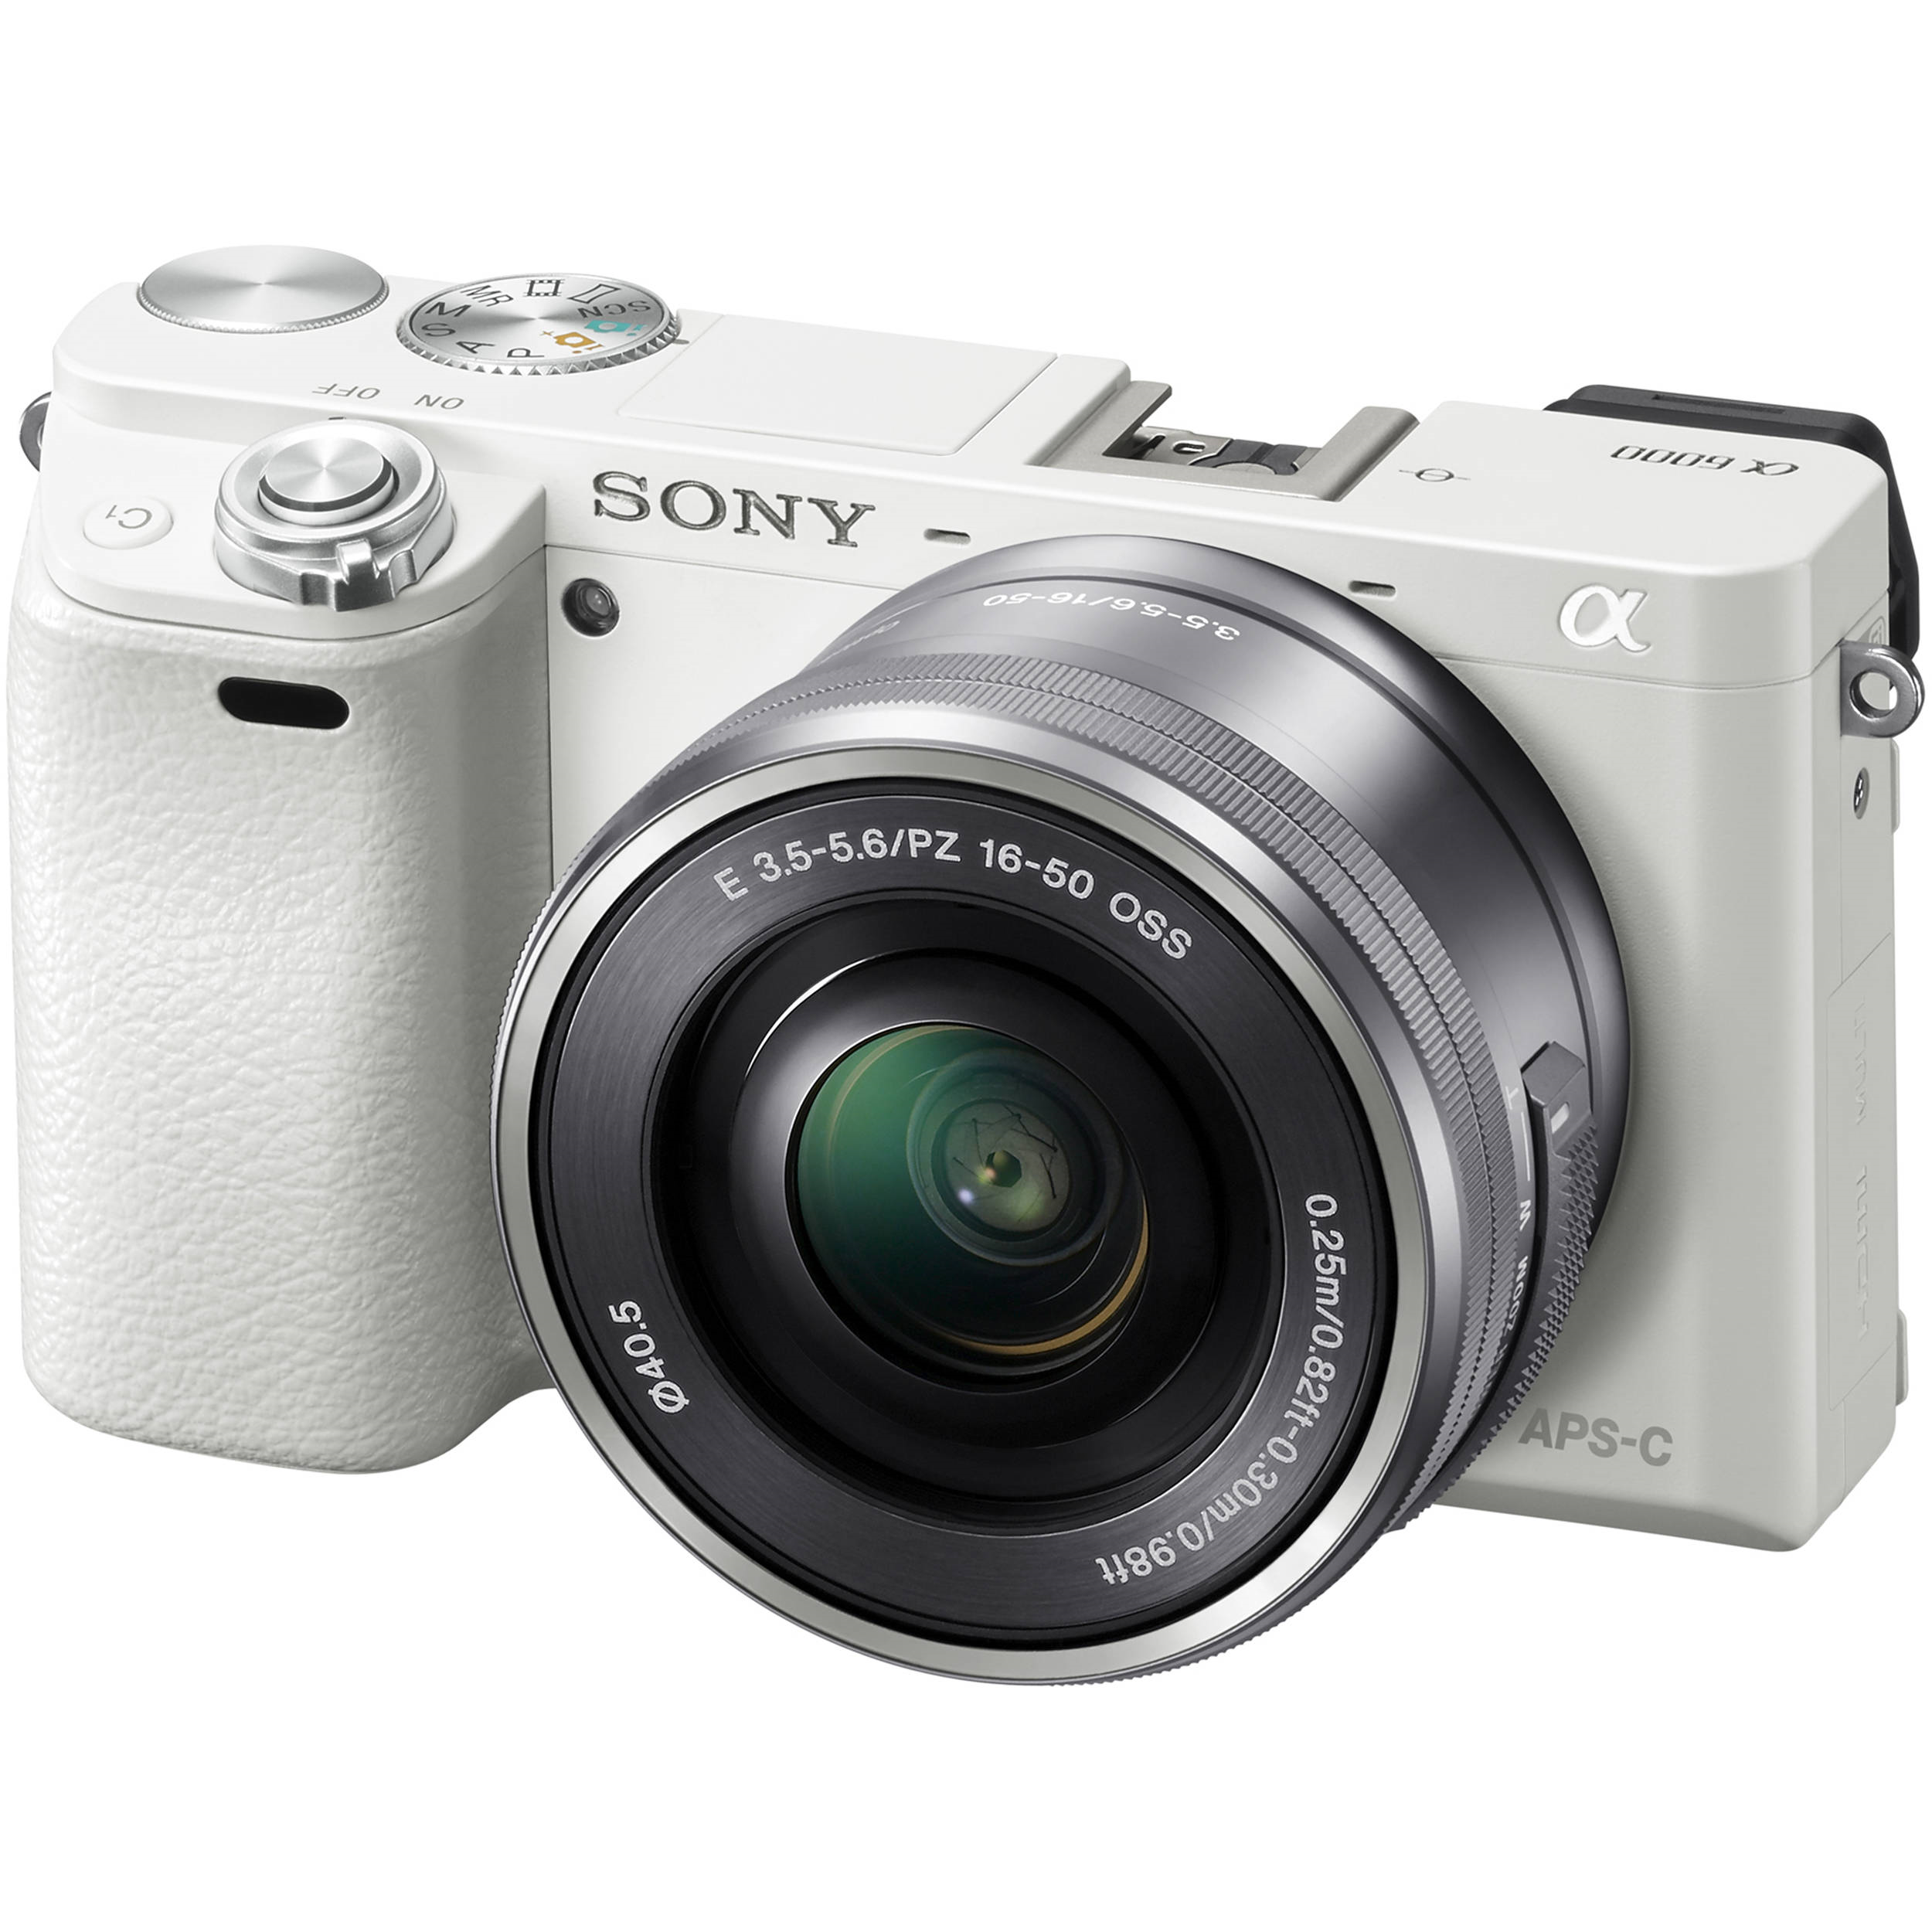
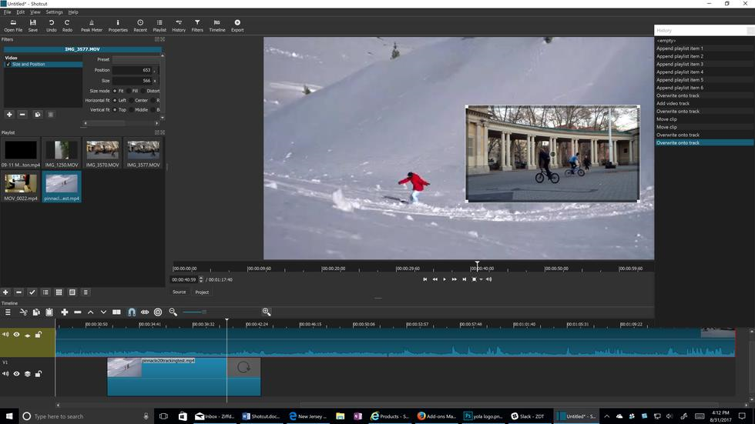
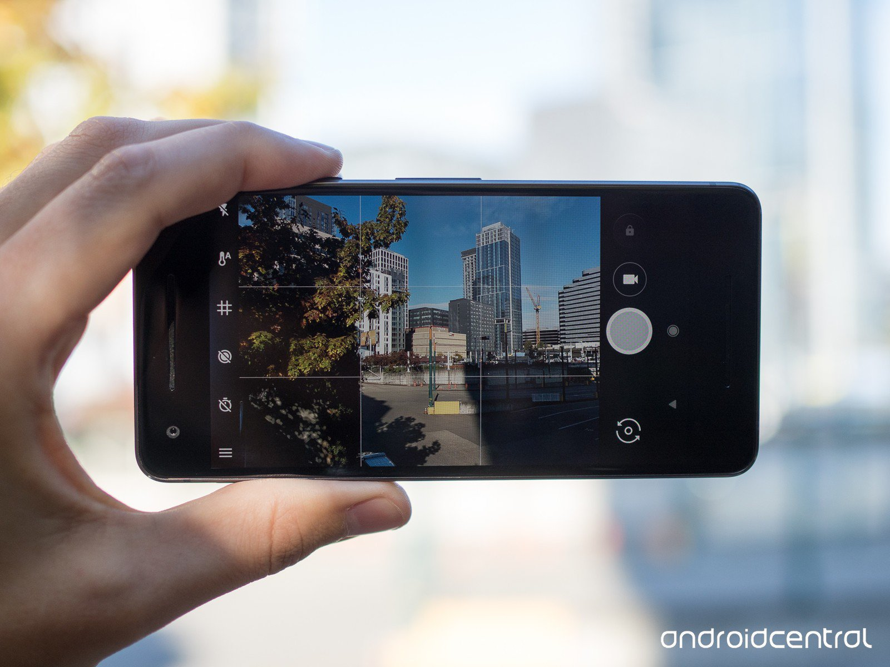
BACIS IDEA
Promotion has been carefully managed is because this activity is quite expensive
The rise of new digital tools has dramatically changed this equation
Low cost digital camera
Free digital editing software
Broadcasting Platform

Slide 26
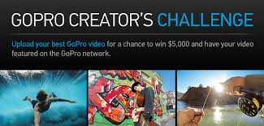
GO PRO
strategically uses UGC by holding contests in which they ask their customers to submit photos or videos of their adventures that they have taken with their cameras.

Slide 27
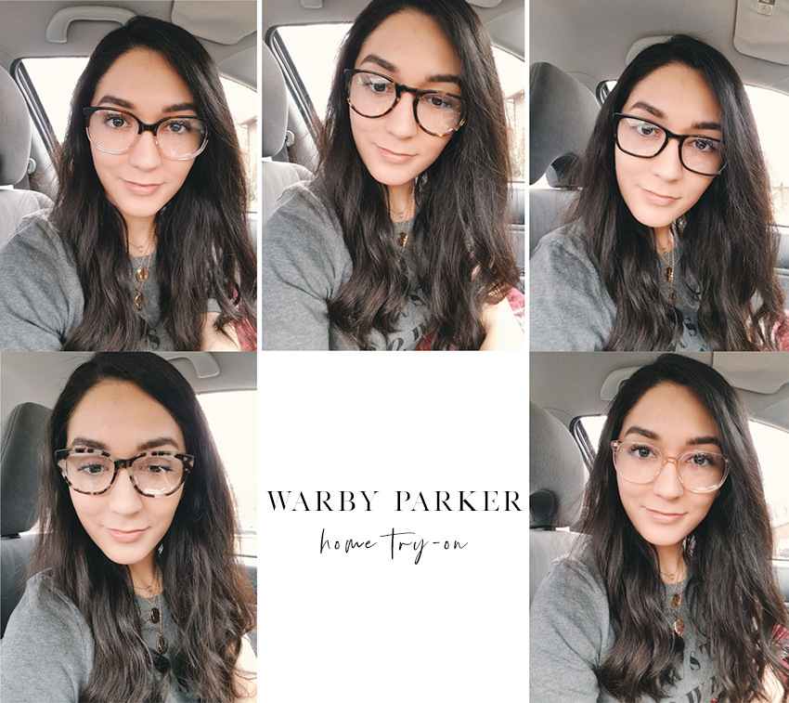
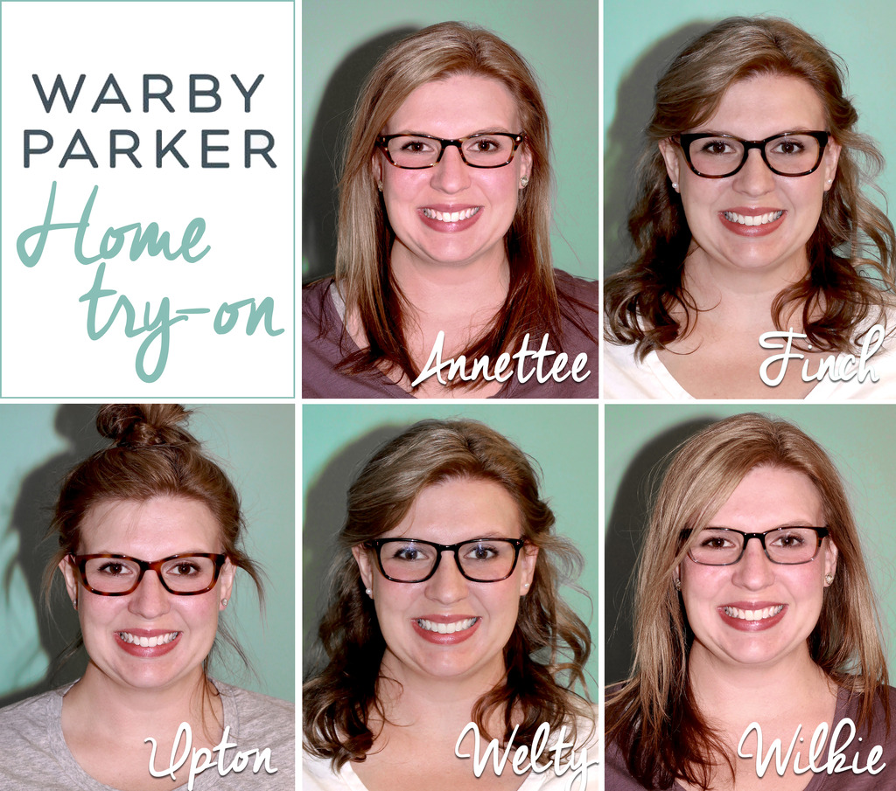
WARBY PARKER
encourages these customers to take photos of themselves and share these photos on social media using #Warby home try on. .

Slide 28
What IS UGC ?
a product's customers create and disseminate online ideas about the product of the firm that markets it.
3 Key Characteristics
Contribution by users of products
Creative in nature
Posted online/accessible

Slide 29
What are the different type of UGC
Social media platforms
Online platforms
Product reviews have strongest impact on customers decisions

Slide 30
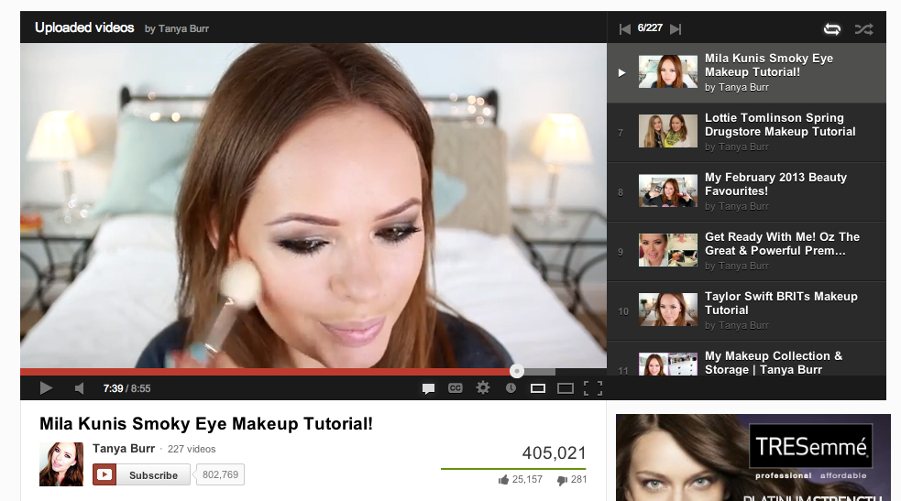
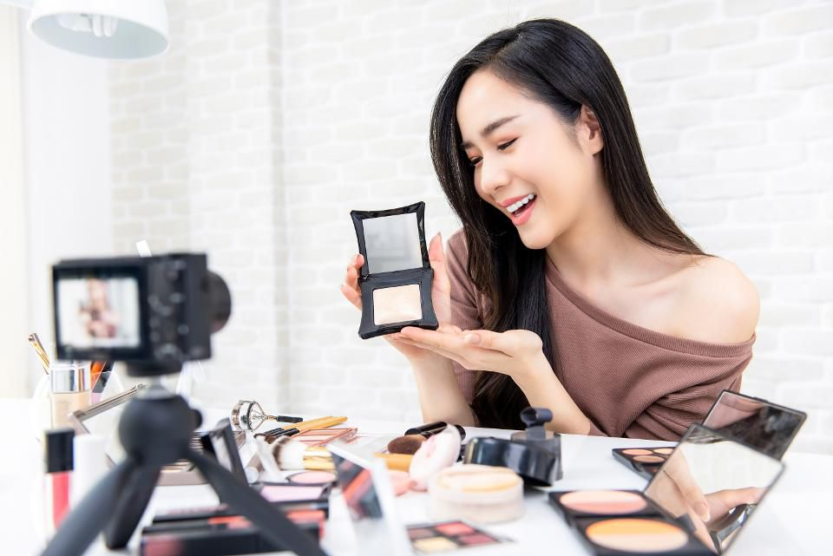
What is motivation to create UGC
Social Recognition
Financial Intensive

Slide 31
Thank You !
End

