Slide 1
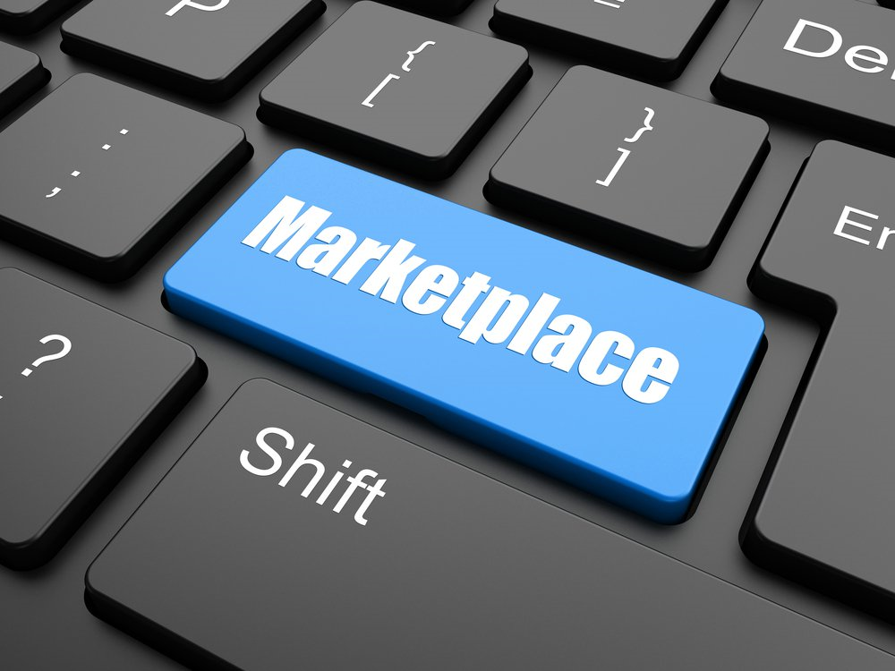
Section 4 Digital Tools for Effectively Distribution
Digital Marketing
Prepared for
Magister Management Class
Esa Unggul University
Prepared by
Diana Fajarwati

Slide 2
Syllabus
The first half of semesters will explore the digital marketing concepts
1
Marketing in Digital World
4
Digital Tools for Effectively Distribution
7
Digital Analytic for Marketing Professional #1
What is Digital Marketing
History of Digital Marketing
The Changes of Consumer Behavior
Basic Concept: Place
Digital Concept: New Retail
Digital Concept: 3D Printer
Pengumpulan data-data sosial media
Kerangka analisa
Visualisasi data
2
Digital Tools for Developing Innovative Product
5
Digital Tools for Setting Right Price
8
Marketing in an Analog World
Basic Concept: Product
Digital Concept: Customer Co-Creation
Digital Concept: Doppelgänger Brand
Basic Concept: Price
Digital Concept: Pay what you want
Digital Concept: Pricing comparison tools
Analog vs Digital
4 cara dunia analog mempengaruhi digital
Transformasi analog ke digital
3
Digital Tools for Persuading Costumers
6
Digital Analytic for Marketing Professional #1
Basic Concept: Promotion
Digital Concept: Authenticity
Digital Concept: User-Generated Content
Memahami berbagai web analytics
Kerangka analytic dan memilih web analytic yang tepat

Slide 3
Basic Concept :
?
What is a Placement?
How are digital tools changing this part of the marketing mix?
?
Two key PLACEMENT concepts:
Distribution & Retailing
Notes:
Placement is the third element of the marketing mix. This aspect of the marketing mix focuses on making a product conveniently accessible to potential customers. In this video, Professor Rindfleisch explains the concept of Placement, examines two key placement concepts (distribution and retailing), and then discusses how this part of the marketing mix is changing in our increasingly digital world.

Slide 4
Product
Promotion
Price
Place

Slide 5
Product
Promotion
Placement physical movement of a product for manufacturer through a series of marketing channel intermediaries ending typically with an independent retailer.
Price
Place

Slide 7
KEY CONCEPTS
Inventory Management
Logistics
Sales Force Management

Slide 8
DISTRIBUTORS
The distribution channel used by most firms is typically outsourced to a series of independent firms, such as an importer, a wholesaler, and a retailer
Maximize Revenue and Minimize Cost → CONFLICT

Slide 10
RETAILING
Final step in the distribution chain
Selecting the number and type of retailers affects the number and type of customers that a firm can acquire for its products

Slide 11
WHATS’S CHANGING
Traditional product placement is expensive both for firms and consumers
Most firms are bypassing physical retailers by making their products directly available online

Slide 12
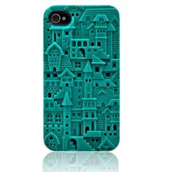
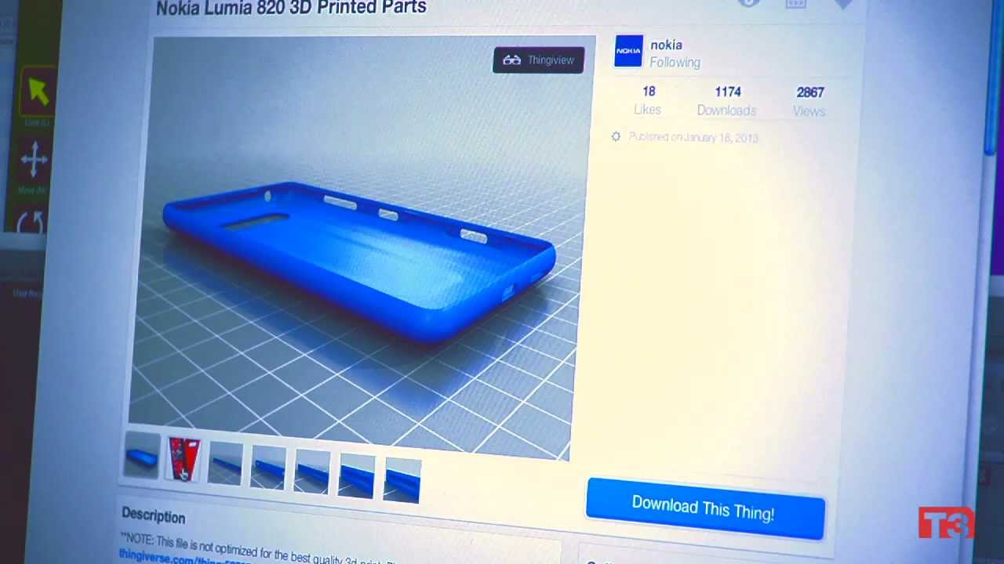
Digital tools are not only capable of replacing the retailer, but the entire distribution channel.
3D Printer case customization

Slide 13
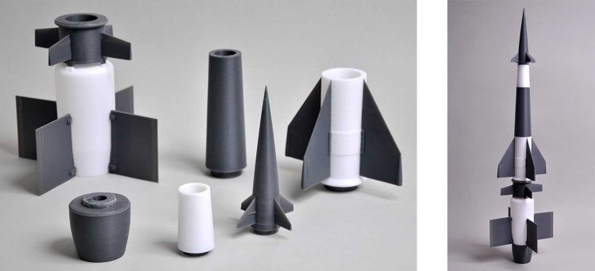
Moving from long distribution channels that transport physical goods to short distribution channels that transport digital goods.

Slide 14
DIGITAL CONCEPT#1 NEW RETAIL
Notes:
ike most of us, you probably purchased most of the things you own in a physical retail establishment such as a grocery store, a department store, or a specialty retailer. Today, digital tools such as the Internet and the smartphone are challenging these retailers and forcing them to adapt the way they do business. As a result, we are seeing the rise of "New Retail." This video lecture will introduce this concept, provide several examples of the changing retail landscape, and discuss how firms can adapt their retailing practices to prosper in a digital world.

Slide 15
BASIC IDEA
Amazon.com sells over 250 million different products on its US website alone.
online retailing is a considerable threat to traditional physical retailers

Slide 16
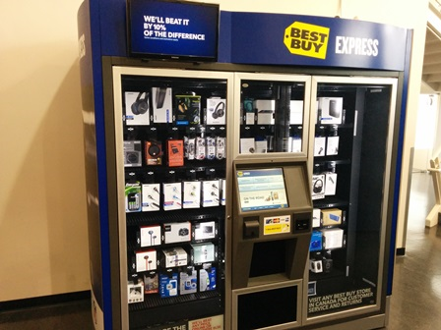
BEST BUY VENDING MACHINE

Slide 17
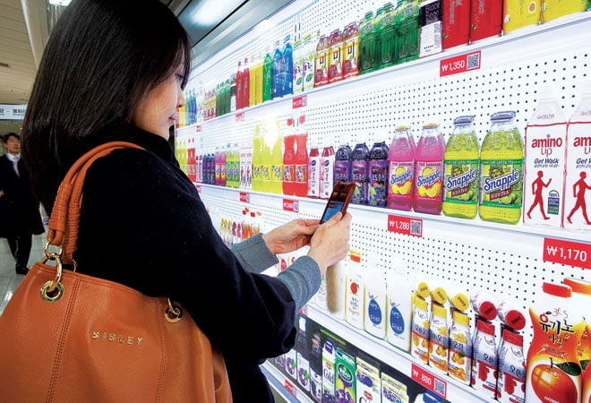
TESCO VIRTUAL STORES
Shoppers just need to download a Tesco app in their smartphone
#1 shopping app in Korea

Slide 18
NEW RETAIL
Rigby, Darrell “the future of shopping”, Harvard Business Review, 2011
a collection of strategies, both physical and digital, that physical retailers are using to react to the challenges of operating in a digital world.

Slide 19
KEY ISSUE
LOCATION
Online retailing is heavily influence by location
People who have easy access to well-priced physical stores are less likely to shop online.
PURCHASE VS INFORMATION
consumers who visit digital retailers not only purchase products, but also obtain information about them.
Showrooming : customers first visit a physical store and then buy a product online
DIGITAL & PHYSICAL
Omnichannel retailing .

Slide 20
Omnichannel : Online + Offline Retailer

Slide 21
DIGITAL CONCEPT#2 3D PRINTING
Notes:
Over the past few years, Jeff Bezos (Amazon), Jeffrey Immelt (GE), and President Barack Obama have identified 3D printing as a revolutionary new technology. According to several leading media sources including Wired Magazine, the Economist, and the New York Times, 3D printing will lead to a new industrial revolution and dramatically alter our economy. Thus, this is an emerging digital tool that has important implications for the way products are distributed and placed in the market. This video lecture, which was filmed in the Illinois MakerLab, will explain what 3D printing is and discuss its implications for the placement portion of the marketing mix.

Slide 23
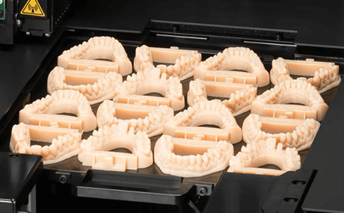
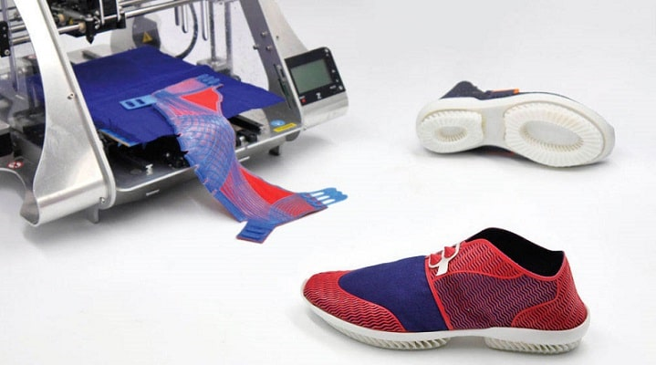
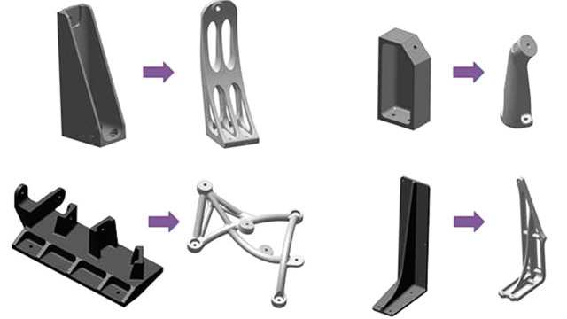
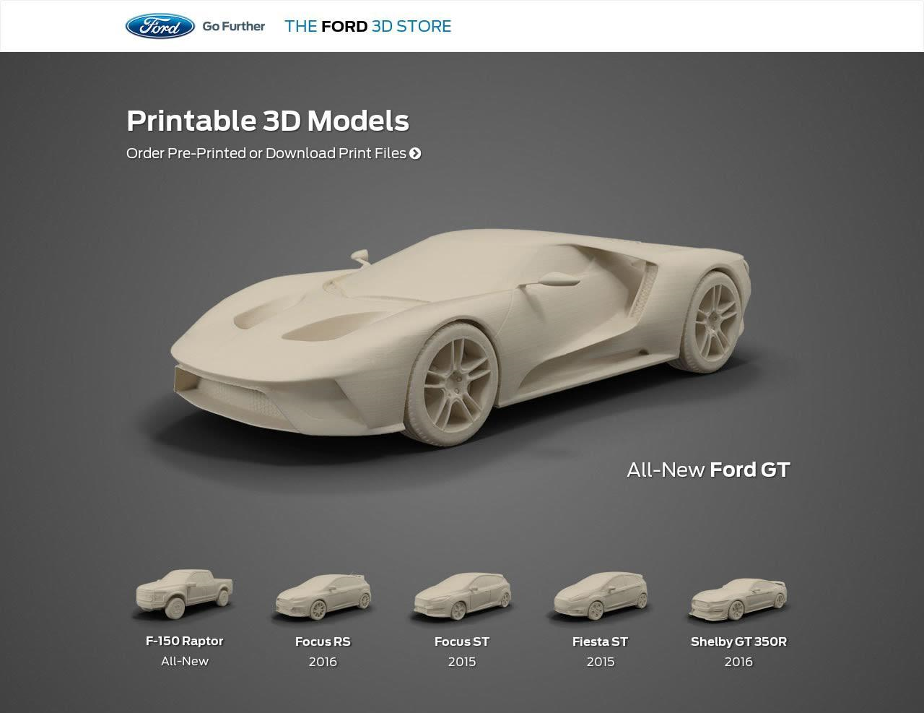
Application 3D Printing
MEDICAL & DENTAL
FASHION & CLOTHING
MANUFACTURING
CAR MANUFACTURER

Slide 24
3D PRINTING
Creates objects by an additive process, using a computer-driven device that reads a digital model

Slide 25
THINGIVERSE CLASSIFICATION

Slide 26
Thank You !
End

