Slide 1
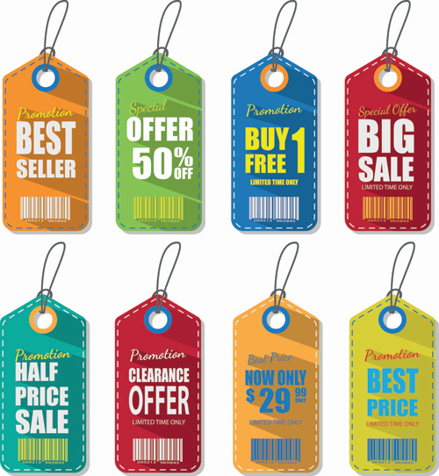
Section 5 Digital Tools for Setting the Right Price
Digital Marketing
Prepared for
Magister Management Class
Esa Unggul University
Prepared by
Diana Fajarwati

Slide 2
Syllabus
The first half of semesters will explore the digital marketing concepts
1
Marketing in Digital World
4
Digital Tools for Effectively Distribution
7
Digital Analytic for Marketing Professional #1
What is Digital Marketing
History of Digital Marketing
The Changes of Consumer Behavior
Basic Concept: Place
Digital Concept: New Retail
Digital Concept: 3D Printer
Pengumpulan data-data sosial media
Kerangka analisa
Visualisasi data
2
Digital Tools for Developing Innovative Product
5
Digital Tools for Setting Right Price
8
Marketing in an Analog World
Basic Concept: Product
Digital Concept: Customer Co-Creation
Digital Concept: Doppelgänger Brand
Basic Concept: Price
Digital Concept: Pay what you want
Digital Concept: Pricing comparison tools
Analog vs Digital
4 cara dunia analog mempengaruhi digital
Transformasi analog ke digital
3
Digital Tools for Persuading Costumers
6
Digital Analytic for Marketing Professional #1
Basic Concept: Promotion
Digital Concept: Authenticity
Digital Concept: User-Generated Content
Memahami berbagai web analytics
Kerangka analytic dan memilih web analytic yang tepat

Slide 3
Basic Concept :
?
What is a Price ?
How are digital tools changing this part of the marketing mix?
?
Two key PRICING concepts:
Price Comparison Tools and Pay What You Want (PWYW)
Notes:
How should a firm determine the price of its products? This is an important but difficult question. In this video, Professor Rindfleisch explores the topic of price and examines two key digital pricing concepts: Price Comparison Tools and Pay What You Want (PWYW). He then explores how new digital tools are impacting the way in which products are priced.

Slide 4
Product
Promotion
Price
Place

Slide 5
Product
Promotion
Pricing is amount that a customer pays for a product
Price
Place
Price capture value for the firm
Notes:
rice is different from the other three elements
of the marketing mix.
Product, promotion,
and placement all create value for a customer.
Instead price captures this value
and brings it back in to the firm.
Thus having a good pricing strategy is critical
for your firm's profitability and basic survival.

Slide 6
KEY CONCEPTS
Break Even Analysis
Price Elasticity
Reference prices.

Slide 7
PRICING STRATEGY
COST-BASED PRICING
a technique in which the price of a product is based upon the cost of manufacturing or acquiring this product plus a commonly accepted markup percentage
COMPETIOR BASED PRICING
a strategy in which the price of a product is based on closely matching the price of relevant competitors
VALUE BASED PRICING
a strategy in which the focus is on the added value that a product provides to its customers.

Slide 8
PRICE KNOWLEDGE
Knowledge helps set price expectations and also gives customers more power in the marketplace.

Slide 9
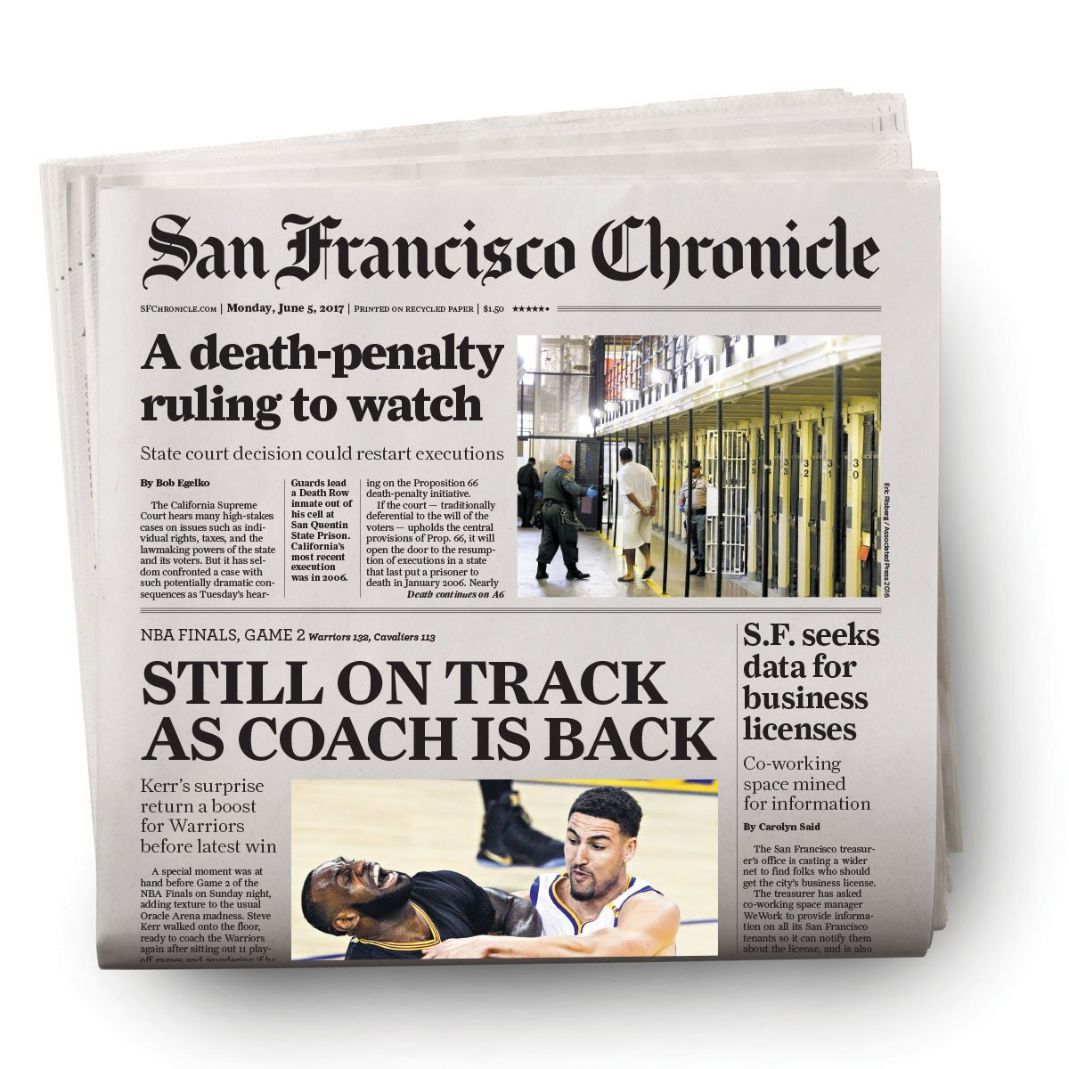
WHAT’S CHANGING
Traditional
don't know the exact price until we see it on the shelf
This firm centered approach is starting to break down due to the rise of digital tools.

Slide 10
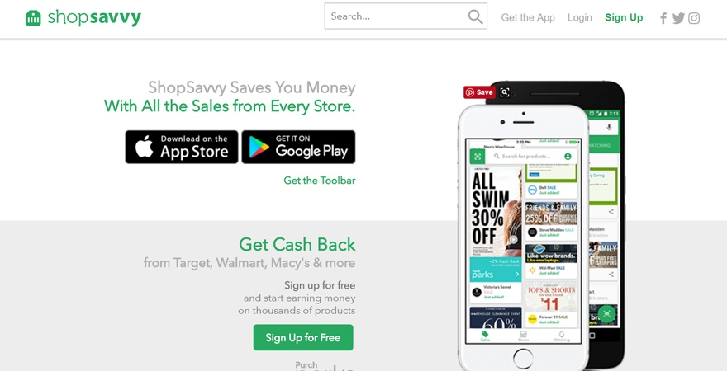
Moving from prices revealed at the point of purchase to prices negotiated at the point of consideration.

Slide 11
DIGITAL CONCEPT #1 PAY WHAT YOU WANT
Notes:
Most firms set the prices for their products. Thus, if a customer wants to buy a product, they have to pay this price. However, for some customers this price is too high and for others it is too low. The rise of new digital tools is enabling customers to set their own price. This innovative pricing strategy is called Pay What You Want (PWYW) and is quickly spreading across multiple industries. This video lecture introduces this concept, provides examples of how it is being used, and discusses its implications for both consumers and firms.

Slide 12
BASIC IDEA
PRICE too HIGH
Lose Potential sales
PRICE too LOW
Lose Potential Profit

Slide 13
PRICE SEGMENTATION
The setting of these different price segments has been traditionally determined by firms rather than customers.
Change….
Allowing the customers to segment themselves by letting them name their own price.

Slide 14
PAY WHAT YOU WANT (PWYW)
A Pricing strategy that lets customers decide how much they want to pay for a particular products
Work Well
Digital Environment
Firm’s control distribution product
Track customer payment activity in digital platform

Slide 15
HEADSETS.COM

Slide 16
DIGITAL CONCEPT #2 PRICE COMPARISON
Notes:
Before the rise of digital tools, the price of a product was often not known until a consumer was actually at the retail location and saw the price on the shelf. The Internet changed all this by making prices much more visible and by allowing customers to see the price of a product prior to entering a store. Today, customers have even more power, as there are now a number of price comparison tools that allow customers to easily compare prices across a number of retailers (both physical and online). This video lecture will introduce these tools, provide some examples, and discuss how firms can respond to this new technological development.

Slide 17
BASIC IDEA
Especially important for expensive products, such as appliances, furniture, and automobiles, in which prices can vary substantially from one retailer to another.
Today, customers have even more power due to price comparison tools

Slide 18
BASIC IDEA
Mobile Platform
Customers can compare price before going to or while at the store

Slide 19
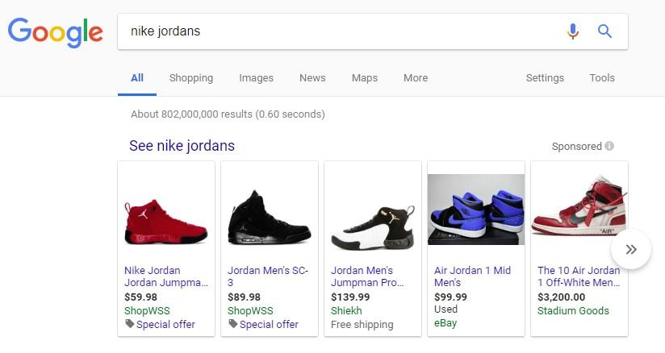
GOOGLE SHOPPING

Slide 20
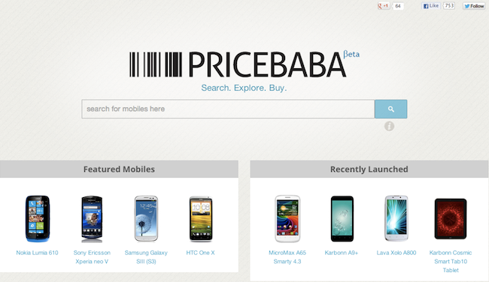
PRICEBABA

Slide 21
PRICE COMPARISON TOOL
a digital platform that provides shoppers with the ability to easily compare prices across a set of retailers that can be both online as well as physical retailers.
Some price comparison tools focus on a single product category while others cover a much wider range of products

Slide 22
KEY ISSUE
Information On :
Comparative Prices
Shipping Cists
Retailer
Product Review
Product Photos
How do They Work
Free to use
Earn money through advertising
Vendors typically pay a fee
Easy to use
Price data comes from variety sources
Save Customers Money?
Customers somewhat lower price than those ho don’t
None of these tools are perfect
Customers may exercise caution when using them

Slide 23
Thank You !
End

