Slide 1
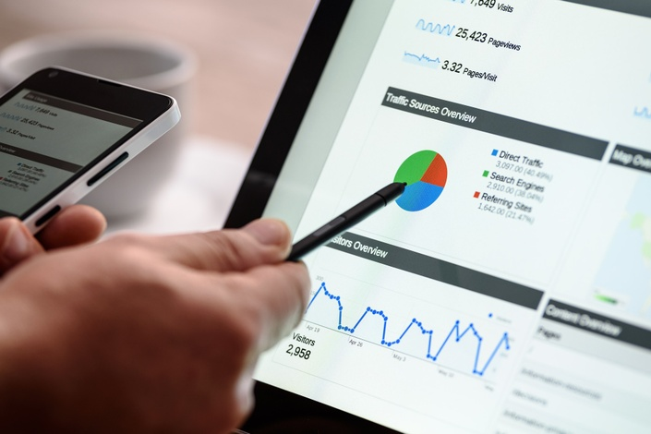
Section 7 Digital Analytic for Marketing Professional - Practice
Digital Marketing
Prepared for
Magister Management Class
Esa Unggul University
Prepared by
Diana Fajarwati

Slide 2
Syllabus
The first half of semesters will explore the digital marketing concepts
1
Marketing in Digital World
4
Digital Tools for Effectively Distribution
7
Digital Analytic for Marketing Professional #1
What is Digital Marketing
History of Digital Marketing
The Changes of Consumer Behavior
Basic Concept: Place
Digital Concept: New Retail
Digital Concept: 3D Printer
Pengumpulan data-data sosial media
Kerangka analisa
Visualisasi data
2
Digital Tools for Developing Innovative Product
5
Digital Tools for Setting Right Price
8
Marketing in an Analog World
Basic Concept: Product
Digital Concept: Customer Co-Creation
Digital Concept: Doppelgänger Brand
Basic Concept: Price
Digital Concept: Pay what you want
Digital Concept: Pricing comparison tools
Analog vs Digital
4 cara dunia analog mempengaruhi digital
Transformasi analog ke digital
3
Digital Tools for Persuading Costumers
6
Digital Analytic for Marketing Professional #1
Basic Concept: Promotion
Digital Concept: Authenticity
Digital Concept: User-Generated Content
Memahami berbagai web analytics
Kerangka analytic dan memilih web analytic yang tepat

Slide 3
Objectives for Marketing Analytics in Theory
Gain an understanding of the data collection and analysis methods used by marketing professionals
Learn how to evaluate and choose appropriate web analytics tools and techniques for your analysis
Understand frameworks and approaches to measuring consumer action
Earn familiarity with the unique measurement opportunities and challenges presented by New Media

Slide 5
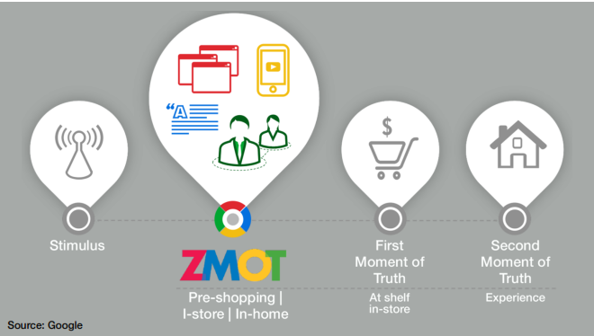

Slide 6
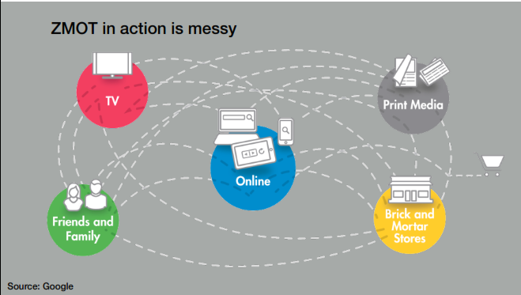

Slide 7
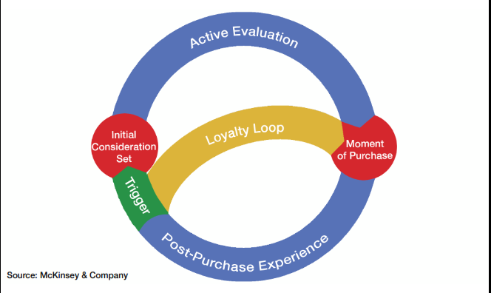

Slide 8
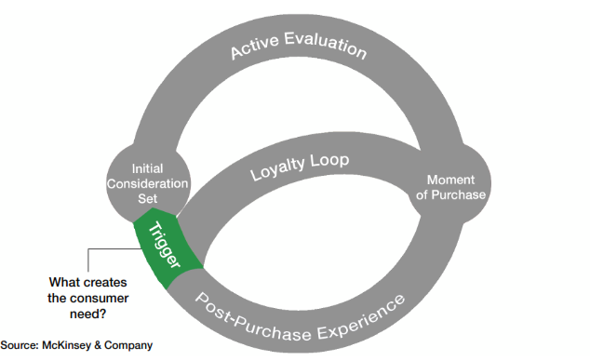

Slide 9
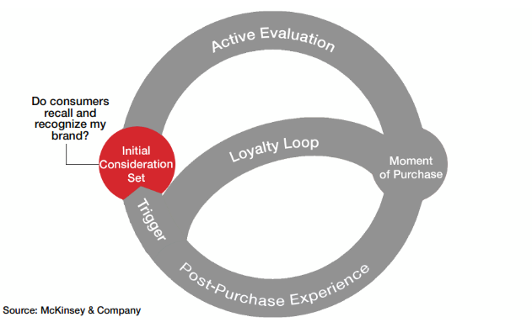

Slide 10
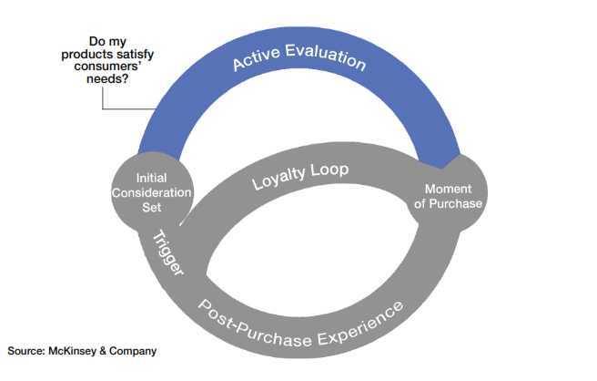

Slide 11
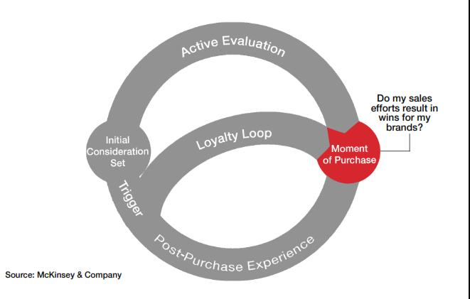

Slide 12
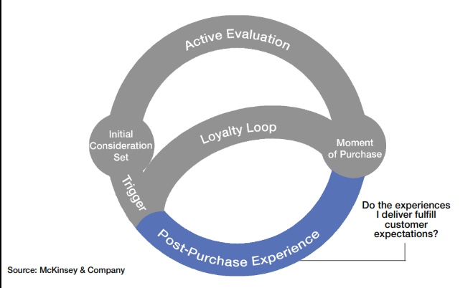

Slide 13
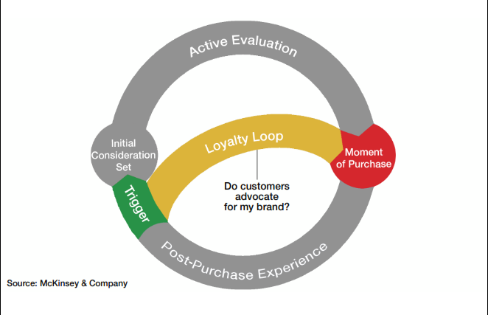

Slide 14
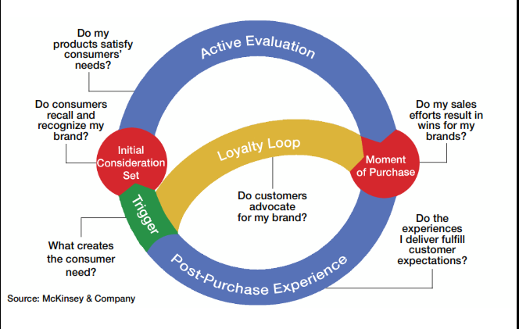

Slide 15
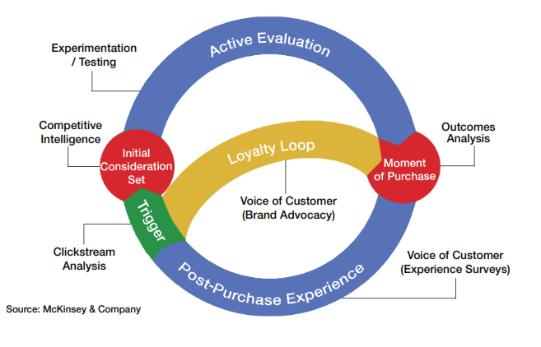

Slide 19
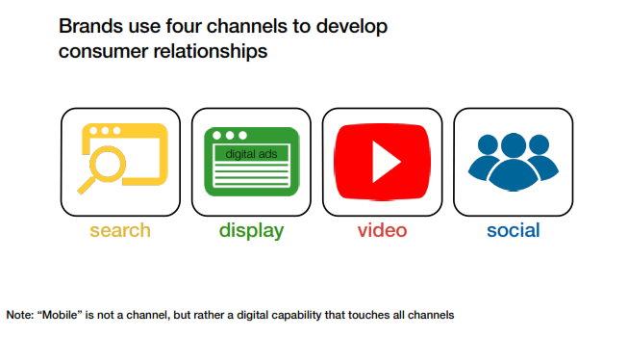

Slide 22
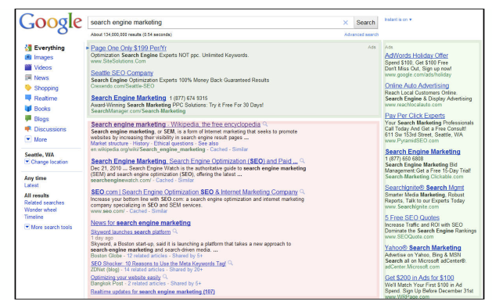

Slide 23
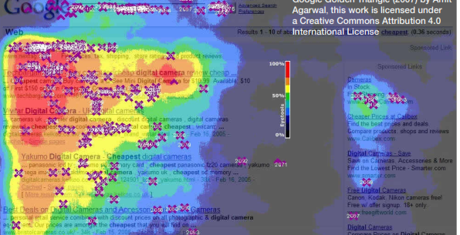

Slide 26
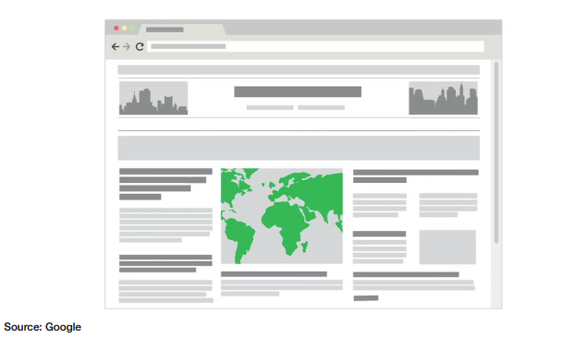

Slide 31
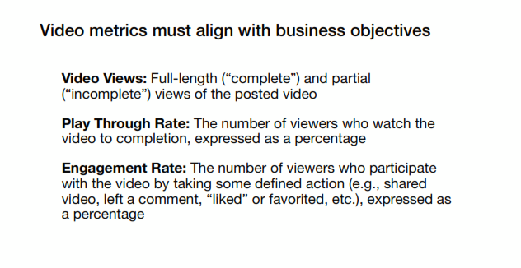

Slide 33
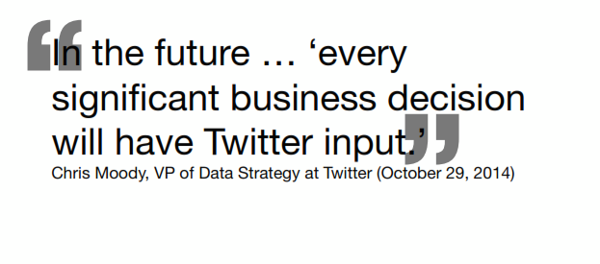

Slide 35
Thank You !
End

