Slide 1
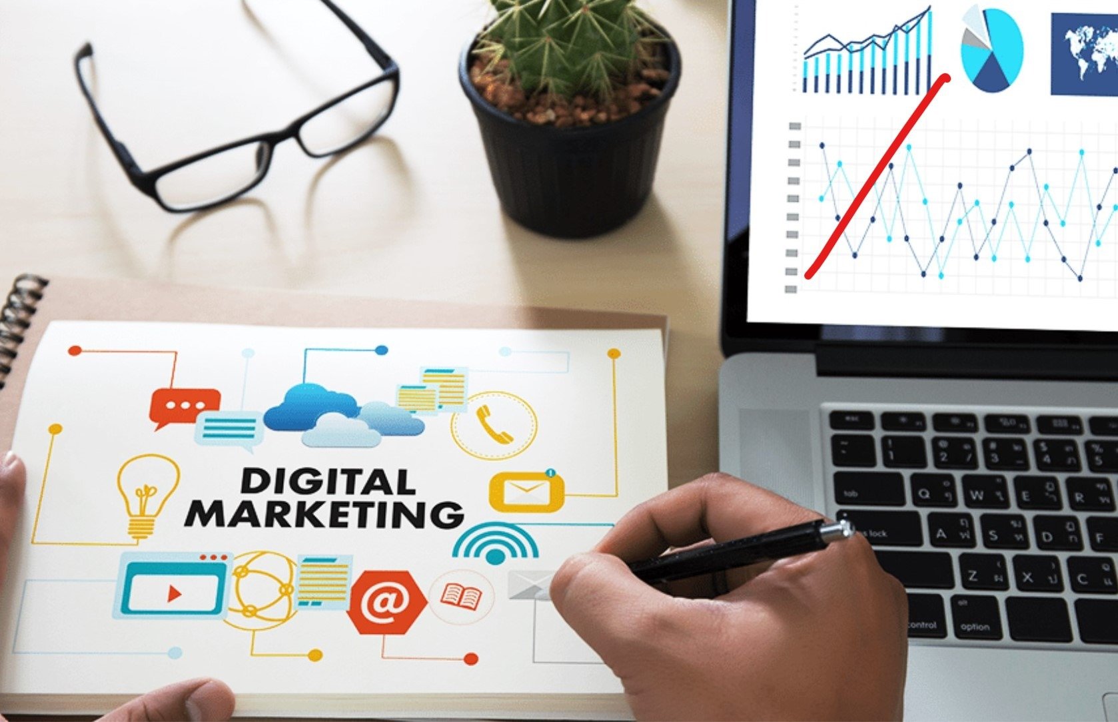
Digital Marketing SET UP A MARKET RESEARCH
Section 9
Prepared for
Magister Management Class
Esa Unggul University
Prepared by
Diana Fajarwati
KHI, 4 Mei 2019

Slide 2
Syllabus
The first half of semesters will explore the digital marketing concepts
1
Marketing in Digital World
4
Digital Tools for Effectively Distribution
7
Digital Analytic for Marketing Professional #1
What is Digital Marketing
History of Digital Marketing
The Changes of Consumer Behavior
Basic Concept: Place
Digital Concept: New Retail
Digital Concept: 3D Printer
Pengumpulan data-data sosial media
Kerangka analisa
Visualisasi data
2
Digital Tools for Developing Innovative Product
5
Digital Tools for Setting Right Price
8
Marketing in an Analog World
Basic Concept: Product
Digital Concept: Customer Co-Creation
Digital Concept: Doppelgänger Brand
Basic Concept: Price
Digital Concept: Pay what you want
Digital Concept: Pricing comparison tools
Analog vs Digital
4 cara dunia analog mempengaruhi digital
Transformasi analog ke digital
3
Digital Tools for Persuading Costumers
6
Digital Analytic for Marketing Professional #1
Basic Concept: Promotion
Digital Concept: Authenticity
Digital Concept: User-Generated Content
Memahami berbagai web analytics
Kerangka analytic dan memilih web analytic yang tepat

Slide 3
Syllabus
…… while the second half of semester will exercise some online tools
9
Set Up Market Research
4
Search Engine Marketing
7
E-Commerce/ Marketplace
Web analytic type and usage
Exercise : Google Analytics
Concept of SEO
Exercise : creating keyword, text search
E-commerce concept
Exercise : Lazada account
10
Email Marketing
5
Video Marketing
8
Wrap Up
Why company need e-mail marketing to growth the business
Exercise : MailChimp
Element and content of attractive video marketing
Exercise : creating YouTube account
Summary all the subject
Finale assignment
3
Display Marketing
6
Social Media Marketing
Introduction wordpress, wix, weeby
Exercise ; creating own website
Different form of social media, the rule of engagement
Exercise : Facebook Marketing

Slide 5
Where it All Begin ?

Slide 6
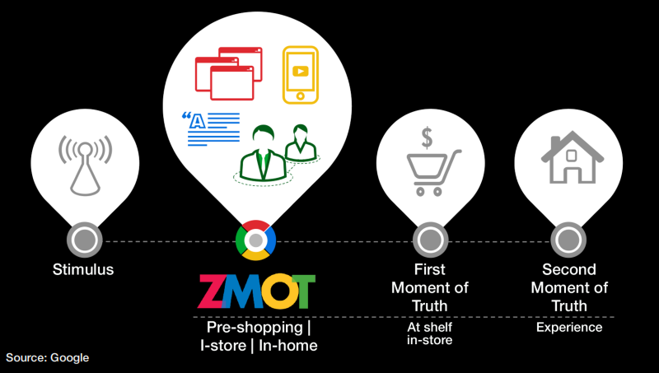

Slide 7
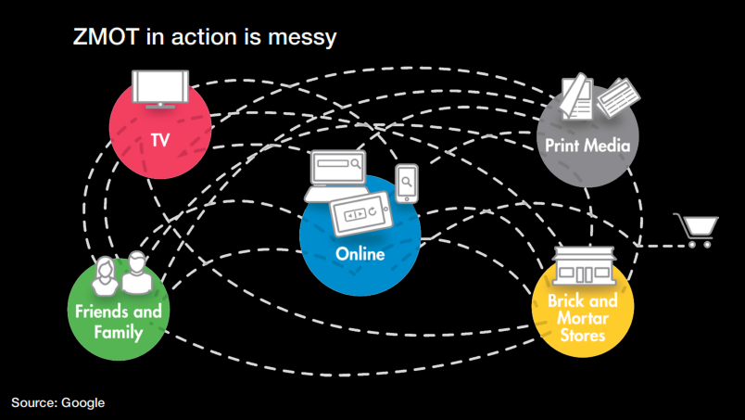

Slide 8
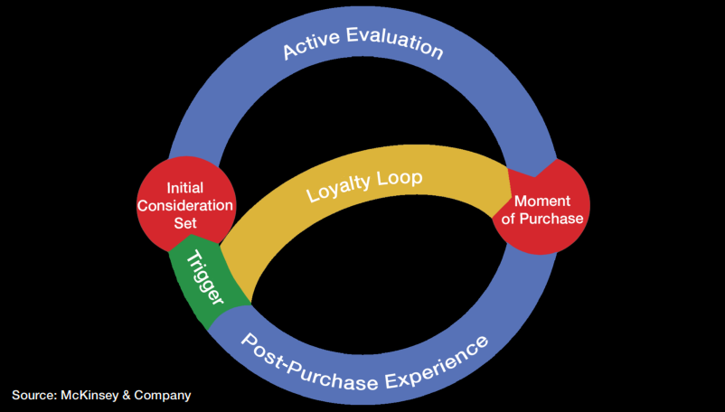

Slide 9
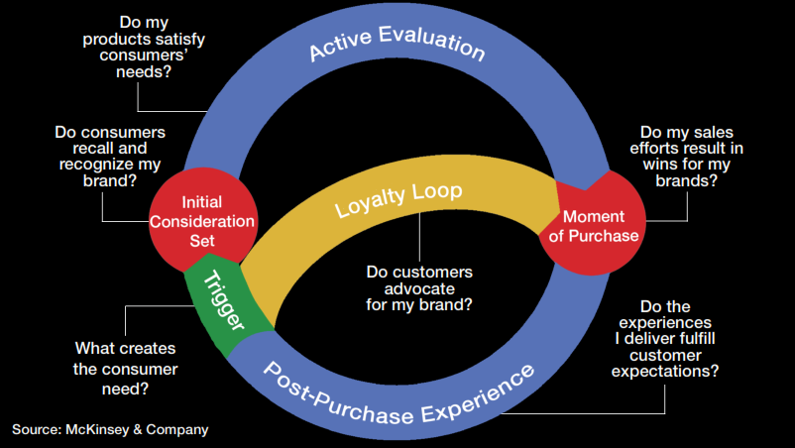

Slide 10
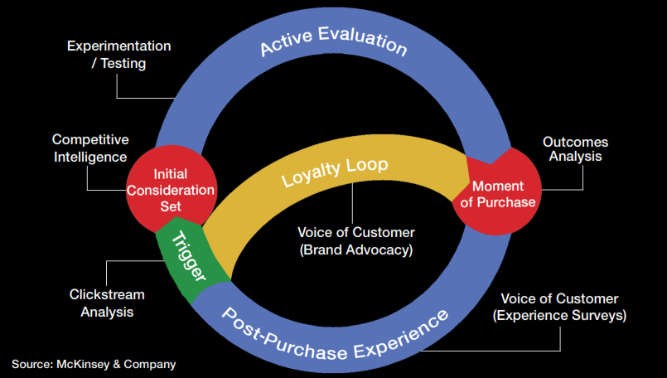

Slide 14
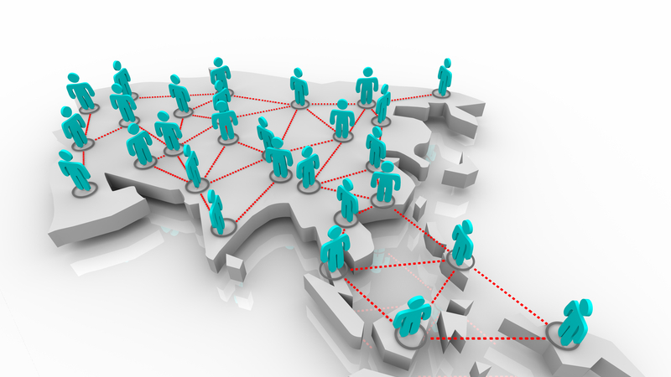
Google Trends

Slide 16
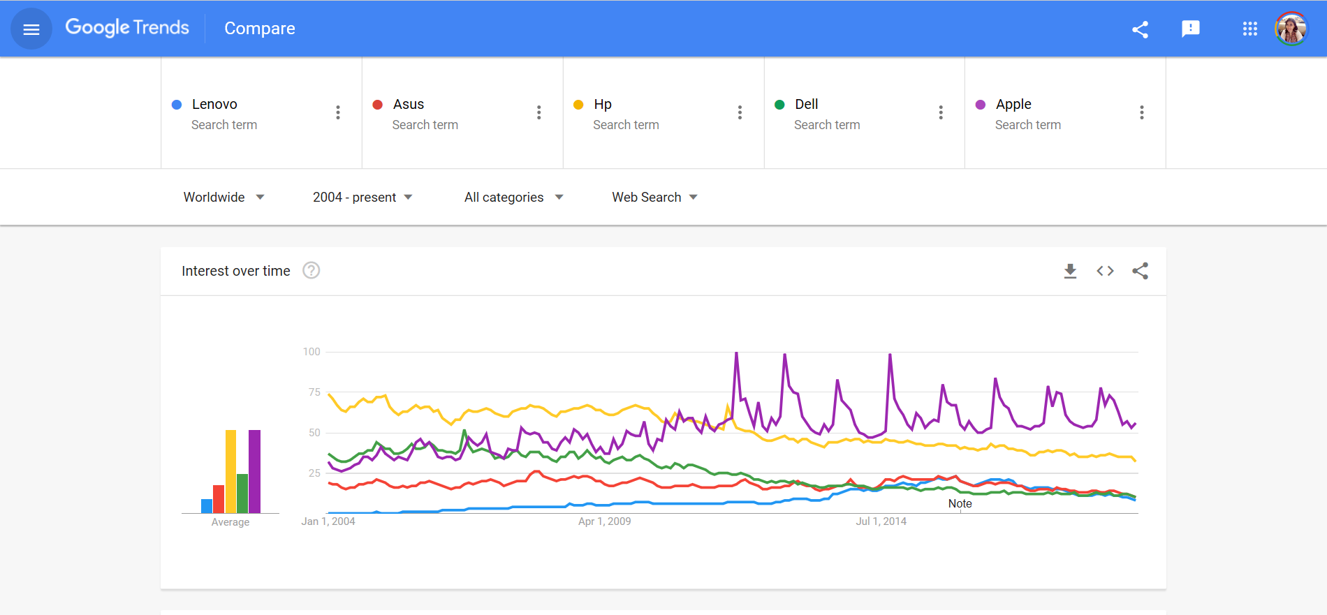
Google Trends Usage
1. Measure Brand Popularity

Slide 17
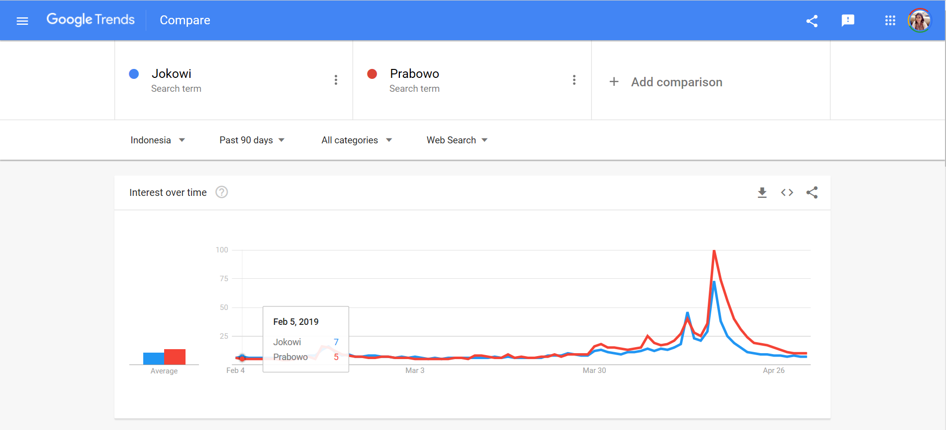

Slide 18
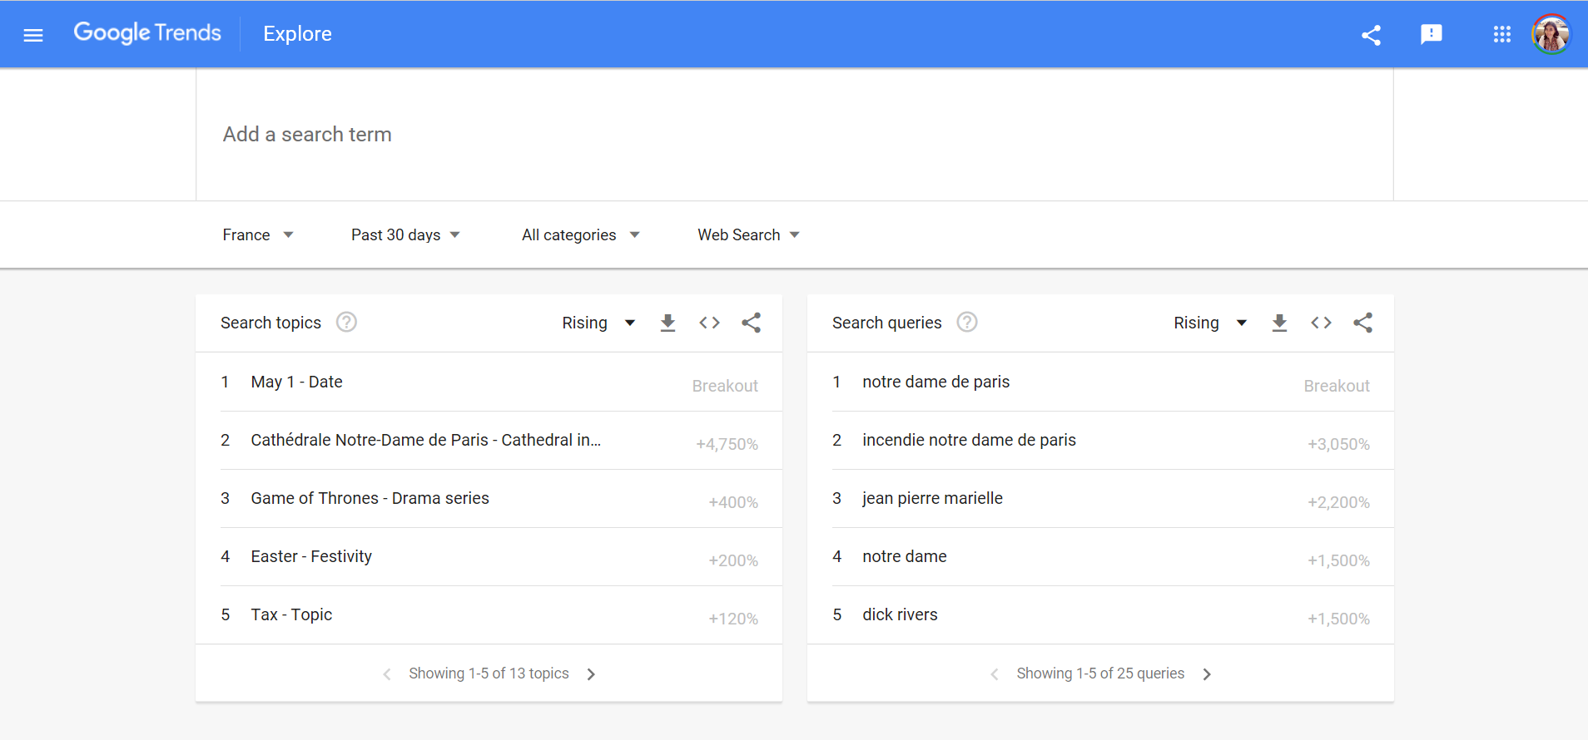
2. Prepare a Business Trip

Slide 19
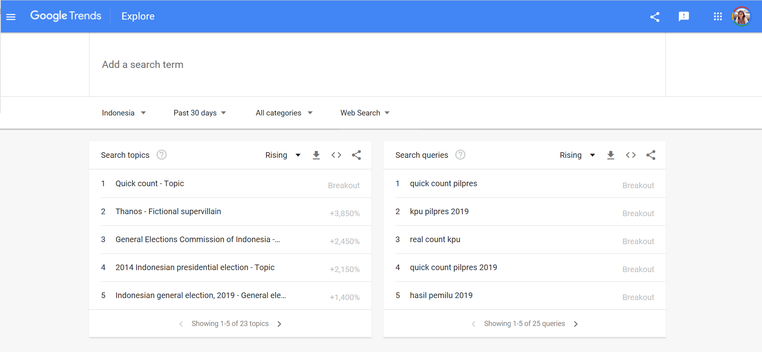

Slide 20
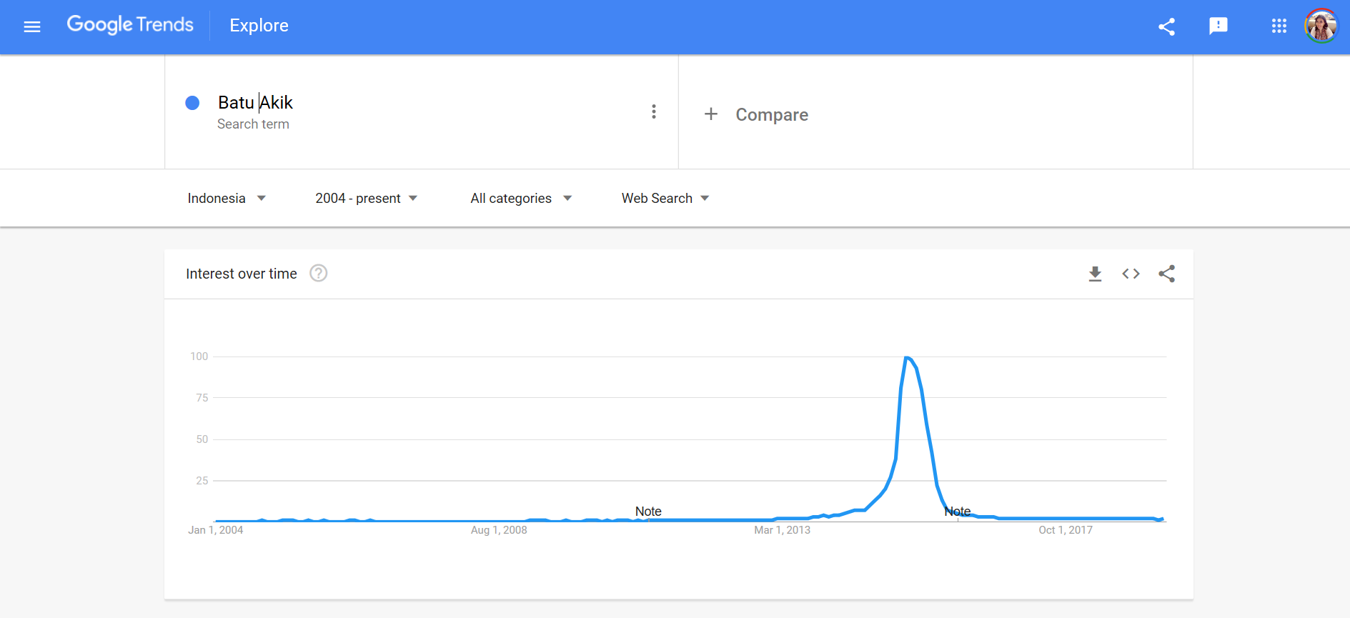
3. Track a Trends

Slide 21
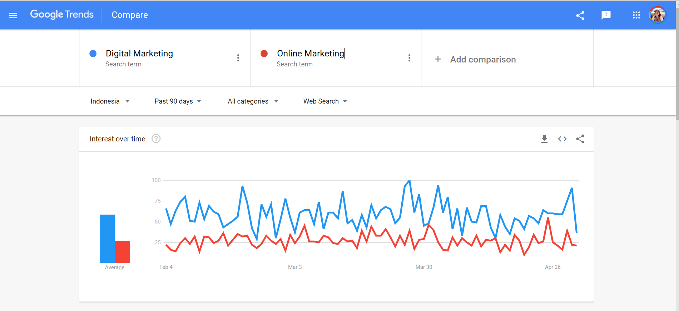
4. Effective Communication

Slide 22
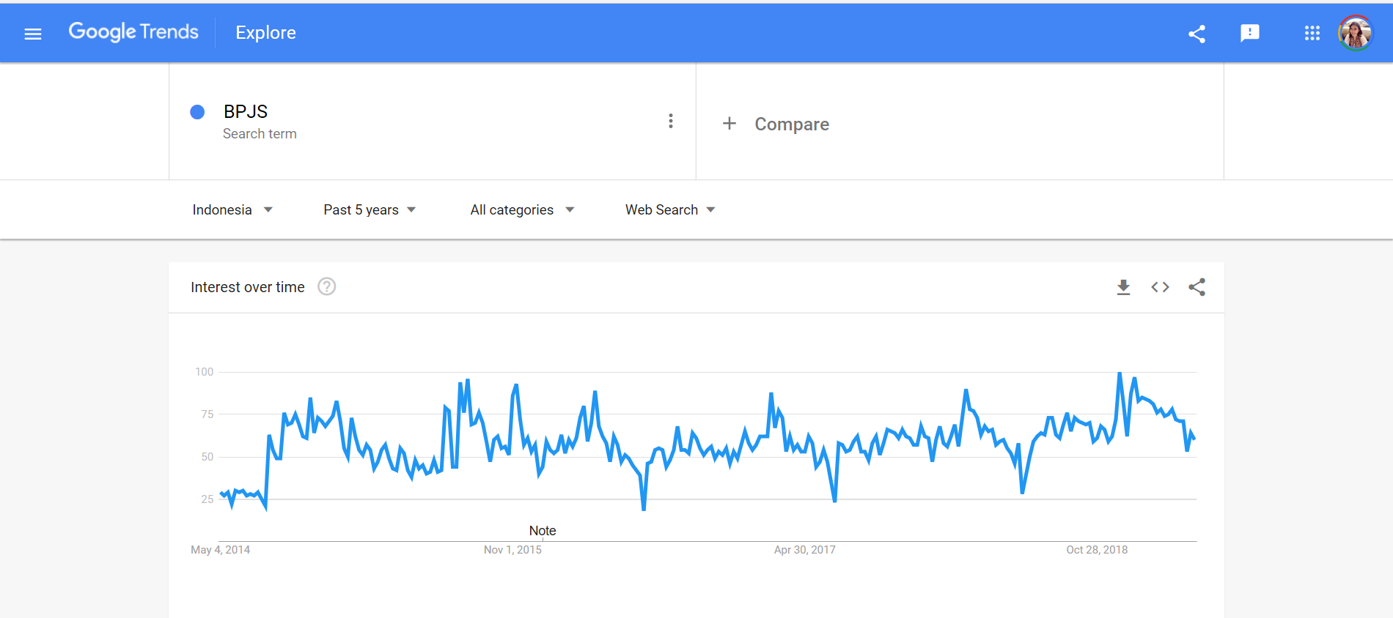
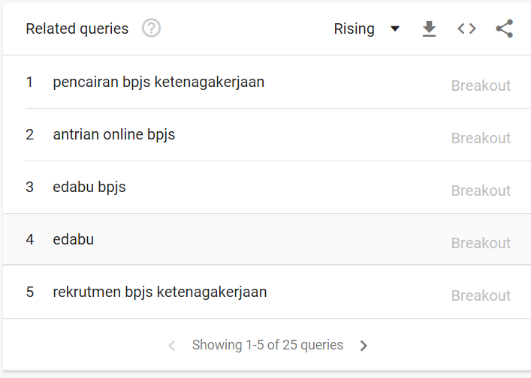
5. Related Key Word

Slide 23
Think with Google

Slide 24
Consumer Insight
Explore real-time data to glean insights about consumer research, shopping and purchase behaviors. Make more strategic decisions about your marketing campaigns and ad spending.

Slide 25
Google Survey

Slide 26
How to Find a Hungry-to-Buy Audience with 3 Simple Questions
What is Biggest problem with xxx
Why would it make a difference in your by to get a good answer for the problem or get a solution for a your need ?
How difficult had it been for you ?

Slide 27
Major Issue
How to create Contact
Export from Google
Export from LinkedIN
Subject Line
Interesting and appealing for Audience
Posting Through Social Media
Facebook Fan Page
Joint the Group List

Slide 28
How to Get Valuable Feedback Without Sending a Survey
1. Meet people in person
“what is the biggest single problem to do your business”
What different you get when you can managing good employee
2. Go to FB Group and see the conversation
See from conversation
3. See from the review from market place
Tripadvisor -- see what people like, and people not happy

Slide 29
Thank You !
End

