Slide 1
APAYANG DAPAT DIUBAH DARI ORGANISASI?
PERTEMUAN #2
|
MANAJEMEN PERUBAHAN
6097 – RINA ANINDITA
PROGRAM STUDI MANAJEMEN
FAKULTAS EKONOMI DAN BISNIS
UNIVERSITAS ESA UNGGUL

Slide 2
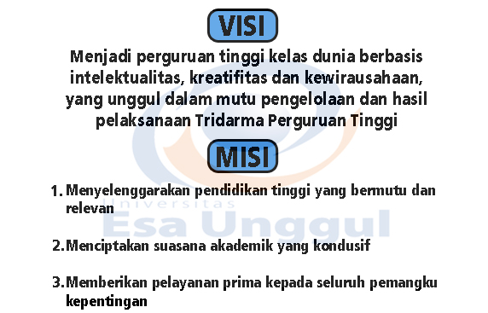
VISI DAN MISI UNIVERSITAS ESA UNGGUL

Slide 3
Symbols, Heroes, Rituals, and Values
Symbols
Heroes
Rituals
Practices
Values
The ‘onion diagram’ : manifestations of culture at different levels of depth
16

Slide 4
Symbols, Heroes, Rituals, and Values (Cont.)
Symbols : word, gestures, pictures or objects that carry a particular meaning which is only recognized by those who share the culture
Heroes : persons, alive or dead, real or imaginary, who possess characteristics which are highly prized in a culture, and who thus serve as models for behavior
Rituals : collective activities, technically superfluous in reaching desired ends, but which, within a culture, are considered as socially essential, they are therefore carried out for their own sake
17

Slide 5
Symbols, Heroes, Rituala, and Values (Cont.)
Values :
  broad tendencies to prefer certain states of affairs over others
  feelings with an arrow to it, they have a plus and a minus side
  among the first things children learn-not consciously, but implicitly
18

Slide 6
Layers of Culture
A national level according to one’s country (or countries for people who migrated during their lifetime)
A regional and/or ethnic and/or religious and/or linguistic affiliation level, as most nations are composed of culturally different regions and/or ethnic and/or religious and/or language groups
A gender level, according to whether a person was born as a girl or as a boy
19

Slide 7
Layers of Culture (Cont.)
A generation level, which separates grandparents from parents from children
A social class level, associated with educational opportunities and with a person’s occupation or profession
For those who employees, an organizational or corporate level according to the way employees have been socialized by their work organization
20

Slide 8
Dimensions of National Cultures
A dimension is as aspect of a culture that can be measured relative to other cultures
The basic problem areas correspond to dimensions which named
  Power distance (from small to large)
  Collectivism versus individualism
  Feminine versus masculinity
  Uncertainly avoidance (from weak to strong)
21

Slide 9
Dimensions of National Cultures (Cont.)
Power distance : the extent to which the less powerful members of institutions and organizations within a country expect and accept that power is distributed unequally
Individualism pertains to societies in which the ties between individuals are loose: everyone is expected to look after himself or herself and his or her immediate family
22

Slide 10
Dimensions of National Cultures (Cont.)
Collectivism as its opposite pertains to societies in which people from birth onward are integrated into strong, cohesive in-groups, which throughout people’s lifetimes continue to protect them in exchange for unquestioning loyalty
A society is called masculine when emotional gender roles are clearly distinct: men are supposed to be assertive, tough, and focused on material success, whereas women are supposed to be more modest, tender and concerned with the quality of life
23

Slide 11
Dimensions of National Cultures (Cont.)
A society is called feminine when emotional gender roles overlap: both men and women are supposed to be modest, tender, and concerned with the equality of life
Uncertainly avoidance can therefore be defined as the extent to which the members of a culture feel threatened by ambiguous or unknown situations
24

Slide 12
SEKIAN
DAN
TERIMA KASIH

