Slide 1
Measuring and improving key sales driver and sales strategy

Slide 2
The world of Sales -

Slide 5
Case of Shell ..

Slide 6
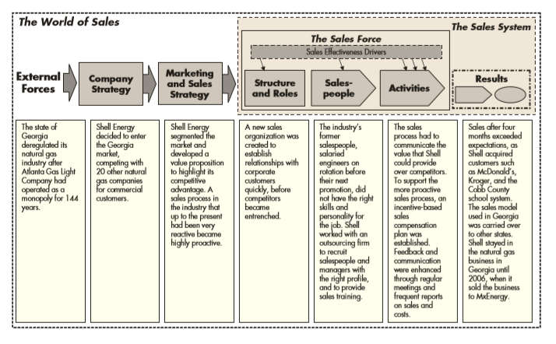

Slide 7
Case Discussion – what to look at
Definers
Define new sales roles/territories
Sharpers
Establish sales hiring profile
Recruit and train sales people
Enlightener
Provide information about new customer if they want to be successful
New managerial structure for the new sales organization
Exciters
Provide compensation plan that would motivate salespeople
Controllers
Need to set up goals for sales people and establish ongoing feedback system

Slide 8
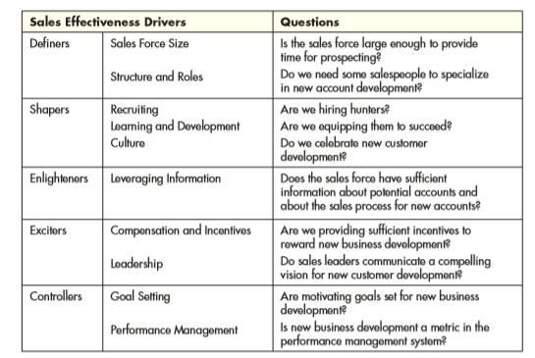
Looking at your sales drivers

Slide 9
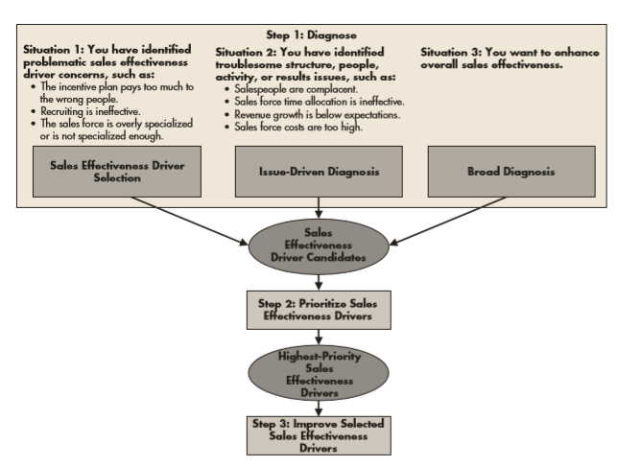
How to measure and fix sales problem

Slide 10
Sales system problem diagnosis

Slide 11
Sales Strategy
Sales strategy defines who a company’s customer are, what the value proposition is and how the selling is done
It is the communication and activities that need to take place between company and customer with the goal of understanding customer needs and how company product and services can create value by meeting those needs.
Good sales strategy must have:
Focuses sales force attention on attractive market segments that value the company’s offering.
• Create value proposition and the sales process to each market segment’s specific needs.
• Defines cost-efficient sales processes that communicate the value that the offering creates for customers.

Slide 12
Example of sales strategy

