Slide 1
Sales Strategy and Key Account

Slide 2
Key to winning Sales force
Focus on Company Result
Focus on Sales People
Focus on Customer Result (loyalty and trust)
Focus on Sales effective Drivers
Focus on High Quality and Value driven activities

Slide 3
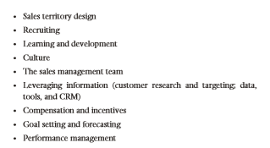
What is Sales effective Drivers?
Sales Strategy
Sales force Size
Sales force structure and roles
Sales Territory design
Recruiting
Learning and Development
Culture
Sales management team
Leveraging information (CRM, data tools, research)
Compensation and incentives
Goal Setting and Forecasting
Performance Management

Slide 4
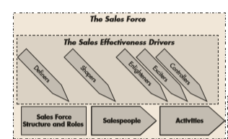
5 Dimension of Winning Sales Force

Slide 5
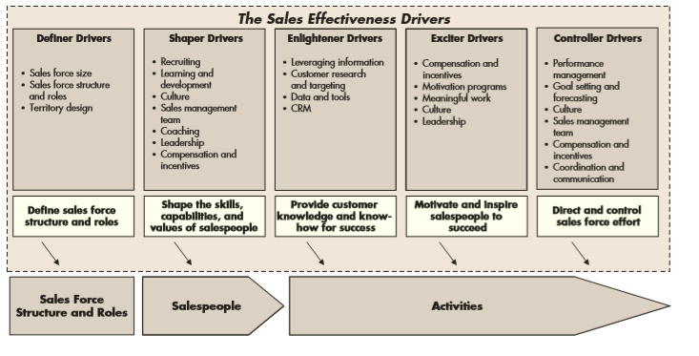
Further on sales effective drivers..

Slide 6
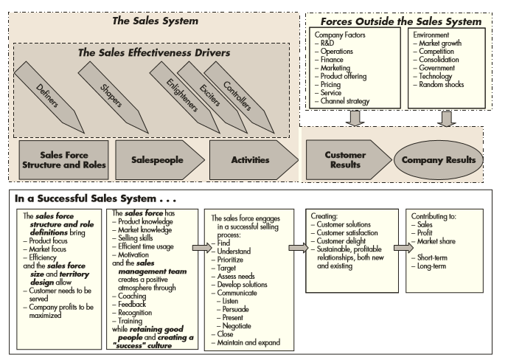
In summary of All…

