Slide 1
Basic Sales Management

Slide 3
Canvas Business Model

Slide 4
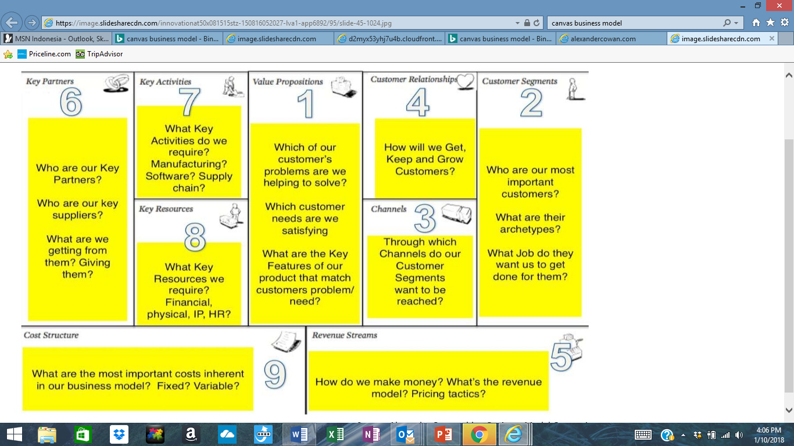
Canvas Business Model

Slide 5
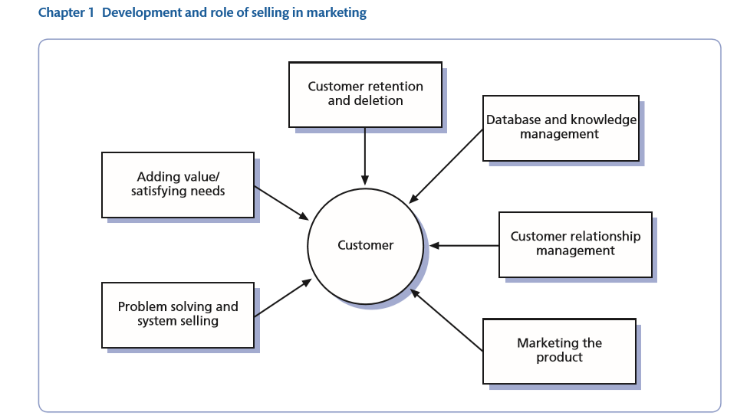

Slide 6
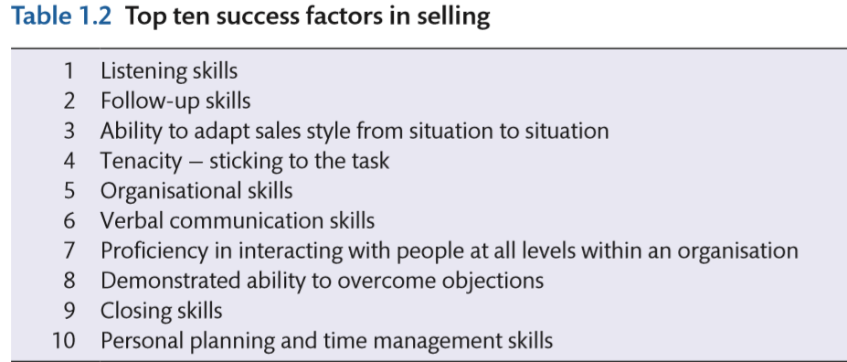
Good sales people must…

Slide 7
5 Dimension of winning sales organization
Sales effective Driver (SED)
Sales Strategy; Sales Force size; structure and roles; territory design; recruiting; learning and development; Culture; Sales management Team; leveraging information (CRM); compensation and incentives; Set Goal and Target; Performance management
Sales People
Having strong sales team; have right value with high performance : low turnover;
Company Result
Ex. Sales value; market Sales; Profitability; growth in the industry
Customer Result
Ex. Deep customer intimacy; loyal customer base; High customer retention
Sales effectiveness Driver (SEO)
Decision; process and system that sales lead is responsible for
Activities
All activities that provide value to consumers; in business development, balancing Hunting and framing

Slide 8
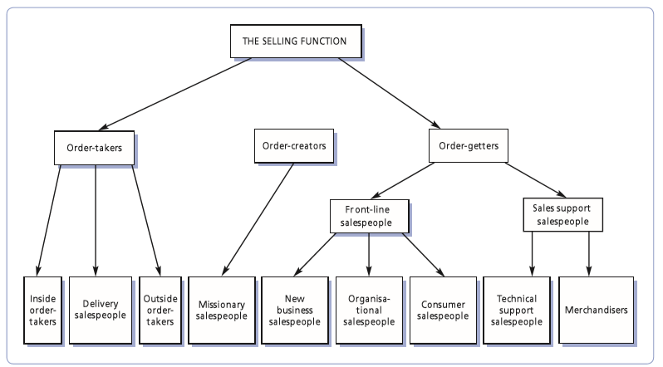

Slide 9
Winning Sales Organization

Slide 10
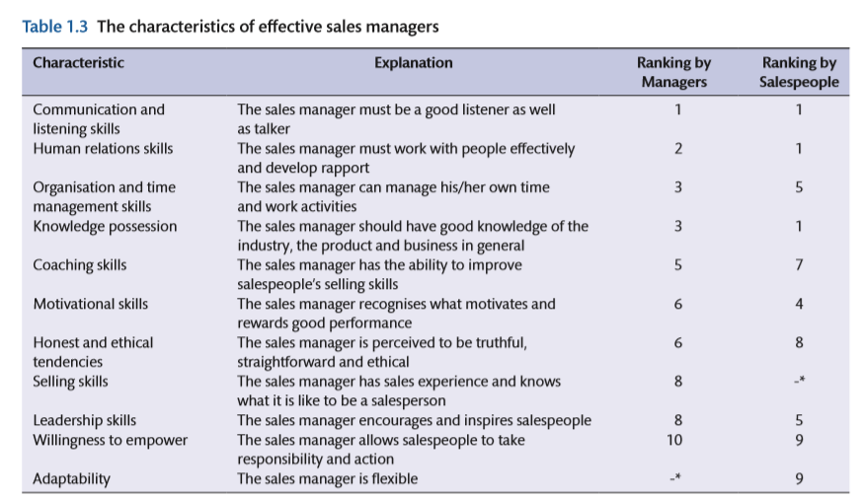

Slide 11
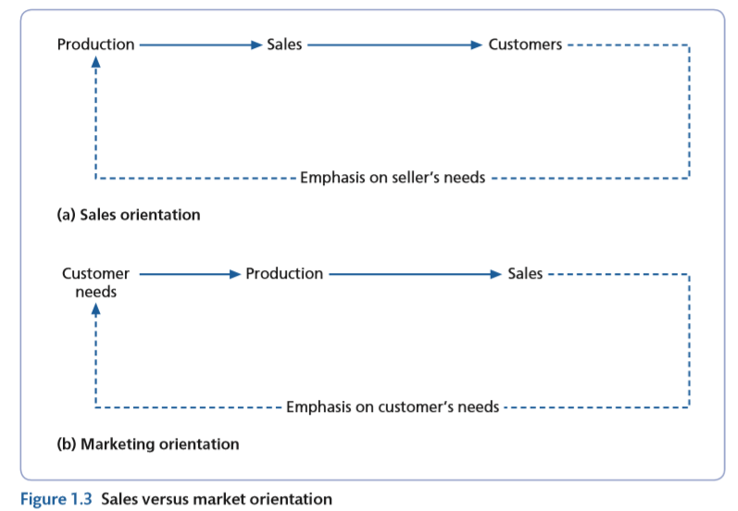
History of sales..

Slide 12
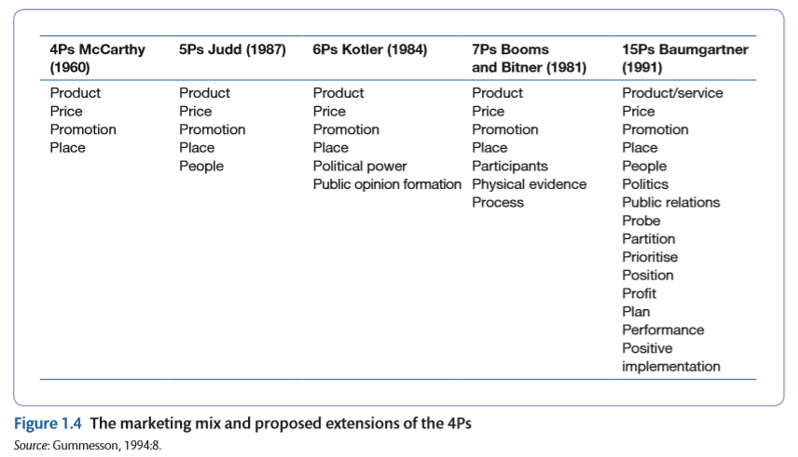

Slide 13
Fundamental of Product management
Product life cycle
Adoption Theory

Slide 14
Product Life Cycles
Cost of development and production
Sales revenue
Net revenue (profit)
Sales, cost, and cash flow
Cash flow
Negative cash flow
Loss
Introduction Growth Maturity Decline
Figure 5.1

Slide 15
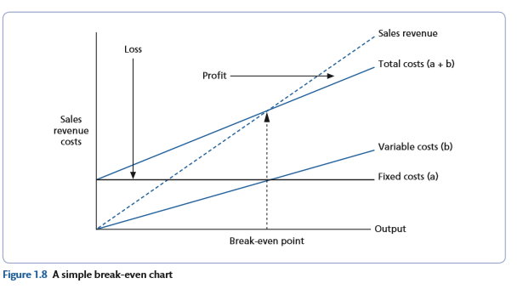
Break even chart

Slide 16
