Slide 1
Winning Sales Organization

Slide 2
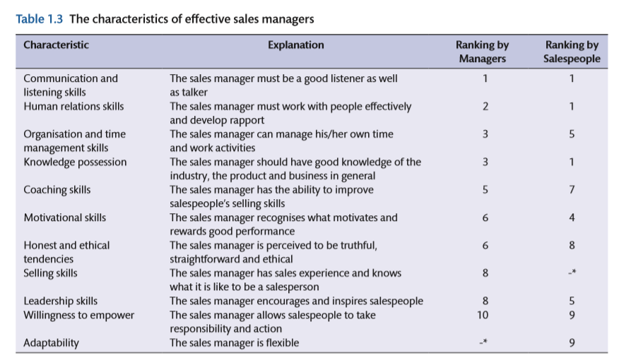

Slide 3
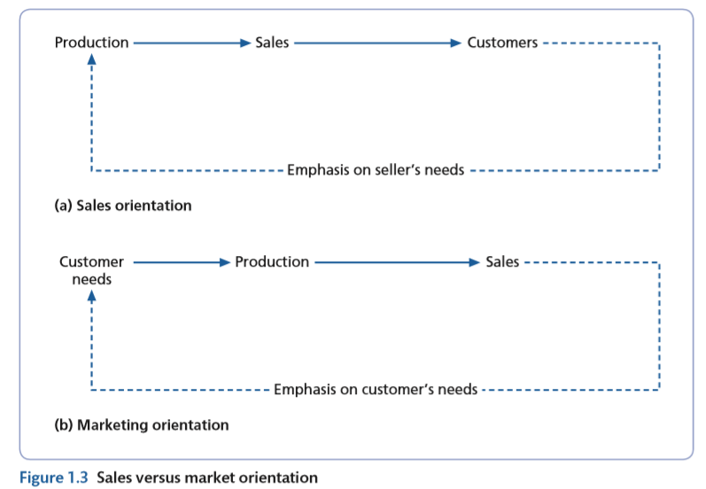
History of sales..

Slide 4
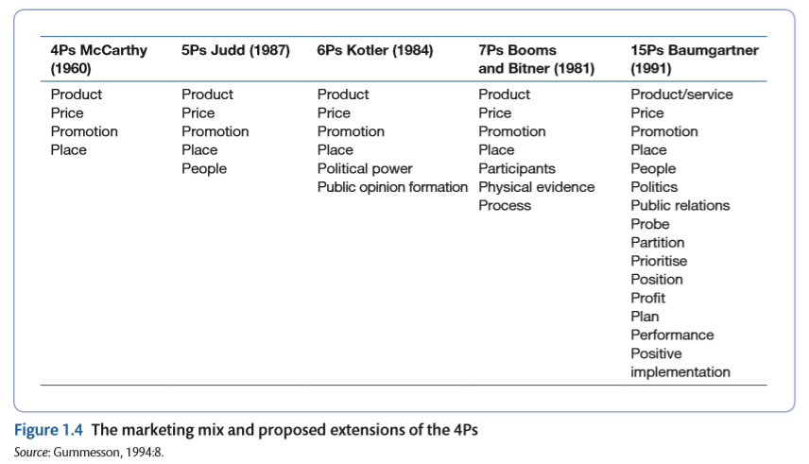

Slide 5
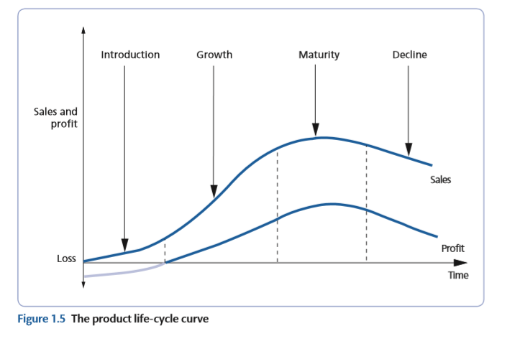
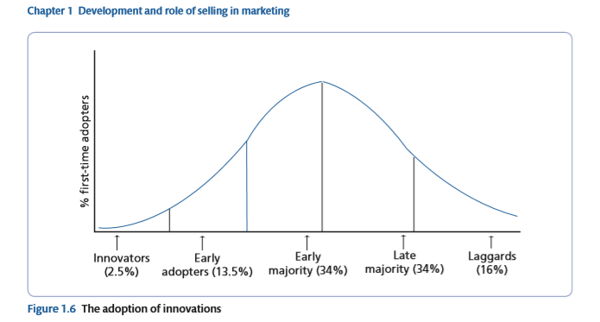
Fundamental of Product management
Product life cycle
Adoption Theory

Slide 6
Product Life Cycles
Cost of development and production
Sales revenue
Net revenue (profit)
Sales, cost, and cash flow
Cash flow
Negative cash flow
Loss
Introduction Growth Maturity Decline
Figure 5.1

Slide 7
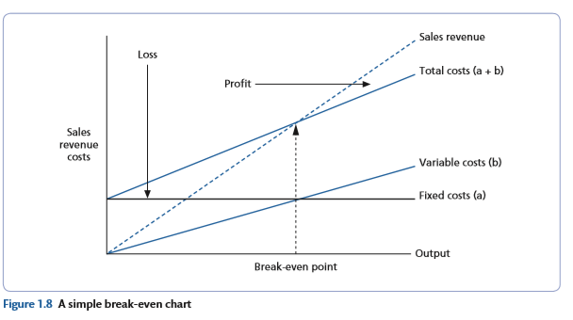
Break even chart

Slide 8
