Slide 1
Financial Modeling
Getting Started

Slide 2
Course Structure
.

Slide 3
Course Structure
Models
In-Class Exercises
MMIL Certification
Project

Slide 4
1] Models
In each class we will develop a model or portion thereof
Each model will be given a due date (generally midnight Friday )
Excel.xlsx
PowerPoint.pptx
[][][][][][][][][][][][][][] [][][]
[][][][][][][][][][][][][][] [][][]
[][][][][][][][][][][][][][] [][][]

Slide 5
1] Models
Models returned with comments
  You are encouraged to resubmit corrected models for 80% of full marks.
  The due date for re-submissions is noon on the day following the next class.
  There are no re-re-submissions

Slide 6
1] Models
We will frequently work a model from class to class.
  If you do not have the previous model completed then you will have nothing with which to work
  If you miss a class remember that the template and class powerpoint are on Compass.

Slide 7
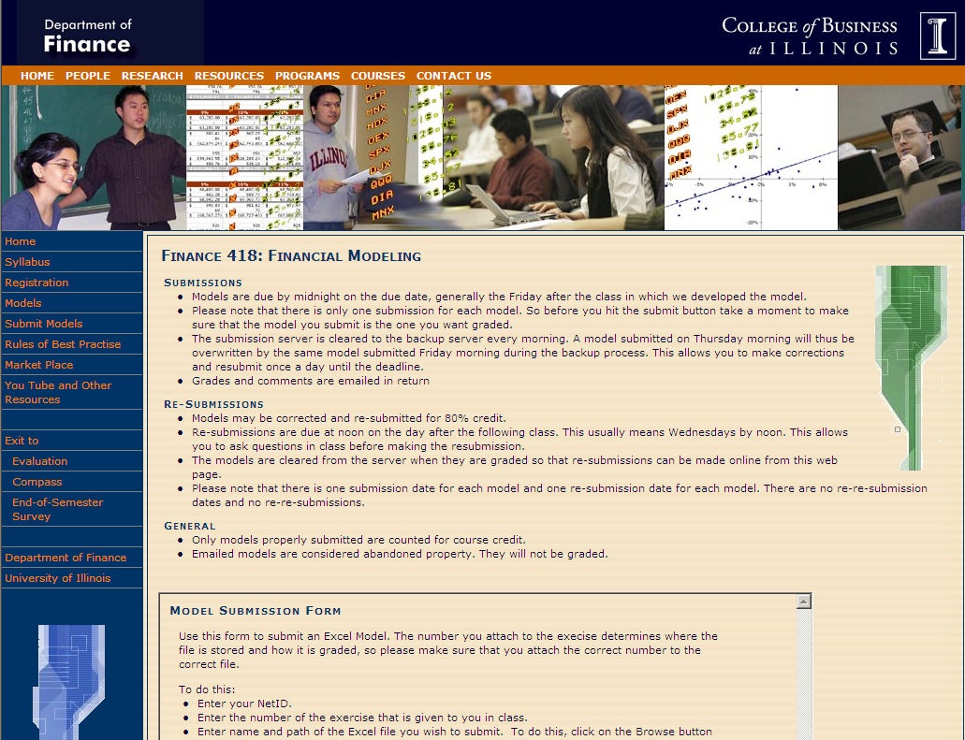
Submission
Submit models through the course web page

Slide 8
Submission
On submission
  the file name is changed to NetID & model number.
  The file is time and date stamped
MyModelSixteenVersionTwelve.xlsx
MyModelForThursday.slsx
oltheten016.xlsx 12/12/2013 6:42pm
oltheten017.xlsx 12/12/2013 6:43pm

Slide 9
Submission
Submissions are relayed to the grading and backup servers every morning.
Subsequent submissions will overwrite previous submissions for the same model.

Slide 10
2] In-Class Exercises:
There are several in-class Exercises throughout the course
  These are due at the end of the in-class exercise time period.
  These exercises are designed to test your modeling skills under pressure; there are no re-submissions.
  The lowest scoring in-class exercise will be dropped

Slide 11
3] MMIL Certification
In the course of the semester you must acquire Basic MMIL Certification
    Bloomberg 101, 102, 103
    Capital IQ 101
    Moody’s KMV 101
    Crystal Ball 101
    Matlab 101
    Morningstar Encorr 101 or Direct 101

Slide 12
4] Project
Presentation of a model developed
  As an extension of a class model
  For another class (so long as you have permission from the instructor)
  For an internship or other work (so long as you have permission from the company for whom the model was developed)

Slide 13
4] Project
Developed for class
  This is not show-and-tell,
  we expect to see a model developed or extended by the presenters
Projects are developed and presented in groups of 2

Slide 14
4] Project
Presentations are peer evaluated.
Project scores come from
  The evaluation of your peers
  The evaluations by you of your peers

Slide 15
Professionalism
.

Slide 16
Professionalism
Professionalism requires decorum
  While in class you will work on Financial Modeling.
  Students working on games, email, networking, or assignments for other classes will be asked to work elsewhere.

Slide 17
Professionalism
Professionalism requires collaboration, not cheating.
  You are encouraged to help each other succeed, but not by doing their work for them.
  I expect each student to develop their models independently. Copying, using, or linking to another’s model is considered cheating and will result in a grade of 0.
Examples

Slide 18
Example
How do I get the line on this graph to go straight?
Use an XY scatter instead of a line chart

Slide 19
Example
Lets both use 5% for 10 years and compare results
Hold on, I get $12 per share instead of $120

Slide 20
Example
Let me see how you get that graph
Sure,
take a look

Slide 21
Example
I forgot my flash drive. Can you email me your model 12
Maybe ask the professor if she has your model 12 in the submissions file
/
0
5

Slide 22
I had a great interview last week, but I missed class. Can you send me your model 13 so I don't fall behind.
You're kidding, right?
/
0
5

Slide 23
I had a great interview last week, but I missed class. Can you send me your model 13 so I don't fall behind.
/
Congratulations!
Oops…
gotta go
0
5

Slide 24
I had a great interview last week, but I missed class. Can you send me your model 13 so I don't fall behind.
Are you kidding?
File sharing can be hazardous to my grade
/
0
5

Slide 25
I had a great interview last week, but I missed class. Can you send me your model 13 so I don't fall behind.
Compass has the template and the powerpoint. It walks you right through the model. If you buy JimmyJohns I'll come to the lab and give you a hand.
/
0
5

Slide 26

Bottom Line
Share insights
& expertise,
not files.

Slide 27
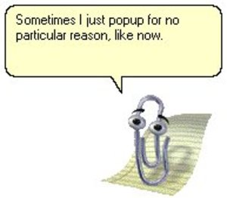
Financial Modeling
Some notes before we begin

Slide 28


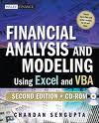
Finance vs Modeling
You cannot model what you do not understand
The assumption is that you know the finance
If you need to refresh your memory
  Financial Markets (Oltheten & Waspi)
  Corporate Finance
  Financial Modeling (Sengupta)

Slide 29
Financial Modeling
.

